Slide 1
Shoes: Function and Fashion
Advanced Studio

Slide 2
You will…
You will create two different shoes from ceramic clay (they will be finished with acrylic paint).
The first shoe will be an exact replica of an actual shoe (it will look like its real). The second will be based on the form of the original shoe, but you will transform it so it is more abstract/imaginative.

Slide 3
First Shoe: Realistic

Slide 6
Shoe #1- Good Choices
Choose a shoe that is complex and has multiple pieces to it (sneakers, boots, high heels work well; flip flops are too simple). Sometimes an old-looking shoe could be a fun challenge. You will have to keep the shoe here for the entire project.
Make sketches of the shoe from different angles so you can really get a feel for what it looks like from all sides.

Slide 7
Construction
The Slab method will be used to construct the main structure of the shoe. You will create templates from paper and roll slabs out of clay then cut out the slabs and attach them (pretend you are a seamstress/cobbler, but you’re working with clay instead of leather, canvas, fabric etc.)
Smaller details can be created by using additive methods (rolling coils and turning them into eyelets, flattening coils for laces, creating zippers etc.)
Textures and other details can be created using subtractive methods (carving away textures on the sole, etching in stitching etc.)

Slide 8
Creating Patterns
Use newsprint to create patterns directly from the shoe itself.
For flat parts, you can trace by holding your pencil on the outside of the shoe and/or measuring.
For parts that have roundness, you will have to use string or a strip of paper to measure the form. The shapes may look strange to you because they will end up being folded or rounded to create the shoe.
Create patterns for the main form of the shoe.
The patterns should be life size if not slightly larger (clay shrinks as it dries). You will be making the clay shoe as close to the real thing as possible; remember: when people see these shoes, we want them to be tricked into thinking they’re real!

Slide 9
Pattern Example: High heel

Slide 10
Rolling Slabs and Cutting Pieces
Cut out the patterns.
Roll out a slab of clay on the slab-roller (start with about an inch of clay; place under the canvas sheets and use the wooden boards to give you the height you need. Start pushing the board through and turn the wheel to guide the clay through. If you need the slab to be thinner, put more boards underneath). You want about a ¼ inch slab.
You can use a rolling pin to create slabs, too. This works best for small/thin slabs.
Bring the slab back to your work area and lay the cut pattern pieces out on it (fit them as closely together to maximize the amount of clay used). Poke your fettling knife down through the clay and trace around the pattern pieces to cut the clay pieces out.

Slide 11
Patterns placed on rolled slab

Slide 12
Cutting out the slabs
Note: this artist is using a tool called a miter to give a beveled (diagonal) edge (not a fettling knife). Her slabs will join snuggly because they are cut at an angle. If you want, you can hold the fettling knife at a 45 degree angle as you cut to replicate this technique.

Slide 13
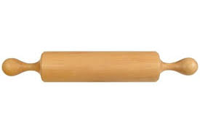
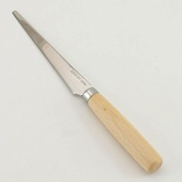
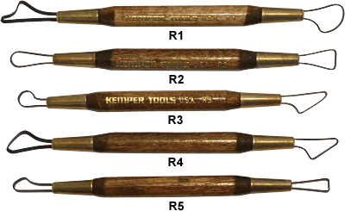
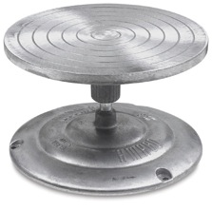
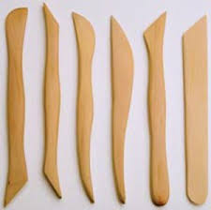
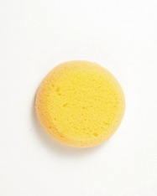
Clay Tools 101
Rolling pin/slab roller- for rolling thin slabs of clay
Fettling Knife- For cutting and carving clay
Loop tools- For slicing/shaving off clay to reduce weight; for carving into clay
Wooden modeling tools- For smoothing and carving into clay
Banding wheel- For turning your piece as you work on it THESE ARE IN TWO PIECES! HOLD ROM THE BOTTOM!
Sponge- For smoothing clay (not for washing tables)

Slide 14
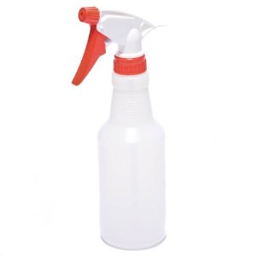
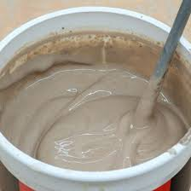
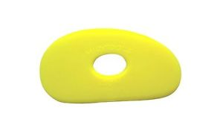
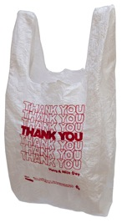
Clay Tools Continued
Serrated rib- For scoring clay so you can slip and attach two pieces together
Spray bottle- To keep your work damp and to keep the bag damp when storing your work
Slip- (powdered clay mixed with water) used to bing two or more pieces together once they have been scored
Soft rib- For smoothing edges and surfaces
Plastic bag- To cover your work when storing to keep it wet

Slide 15
Stages of Clay
Slip- watered down clay in a muddy form used to join clay together
Plastic- workable stage of clay; can join to other pieces; can drape/support to create a form; can recycle
Leather hard- Stiff and will hold its shape; can be joined to other pieces; best stage to carve into; can be recycled
*When you are working with the sculptural part of this project, you want to keep your clay in the plastic and leather hard stages.
Bone dry- Can be carved into but is very fragile; can be recycled
Bisque- Clay that has been fired in the kiln and is ready to finish
Glazeware- Clay that has been glazed and gone through a second firing
*we do not need to do the second firing because we are finishing our work with acrylic paint instead of glaze

Slide 16
Assembling the slabs
Make sure you score and slip all edges (both sides!) before attaching them, otherwise they will not stay together once the piece is fired. (To score and slip: make little marks with the serrated rib and add slip {clay mixed with water} and adhere) Your score marks should be smoothed down and not show in the final product.
You can add a coil on the inside of the corner of slabs to further support the joint. Seal and smooth the inside and outside of the slab together.
You can support areas that need to sit up with wadded-up paper.
Sometimes, it helps if the slabs are slightly dry rather than fresh and wet when you are assembling them.

Slide 17
Scoring the edge of slab with a serrated rib

Slide 18
Applying slip to scored edge
Note: This artist is using water and a brush instead of slip. You can use slip and your finger instead, too.

Slide 19
Bringing edges together
Squeeze together scored and slipped edges and wiggle a little; they should ooze

Slide 20
Smooth creases and adhere smoothly

Slide 21
Add a coil to the inside

Slide 22
Integrate the coil with the rest of the clay…

Slide 23
…and smooth down.

Slide 24
Adding details
At this point, the main structure of the shoe will be in tact.
You can now utilize both additive and subtractive methods in the detail work on your shoe.
Additive- Adding something onto a sculpture (adding coils, additional slabs etc.) Make sure to slip and score everything before adding on; no clay thicker than a quarter inch.
Subtractive- Taking something away from the sculpture (carving, etching texture, impressing texture etc.) Support the clay at all times as you are working into your sculpture. The clay is fragile and you don’t want the sculpture to collapse.
Try to keep the clay at the same stage as you are working on it. You want the clay to dry at the same rate (remember that clay shrinks as it dries). This will minimize cracking and breakage.

Slide 25
These leaves were constructed separately and added on to the shoe that had been constructed.

Slide 26
Ready to Bisque Fire
When all the moisture is removed from the clay (it has dried out uncovered for a couple days) it will become cold and turn light gray. This means it is ready for the kiln.
Your work will be fired in the kiln (we may not get to it right away) and returned to you.
Now, it is ready to paint.

Slide 27
After Bisque Fire (clay turns white)

Slide 28
Finishing your work- Acrylic
Try to mix the colors on your shoe EXACTLY as they appear, or as close as you can make them by mixing. Remember to add a little water to the acrylic so it flows better.
Paint neatly and “within the lines.”
You can add a “distressed” effect by watering down a brown/gray/white paint and applying it over the dry paint colors to make the shoe look dirty.
Pay attention to all those little details- that’s what’s going to make your shoe really look special and fool people into thinking that it is a real shoe!

Slide 32
What am I looking for?
Sturdy construction of clay; form replicates the chosen shoe
All edges “flow” together and are attached seamlessly (score and slip marks do not show; seams do not show)
Clay is smooth (consistently thickness of surface; not bumpy) unless intentional texture has been created there; no rough bits left over
Paint is applied to the surface to replicate the color and texture as accurately as possible
Good work habits, good use of time, attention to detail and care/pride in work

Slide 33
Shoe #1 Due Date Information and Timeline
March 3rd- Intro project and make sketches
March 7th, 9th and 14th- Working in wet clay and assembling shoe
Bisque fire- ??? Depends on the kiln schedule; if you have “down time” go on to sketching and planning for shoe #2
March ?, 14th and 16th- Finishing with paint
Shoe #1 due Wednesday March 23rd (This will go on Q3).

Slide 34
Shoe #2: The first shoe transformed
For the second shoe, you will be using the same ceramic techniques and approach and finishing your work in acrylic paint.
The second shoe will be based off the first shoe (the connection should be obvious) but you will take more artistic license and creativity in the shoe; you will have more creative freedom and the opportunity to problem-solve as you make the shoe.
Some of you will transform the form, some of you will transform the surface, some of you will transform the form and the surface.
The second shoe is easier because you don’t have to get things looking 100% realistic, but also harder because you don’t have a clear model/template to follow. Figure out your approach (slab construction etc.)
Begin with a clear idea (sketch/plan so you know exactly what you’re doing before you go into clay)

Slide 35
Shoe #2 examples

Slide 36
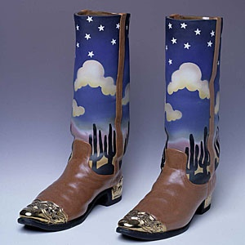

Slide 39
