Slide 1
Foreshortened Figure
Advanced Studio

Slide 2
Where are we going?
We’ve been focusing on identity so far this year in class. Mostly our work has been limited to the face (self portrait, mask). For our third project, I’m really going to challenge you!
You will create a figure drawing/painting of yourself that includes a foreground, middle-ground and background, but there will be a unique element of foreshortening to provide a more interesting point of view.
You will work BIG using matte board as your surface in dimensions of 36 x 48 inches (3 x 4 feet)
You will choose your 2D medium (pick one): Tempera, acrylic, oil pastel, charcoal (other media will be considered upon request).

Slide 3
Artists Control How People Interact with Their Work (2D pieces)
The viewer- The audience viewing a work of art
Picture plane- The space described by the paper/canvas; the point of view/how much depth/how much cropping the artist shows to the viewer
Depth of Field- How deep the picture plane portrays (how far back in space) shallow or deep
Foreshortening- The picture plane shows a deep sense of space, and it seems like something is coming out at the viewer
Point of View- Where the viewer’s eye level appears to be (where does it feel like they’re looking from?)

Slide 4
Think about it like this…
Often, we tend to create an experience for the viewer that is pretty close to what we would actually see most naturally (straight on, not too tightly cropped, the depth-of-field shows what we’re looking at and not much behind it etc.) But a good artist knows how to make the viewer look at something differently, in a unique way. Playing around with cropping, point of view, depth of field, foreshortening etc. is a great way to make your work (be it a drawing, painting, sketch, photo etc. Even your Instagram posts!)

Slide 5
Your Assignment Criteria
A figurative drawing/painting of you as the subject using tempera, acrylic, oil pastel, charcoal
A depth of field of at least 15 feet
Foreground/Middle-ground/Background as follows:
-Something unexpected that “pops out” in the foreground (probably an hand or foot)
-Your face in the middle-ground
-A descriptive environment in the background

Slide 6
Continued…
Work should show facets of your personality, interests, identity etc. as you see fit (we should get a sense of who you are as a person from this piece, as well as what you look like). How in depth you want to go with this is up to you. Think about what choices you will make in terms of clothing, facial expression, props, setting etc. Your piece should tell a story.
You will need to show contrast/range in value in your chosen medium so your work does not look flat.
You should demonstrate ability to push the limits of your chosen medium (something you’re pretty comfortable in)
You will need to work fairly expressively on this assignment (looser; more gestural) since you are working so big. Your work will be realistic but exaggerated! It should really make a big statement when you’re done (not hesitant!)

Slide 7
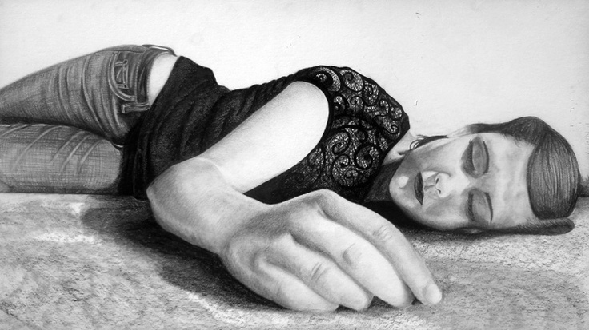
Examples (some of these lack backgrounds as you are required to do)

Slide 8
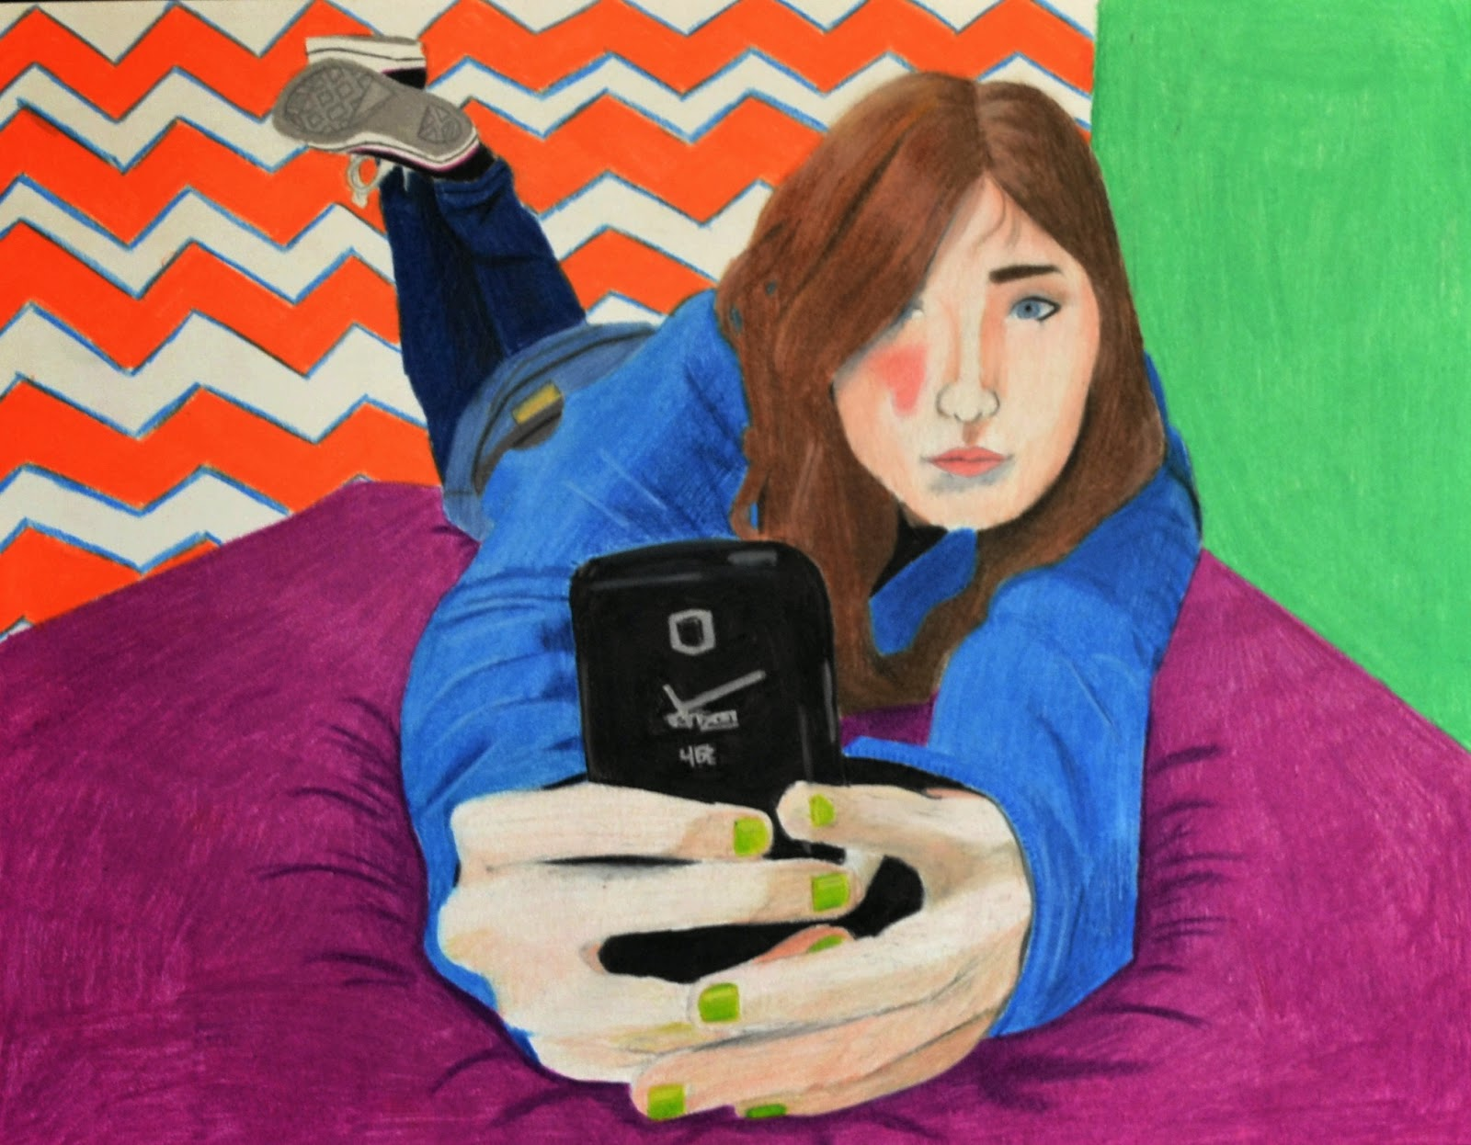

Slide 9
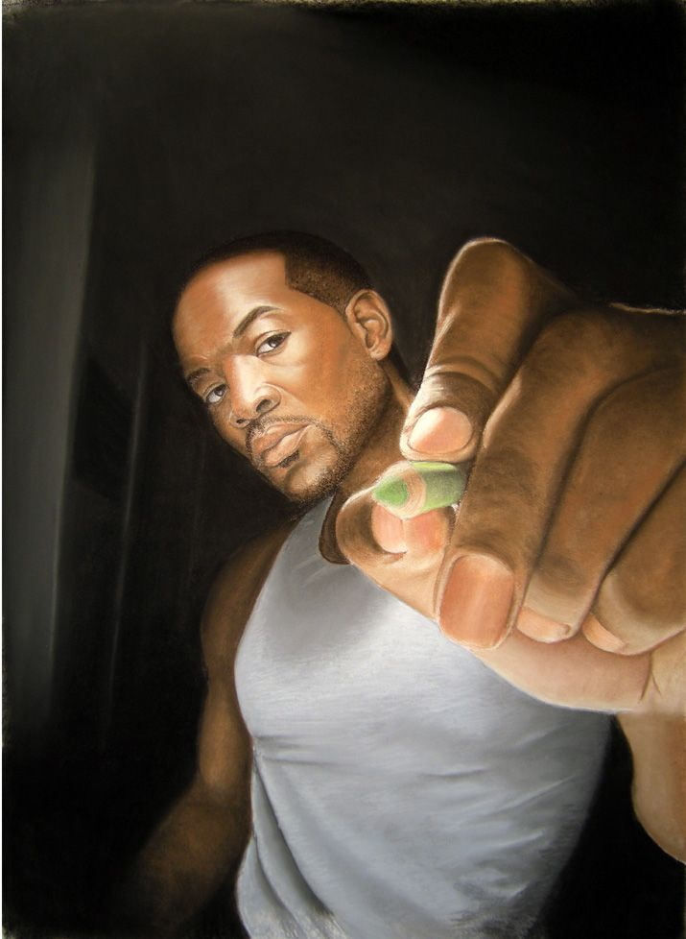

Slide 10
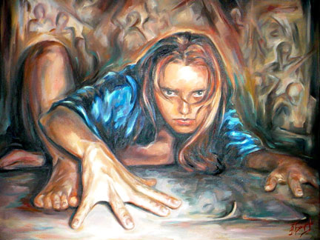

Slide 11
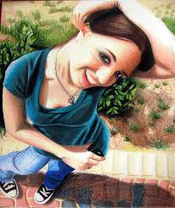

Slide 12
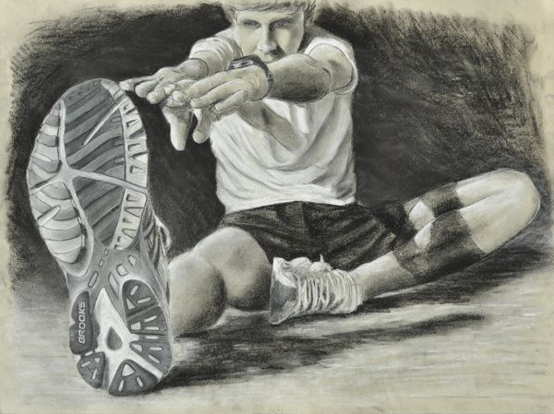

Slide 13
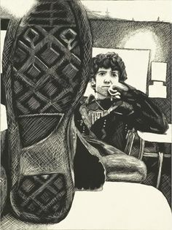

Slide 14
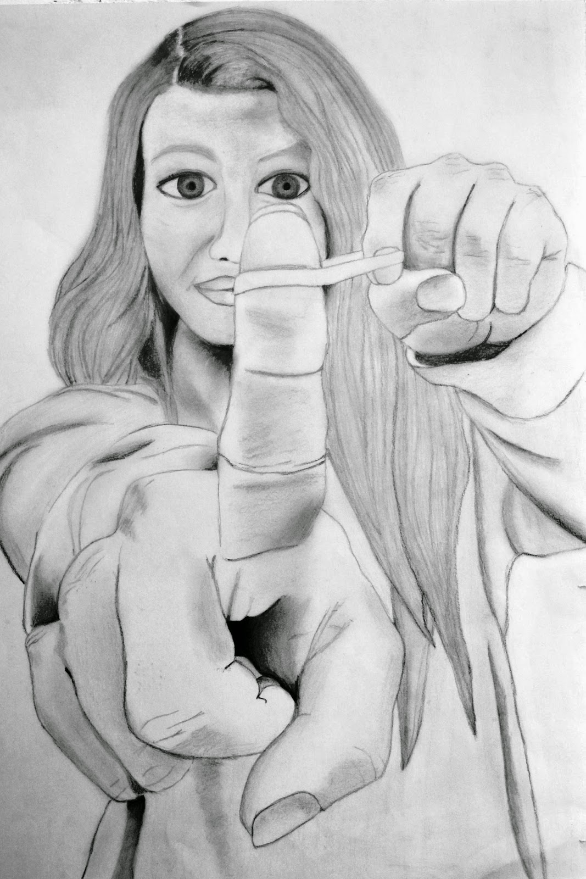

Slide 15
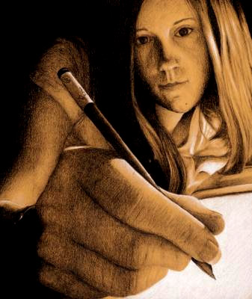

Slide 16
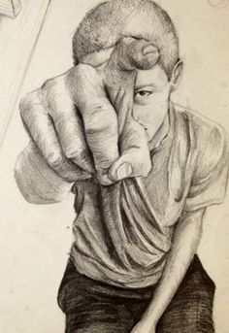

Slide 17
Timeline
10/27 and 10/29- Prep work (gesso surface, make thumbnails, explore medium)
11/2 and 11/5- Transfer drawing to surface (use charcoal)
11/9, 11/11, 11/13 and 11/17- Media application
11/19- Refining; touch-ups; PORTRAITS DUE AT THE END OF CLASS ON NOV. 19th

