Slide 1
Agamograph
Advanced Studio

Slide 2
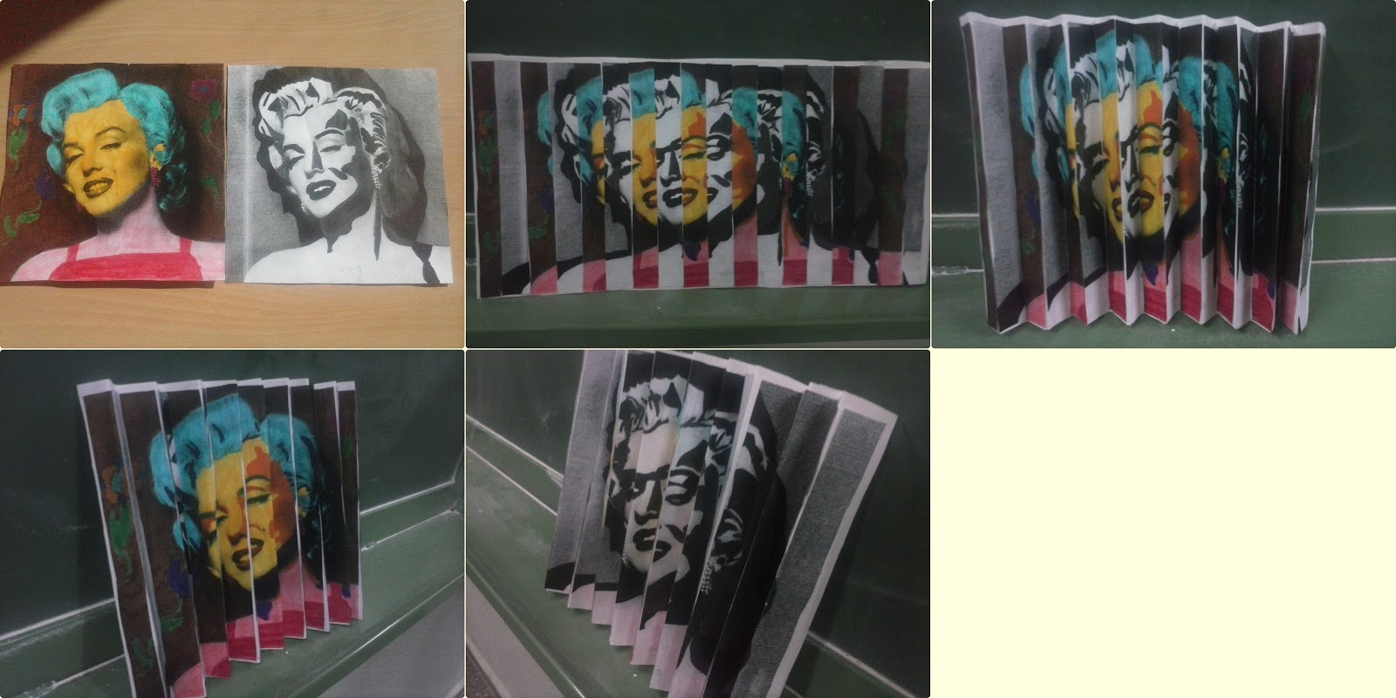
What is an Agamograph?

Slide 3
What is an Agamograph?
An agamograph is an painting or drawing that, when viewed from different angles, reveals a different image
Agamogaphs are named for Yakkov Agam, an Israel artist known for his sculptures that move, change or transform
Agamographs force the viewer to participate with the piece and look at the subject in a variety of ways
The artist can make a comment about the subject based on the images that he/she chooses to put together

Slide 4
Examples
http://www.art-rageous.net/Agamographs.html
https://www.youtube.com/watch?v=WNmVsB0W01w
https://www.youtube.com/watch?v=izTAW_uSOvw

Slide 5
Your assignment
You will create an agamograph that has either two or three “changes.”
The subject of you agamograph will involve something that transforms, changes, or is different on the inside than it is on the outside. You can choose to interpret this in a literal or conceptual way.
You can choose from the following media for your agamograph (or mix and match): oil pastel, ebony pencil or acrylic. Choose a medium that is bold and clear.
You will be working 12 x 20 on heavy white sulphite paper.

Slide 6
Process
Thumbnail sketches- in order for this to work well, the shapes of the images have to work together/be similar
Create two or three separate drawings on 12 x 20 paper
Measure two inch stripes and cut carefully
For two sided agomograph: Fan fold a 12 x 20 piece of paper; score and fold into a zig-zag. Put a backing piece of paper or a frame so that the zig zag stays in place. Glue strips in the correct spot.
For a three-sided agomograph: Image 1 and three are glued back to back (make sure the right sides are facing up). Image 2 gets glued down flat; leave a little space and glue (hot glue) the image 1/image 3 strips standing up in between.

Slide 7
Your agamograph needs to:
Have a subject matter that deals with the idea of transformation
The various images’ shapes should relate
There should be a strong demonstration of proficiency with shading, color and texture
The images should be bold and clear; the transformation should be obvious and make sense
Should be assembled neatly and carefully so the illusion is successful

Slide 8
Due Date Information
You will have approximately 8 classes on this project:
Day 1- planning and sketching
Days 1-7- drawing the source material
Day 8- assembling the agamograph
Agamographs due: ___________

