Slide 1
Name Zentangle Design: Using Color and Pattern to Show Value
Art 1

Slide 2
Set Up
Draw out your name in bubble letters. Keep the letters BIG!
You can start by writing out the letters and then draw the bubble edges around each letter (don’t forget to erase inside the letter afterwards).
The thickness of the letter needs to be at least as wide as two fingers.
If you feel confident and would like a challenge, you can utilize a funky font for your letters. Some examples will be provided.
Make a series of lines that intersect your letters and create a variety of shapes in the background.

Slide 3
You Will…
You will create a series of patterns, designs, textures etc. in your background shapes. (“zentangle”)
There will be a variety of visual weight (dark areas) evenly distributed throughout to move the eye around your composition.
You will color the letters using a minimum of THREE different colors (using colored pencil).
There will be a variety of color value shown in the letter shapes (varying pencil pressure).
You may choose an “accent” color and add color/visual interest to the background designs in select areas.

Slide 4
The Background: Zentangle
What is a “Zentangle”? Think of a zentangle as a complex doodle. A variety of patterns come together to make a larger overall design. Some people create zentangle designs to help them relax (when something is relaxing, we might say it’s a “zen” like activity). The design is typically a “tangle” of smaller patterns and lines. That’s where the name “zentangle” comes from!
There isn’t really a right or wrong way to do a zentangle. There are lots of pre-made patterns you can use as inspiration. I have books and handouts to help you, and you can also look online.
We will start our zentangle in pencil, then trace the lines in Sharpie and eventually erase any leftover “ghost” lines.
If you have dark shapes, make sure they are distributed evenly.

Slide 5
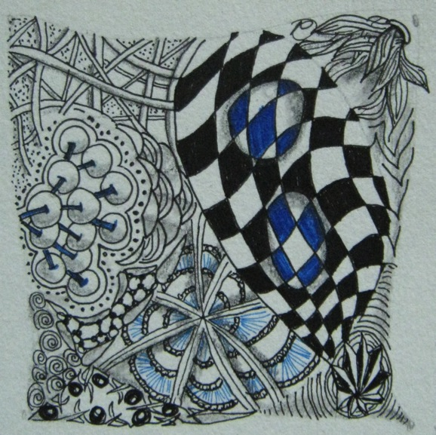

Slide 6
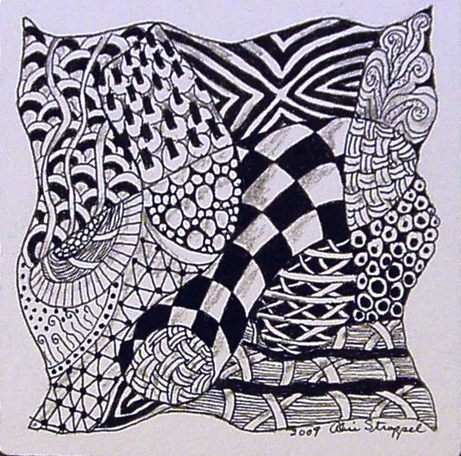

Slide 8
The Letters: Value with Colored Pencil
In your value collage, you created a variety of value (dark and light areas) by pressing down harder of more lightly with your ebony pencil. Some of you may have even smudged with your finger or a tortillon. You could erase to bring out light areas if they got too smudged.
Colored pencil has some of the same properties, but there are some differences.

Slide 9
Colored Pencil vs. Ebony Pencil
Colored pencil has harder lead so it doesn’t smudge as easily. You need to start lightly and work in layers by gradually pressing down harder to create darker values. Make light strokes back and forth and/or use little circular motions to build up color.
Colored pencil also doesn’t really erase. This is another reason to start light and build up little by little: once you make a mark, it’s going to be hard to get rid of it.
Your natural tendency will be to color hard with solid lines starting out, but try not to do that! Start light and build up! You can always get darker!
You also have the option of a variety of colors at your disposal. You can use a darker version of a color (a green to a dark green, for example) to help you in shading. This only works to darken, it doesn’t really work to lighten (the colors tend to get “muddy”). Always start with the lighter color.
Try to eventually eliminate your pencil stroke marks. If you’re noticing that a lot of the marks are visible in one direction, layer over, making marks going in the opposite direction to get rid of them.

Slide 10
https://www.youtube.com/watch?t=93&v=k0d9oyL3Egs

Slide 11
What Am I Looking For?
A variety of interesting and carefully-completed zentangle designs in the background
Dark shapes evenly distributed throughout the background
A variety of value in each letter shape (using pressure and color)
Carefully and neatly colored letters (eliminate stroke lines)

Slide 12
Due Date Information
Project due with rubric completed (BOTH sides) on FRIDAY, OCTOBER 16th.
No rubric/incomplete rubric? 10 points off.
Work looses 5 points for each day it is turned in late. No work accepted after two weeks late without prior teacher approval. If you’re behind, come in for extra time and catch up!

