Slide 1
Art 1
Self Portrait

Slide 2
You Will…
Create two self portraits working from one photo.
One portrait will be monochromatic.
The other portrait will use realistic colors.
You will learn and use the grid method to transfer an image accurately.
Show a range in value (and color) by mixing different hues, tints and shades.
Show textures and details using different brush techniques.

Slide 3
Set Up- Photo
You will choose a photo of yourself that you like. It should be mostly of your face, but you can include part of the shoulders and hair. You can have an expression if you want, or have something (an accessory, background etc.) that represents you included. Just remember that the more complex details there are, the more time-consuming your photo will be to paint, and you have to do two of them.
Make it so that you can access your photo on my computer (email it to yourself, go on your Instagram- whatever) and I’ll have you put your photo in a folder on my computer’s desktop so I can get to them and print them out.
I will print you a black and white copy and a color copy. Both will have the dimensions of 6 x 10 inches. DO NOT LOSE THESE PHOTOS. THEY ABSOLUTELY MUST STAY IN YOUR FOLDER. IT IS CRUCIAL THAT YOU KEEP TRACK OF THEM.

Slide 4
Set Up- Grids
Use a ruler and make a one inch grid on both of your photos.
Go around the edge (all four sides of the photo) and make little marks every one inch, then connect the marks to make lines (don’t try to hold the ruler straight and go straight across).
Make sure you’re starting from the “one inch” line- not the edge of the ruler otherwise your measurement will be off.
Do this part in pencil.
Don’t rush this step and mess up, because it will ruin the photo. Please ask for help if you’re having trouble.

Slide 5
Creating the grid on paper to transfer image
You will be given two 12 x 20 pieces of paper. You will create an “empty” grid on each of these. This time the tick marks will be TWO inches apart instead of one. (12 x 2o is double the dimensions of your photo, which are 6 x 10)
Do this lightly in pencil.
You should now have the same number of squares on the photo as you do on the paper. This will allow you to transfer the visual information from the photo to the grid, box by box; it really breaks it down for you and I think it makes it A LOT easier than trying to draw freehand.
Some students have found a successful trick to be to label their boxes on the photo and the paper (number 1-60; “Battleship” with numbers and letters; doesn’t matter as long as the system is consistent).

Slide 6
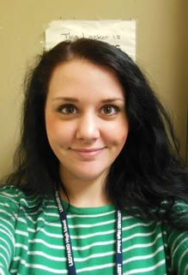
Please note that these boxes are not drawn to scale.

Slide 7
Transferring the Image
Your photo will have been “posterized” by me using a photo editing program. This means that the major shapes will be simplified so they are easier for you to see and replicate.
(side note- the program is called GIMP and it’s 100% free to download; you can do almost everything with it that Photoshop does. You might be interested in using this at home for your own purposes).
Think of each shape you see as having an outline/edge. You want to see where these lines enter and exit each box. Some people like to trace around the outlines/edges of the shapes they see first, then transfer those lines using the grid.
You want to look for major outlines of the head, hair, shirt, facial features, and big areas of shadow and light. Make sure they are included in your drawings. Don’t worry too much about little details at this time- just make sure the big picture makes sense.

Slide 8
Tips and Tricks
Some people go box by box and transfer what they see little by little in order. (you can also use scrap paper to “block off” the other boxes you aren’t working on)
Some people (myself included) work general to specific, following the overall outline of the head and hair first, then the major light and shadow areas, then leave the facial features and details for last.
If you have a particularly complicated box (like where the eyes are) you can make a little grid inside that box on your photo, find that same box on your paper, and make the same little grid in that box so it breaks if down.

Slide 9
Don’t Forget!
You need to have TWO identical outline drawings. You can use the grid method to transfer a second time, or make it A LOT easier on yourself and use the light table/a window to trace your first drawing.
Don’t forget to erase your grid lines before you start painting. They aren’t part of our final piece. You can use the little cap erasers to get in the tiny spaces when erasing your grid lines.

Slide 10
Please note that these boxes are not drawn to scale. Also, this isn’t a posterized photo.

Slide 11
It’s time to paint- Monochromatic
Remember that monochromatic means “tints and shades of one color.” Choose one color (I’ll let you use the bottles of secondary and intermediate for this, if you’d like!) and black and white.
When you look at the photo, the darkest values are going to be the blacks and dark grays, the lightest values are going to be the lighter grays and whites. Think of everything you see as a “value.” How dark or how light is it?
Remember your value scale from the color wheel project. The darkest shades will correspond to the darkest values, and the lightest shades will correspond to the lightest values and so on. Some people find it helpful to label each area in terms of how dark/how light (using a number scale for example)
I want to see at least five DISTINCT values on your work that correspond to the values on the photo. Make sure they are different enough so that we can tell them apart. When in doubt, give more contrast than you think you need. It will make your work more dynamic and more interesting to look at.
You might want to do two tints, your hue and two shades.

Slide 12
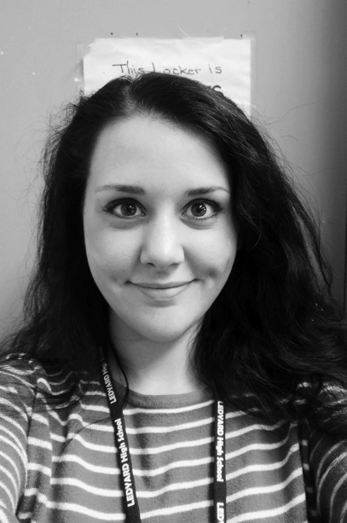
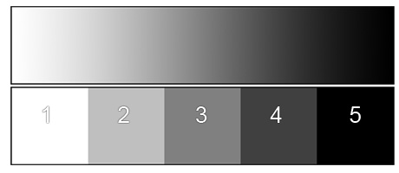
3
4
2
4
1
1
1 (tint)
2 (tint)
3 (hue)
4 (shade)
5 (shade)
5
4
See here how the grayscale photo corresponds to five distinct values that we can roughly label as being on a scale from 1 to 5, as well as how that would look in a monochromatic scale of red.
4
3
1

Slide 13
Color and Value
An important thing to realize is that you’re dealing with color but also with shading. For example, my hair is a dark color (it was very dark brown when this picture was taken) so it will show up as a dark value (5). But notice where the light is hitting my hair on the top right? Even though my hair is a dark color, that area will read as a lighter value (4). Compare that to my shirt, which had green and white stripes; green is a medium-dark color, so I will make that a medium value (3). Another good example of this are lips. The lips will usually be darker than the skin around them, but they will also have an area of light and shadow on them. You can simply look at the grayscale phtoto to determine if you need a tint/shade/hue etc. but keep the idea about color vs. value in mind.
3
4
2
4
1
1
5
4
4
3
1

Slide 14
Color Vs. Value
An important thing to realize is that you’re dealing with color but also with shading. For example, my hair is a dark color (it was almost black when this picture was taken) so it will show up as a dark value. But notice where the light is hitting my hair on the top right? Even though my hair is a dark color, that area will read as a lighter value

Slide 15
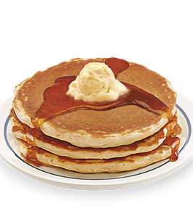
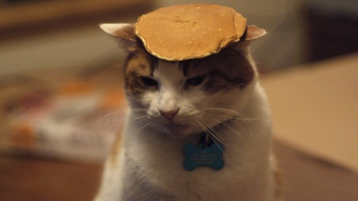
Remember…Pancakes are for breakfast, not for faces.
When your portrait doesn’t have enough range in value (there isn’t shading/your values aren’t different enough) your portrait will look flat like a pancake! Don’t do this. Make sure to be bold with your contrast.
There will be shadow on one side of the face/hair/shirt overall, underneath the brow bone, on the side of the nose, and under the chin, and anywhere that goes in.
There will be light on the other side of the face/hair/shirt overall, on the top of the cheek, on the top of the nose, and anywhere that sticks out.

Slide 16
Steps when painting
Artists typically start with the background first.
I would recommend to do the big shapes next- the overall hair shape, the face, the shadows on the face.
Next I would do the small details- eyes, brows, lips, nostrils, jewelry.
Last I would add textures, minor details and touch ups on top of what you’ve already painted.
You can water down the paint a little to achieve a wash; you can use a brush with stiff bristles to achieve sharper texture. This works really well for hair!

Slide 17
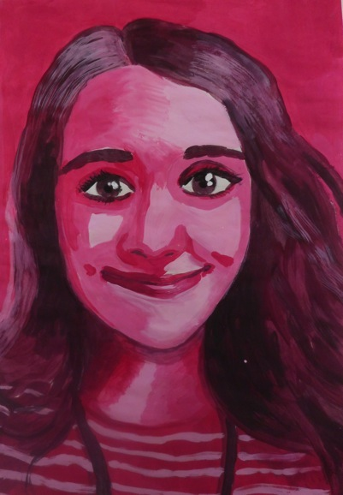

Slide 18
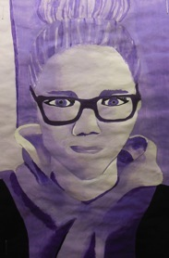
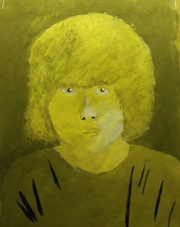
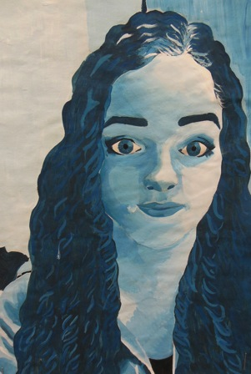
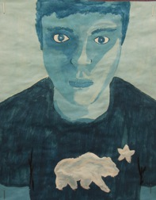
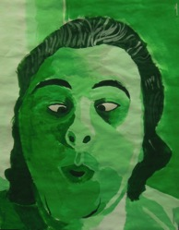
Successful contrast?

Slide 19
The Second Painting- Realistic
For this painting, you’ll go back to using only the primary colors and black and white (sorry/not sorry).
You will have to mix the local color first, using different ratios of the colors you have available.
What is local color? Local color is the color of something before light/shadow hits it.
You will have to mix the perceptual colors second and third. Mix with black (or blue) for the shadows, mix with white for the light areas.
What is perceptual color? Perceptual color is the color something looks (or is “perceived” after the light/shadow hits it.

Slide 20
Mixing Local Colors
Remember that mixing all three primary colors together results in what’s called a neutral.
Neutral colors usually look like natural colors; different types of browns, beiges etc. When you mix in black and/or white, this adds an even further range in the colors you can achieve.
Our faces and hair are natural things; you will see a variety of neutral colors here that need to be mixed. Colors that are more straight from the tube might be found in your shirt etc. because these are man-made things.
You can do this by trial and error (test colors on a scrap paper) but I also have some color “recipes.”
See my chart for specifics.

Slide 21
Mixing Perceptual Color
Don’t forget about that initial value scale! You will just approach it a little differently this time around, because you’re dealing with more colors. You will have a different color to mix for your:
Face
Shirt
Hair/brows
Lips
Eyes
Additionally, you will have a SHADOW and a LIGHT for EACH of these portions that relates to your light source.
You will use a local color for the middle value, a shade of that for the shadow, and a tint of that for the light.
Note- sometimes, black darkens but doesn’t look quite right. You can also use the option of darkening with blue instead of black, and it might look more natural.

Slide 22
As you are working…
Study the photo closely when mixing your colors.
You will not be able to mix everything 100% realistically, but you will be able to get pretty close.
I want to see at least THREE distinct values in each area of your portrait.
What happens if your colors aren’t coming out right? To neutralize a color, add a little of its opposite on the color wheel (if your hair is too yellow, add a little violet aka red and blue; if your skin is too orange, add a little blue)
Remember, you can always paint over if you make a mistake!

Slide 23
Remember your painting steps…
Artists typically start with the background first. You can choose what color you’d like to use.
I would recommend to do the big shapes next- the overall hair shape, the face, the shadows on the face.
Next I would do the small details- eyes, brows, lips, nostrils, jewelry.
Last I would add textures, minor details and touch ups on top of what you’ve already painted.
You can water down the paint a little to achieve a wash; you can use a brush with stiff bristles to achieve sharper texture. This works really well for hair!
DON’T FORGET THE PANCAKE SAYING! Make sure your values a clear, distinct, and consistent with the light source.

Slide 24
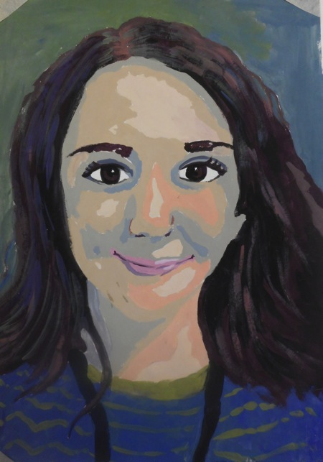

Slide 25
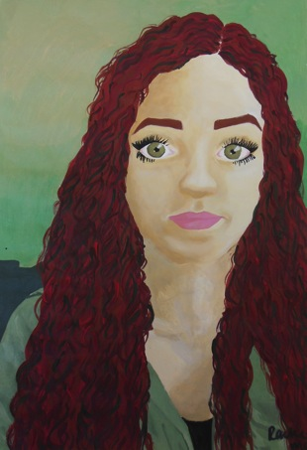
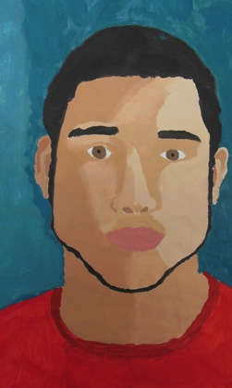
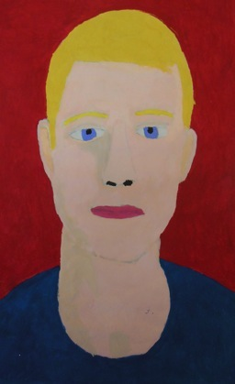
What worked well or not so well here?

Slide 26
Due Date Information
1/19- Intro/print pictures
1/21 and 1/25- Setting up grids and drawing
1/25, 1/27, 1/29- Painting Monochromatic
Monochromatic Portrait due Tuesday February 2nd
2/2, 2/4, 2/8, 2/1o- Painting Realistic
Realistic Portrait due Wednesday February 10th

