Slide 1
Imaginative Watercolor Landscape
Art 1

Slide 2
What will you be doing?
You will be creating a landscape painting from your imagination (size will measure 12 x 18 inches, or more if you choose)
Your landscape will be required to have certain features.
You will learn how to create depth and space in a composition.
You will use watercolor.
You will learn traditional and non-traditional watercolor techniques.

Slide 3
Set Up: Subject Matter
Decide what type of landscape you’d like to create.
Your landscape must include:
-Foreground, middleground, and background interacting with each other
-An architectural/man-made element (building, bridge, etc.)
-Natural elements (trees, bushes, flowers, animals, etc.)
-Texture! (The tree shouldn’t have the same texture as the building)
-Creating washes of color to develop depth and dimension
Your goal is to create an interesting, creative, unique landscape that will be fun to create because you are in charge of the theme. We are not looking for the generic landscape: a puffy tree with a swing next to a house with a triangle roof and a road going into mountains.

Slide 4
DON’T EVEN THINK ABOUT IT!
PLEASE NO “V BIRDS,” POINTY MOUNTAINS, EYELASH SUNS, “TOY STORY” CLOUDS, HIPPIE DAISY FLOWERS, TRIANGLE/SQUARE HOUSES, LOLLIOP TREES ETC. YOU CAN STYLIZE, BUT WE DON’T WANT OUR WORK TO LOOK JUVENILE!!!

Slide 5
Ideas to Make Your Landscape Interesting (brainstorm in sketchbook)
What season is your landscape in?
Where is your landscape (desert, forest, jungle, beach, outer space, etc.)
What’s going on? Is there a story to your landscape?
What texture are the elements in your painting?
What’s the color scheme?
How is the landscape personal to you?
Is there a theme or feeling you’re trying to portray?

Slide 6
How to Create Depth
Establish a horizon line towards the center of the paper (don’t just have things floating- show where the ground and sky meet {eye level})
Size/scale (things get gradually smaller as they go further back in space, or nearer to the horizon line)
Linear perspective- things with normally straight edges (such as a road or the side of a building) will appear to taper/narrow as they go away from the viewer
Atmospheric perspective- things appear sharper in the foreground (also darker) and blurrier in the background (also lighter)
Overlap- show that one thing is behind something else (you won’t be able to see part of the thing that is behind)

Slide 7
Horizon line= eye level

Slide 8
Size and Scale- things get smaller and closer together as they go further back in space

Slide 9
Linear Perspective

Slide 10
Atmospheric Perspective

Slide 11
Overlap
Grass/tree/fence/bushes/trees/pines
Foreground/middleground/background

Slide 12
Sketch work
Create thumbnail sketches in your sketchbook
Try to concentrate on overall composition and big shapes (don’t get too detailed)
Look up references if you’d like but please DO NOT copy a picture from Google verbatim
If you have a photo of a place you have been that you have taken, you could base your landscape off that
We’ll see about getting the Google goggles to experience different types of landscapes to inspire you for this project

Slide 13
Watercolor- How Do We Use It?
Watercolor in tubes is not meant to be used without water. You need a TINY amount (like the size of a ladybug or smaller) of each color you’re using. Think of what’s in the tube as the pigment, and when it is mixed with water, that becomes your paint.
More water equals lighter values/colors. DO NOT lighten with white. This will make your work look “muddy” or “chalky.” (I also don’t like to use too much black. I think it gets too heavy in a watercolor painting. I only use it if I absolutely cannot use another color. I like to use the pthalo blue for shading).
A nice thing about watercolor is that you usually don’t have to put out more paint each session! Once you have prepared your palette, the colors can still be used, even if they’re dry (just put water on your brush and rub it on the dried pigment). The only time you will need to put out more color is if you run out of if you need an especially vibrant color.
There is a specific way that your palette needs to be set up…

Slide 14
Setting Up Your Palette
Watercolor pigment (only a tiny bit!) goes towards the top
This is where you mix the pigment and water, creating the paint you’ll be working with
Each well is filled with a few drops of water (not all the way to the top)

Slide 15
Watercolor- Three Main Techniques
Hard edge- The edge of the first shape has dried before you paint the shape that is next to it. No bleeding occurs. In your stripes, work this way. Jumping around (working sequentially) will give the stripes time to dry before moving on.
Wet on dry- The first layer is dry. Then additional layers are painted on top. In your organic shapes, work this way (step in parallel to the edge of the shape with each layer; start very light)
Wet on wet- The paint is left wet and colors bleed and blend into one another. Your border will be done this way. Put the colors down pretty quickly so they don’t dry and lose that effect.

Slide 16
Other Experimental Techniques
Adding salt into wet wash (creates textures)
Blotting tissues into wet wash (creates textures)
Add drops of rubbing alcohol into wet wash (creates bubbles/resist)
Apply crayon and paint wash on top (wax of crayon resists the wash)
Pen and ink (doodle over dry paint, or draw the design first and paint into it)
Splatter (into wet wash or over dry paper/wash)
Watercolor pencil- Can be used wet or dry to create detail; can integrate with regular watercolor paint
In your sketchbook, experiment with some or all of these techniques. Where might they work well in your final landscape? You can work right into your pencil thumbnail sketch if you’d like, and/or try out the techniques on your own.

Slide 17
Putting it all together
Sketch out your composition lightly in pencil on the final paper. Try to do a light outline only. Lighten with a kneaded eraser if pencil lines are too heavy.
Begin painting- usually, we work background to foreground, coming forward in space so the painted forms overlap as they would in real life.
Think about where you are going to use the various techniques, and when you need to do them. Watercolor is all about timing.
Don’t forget to include a consistent light source with a light value, dark value and cast shadows! Blue or violet often work well for shadow colors.

Slide 18
Painting Skies- General Tips
Use a large brush with soft bristles.
Use a wet-on-wet technique to get the bleeding/blending effect of the sky. You could also dampen or mist the whole area with plain water first, then work in your colors.
Sunsets/sunrises have LOTS of colors in them.
Typically, the sky is lighter towards the horizon and gets gradually darker as you go up.
Clouds- typically have several fluffy masses compiled together with shadow on the bottom (think of the light source as coming from the top; they are really just a bunch of bumpy spheres stuck together); I would use wet on wet technique first, then refine if needed

Slide 19
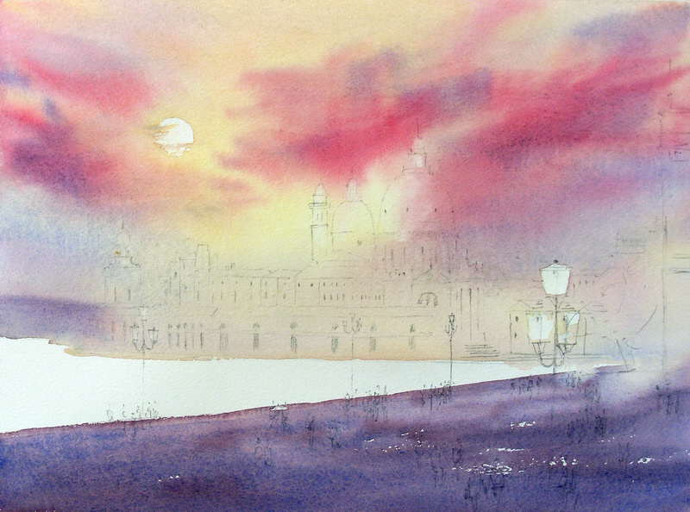

Slide 20
Painting Foliage- general tips
Trees and bushes are typically a mass with an overall dark side and light side (including tree trunks)
Use the wet on wet technique first to show the overall form.
When that has dried, use a smaller brush or a stiff bristle brush and “stipple” or “hatch” textures (repeatedly dab or make lines)
Sometimes, I like to use a crumpled paper towel or sponge to help me create an implied texture.
If your tree has branches and leaves, you will be able to see those through the clumps of leaves.

Slide 21
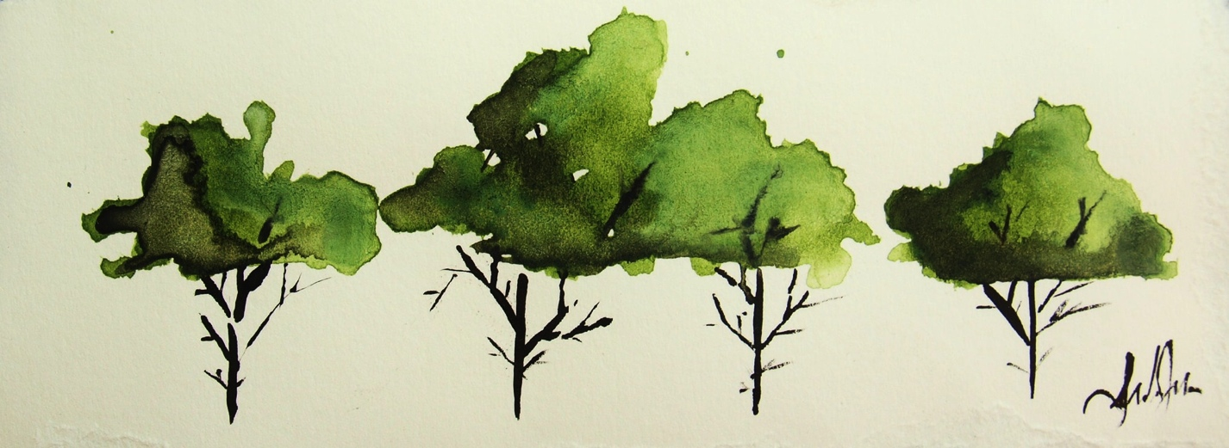
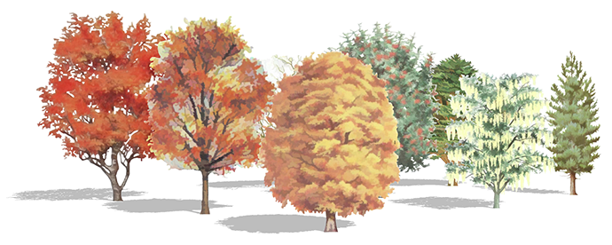

Slide 22
Examples

Slide 27
Timeline
Day 1 and 2- Intro, sketch landscape, experiment with watercolor techniques
Day 3, 4, 5, 6- Working on the landscape
Landscape painting due: _____________

