Slide 1
Cubist Still Life
Art 2

Slide 2
What is Cubism?
*Style of art that came to being in the early 1900s
*One of the most influential art styles of the century
*Comes from the real, but characterized by straightened edges and angles, flat shapes, distorted colors/values, and multiple vantage points (“Abstraction”)
*Pablo Picasso, Georges Braque, Juan Gris, Paul Cezanne

Slide 3
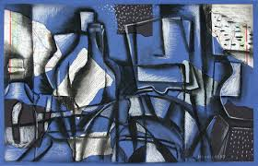

Slide 4
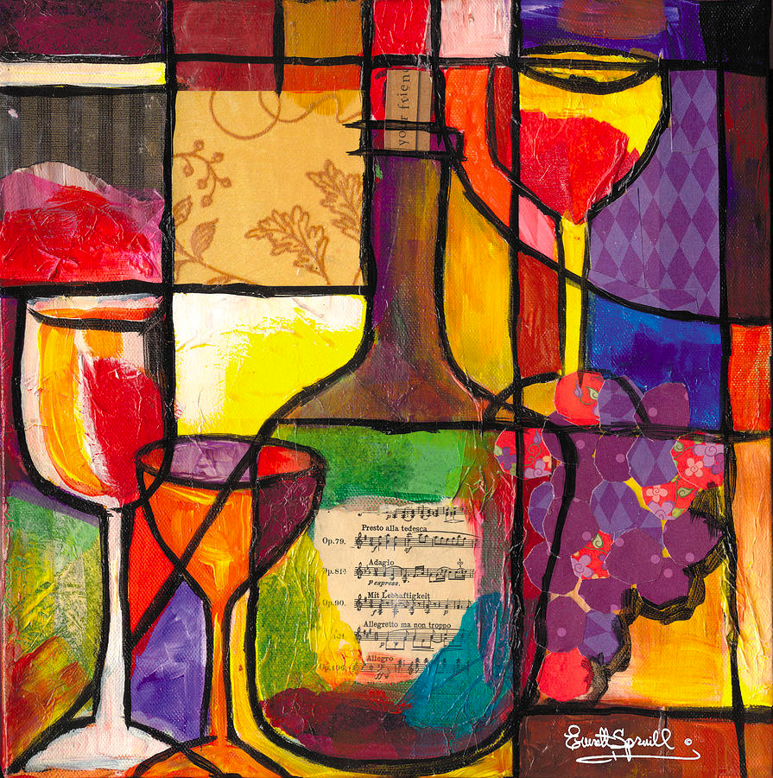

Slide 5
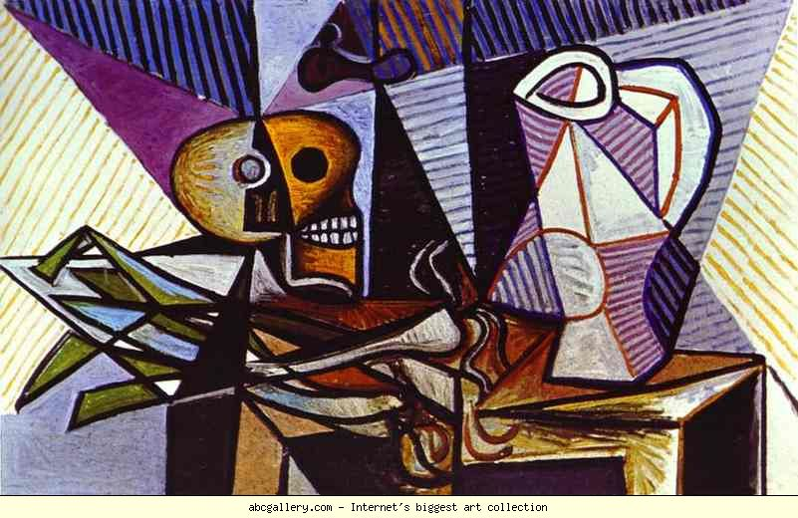

Slide 6
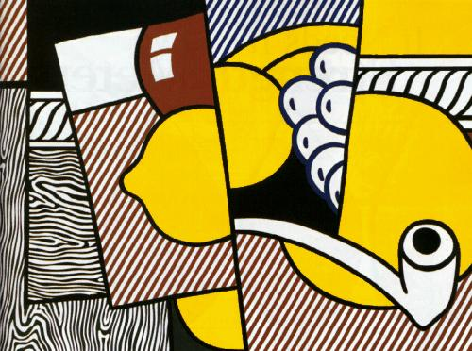

Slide 7
Your Assignment: Set-Up
You will begin by creating an observational drawing of the still life set up at your table. You can simplify/distort edges and details, play with alignment/transparency/repetition etc. Look for major forms as well as reflections/distortions. Your composition should take up most of the page.

Slide 8
Your Assignment: Set-Up
You will work on 16 x 16 paper. You will apply a ground to your paper. Cut out three shapes from newspaper and glue them on to the white paper. You will work right on top of this as your new surface.

Slide 9
Composition
Transfer your sketch (you may change the composition to suit the paper, if needed) to your final paper. Work right over the newspaper.
Utilize a series of lines to “chop up” your composition into several sections.

Slide 10
Medium
*We will be using water-soluble graphite for this project (“Sketch and Wash” pencil). {we’ll have a review/demo lesson}
*You will need to display a range in value (contrast/gradation) and use the pencil in both wet and dry fashion.
*The values do not have to be observed from real life.
*You may create designs/patterns in the shapes (esp. background)
*You may work in color with colored pencil after the graphite is complete.

Slide 11
What am I Looking For?
*Composition is balanced and unified: Even distribution of dark and light areas, shapes “flow” and the eye moves around the page
*There is observation and abstraction (we know what we’re looking at, but it has been altered and made more interesting)
*Make it look GOOD! And have FUN!

Slide 12
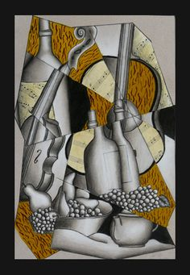

Slide 13
Due Date Information
Sept. 14/15- Demo and make thumbnail sketches
Sept. 16/17- Set up paper and transfer sketch
Sept. 18/21- Sketch and wash practice (mini lesson)
Sept. 22/23, 24/25, 28/29- Apply value and color to drawing
Drawings DUE 9/30 (A) and 10/1 (B) with completed rubric
Remember- I only give extensions if the whole class is on task; also, late work looses 5 points per day.

