Slide 1
Installation Sculpture
Art 2

Slide 2
You will
Work in partners or groups of three to create a larger-than-life installation sculpture in paper mache.
You will conceive of the structure/plans and carry out your ideas so that you have a sturdy piece.
You will apply paper mache, gesso and finish your work in acrylic paint.
You will create a sculpture of a common/everyday object, but the size will be very much exaggerated.
You will consider (and possibly execute) the placement/installation of your sculpture in a place throughout the school.

Slide 3
What is Installation Art?
Installation are pieces are a fairly modern movement in the art world (last 40-50 years or so)
Installation art pieces typically consist of sculptures (3D).
Installation artwork is dependent on the site where it is displayed. The artist has to consider this first and foremost before he/she actually designs and creates the piece.
Often, installation pieces are more public and accessible than traditional art. They might be on the street, in a park, or in other busy areas. Sometimes they can be found in art museums.
Sometimes, installation art is quite unique. It often involves the experience of the viewer as a crucial element. It can be much more interactive than how we might usually think of fine art.

Slide 4
Claes Oldenburg
Of Swedish decent, but worked mostly in America (Chicago/New York) in the 1950s-1980s (still living and working today in NY). Oldenburg also worked closely with his wife, Coosje Van Bruggen (she died in 2009)
Began working in paper mache and other “found” materials then went on to larger, public works
Best known for giant sculptures of everyday objects
Sculptures are planned by Oldenburg (subject, material, dimensions, site etc.) but he often executes them with the help of a team of builders
Oldenburg’s work is displayed all over America and the rest of the world

Slide 5
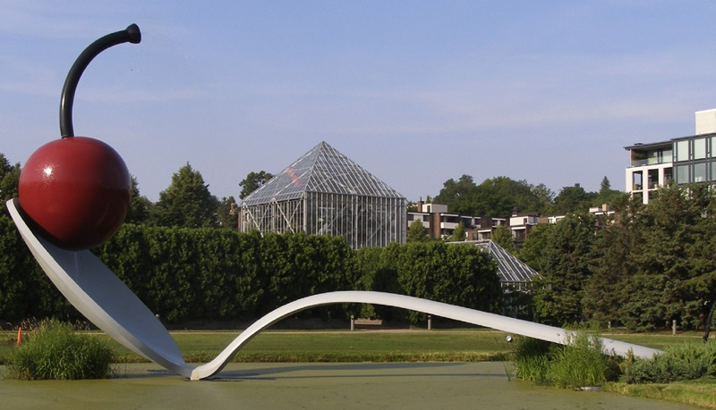
Spoon Bridge and Cherry Minneapolis, MN

Slide 6
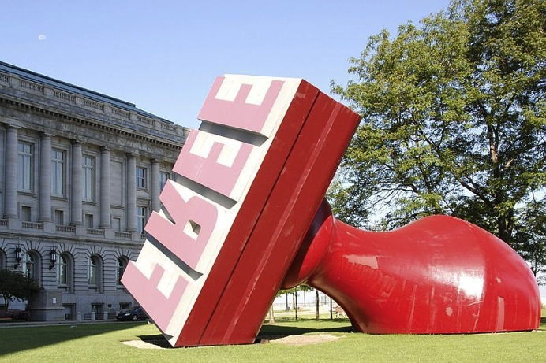
Free Stamp Cleveland City Hall, OH

Slide 7
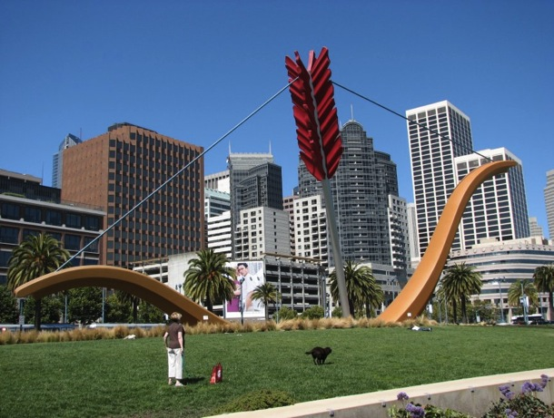
Cupid’s Span San Francisco, CA

Slide 8
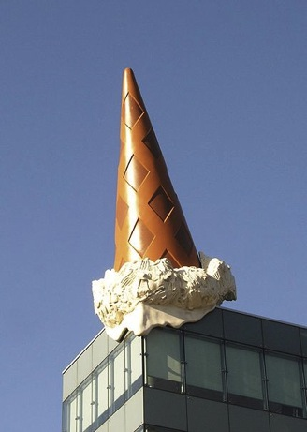
Dropped Cone Germany

Slide 9
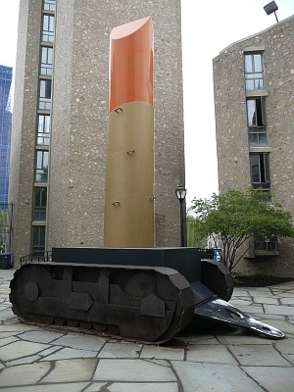
Lipstick (Ascending) on Caterpillar Tracks Yale University- New Haven, CT
In 1969, women were allowed to enroll at Yale University for the first time. Oldenburg installed this sculpture in 1970. It still stands on the university campus today.

Slide 10
What You Will DO- Set UP
Choose your partner/group. Think of your strengths/weaknesses when choosing who you will work with. This project is going to take us at least three weeks, if not more. If I am concerned about particular chemistry between group members, I reserve the right to make adjustments.
We will vote on the theme as a class.
Choose what your particular sculpture will be in that theme. Your sculpture will be a minimum of 2x2x2 feet and a maximum of 4x4x4 feet. I will expect more complexity depending on the number of group members.
Start planning how you want your sculpture to look. Then, begin designing the structure and armature.

Slide 11
Armatures
Armatures are the base or “skeleton” of a sculpture. We will be making ours out of corrugated (recycled) cardboard and adhering things together with masking tape. You also might wish to use heavy paper/posterboard for smaller details and/or “bulk things up” with crumpled newspaper.
The armature will be covered with paper mache (strips of newspaper dipped in wheat paste) and allowed to dry and harden. This will create the overall form of your sculpture.
The armature has to be strong in order for the overall sculpture to be strong.
You will draw a sketch with dimensions before beginning to construct your armature.

Slide 12
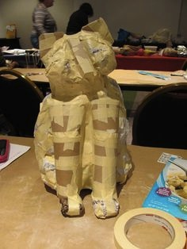

Slide 13
Armatures- Tips
Use thin strips (“ribs”) when possible to cut down on the overall weight.
Crumpled paper can help you build up form/volume without adding extra weight.
Make sure everything is very secure with masking tape. Make sure the sides of the tape are tucked in. Be careful, however- don’t go overboard with the tape because sometimes you’ll run into problems with the first layer of paper mache sticking. Pro tip- rip off a bunch of little pieces of tape from the roll and stick them to the corner of the table to make it easier while you’re working.
You can “score” the cardboard with an X-acto knife (cut through the top layer, not all the way through) so that it folds on a curve. You can also run it on the side of the table (like a dollar on a vending machine) so it bends better.
Work general to specific. Establish the big shape first, and leave details for later.
It is possible to build pieces separately, paper mache them with 1-2 layers separately, then paper mache them together. This might be a good method to use if you have a particularly complex shape.
If you find things (boxes, balloons, tubes etc.) that have a form you need this could cut down on time. I can’t guarantee that I’ll have these on hand, though.
Heavy paper can be used for smaller pieces. It will need to be paper-mache’d over, too.

Slide 14
Paper Mache
Paper mache is what we call the overall process of this type of sculpture.
Paper mache means “chewed paper” in French. Traditionally, paper was shredded into a pulp and mixed with a paste, then applied and sculpted while wet and allowed to dry and harden, taking on the form of the wet, sticky paper pulp.
Paper mache can also be wrapped around a form using wet pieces of paper. When it dries and hardens, it solidifies the surface of that form.
We will use strips of newspaper in our sculptures. We will use a wheat paste mixture to dampen the strips. When it dries, it will be sturdy.
We will do about three layers of the paper mache before finishing our work.

Slide 15
Paper Mache- Tips
Rip the paper; don’t cut with scissors (rip down the fold of a newspaper sheet)
Dip the newspaper strip in the wheat paste mixture and run off the excess between your fingers. Then lay the strip carefully and smooth down (avoid bubbles and bumps. Smooth down the entire thing periodically.
If your strips are sinking in, that means your armature has too many gaps, and needs to be filled.
When you apply subsequent layers, crisscross the strips for a stronger application.
Make sure to smooth joints carefully and neatly.
TUCK YOUR EDGES AND WRAP YOUR CORNERS! This is what makes the difference between an “okay” sculpture and a professional-looking piece.
As you’re working, the sculpture needs to have a nice, cohesive flow throughout the form. Mistakes aren’t easily hidden, so take your time, and make everything look neat and careful.

Slide 16
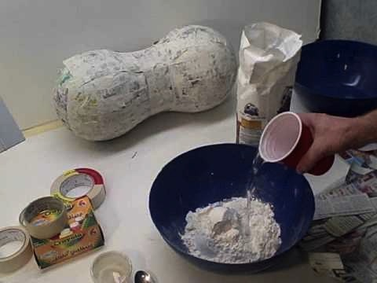

Slide 17
Finishing- Acrylic
You will gesso (prime) the sculpture with gesso after sufficient layers of paper mache.
You will then finish your work using acrylic paint.
Strong form+ strong surface= strong sculpture
MAKE SURE YOUR PAINTING IS NEAT! The painting is an integral step, not an afterthought.
You can also add embellishments/details, if you’d like (consider different materials)

Slide 18
Painting- Tips
Mix colors when you can for a more interesting piece (not straight from the tube). Mix up enough do you don’t have to re-make a color. Add a little water so the paint spreads better.
You can draw right onto the gesso using a pencil so you don’t have to paint perfectly with a brush. You can also paint a base layer color, let it dry, then draw onto that.
Make sure you have enough coats.
You can paint a color, then do a wash over it to create implied texture.
You can apply shading (dark and/or light) to exaggerate the 3D form.
Make sure your lines and shapes are neat and careful. A bad painting job can ruin an otherwise good sculpture. If you mess up, paint over, let dry and re-paint.

Slide 19
What Are We STRIVING FOR?
An interesting idea/subject
A strong, sturdy, balanced 3D form (keep in mind the size)
A smooth, flowing, sculptural surface
A carefully painted surface that enhances the form
Strong collaboration, division of labor, playing off each other’s strengths in the group
Neatness, carefulness, good craftspersonship
Your work, although very large in size, should be realistic/believable
Thought to where the piece could be displayed in the school (Arts Night, too)

Slide 20
Timeline
*Day 1- Plan idea; establish armature
*Days 2, 3, 4- Construct armature
*Days 4, 5, 6, 7- Paper mache (1 layer per day)
*Day 8- Gesso
*Day 9, 10, 11- Painting and finishing
Sculptures due: ______________
Since this a group project, you will be graded overall as a team. However, you will also be asked to reflect on the individual habits of the group members, and an additional component of your grade will be an individual grade that reflects such.

