Slide 1
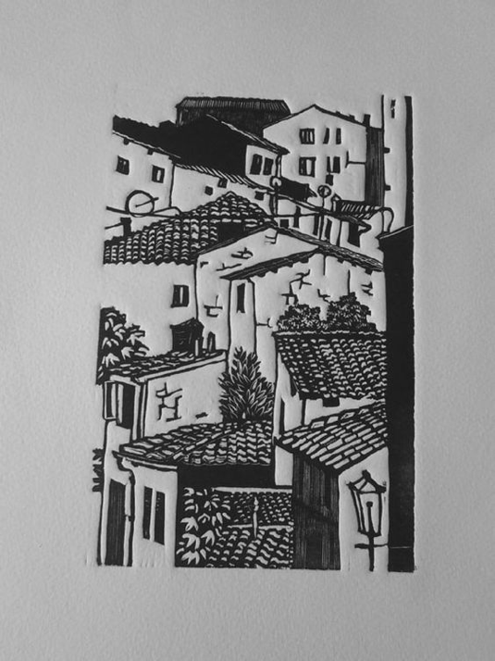
Block Print
Art 1

Slide 2
What is Printmaking?
Block printing is one type of printmaking (intaglio, callograph and screen printing are others). In printmaking, a surface is taken away from or added to. Then ink is applied to the surface and printed on paper. With printmaking, you can make several images from the same source.
We will be using soft cut linoleum blocks and a linoleum cutter to carve out textures. What you carve away does not get ink applied to it and, therefore, becomes the color of your paper. We will work on white paper and print with black ink. The areas you carve from the block will show up as WHITE.
Remember that you are carving out textures and light values. Try to minimize outline.

Slide 3
Subject Matter
For the subject matter of your block print, you will depict a place that is special to you. You can do your home, bedroom, an important landscape etc. You can choose to do an interior or exterior but your work should show depth/space.
I would suggest you get a photo to work from to make your work more believable. You can take artistic license/stylize, but there should be some element of realism.

Slide 4
Examples

Slide 7
LHS Student Examples (website)
http://ledyardart.weebly.com/art-i.html

Slide 8
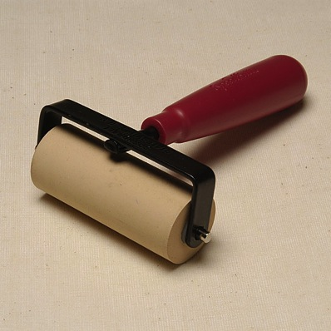
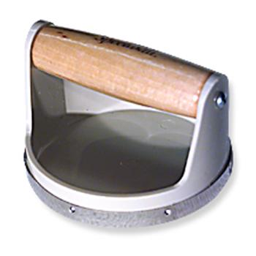
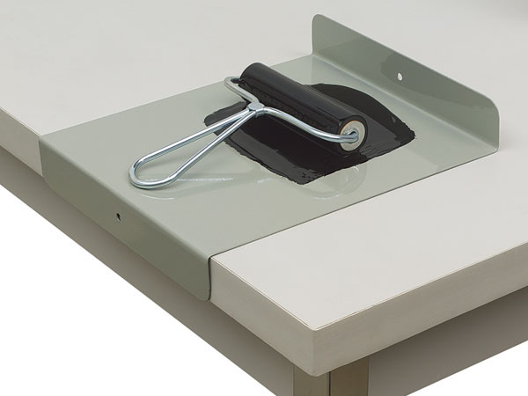
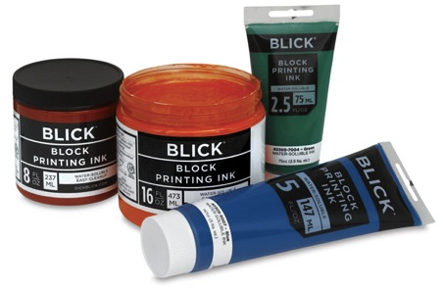
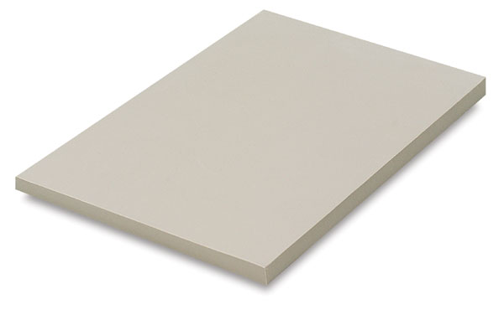
Printmaking Tools
Lino-cutter and gouge tips
Barren
Brayer
Block Printing ink
Inking plate
Linoleum (Soft-Kut)

Slide 9
Linoleum Cutter
Make sure you understand how to take these apart and put them back together. If they fall apart and a piece gets lost, the whole tool is ruined.
Linoleum scraps do not need to hide in the handles, please!
http://fudgeandjoy.com/crafting-2/the-dummys-guide-to-using-a-speedball-linoleum-cutter-to-carve-rubber-stamps/

Slide 10
YouTube video of the process
https://www.youtube.com/watch?v=gYwfB28Xc-8

Slide 11
The Process: Set Up
You will get a piece of paper that is the same size as your block. Draw out your image using a heavy #2 pencil. Concentrate on big, simple shapes.
Rinse the talc off the block. Flip the sketch over so the pencil marks are pushing down on the surface of the block. Hold it still and burnish (rub) on the back with a bone folder so that the pencil marks transfer onto the block.
Your drawing will be backwards at this point. Don’t freak out! When you print, it will flip back the other way!
You can use a pencil or marker to make the lines easier to see. You can draw right onto the block.

Slide 12
Carving
When your image is on the block, you are ready to carve.
Remember to carve textures and light areas.
Don’t go right in and carve over all your outlines. This makes the print look juvenile and cartoony.
Carve away from yourself and hold your hand out of the way as you carve. The gouge will hurt if you jam it into your skin!
Use the appropriate size tip for what you need to do.
Try to carve in a consistent direction to show volume. If you have a little of the block left over, even in a white area, it adds some nice dimension to your print.
At first, take out a little less than you think you need. You can always wash the block after you’ve printed the first time through, carve away more and print again. You can’t add the block back once its gone, though!

Slide 13
Printing
Squirt a dime-size dollop of ink onto the inking plate.
Roll it flat with a brayer. Listen for the ink to crackle. Printmakers call this “singing.”
Roll the ink in a single layer onto your carved block.
Place your paper on top of the inked surface. Press down lightly with a barren.
Pull up at a diagonal.
Judge- is it a good print or a bad print? See next slide.
If yes, you’re good! If no, wash, re-carve and re-print as needed. You are looking to get a nearly perfect print.

Slide 14
Good Print (image)?
Is imagery clear?
Is there a variety of texture?
Is there a variety of thickness and line direction?
Is there a range in value?
Has outline been minimized?
Are flat, solid black and white shapes minimized?

Slide 15
Good Printing (technique)?
Centered on paper?
Lines not “flooded” with ink?
Ink consistently black (not fuzzy)?
Minimal blips?
Minimal smudges in borders?
Signed correctly?
{Name, “Title,” print #/edition #

Slide 16
Cleaning
Wash and dry brayers- make sure ink is out of the sides. Return to container.
Wash and dry inking plates completely. Stack facing the same way.
Wash and dry block. Place in drawer.
Place wet print(s) on drying rack.
Put linoleum cutters away. Make sure all pieces are in tact.
Sweep linoleum bits into the trash.
If you do a bad job cleaning up, I WILL pull this project and you will have to write papers instead.

Slide 17
Make it special
Remember to use resources like a good student (Farmer’s Alphabet, Block Printing, posters in classroom, Pinterest board etc.)
For your grade, you will submit your nearly-prefect black and white block print.
If you have extra time and want to go above and beyond consider:
-Printing with different colored inks
-Printing on different colored paper
-Cutting up scrap prints to create a mosaic/collage
-Printing on fabric (canvas bag, shirt etc.)
-Giving extra prints to friends

Slide 18
Timeline- this is a quick one! 5 days!
May 17th- Intro; begin creating your sketch
May 19th- Transfer sketch to block; begin carving
May 23- Carving/printing
May 25th- Carving printing
May 27th- Finalizing print PRINT DUE with Rubric
May 31st- Wrap-up day (loose ends from the quarter)
June 2nd- Final exam review
Thursday June 9th- Final Exam

