Slide 1
Wire Sculptures
“Cirque de Calder” inspired
Art 1

Slide 2
Alexander Calder
Engineer, Sculptor, Inventor, Family Man
Born 1898 in Lawnton PA
By the age of 4 Calder was creating animal sculptures from clay, sheets of metal and rock.
Both of Calder’s parents were artists but discouraged him from becoming an artist because the profession was uncertain and financially difficult during his time. He instead received a chemical engineering degree from Stevens Institute of Technology in Hoboken, NJ in 1919.
Calder’s interest in art never diminished so in 1923 he started attending the Art Students’ League in New York. While attending school he also worked as a freelance artist for the National Police Gazette and spent two weeks sketching scenes from the Ringling Brother’s and Barnum & Bailey Circus. He became fascinated with the circus.

Slide 3
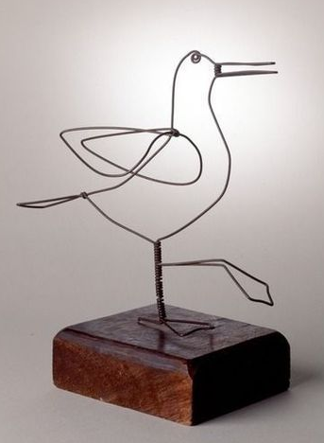
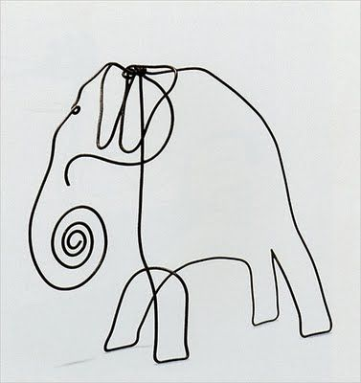
Cirque de Calder!

Slide 4
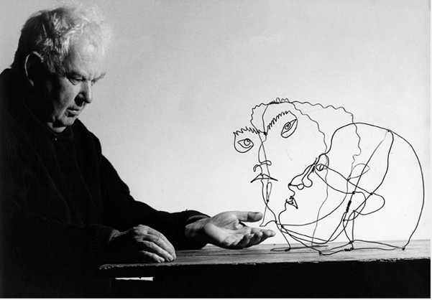

Slide 5
Calder and Mobiles
In 1926 Alexander Calder moved to Paris and began building toys that moved. His collection eventually became a miniature circus performed in the USA and Europe.
You all know what a mobile is right? A mobile is an object that is able to move and/or move easily *kinetic sculpture*
Calder’s interest in kinetic art led him to create mobiles!
Alexander Calder invented the first kinetic sculpture that was named “mobile” by Marcel Duchamp
Alexander Calder died on November 11, 1976 in New York.

Slide 6
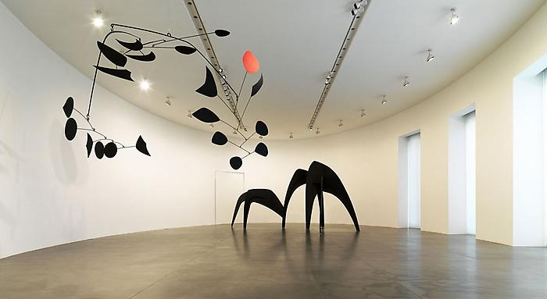

Slide 7
You will create…
A wire sculpture of an circus animal inspired by Alexander Calder.
The sculpture will be 3D which means it must have volume and is interesting from all sides! The form of your animal will be just the wire. The movement of the wire should bring to life the animal you choose.
Your sculpture will mainly be created with one long, fluid wire
Your wire sculpture will be mounted to a block of wood so it will stand sturdy
Your wire sculpture will be within these dimensions:
6-8 inches in height
6-8 inches in length
3-4 inches in width

Slide 8
Things to consider…
What animal are you choosing? Why?
How does the animal move? The animal does not need to be standing static on the block of wood
How will your animal be different from other people’s?
------------------------------------------------------------------------------------
You are going to start drawing the outline of the animal you’ve chosen and while you are drawing, imagine your pencil is the wire and the wire is what creates the shape
Keep in mind proportions of the form...
Simplify the form of the animal

Slide 9
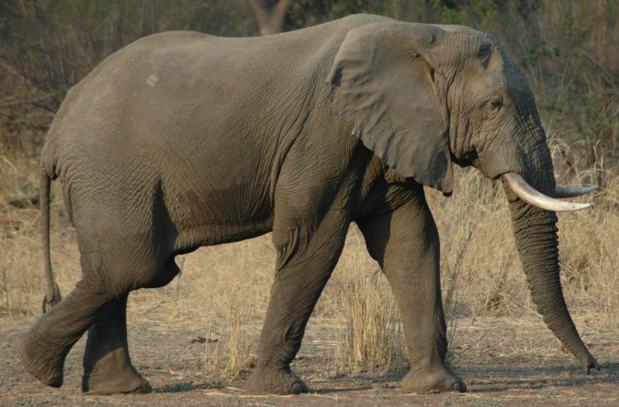
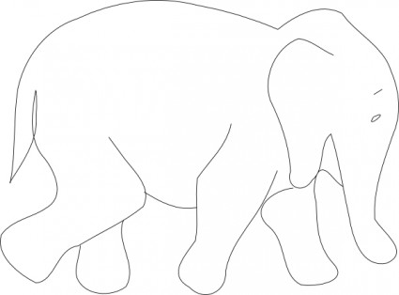
Figure out the basic shapes of the animal. For example, the legs are cylinders, the ears are triangular, the body is a rounded rectangle, etc.

Slide 10
What tools are we using?
Long needle nose pliers that also cut through the wire
15 gage aluminum wire
Gage refers to the thickness of the wire
Hammer and nails to connect sculpture to wood
*hint
When wire is bent back and forth a lot, the wire becomes tougher to bend and it may become more difficult to work with

Slide 11
Due date
Your project should be completed, mounted to wood and a rubric filled out by March 28th (this gives you 5 class days to create this project)
Every day your project is late, it’s 5 points off. After 2 weeks, the project grade is a zero.
If you finish early, there will be another group-based project to complete…more information to come in the near future.

