Slide 1
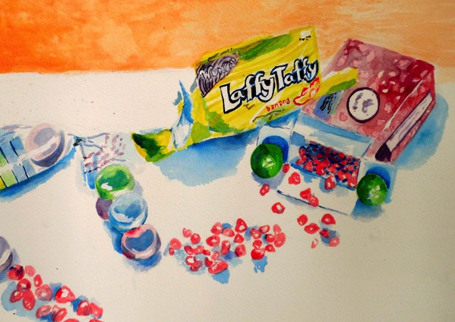
Watercolor Candy Still Life

Slide 2
Set Up
You will be provided with an assortment of candy. Choose at least five pieces and set up your candy into an interesting arrangement. Be creative! Open wrappers, set pieces out etc. Be clever, but not too complex. Glue your arrangement in place on the board provided.
Create a thumbnail sketch in your sketchbook to practice drawing what you see and establish composition. The candy will be drawn slightly larger than life. It is okay to crop the composition. Be sure to include a horizon line to ground the still life. Keep the eye level consistent. Look for areas of shadow (especially cast shadow). Try to replicate the unique typography and graphics on the boxes and wrappers to make your work interesting.
When you are ready, move on to the final paper (we will be working the same size as we did for the abstract watercolor piece. Sketch the drawing’s major defining lines out LIGHTLY in pencil. If you see any major areas of highlight/reflection, you can sketch them in, and mask them off using a liquid frisket. {You can also apply a tiny bit of white tempera using a very thin brush when your watercolor is complete and dry. Very tiny details (words etc.) can be carefully written in with a pencil or Sharpie pen at the very end as well. }

Slide 3
Watercolor Application
I recommend starting in the background first, laying down a wash to describe the table surface and background (keep consistent with the light source). This is where you might want to use the wet on wet technique to get an interesting blending/gradient effect.
It is a good idea to use a wash of neutralized blue or VERY watered down black to establish form shadows and cast shadows first. Let these dry, and then paint the local color of the candy and wrappers right on top (this will be the wet on dry technique).
For logos, text and candy pieces you will use the hard-edge technique. The colors will probably be fairly saturated so you can get the bright, bold “pop” colors used in candy and candy packaging. Many colors will be straight out of the tube, not so much natural or neutralized. Make sure shapes are dry before painting adjacent shapes.
When your work is dry, you can go back into it, darkening shadows with an additional wash, refining details etc.

Slide 4
Tips and Tricks to Really Make Your Work SWEET
Look for slight color reflections on the white surface. Put them into the cast shadows with a light wash.
Remember, you can write in tiny text with a pencil (mechanical works best) or Sharpie pen. Really try to achieve the font/computer-generated look.
A few little highlights using frisket or tempera can go a long way!
When you’re setting up, you can work with a border, or work right up to the edge.
The pieces that have the most “presence” are the ones where the candy is drawn big, there isn’t a lot of extra negative space, and there are clear and contrasting shadows.
Over-working watercolor can be just as bad as under-working watercolor.
Remember, don’t whiten with white pigment. Lighten with more water.
Take your time…think, plan, execute. Watercolor isn’t a very forgiving medium, but you can have great success if you think about what you’re doing, the best way to go about it, and take the time to carry it out carefully.

Slide 5
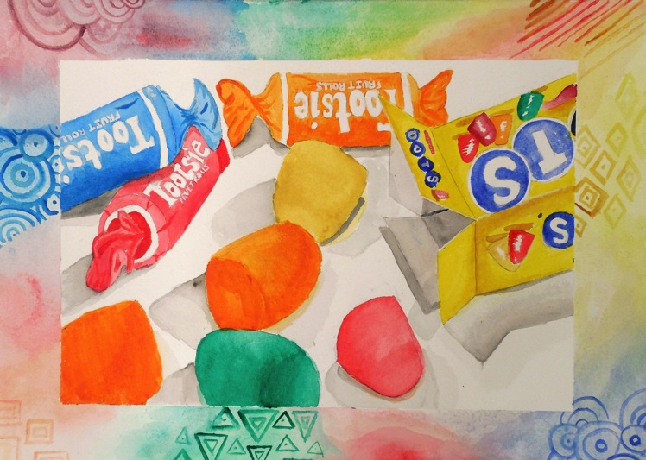

Slide 6
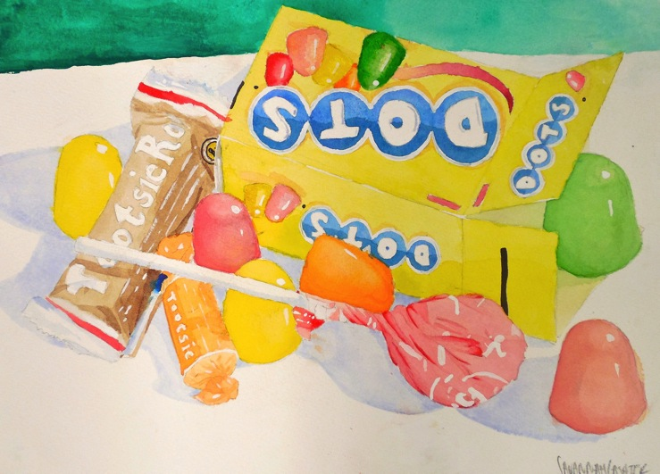

Slide 7
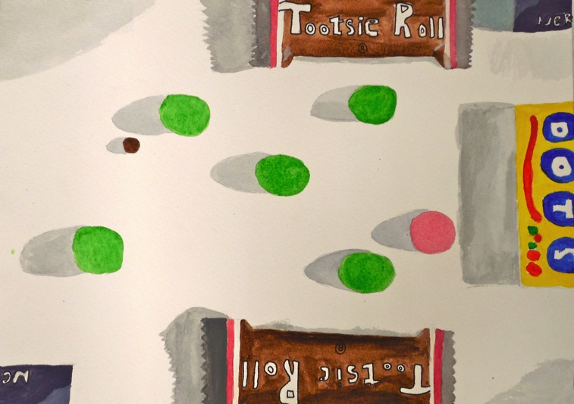

Slide 8


Slide 9
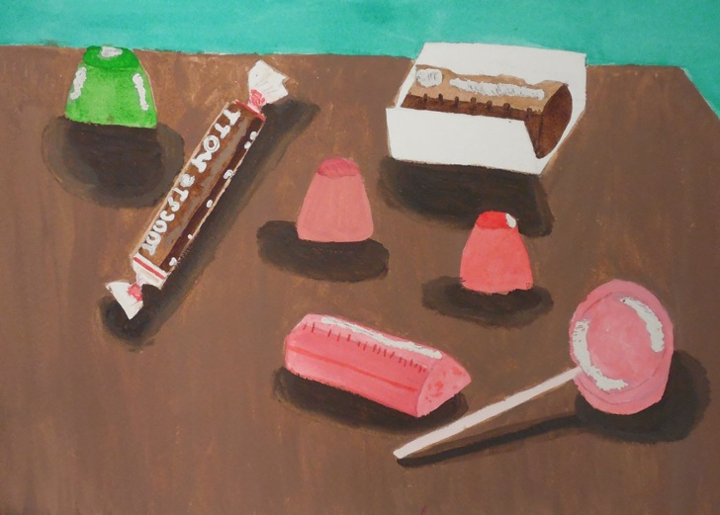

Slide 10
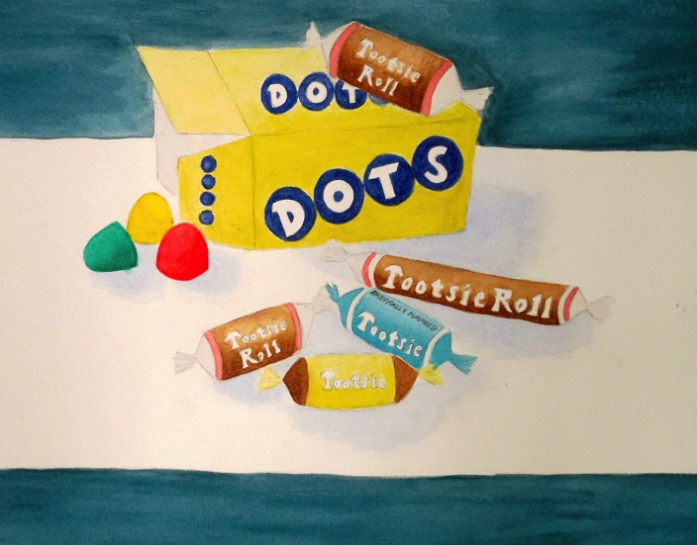

Slide 11
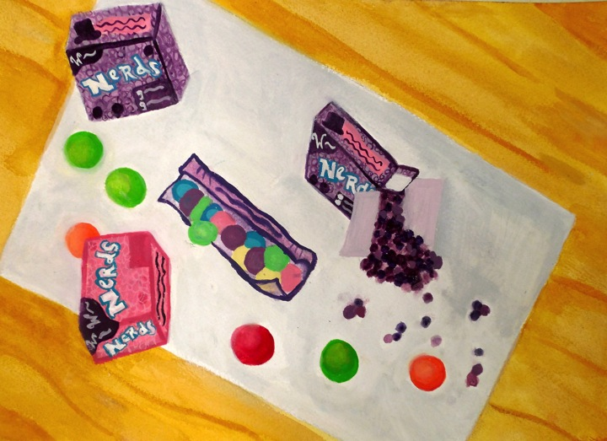

Slide 12
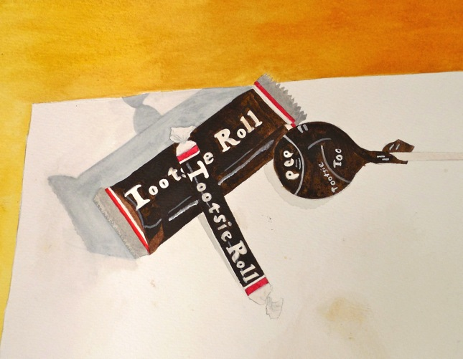

Slide 13
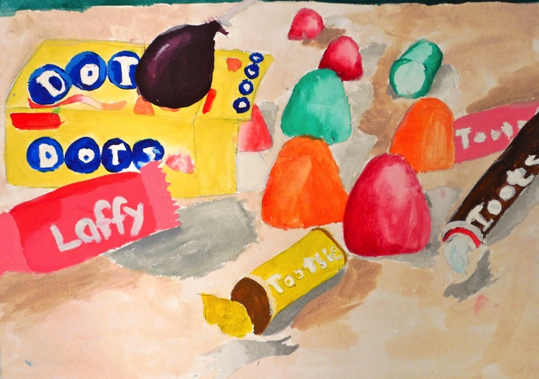

Slide 14
Due Date Information
Piece is due with rubric on November _______.
You have approximately five class periods to finish this painting.
Remember that work loses 5 points for every day it is late, and is not accepted after two weeks unless under pre-negotiated, extenuating circumstances.
Remember to submit rubric (filled out on both sides) with your completed work.

