Slide 1
Drawing from Observation Color Pencil
Art 1

Slide 2
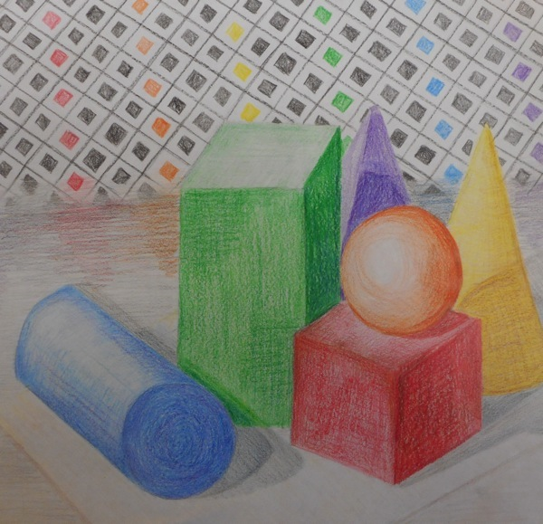

Slide 3
Set Up
*Sit so you can see, facing the still life (nobody blocking you, no turning)
*Make sure the drawing fills your page well, but most of it should fit on the page.
*Start with a light outline (placeholder shapes) then refine the drawing (3D shapes) and leave shading for the end. Swing light, loose lines at first, and gradually create tighter, more defined lines as the drawing develops.
*I like to pick an object in the middle of the arrangement and put that in the middle of my paper, then work out from there.

Slide 4
Creating Depth
Making the jump from 3D to 2D- higher on the page also means further back in space
Foreground- The place where objects are closest to you
Background- The place where objects are furthest away from you
Middleground- The place between the foreground and background
Depicting overlap will help you show depth (What is in front? What is behind that? What is behind that?)

Slide 5
General Procedure: Blocking Out Your Drawing
Block out “placeholder shapes.” Compare heights/widths and line up forms. Make sure still life fits on the page, and fills up the page. Lightly block in background and surface.
Refine, filling in placeholder shapes with more developed 3D forms. Look at where edges and angles run into one another. Darken lines a little.
Fix edges and angles, and get the outlines as accurate as possible. Also look for any extreme shadow shapes that you see.
Think of your drawing growing gradually as a whole (general → specific). Do not finish one part entirely and then move to the next. Work little by little, in layers.

Slide 6
Other things to consider…
No “floating” still life (ground the objects by drawing foam-core board)
No “magic carpets” (draw the table’s edges/sides and the background; think of two planes coming together)
Resolve the background (you will create patterns and designs in the background. Make sure the objects overlap the design).
Look from the exact same position if you come back at a later time to work on your drawing

Slide 7
What is successful about this drawing?

Slide 8
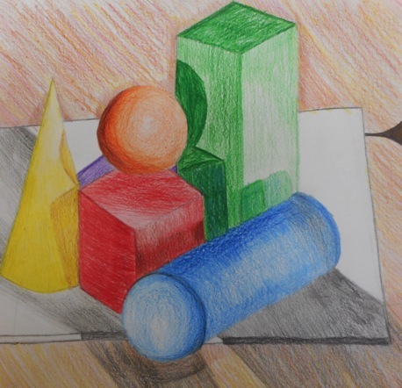
What is successful about this drawing?

Slide 9
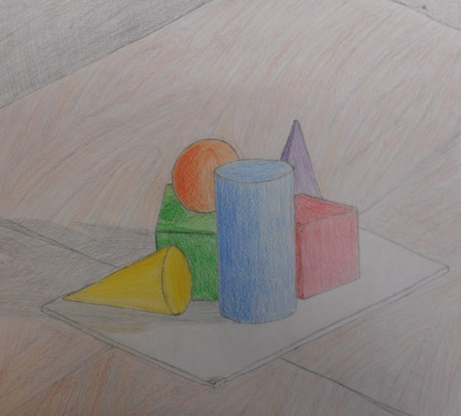
What could be more successful about this drawing?

Slide 10
General Procedure: Shading Your Drawing
There will be color/design on almost all of your paper. Even light values have a little color to them. I like to block my lightest tones in first with medium pressure. Then, I will layer with my next darkest tone, and, finally with my darkest tones as a third layer.
Remember to use the pressure of the pencil to describe dark/light areas (push harder= get darker). You can also incorporate additional colors to darken areas (brown for warm colored objects; blue for cool-colored objects)
Remember to shade in the direction of the objects’ surfaces to show form and volume.
For flat sides, bring the shadow right up to the edges of the sides. For rounded sides, use curved marks, and have the shadow fade gradually.
You might find it helpful to draw in your cast shadow shapes and fill them in with a strong dark value (a light blue works well for the cast shadow on the white surface).
Don’t forget to create patterns and designs in the background!

Slide 11
The background
You will create shapes of zentangles in the background
Zentangles are complex patterns!
Think about how some patterns create a darker value and how some are lighter. If you’re up for the challenge, try to go from light to dark in value from the horizon line up to the top of your page OR relative to the light source.
I’ll let you choose if you want to do the Zentangle using Sharpie, or using colored pencil, or using Sharpie with an accent color.

Slide 12
Due Date Information
This project needs to be handed in with a completed rubric (front and back) on November 5th/6th.
If I see that the entire class needs extra time, it will be given. However, extra time is given ONLY if I see the entire class working consistently.
Every day the project is turned in late, it’s 5 points off. After 2 weeks, the project is a 0.
If a project is turned in without a name on it and/or the project isn’t turned in with a completed rubric, it’s 10 points off.

