Slide 1
Painting Studio
Cross-Contour Painting

Slide 2
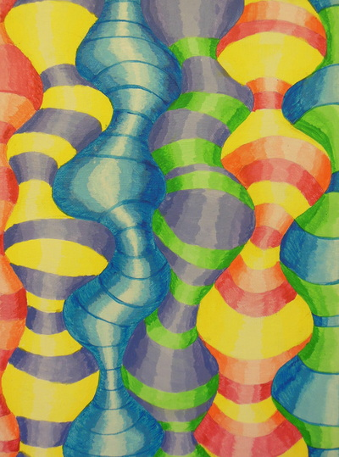
This assignment is intended to get you used to introduced to working with paint, brushes, color mixing, and matte medium. You will get comfortable working with acrylic paint while developing 3D volume and form in an abstract design.

Slide 3
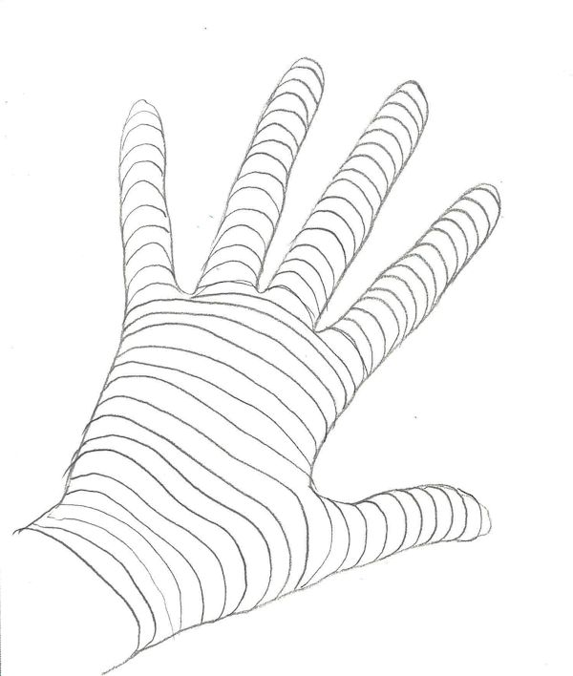
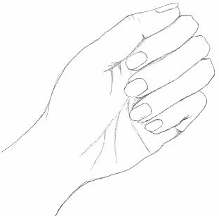
What is Cross-Contour?
Contour lines define an objects’ edge or outline, while cross-contour lines go across the form of an object, showing the objects’ form/volume.

Slide 4
Curved vs. Flat
Objects with flat sides will have straight cross-contour lines, while spherical/curvilinear objects will have curved/rounded cross-contour lines (the more drastic the curve, the more 3D the object will look).
This is especially important to note when we get into trying to paint things so they look realistic; make your brush strokes in the direction of the form of the object to help show form/volume/three-dimensionality.

Slide 8
All of these examples are relative to real life. However, for this first assignment in painting class, you will be using an abstract subject matter (so you do not have to balance observational drawing/painting with utilizing the new medium). The observational part will come in our next assignment, when you apply these concepts to a still life painting.

Slide 9
Set-Up
On a 12 x 16 canvas board, draw out your lines lightly in pencil (try to minimize erasing as it will smudge on the canvas board and show through the paint).
Draw a series of wiggly, squiggly lines from the top of the canvas board to the bottom (keep them a 2 to 3 inches apart). The more you exaggerate the differences between thin and thick shapes, the more of a “bulging” effect you will get.
Make a line that divides the top and bottom just about in half (can be straight, diagonal or squiggly).
On the TOP half of this dividing line, make a series of curved parallel lines to connect your original squiggly segments (about an inch apart). Remember, the more curved they are, the more spherical the sections will look.

Slide 11
Painting
When you paint your design, the outside edges of the segments should be darker, gradually getting lighter towards the center.
Start with the hue towards the edge as your darkest value, then lighter tints as you near the center of the segment.
Mix the tints first and add a bit of matte medium. This slows down the drying time of the acrylic paint. Block your tints in rather quickly, then blend the transitions between them so the tints change gradually.
As you blend, keep your brush strokes in consistent direction to show the spherical form of the segments.
When your paint dries (which happens pretty quickly; 5 to 10 minutes) you can touch up your edges, and increase the contrast (using the hue for the dark areas, and white as a highlight). You can also define the tops and bottoms of the segments a little bit, to really make them pop.

Slide 12
You need…
I want to see at least five different colors used in your painting. One of them needs to be mixed (not straight out of the tube. When you do this, mix your new color first, then create your tints).
If you decide to do stripes or a pattern, paint all the segments of one color at a time (instead of piece by piece). It will save you a lot of time!

Slide 13
Examples on the website:
http://ledyardart.weebly.com/painting-studio.html
I’ll do a demo for you now, and tell you where the supplies are located.

Slide 14
Due Date Information
This project needs to be handed in with a completed rubric (front and back) on September ______________.
If I see that the entire class needs extra time, it will be given. However, extra time is given ONLY if I see the entire class working consistently.
Every day the project is turned in late, it’s 5 points off.
If a project is turned in without a name on it and/or the project isn’t turned in with a completed rubric, it’s 10 points off.

