Slide 1
Shattered Value Design
Drawing 1

Slide 2
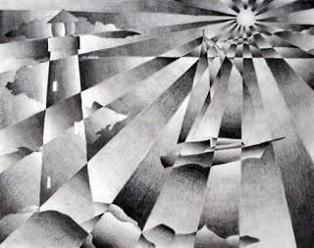

Slide 3
This project will…
Introduce you to the concept of value
Introduce you to the concepts of contrast and gradation
Teach you shading techniques
Introduce you to the ebony pencil medium
Allow you to create an original design using value concepts
Help bridge the gap between creating value in an abstract manner and a realistic manner (it will make the still life unit easier)

Slide 4
Value
Value, in art, means how dark or how light something is
For this project, we will be referring to things in gray scale (in other words, how dark/light is their value from black to white)
Although your eye can detect up to thirty shades of gray, we will aim to create FIVE different values in this project.

Slide 5
Contrast vs. Gradation
Contrast- a strong range/differentiation between values (you want to be able to distinctly tell the values apart, and your work should have both very dark values and very light values)
Gradation- a gradual change between values (you want the values to seamlessly change from one to the next)
We will be aiming for contrast and gradation simultaneously in this project.

Slide 6
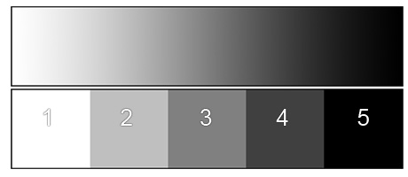
Value scales (gradation on the top, contrast/hard-edged on the bottom):

Slide 7
You will…
You will create a simple line drawing of an object that has significance to you.
You will draw lines over that object to break it up into smaller shapes (so it looks “shattered”)
Each shape will have a range in value, but the values should transition gradually, demonstrating contrast and gradation
Your original outlines will eventually be eliminated because the values will be placed so that they create edges without the need for a defining outline

Slide 8
Set-Up
Draw out your shape/object on the paper- try to keep it BIG (filling up most of the paper and keeping the composition balanced). Aim for a shape that is pretty simple. You can choose to do multiple shapes, or even repeat several shapes, making a pattern. Keep the lines very light.
“Shatter” your shapes by making several lines that go through them, breaking them up. Again, keep these lines very light.
I won’t require an exact number, but if you’re looking for a ballpark estimate, I’d say aim for at least 20 shapes total.

Slide 9
In each shape…
There needs to be a range in value. Aim for five, but if you don’t quite get there in all shapes, that’s okay.
Move from dark to light OR light to dark, reversing each time. The reason for the reversal is so that different values sit up next to each other, creating edges.
Use good ebony pencil techniques (see next slide)

Slide 10
Ebony Pencil
Ebony pencil is graphite (like a #2 pencil) but the lead is softer. Ebony pencil can be used to build up to a very dark value (creating contrast), but can also be smudged (creating gradation).
More pressure = darker value
Try to build up little by little (eliminate pencil stroke marks)
Try to keep pencil stroke marks in a consistent direction so your work looks neat
You can blend with your finger to help bring the value through the shape
You can work into the shape with an eraser to use as a blending tool, and also to “lift” value
Make sure to bring the value right up to the edge of the shape

Slide 11
Other tips
This is a back and forth, gradual process (unlike your line design, where you put something down and moved on)
You WILL get messy, but the ebony will wash right off. I expect clean table tops (magic eraser sponges work wonders!)
Don’t smudge your completed shapes as you work- you can put a scrap paper under your coloring hand to protect your work.
Remember what we learned about in the line design; evenly distribute your black and white shapes to help the eye move around the composition
This project is less creative and more technical than the line design was

Slide 12
What am I looking for?
An interesting image/interesting shapes
Contrast from the white of the paper to almost black
Range in value- we should be able to see FIVE values (in order) in each shape
Gradation; the values should blend smoothly, consistently and evenly
Good ebony pencil technique
Clear imagery WITHOUT the need for outline
Care and pride in work

Slide 13
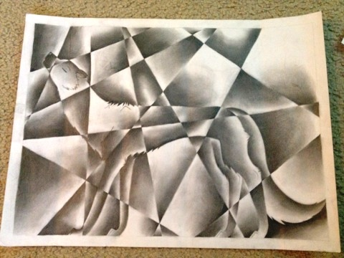
Examples

Slide 15
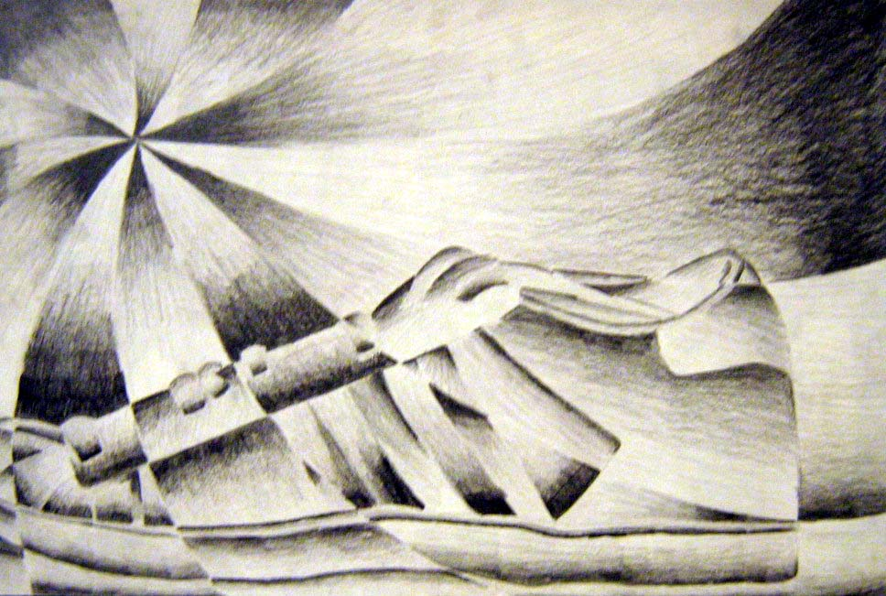

Slide 16
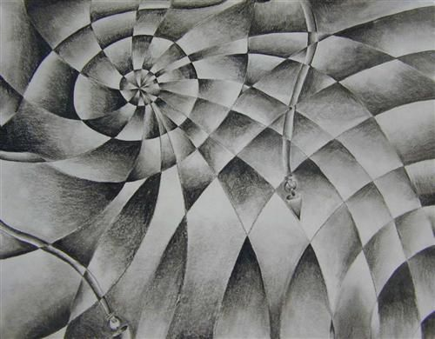

Slide 17
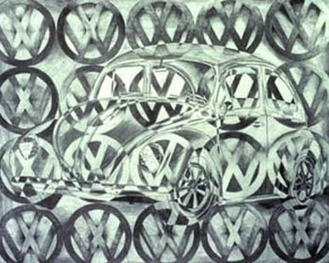

Slide 18
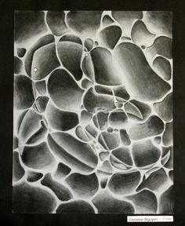

Slide 19
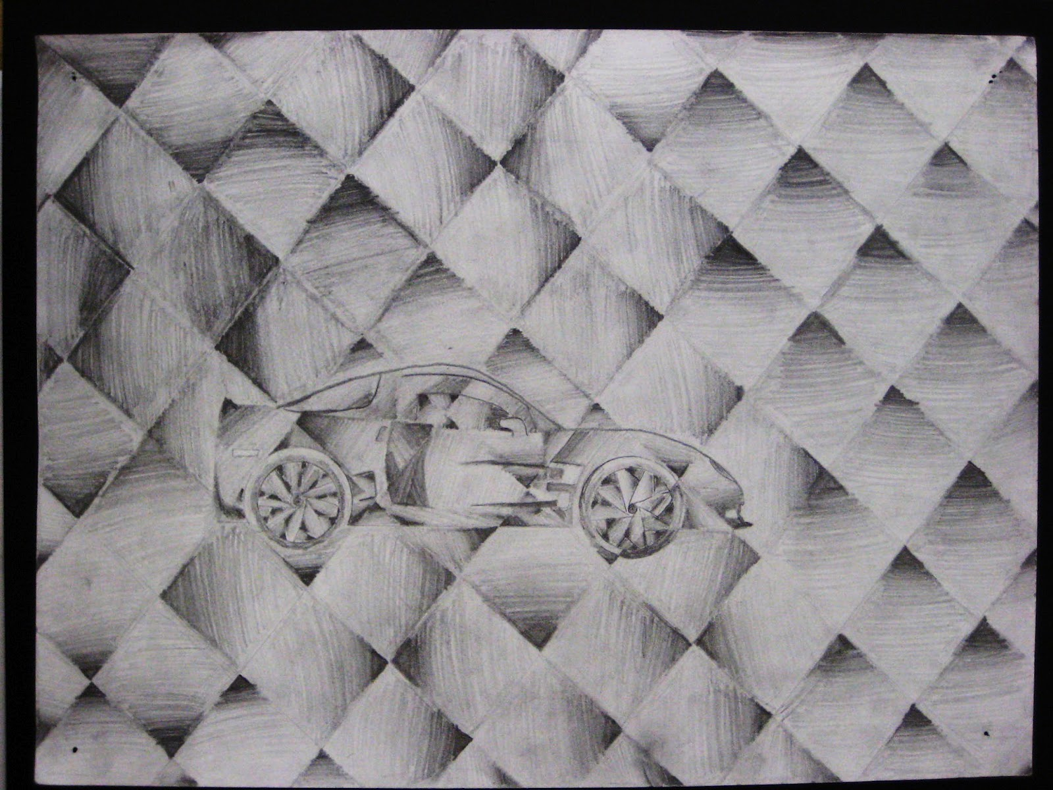
Bad example- object too small

Slide 20
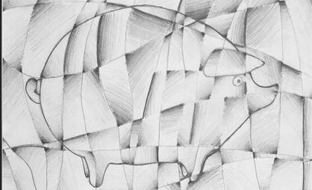
Bad example- not enough range in value; too much outline

Slide 21
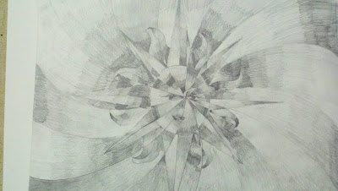
Bad example- not enough blending/not clear because there isn’t enough thought to where the vales are placed

Slide 22
Timeline
You will have four classes to complete this project
Due date is March 3rd (A day) or March 6th (B day)
Day 1 will be intro, setting up design and starting to shade shapes
Days 2, 3 and 4 will be comprised of shading

