Slide 1
Hyper-Realism Eye Study
Drawing 2

Slide 2
You Will…
You will create a hyper-realistic study working from a photo of your eye.
You will work on 11 x 14 paper.
You have the choice of using ebony pencil on white paper, black and white charcoal pencil on gray-toned paper, or colored pencil on flesh-toned paper.
You will be working from a photograph and/or also from a mirror.
You will be responsible for obtaining the source material, although you may use my printer.

Slide 3
Source Material
Work together to obtain a photograph. You can use the camera on your phone, or I have some digital cameras for student use.
Try to use good lighting. You can use the natural lighting or you can use the flash (try not to blind yourself!) Experiment with the macro setting, or see if you get a better picture standing from a little further away and zooming in.
Experiment with different angles/cropping/points of view.
Aim for a clear, complex photo with a lot of detail to look at. Set the photo resolution to be pretty high.
Send or share anything you want me to print to kflanagan@ledyard.net.
You can also use mirrors to help with continual observation.

Slide 4
Procedure
In your sketchbook, practice sketching eyes. You can also try out different media to see what might suit you.
When you’ve chosen your medium and paper, begin by drawing an EXTREMELY light pencil outline. Try to focus on major shapes.
The eye itself should take up about 75% of the page.
You can show the lids and lashes, as well as part or all of the eyebrow. The eye should be contextualized and go right to the edge of the page.

Slide 5
Developing Medium
Think about shading. The eyeball is essentially a sphere, and will have dark and light on it accordingly (the lid and under-eye area will also follow this). The hood of the lid tends to cast a shadow on the eyeball. The brow-bone tends to cast shadow on the entire eye. The inside corner (near the nose) also has shadow in it.
Look for reflections and shapes in the iris. Try to think about abstract shapes.
Develop your medium little by little. Aim for a very dynamic contrast, and crisp shapes. Tone down outline. We want these drawings to be bold, not sketchy! I am having you work small so that you really have time to develop them.

Slide 6
What Medium?
Ebony pencil on white paper- Good for developing a strong contrast and pretty easy to work with, but you’ll have to spend a lot of time building tones since the paper is white.
Black and white charcoal on gray paper- Easier to build up the shadows and highlights on a mid-toned paper; can smudge but also color in shapes; can be messy.
Colored pencil on flesh-toned paper- The flesh tone is already established for you; the range of colors available look great; takes a lot of time to build up color sufficiently
Can also use white gel pen or white out to show bold shiny highlights as well as black marker or paint to show really dark shadows

Slide 7
Tips
I’ll walk you through a little tutorial that might help you through some of the process.
I’ll draw your attention to several different printed resources you might want to use.
Try looking on Google/Pinterest/YouTube for a tutorial. There’s a lot out there. {pinterest.com/colonelart → Eye Studies board}
Your #1 resource is going to be careful observation. If you pay close attention to details and try to draw what you see, and take your time to develop your drawing, it will come out well.
A note on reflection- you will most likely see a reflection of the camera in your iris. Could you change this? What could you imagine would be reflected in your eye that you could pretend to look at?

Slide 11
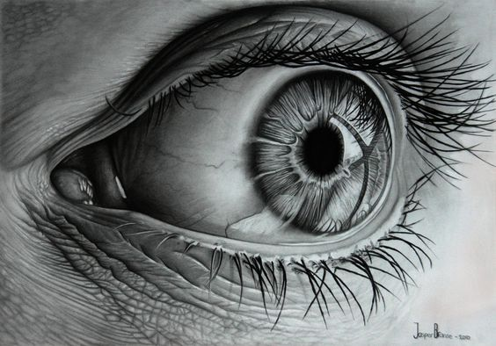

Slide 15
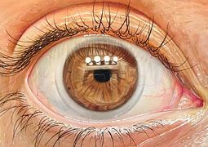

Slide 16
TimeLine
Day 1- Sketchbook studies and choosing medium
Day 2- Draw out composition; begin applying medium
Days 3, 4, 5, 6- Developing medium
Due:_____________

