Slide 1
Everyday Object Abstraction
Value Study
Drawing 2

Slide 2
Composition and Abstract
Composition: The overall placement and organization of elements in a work of art.
Abstract: Artwork in which the subject matter is stated in a brief, simplified manner.
Your object will be cropped and zoomed in to create an abstract, visually appealing composition.

Slide 3
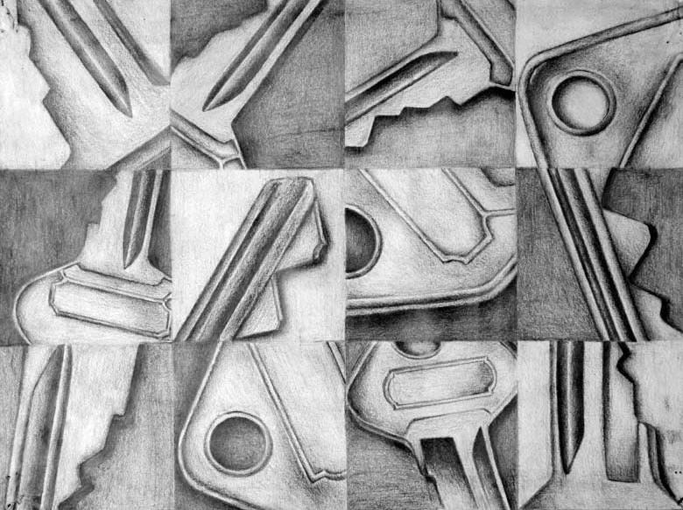

Slide 4
What is an interesting object?
An interesting object is something that has a variety of lines, shapes, and edges.
The object needs to be an everyday object most people will recognize even when zoomed in and cropped
Keys
Electronics
Shoes
Etc.

Slide 5
Value and Contrast
Value: Lightness or darkness of a hue or neutral color.
Contrast: Differences between two or more elements (e.g., value, color, texture) in a composition. Also refers the degree of difference between the lightest and darkest areas of an image.

Slide 6
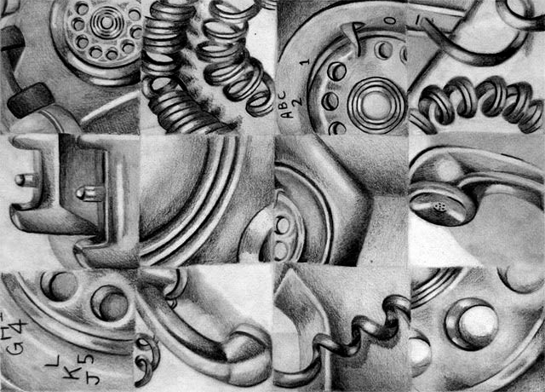
A drawing with great value and contrast pushes the darks and has minimal white space.
The overall paper should be arranged so shapes create a unified larger composition; the eye “flows” around the paper

Slide 7
Form and Volume
Form: A three-dimensional volume or the illusion of three dimensions; related to shape
Volume: Describes the space within a form, such as that of a container or building.
Even though there is abstraction in this artwork because the object is zoomed in and cropped, you are asked to draw the object as realistic as possible which includes giving it volume by adding value.

Slide 8
Requirements
At least eight shapes with various points of view/composition utilized
Edges of objects are clear without solely relying on outline
A range of value 0=black, 10=white

Slide 9
Due Date Information
This project needs to be handed in with a completed rubric (front and back) on September ______________.
If I see that the entire class needs extra time, it will be given. However, extra time is given ONLY if I see the entire class working consistently.
Every day the project is turned in late, it’s 5 points off. After 2 weeks, the project is a 0.
If a project is turned in without a name on it and/or the project isn’t turned in with a completed rubric, it’s 10 points off.

