Slide 1
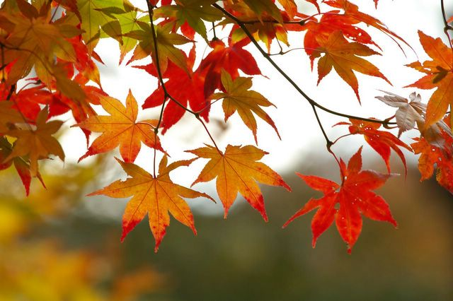
Fall Still life
Drawing 2

Slide 2
What we’ll do
You will create an autumn-themed still life drawing using Sharpie and hatching/stippling techniques to depict a range in value as well as describe texture/detail
It is your responsibility to create an interesting composition-first planning by creating thumbnails in your sketchbook
After ink is applied, you will go back in and give realistic color to the objects using watercolor

Slide 3
Hatching And. stippling
Ink (Sharpie) is a versatile medium because you can shade, but also get very detailed and precise.
Remember, you’re only working with the black of the ink and the white of the paper (no mixing gray values). Therefore, to show different values you need to cluster your lines/dots closer together to get darker.
Once a mark is on the paper, you cannot eliminate it, so start lightly and build up little by little.
Try to eliminate outlines; if you need to define an edge, build up the hatching/stippling FIRST, then define the edges later (implied line). Don’t start with an outline.
You will practice both stippling and hatching (value scales and object studies) in your sketchbooks before deciding which one you want to use in their artwork.

Slide 4
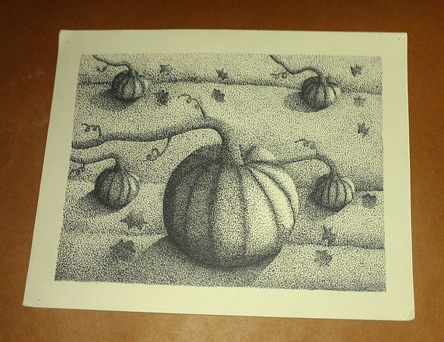

Slide 5
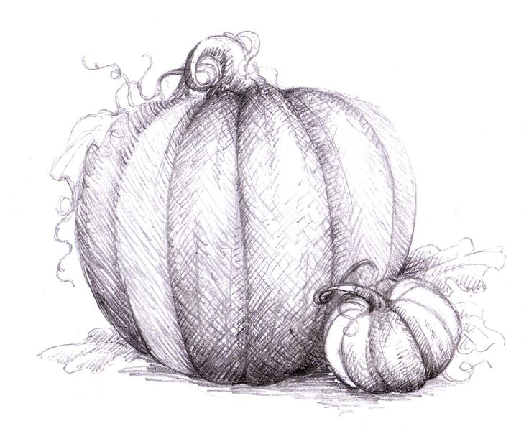

Slide 6
Composition
A strong composition includes
Movement through out that draws the eye around the entire paper
No images should be right at the edge of the paper
Some objects should go off the paper
Objects are grounded
Foreground, middleground and background are included
Try to give us a different point of view…something we haven’t seen before

Slide 7
What I’m looking for
Realistic rendering
Value contrast/range using hatching/stippling
Application of watercolors are vibrant and realistic
Strong composition

Slide 8
Set Up
Create value scales in your sketchbook as directed
Create several smaller, quick studies of the individual objects using ink and watercolor in your sketchbook
Create thumbnail sketch(es) in your sketchbook to determine placement and composition
When you are satisfied with the composition, block out your drawing lightly in pencil on the final paper.

Slide 9
Drawing: Procedure
Begin creating form and describing texture/detail with your chosen ink technique (stippling/hatching)
Build up your ink work- this will take considerable time!
Work in some color using watercolor (don’t overwork your drawing- a little color goes a long way).
If you need to, when the watercolor is dry, you can refine with the ink once more.

Slide 10
Due date information
This project needs to be handed in with a completed rubric (front and back) on Wednesday October 23rd.
If I see that the entire class needs extra time, it will be given. However, extra time is given ONLY if I see the entire class working consistently.
Every day the project is turned in late, it’s 5 points off. After 2 weeks, the project is a 0.
If a project is turned in without a name on it and/or the project isn’t turned in with a completed rubric, it’s 10 points off.

