Slide 1
Impressionist Autumn Still Life
Painting Studio

Slide 2
What is Impressionism?
Impressionism is a style of art, most notably related to painting.
Impressionism came to being in the mid 1800s in France. New technology in materials were allowing artists to work outside. They sought to capture the feeling of natural daylight and re-create it in their work.
Impressionistic painters use color to create a feeling of light in their work, often creating a certain mood or capturing a specific time of day/year.
Impressionistic painters often use short, quick brushstrokes, un-blended color (“dirty brush”), and expressive paint application to give an “impression” of the subject matter (that’s where the name “Impressionism” comes from!)
Claude Monet, Edgar Degas, Mary Cassatt, and, later, Vincent Van Gogh are probably the most well-known Impressionist artists.

Slide 3
Monet’s Haystacks

Slide 4
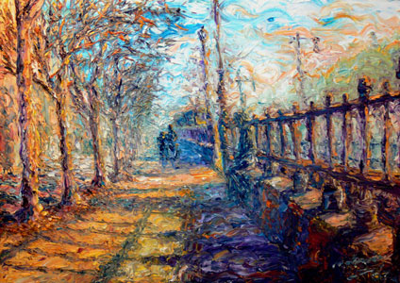
Impressionist Landscape

Slide 5
Modern Impressionist Landscape (night in the rain)

Slide 6
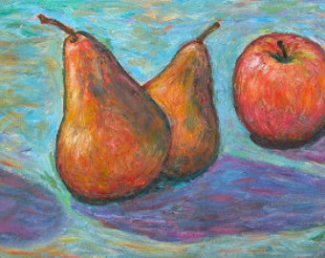
Impressionist Still Life

Slide 7
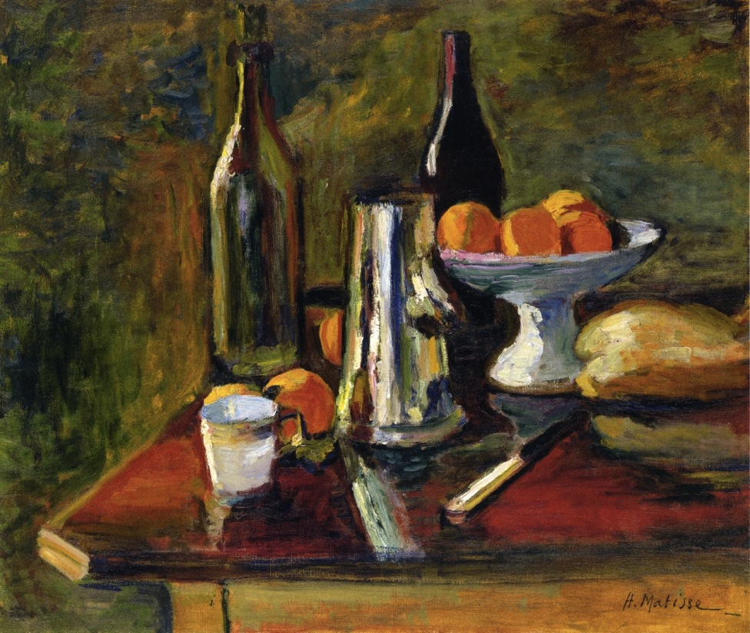
Impressionist Still Life

Slide 8
Impressionist Still Life

Slide 9
Your assignment
You will be creating a 12 x 20 water-mixable oil painting of the still life arrangement that you see before you.
You will use elements of the Impressionist style (short, loose, expressive brushwork/dirty brush/light as color) in your work.
You will use a coarse-bristled brush to begin painting your work, and refine using a soft bristle brush.
You will NOT use black for shading! You will use blue or violet. You will use white and most likely yellow for light areas.

Slide 10
YouTube Clip- Techniques
https://www.youtube.com/watch?v=eujuEhbVqXo

Slide 11
Painting Practice
You will have two days to practice painting techniques.
Choose a part of the still life and make practice studies utilizing different techniques and approaches shown (or invent a new one!)

Slide 12
Set-Up
Make a rough sketch in your sketchbook to help you practice placement, drawing the objects, and determining your composition.
You don’t have to get extremely detailed with your sketch. Much of this assignment will be tackled in paint.
Remember that your objects should take up a good portion of your page/canvas. You also need to resolve your surface and background.
Transfer your sketch to the canvas lightly in pencil.

Slide 13
Working with the WS Oils
Thin with water
Work general to specific- don’t finish one area before moving on
Mix colors on the canvas (not on the palette and then transfer)
Don’t over mix
Layer; work little by little
Think about drying time; it takes several days for the oil paint to dry. If you need a sharp edge or well-defined color, plan ahead so the under layer can dry.
“Fat over lean” rule: apply more concentrated oil (less watered down first, then more concentrated/pigmented); this is so the paint won’t crack as is dries

Slide 14
Working on the Canvas
Remember to start with the background first and describe light source in the background. Then, work your way forward in space.
Block out large areas of color and form first with a big coarse bristle brush. You want to describe local color and value color. I like to not rinse my brush completely before switching colors; this is called the “dirty brush” technique, and I think it makes my colors more engaging.
Remember to build up your work with little blips of paint (sort of like stippling with paint).
Don’t be afraid to use unexpected colors! They’re like the “secret ingredient” in a recipe that really makes it magical!
A trick to make your work more unified is to take a little bit of all the colors you’re using and use them at some point in every section of your painting, even if it seems counter-intuitive.
As you develop, you can move to a smaller, softer brush to describe details and refine your work.

Slide 15
Logistics
You can leave your colors on your palette and they won’t dry for up to a week! Cover with plastic wrap and store in a place where they will not be disturbed.
Be very careful when leaving work on the drying rack. Make sure it is left in the correct spot.
You need to use brush cleaner when cleaning your brushes and tools. (Water will just dilute, not clean).
Water mixable oils will quickly make a mess and get all over everything (remember they do not dry quickly!) You should feel awful if your negligence is responsible for ruining another person’s work. You need to go above and beyond when cleaning up!

Slide 16
Due Date Information
Project due with rubric completed (BOTH sides) TBD (roughly 2-3 classes for studies; 1 class for sketch and transfer; 3-4 classes for painting)
No rubric/incomplete rubric? 10 points off.
Work looses 5 points for each day it is turned in late. No work accepted after two weeks late without prior teacher approval. If you’re behind, come in for extra time and catch up!

