Slide 1
Metal Tooling
Advanced Studio

Slide 2
You will…
You will create three 6 x 6 inch embossed metal pieces and wire them together to create a wall hanging (if you run out of time, you can have two squares instead of three)
The imagery choice is up to you, but the images between the three pieces needs to relate. Choose an image that has big and simple shapes. You can work from a reference if it helps you.
The metal tooling will have high and sunk relief and utilize a variety of shapes and textures to create a clear image.
You can add color with alcohol-based markers and/or acrylic washes, then wash away with a towel or cloth to provide texture and dimension.

Slide 3
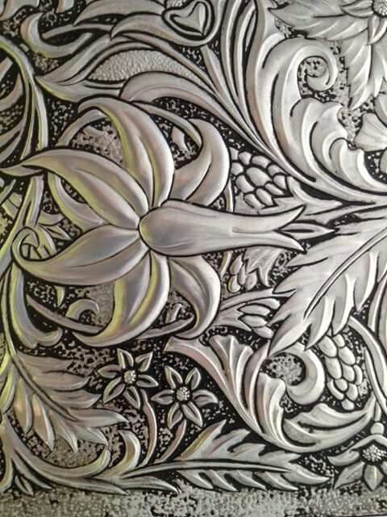
Examples from the Internet

Slide 4
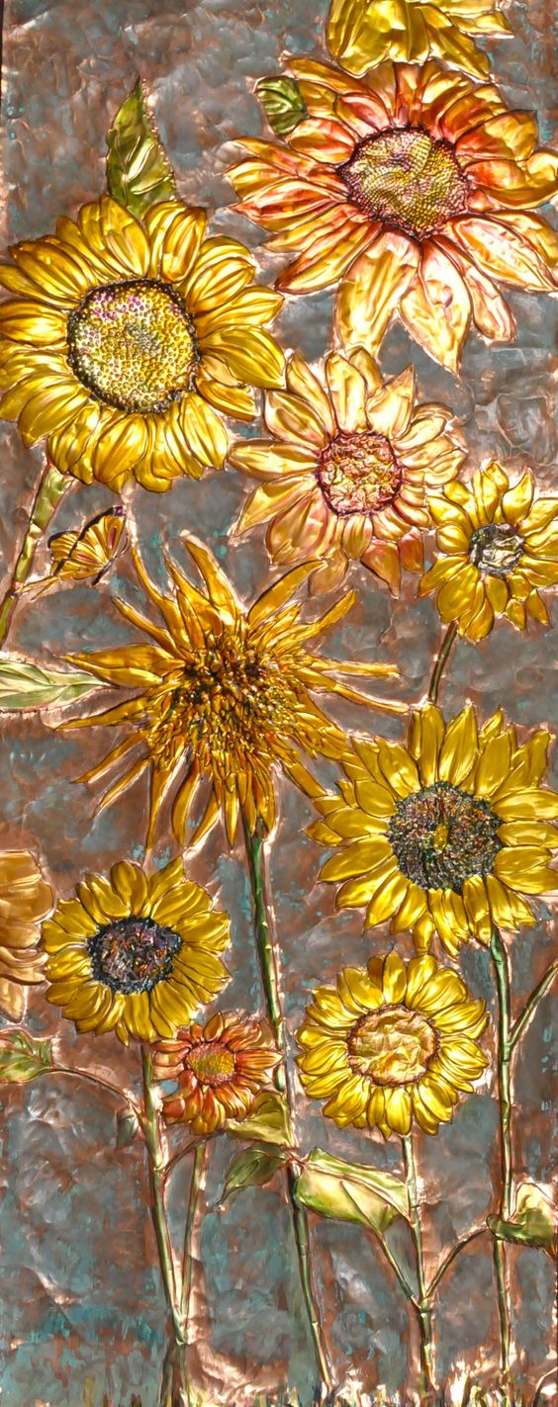

Slide 5
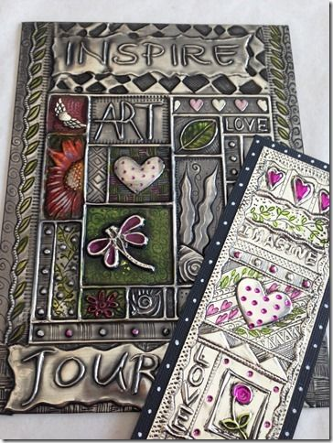

Slide 6
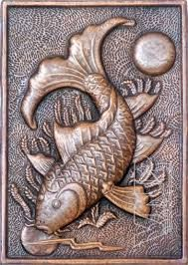

Slide 7
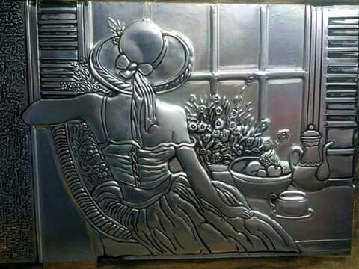

Slide 8
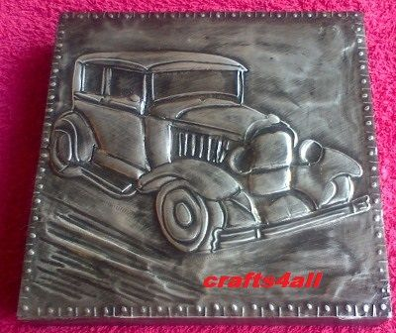

Slide 9
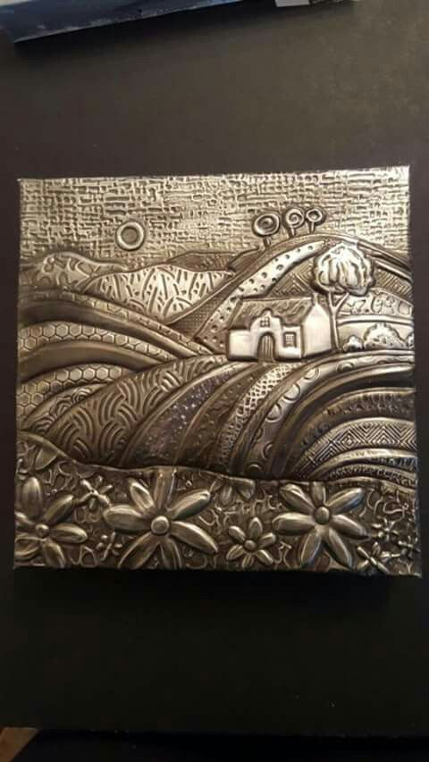

Slide 10
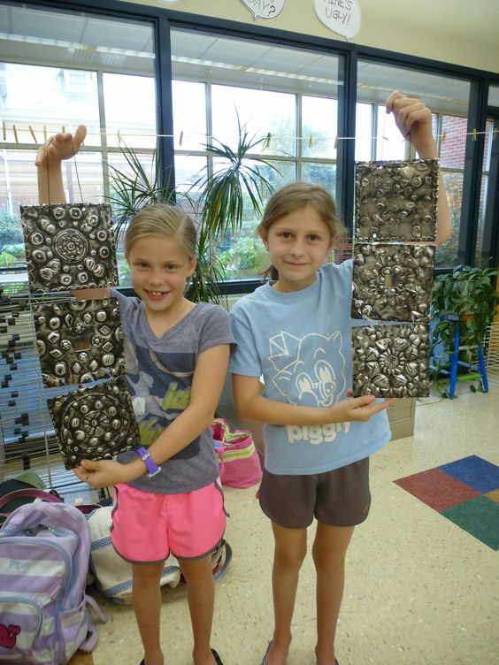

Slide 11
New Terminology
Metal tooling- Pressing into flat metal to create raised designs
Embossing- to carve, mold or stamp a design on a surface so that it stands out
Relief- When a design is raised off a surface or carved into a surface
Low relief- When a design comes out/up/off a flat surface a bit
Sunk relief- When a design goes in/down to a flat surface
Repousse- The process of hammering into metal with a hammer to press designs out on the opposite side
Gauge- The thickness of metal

Slide 12
Subject Matter
Up to you! You don’t have to go super deep or conceptual with this project (unless you want to). You can choose something more decorative if you want.
Remember, it will give you an easier time to choose a design that is big and simple and fills up the whole square.
Natural things (flowers, plants, acorns, animals, shells, trees etc.), single buildings, small landscapes, dreamy designs, abstract designs etc. work well.
Try to also have something that is easily recognizable.
Try to think of things that are appealing to you and interest you when coming up with ideas.

Slide 13
Process
Practice techniques on a small piece of metal to get the feeling of the tools and the embossing process.
Decide on your images and draw out your designs (the paper is slightly smaller than the metal will be, so that you have room for a border). Focus on outlines and major defining lines.
Tape the paper design template on top of the metal sheet and trace over the outlines to press them into the metal sheet.
Take the drawn design template off. You should now be able to see the overall design on the metal.
Start embossing! You can press on the font and the back if you want, so that you have both high and low relief (depending on what you’re looking for).
If you’d like, add color to your fully embossed piece.

Slide 14
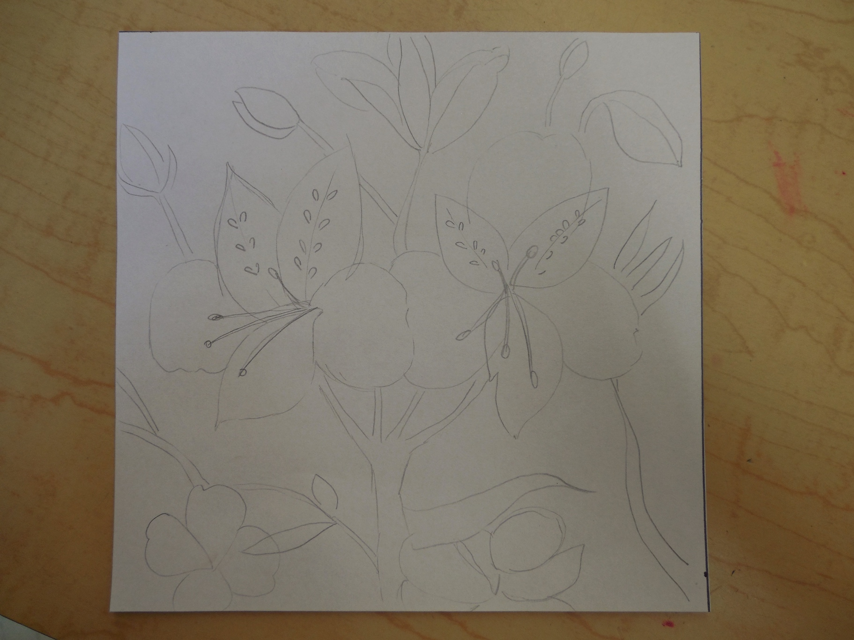
My Tutorial
Here’s my design drawn out in pencil. I chose a fairly simple flower design, and used a picture from the internet for reference (I changed it up a bit, though). I decided to have two big flowers be the main focus, with a few smaller flowers and stems for visual interest. I had some of the shapes go right off the edge of the design to make it look complete.

Slide 15
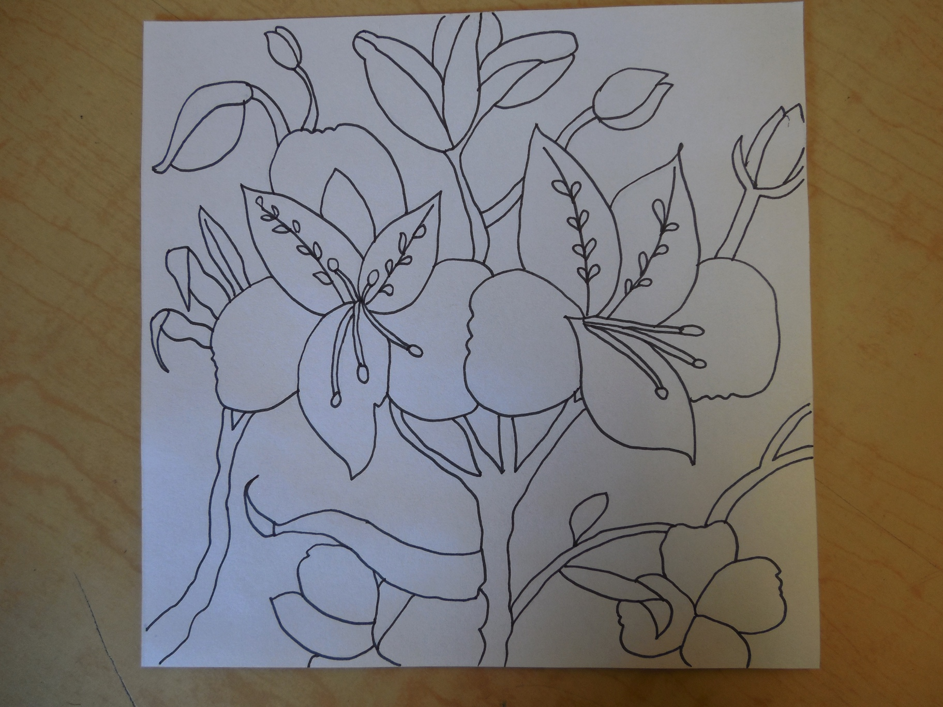
I cleaned up the pencil lines with a thin Sharpie so that they were easier to see.

Slide 16
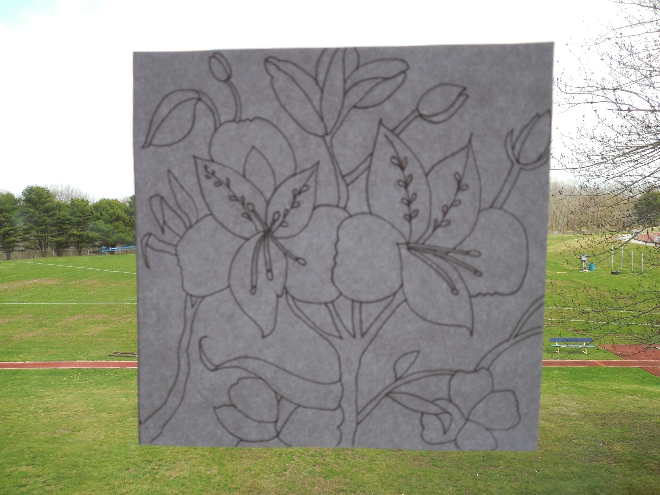
I then chose to flip my design the other way so it was backwards (I put the paper up to the window so that I could see the lines coming through on the blank side- you can also use a light table for this- and re-drew the image on the other side of the paper). I did this because I knew that I wanted the flower petals to go OUT and I would be pressing on the back of the metal, making the opposite side raised. This means that my original image would be backwards. I don’t think it would ultimately make that much difference in how everything looks, and you could skip this step unless it is really important to you that your image be going in a certain direction.

Slide 17
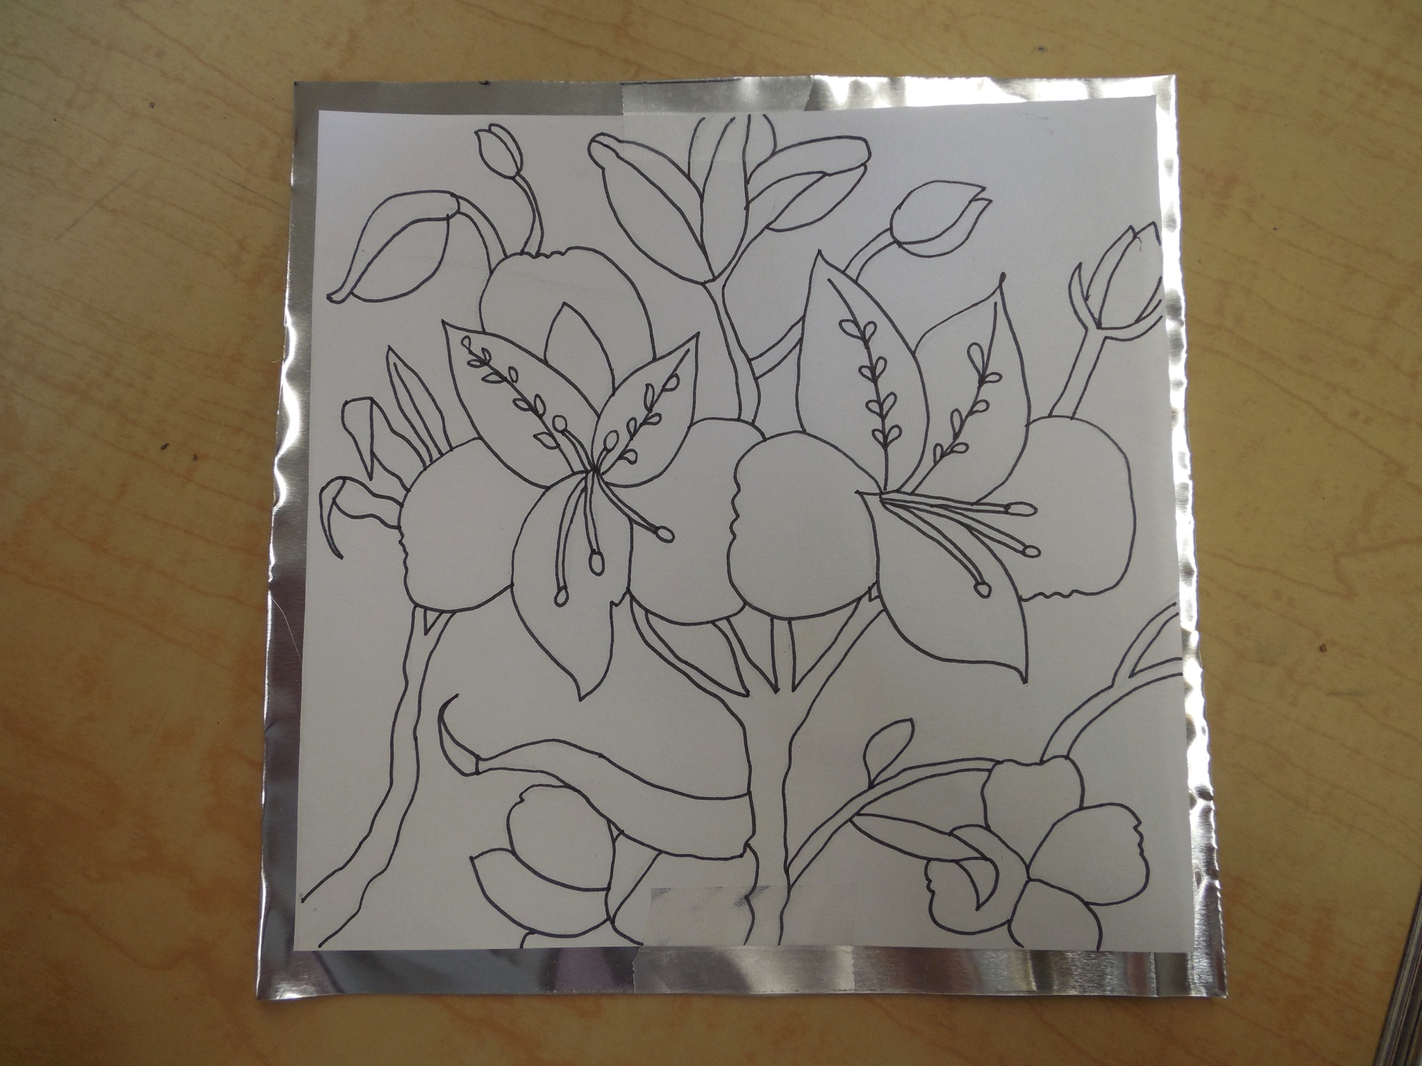
Here’s my backwards design that I just traced placed on top of my piece of metal. Notice how its centered, and doesn’t come right to the edge. I’m going to fold down the sides at the very end so the edges are more finished-looking and not sharp. I taped my image to the metal so it won’t move around.

Slide 18
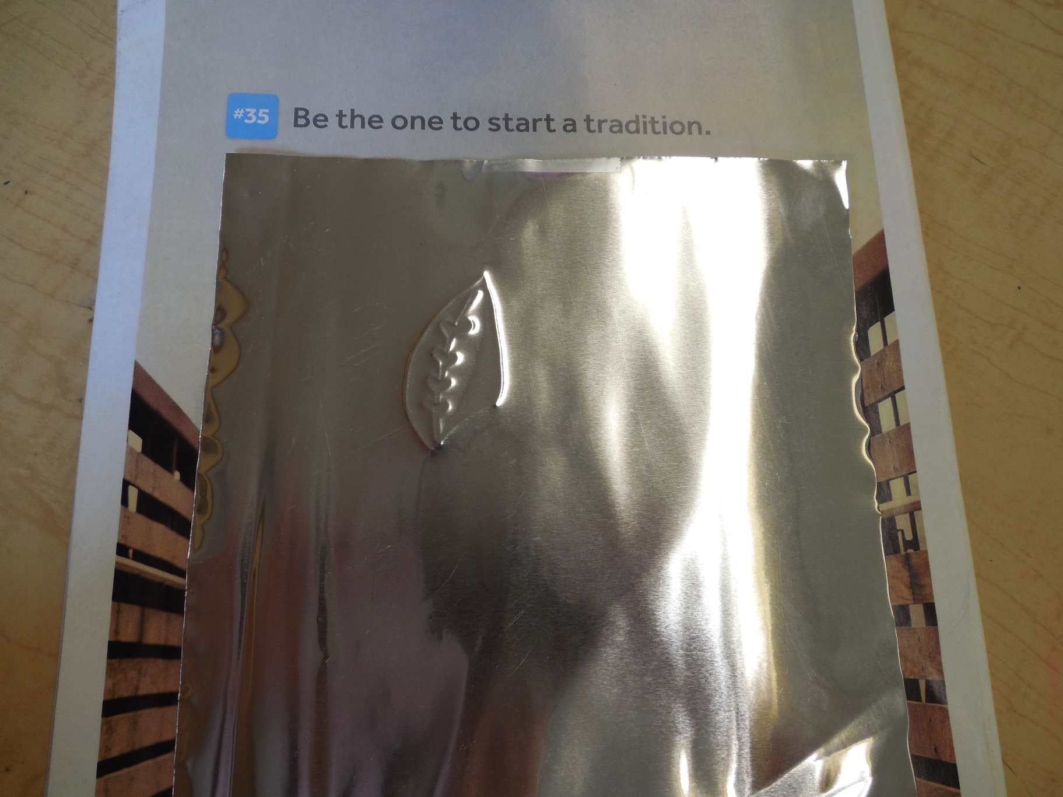
I placed everything on a magazine to get the right amount of cushion/pressure and started going over my lines on my template with the wood stylus. Here it is flipped over- see how it presses the lines out? I had to keep flipping back and forth to make sure I went over all the lines. If I did this again, I might use a dull colored pencil to trace, so I could see what lines I went over and what I still needed to do.

Slide 19
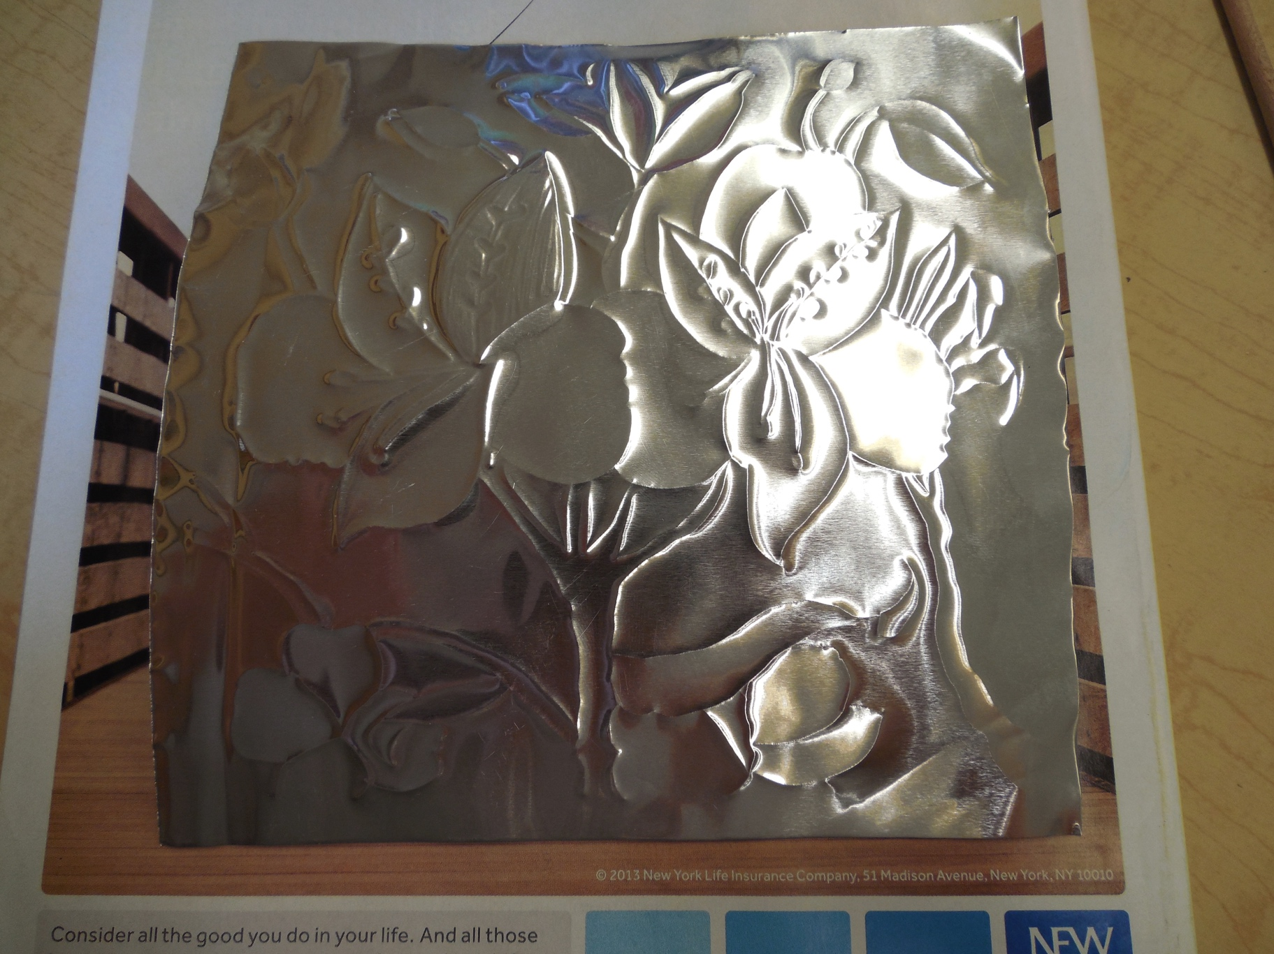
Here are all my pressed outlines. Now it’s really time to emboss!

Slide 20
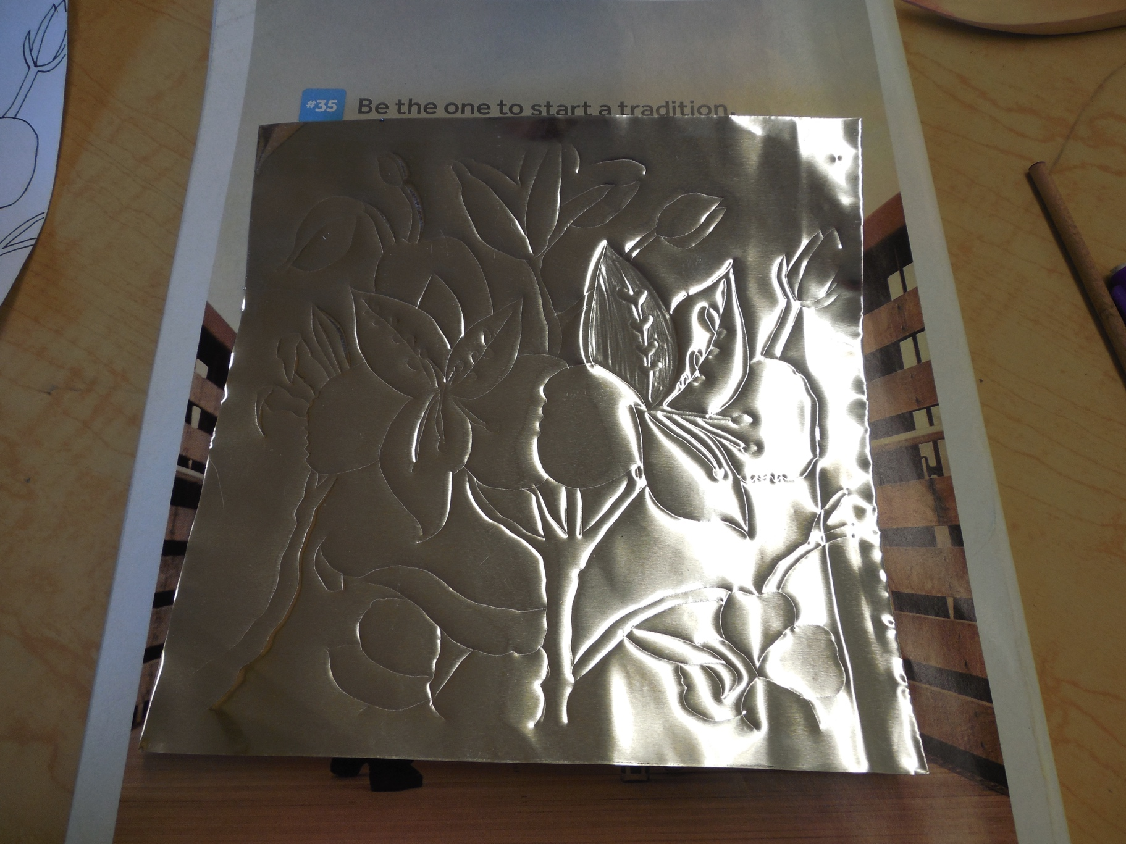
I took the drawing template off and made sure that I was on the back side; the same side I’ve been working on so far (so as I filled in shapes, they would push out). I started going shape by shape, pressing through the shape with my wooden stylus. You can sort of color back and forth, then smooth out the lines. Remember, don’t go over everything (I left the lines in the center of the petals in tact, for example, as well as leaving a line between the petals). I’ll talk about a few embossing/stylus techniques I used a little later.

Slide 21
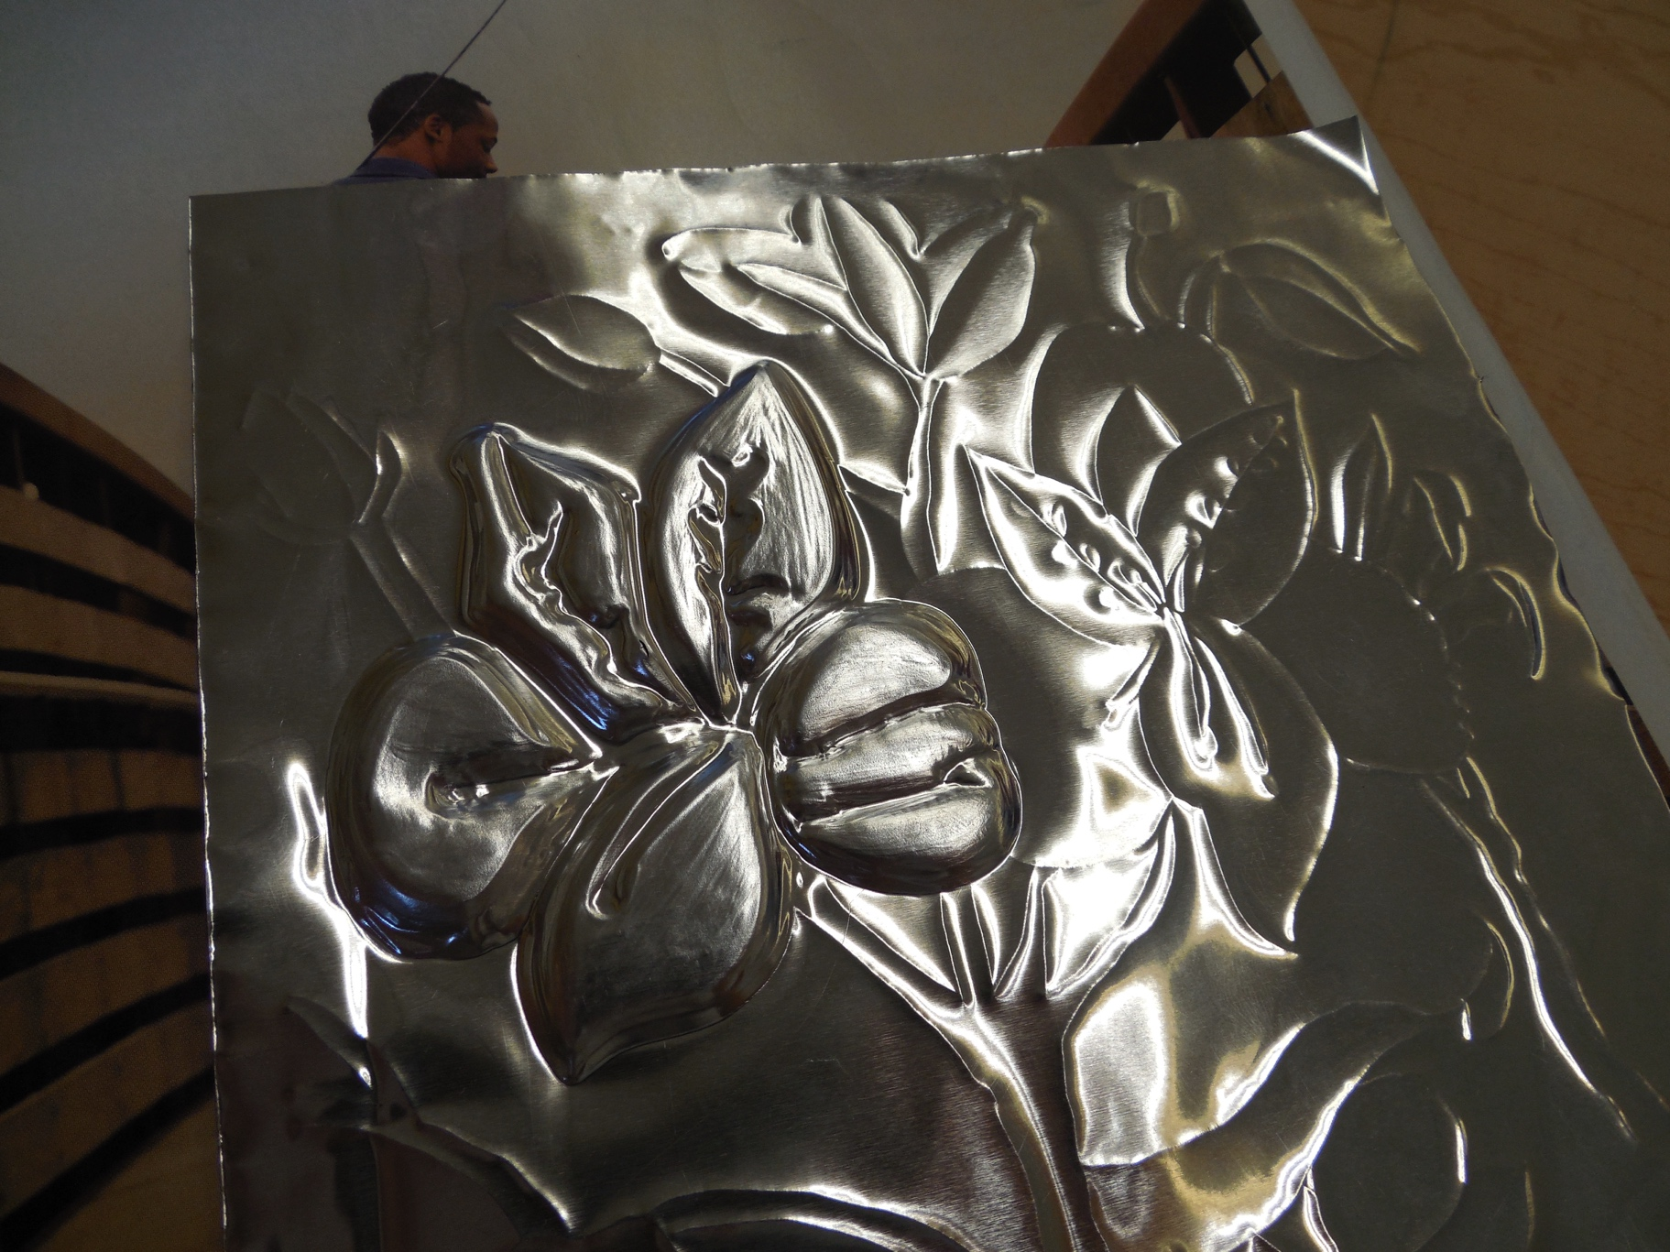
Here’s the opposite side (the front) of the flower, pretty much all embossed. Notice how it pops out, but the lines that I didn’t emboss seem like they go in (although, they’re really just sitting flat on the metal). I defined them a bit by flipping my work over to the front and pressing in a bit. I also found that it worked really well to refine the outlines of the shapes by working from the front and pressing onto the back.

Slide 22
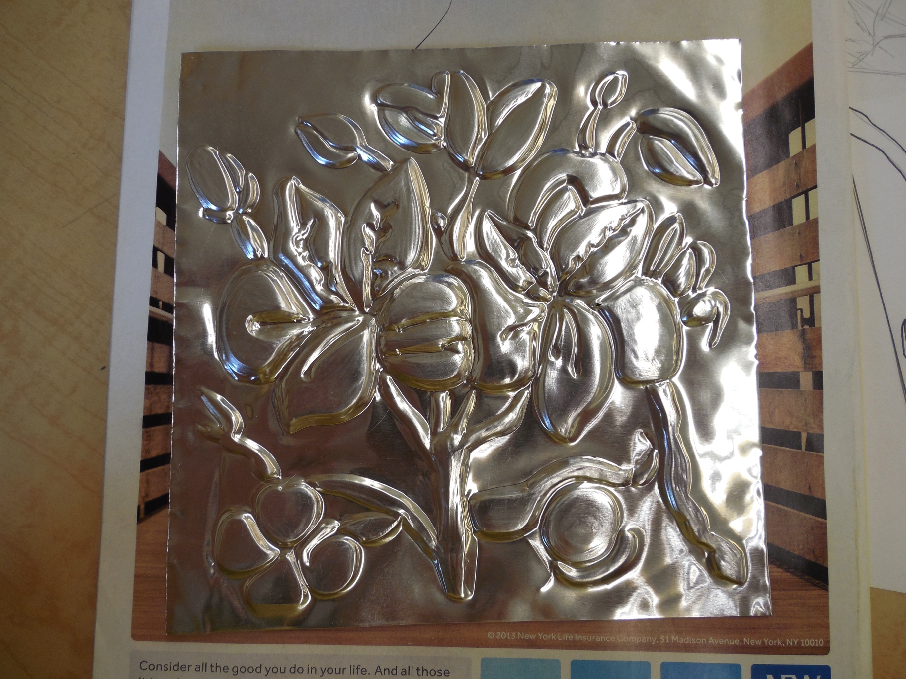
Here’s the entire design once I embossed it, from the front. I was happy with my work so far, but I thought the design still needed something…

Slide 23
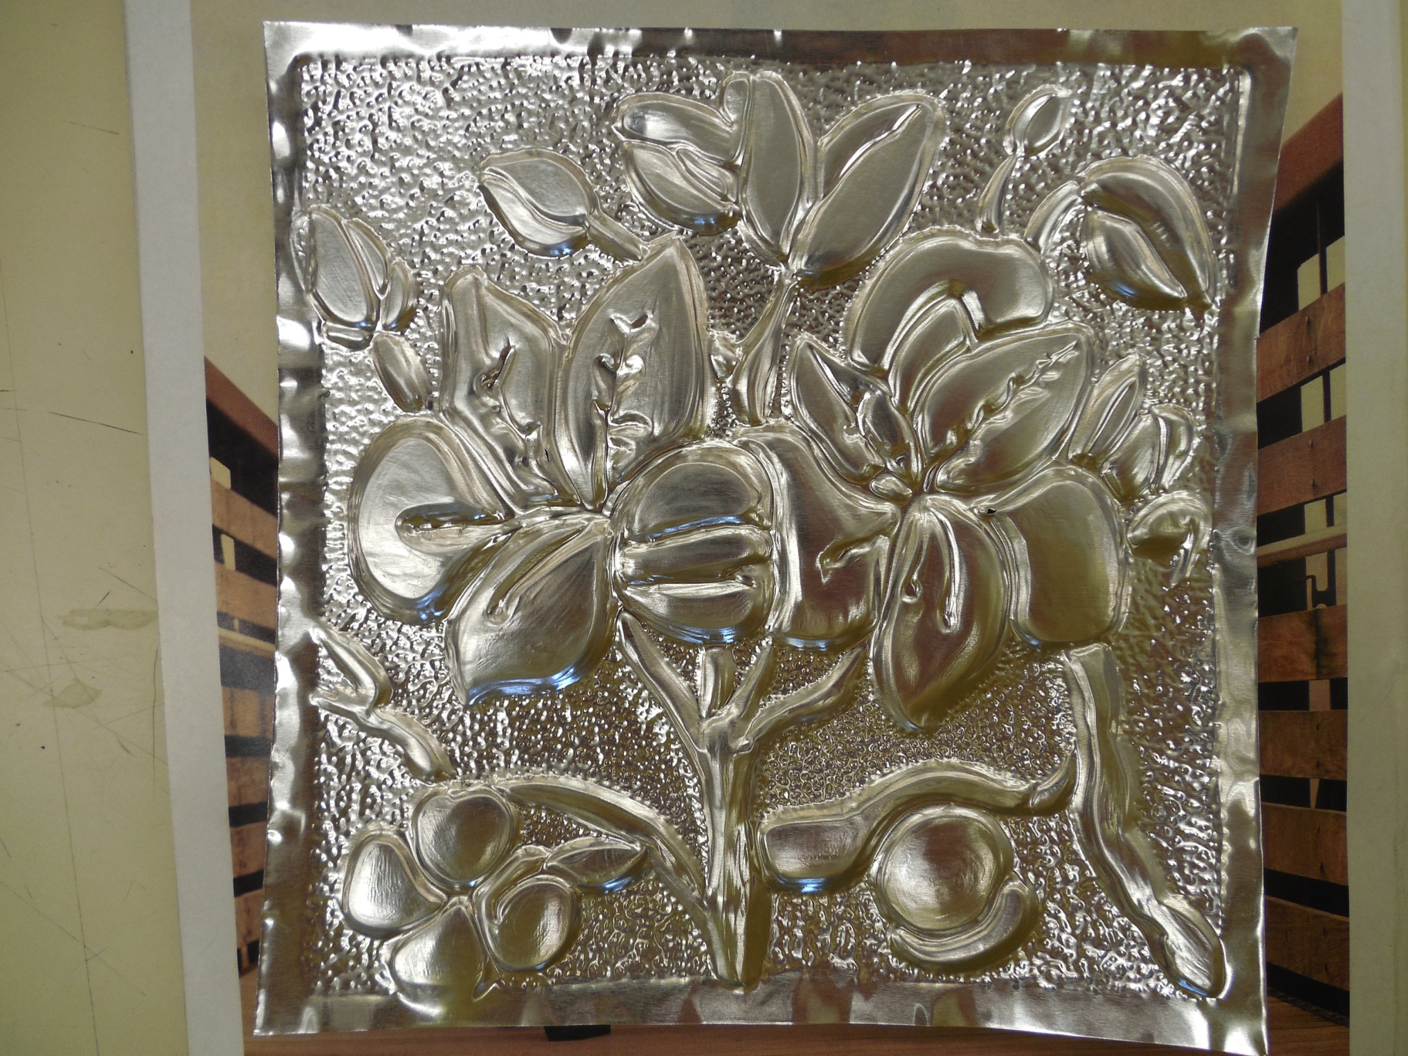
So working from the front and pressing in, I made a series of dots in all the negative shapes to create texture and make my work more interesting. I also defined the border with a dotted outline. I thought that these dots really added a lot to my work!

Slide 26
Embossing Techniques
I found that I was able to do just about everything with the wooden stylus. The pointed tip can be used for detail, the edge of the circle on the backside can be used to press out large areas, and the flat part of the circle on the backside can be used to smooth.
What I usually did was create outline with the tip, filled in with the edge of the backside (again using the tip to get in any small areas), then smoothed with the flat part of the backside.
You can keep going over and over and smoothing; its almost like sculpting. Remember that you can flip back and forth from the front to the back.
One thing I found worked really well was to press down harder towards the center of my shapes (especially the rounded ones) and press down a little less on the edges. This makes it so that the front part has a more spherical look; the center is raised up more, and the sides are lower.
As you work, the metal will naturally raise off your work surface (because the embossed sections are making it sit higher). So you have to work on pressing a little harder and you can also try angling your work to get better leverage.

Slide 27
Embossing Techniques Continued
If you make a mistake, you can do your best to press it out from the other side of the metal. It will never get back to the exact same consistency, though, so you’ll sort of have to work with it.
The metal will get a hole in it if you over work it! I got a couple tears. You just have to be careful and work around them. Try to work them into the design as much as possible (side note- what if you used a sharper stylus to intentionally poke through the metal and create openings in your design? What if you illuminated the back so that light could shine through these holes?)
Your hand and arm will tire out because you do have to apply a pretty good amount of pressure for an extended period of time. You also might get a blister from gripping the stylus. I’d recommend taking breaks and shaking out your hand/arm.
What else could you use instead of a metal stylus? Sculpture tools, needle tools, dull pencils, pens that don’t write anymore, mechanical pencils with no lead- what else can you think of?

