Slide 1
Zentangle Silhouette Self Portrait
Drawing 2

Slide 3
A Self Portrait Usually…
Is of YOU!
Depicts mostly your face but can also depict your shoulders/hands
Shows what you look like on the outside (physically)
Can give some insight into who you are: your experiences, your interests, your personality, how you see/relate to the world etc.
Our next project will have you focus on all four points, but you will especially focus on the last one.

Slide 4
Set-Up
You will create a self portrait that represents various aspects of your identity in a VISUAL way through symbols, doodles, designs, patterns, metaphor, font/text etc.
We will begin by listing and brainstorming various aspects of our identity as well as how to show that in a visual manner.
Do this in your sketchbook. I want to spend a good chunk of time (about 30 to 45 minutes) on this. The more you have to work from, the better (you can always eliminate things, if needed).
I would list first, brainstorm symbolism second, sketch last.
You have 15+ years of experience that no one else in this room has or even in the world has. Try to think about what makes that experience unique. Then, think about how you can show it.

Slide 6
Your List Might Look Something Like This (only longer probably)…
Daughter (a tree to represent family: one big one small → flowing, intertwined roots branches will show family)
Artist (pencils, brushes, pastels, palette, paper roll, easel etc. could be drawing the things that are in the design?)
Likes spooky stuff- (creepy faces, claws, monsters, ghosts, gravestones, etc.)
Teacher- (watering can that is watering little artsy flowers)
Likes holidays- (different decorations/lights etc. winding through the composition)
Likes animals- (Animals wound into composition)

Slide 7
Blocking out your silhouette
Your portrait will need to be in full profile.
You need to take your photo in class today that I will print for you OR if you are bringing it in, it needs to be here next time we meet. Photos on phones do not work as well.
Put the photo under the projector. Move your paper on the wall so that the photo is projected onto it. Make sure is is large and centered (you might want to have an “assistant”)
Trace around the major outlines: the silhouette, the hair, glasses if you have them, the shirt, maybe the eyes and that’s it. You want to leave yourself a lot of space to fill with designs.

Slide 8
Process
Sketch out your designs carefully and lightly in pencil. You don’t have to color in things that will be black in pencil (maybe just make a little note to yourself to fill it in later). Pull as much as possible from your list. Fill in the white space! No “peas,” please. Even large objects can be filled with textures and designs.
Some areas can be non-representational designs, but they should be purposeful and meaningful.
Don’t forget the background. Some students in the past have chosen to treat the background as their world that is outside themselves.
These can be stylized! In fact, they are more interesting if they are realistic, but a little more graphic/exaggerated.
When your pencil lines are set, trace over everything in Sharpie (I have three sizes). Make sure that the black areas are evenly distributed so that the composition flows.
Color can be established with watercolor pencil (we will probably do a little practice with this medium before adding it to our work).

Slide 9
What am I looking for?
You to be thoughtful, clever, and creative in visually representing yourself and your identity (I don’t want to see a lot of relying on cliché things).
Careful, confident, mature artist drawing (even if it is stylized)
A strong composition (balanced, eye moves around the page, background is resolved, little white area)
Careful, fluid Sharpie lines/coloring
Color (wet and dry) makes piece more interesting
You are thinking about your work and making good choices about how to put your piece together
You are taking your time to make your piece look the best is can look
I want to see YOU in this piece! I hope you will be really proud of your work when you’re done.

Slide 10
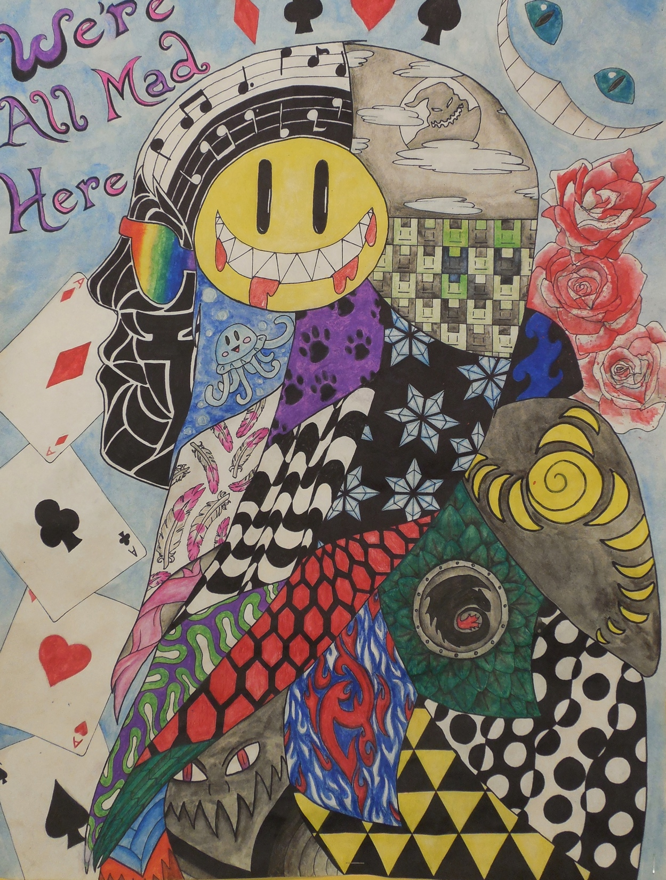

Slide 11
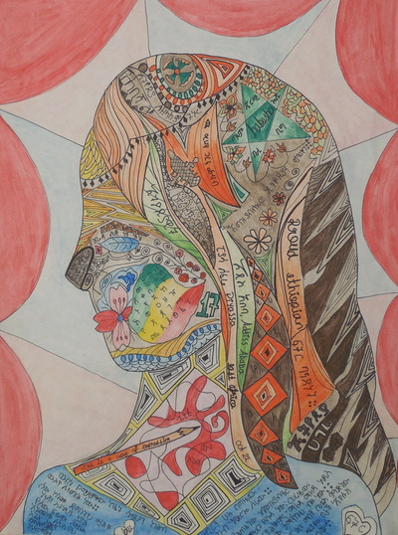

Slide 13
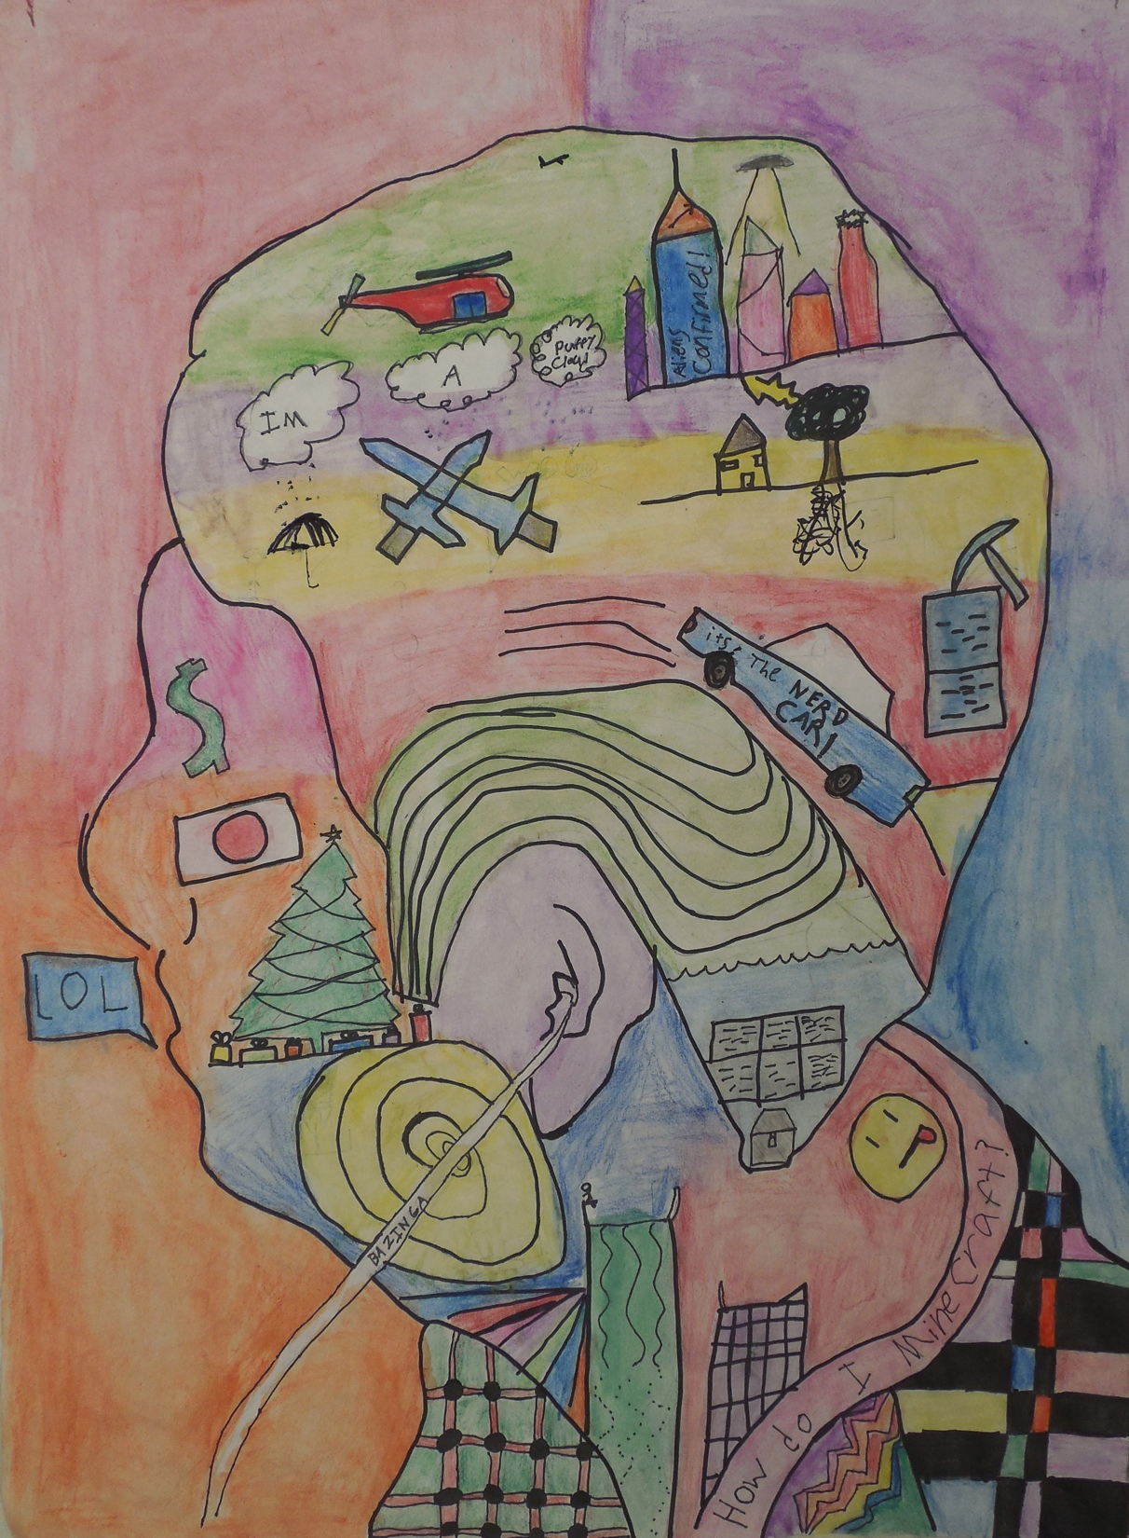

Slide 15
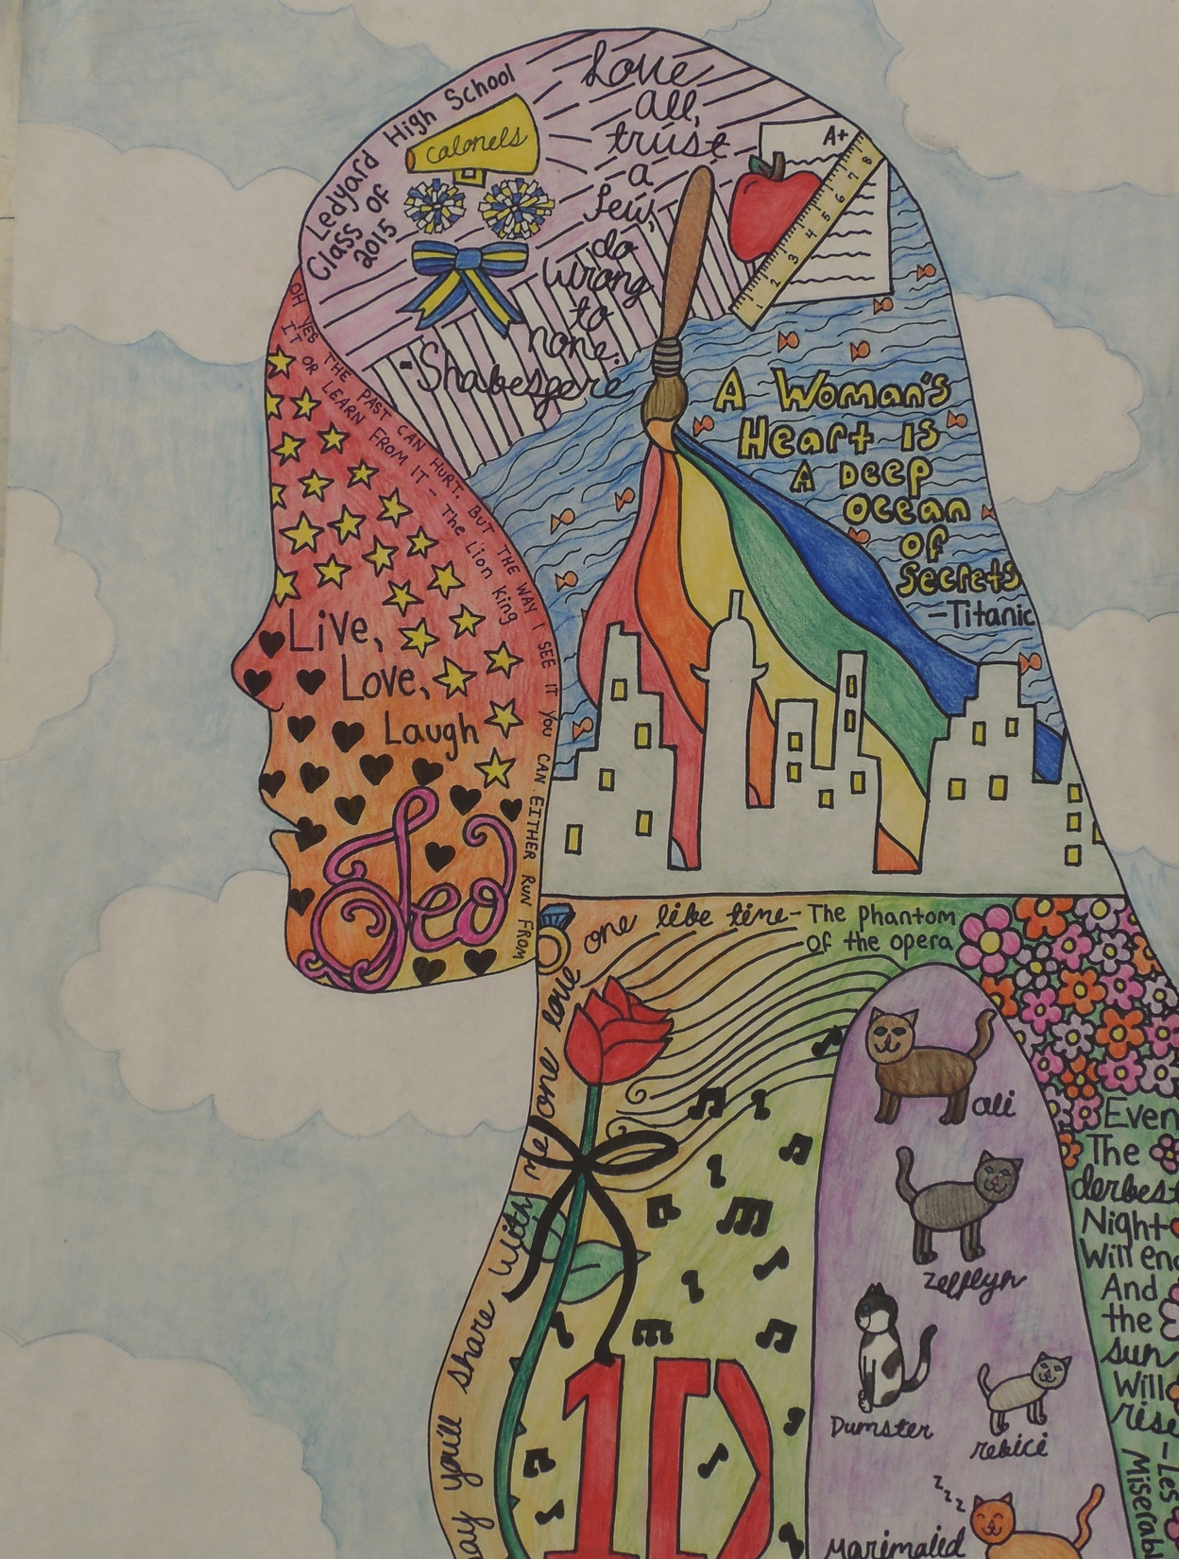

Slide 16
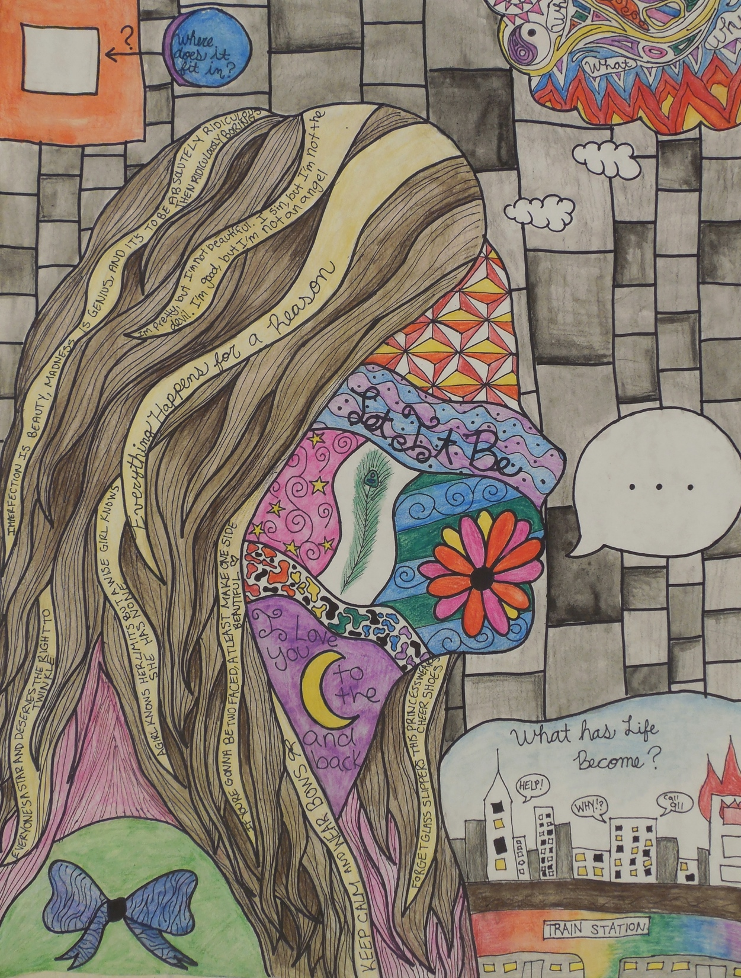

Slide 17
Due Date/Time Line Info
Days 1 and 2- Brainstorming/sketching/tracing photo
Days 3, 4 and 5- Drawing composition in pencil
Days 6 and 7- Tracing composition in Sharpie
Day 8 and 9- Adding Watercolor and refining
I am having this be “due” Wednesday November 25th (the day before Thanksgiving break).

