Slide 1
Tempera Batik
Painting Studio

Slide 2
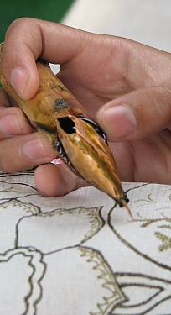
What is Traditional Batik?
A design is created using wax on fabric (the wax plugs the tiny holes in the weaves of the fabric’s fibers). The fabric is then dyed. The wax resists the dye, leaving both the original image and the colors of the dye.
This process has been a traditional method of creating designs and patterns on textile for thousands of years. It is most common to Indonesia, Malaysia, Sri Lanka, and India.

Slide 3
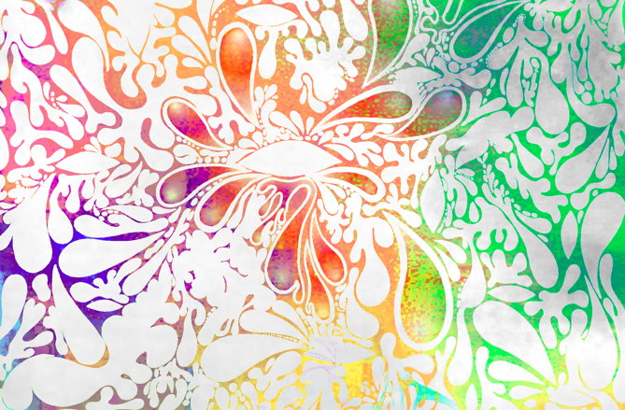
A traditional batik
Clear wax on white cloth; tie-dyed with multiple colors

Slide 4
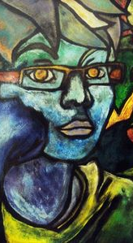
What is Tempera Batik?
The traditional batik process has been adapted from a textile patterning method to a painting technique. Ink is used in place of wax, and tempera paint is used instead of dye. The tempera and ink resist one another, yielding an effect that is similar to traditional batik, but also provides more interesting, unexpected results that often have a distorted of distressed look.

Slide 5
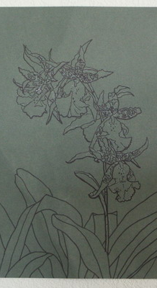
The Process: Step One
The design is drawn out and traced over with a thick, dark marker (chalk can also be used).
A certain type of paper needs to be used (thick, heavy paper; construction paper or “oatmeal” paper work well).
The key is to mark off where you will NOT paint (these areas will take the most ink eventually).
Large, bold shapes work the best. Eliminate textures and details.

Slide 6
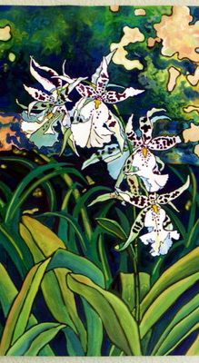
Step Two:
The entire painting is painted over using several layers of tempera paint.
It works well to “glob” the paint on thickly, and use a variety of colors for each subsequent layer. Allow the colors to blend and mix.
Be careful to not paint over the marker lines!
Let the tempera paint dry thoroughly.

Slide 7
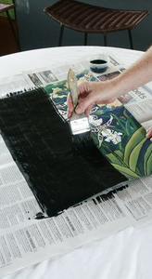
Step Three
Paint over the entire painting with a thin layer of India ink.
Allow to dry for 30 minutes.

Slide 8
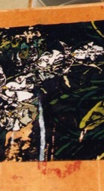
Step Four
Carefully rinse off the ink. A sponge may be used. You are in control of how much/little of the paint will be washed away (various portions of the colors underneath can be revealed).
Rinse and drain the painting.
It will be soaking wet at this point, so take extreme care when moving your work.
Allow your painting to dry on a layer of newsprint overnight.

Slide 9
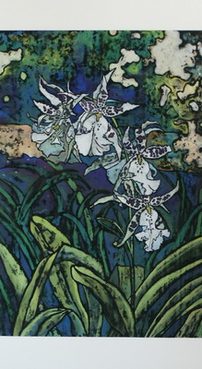
Step Five
The painting can be worked back into once it is dry, to bring out colors that may have gotten overly distorted.
The paper is mounted on stiff cardboard or foam core so that the painting can be displayed flat.

Slide 10
"This is a process oriented style of painting that can bring truly wonderful, interesting, and more importantly, unexpected results! I enjoy the contrast between the realism and the abstraction found in each piece. I also love the vibrancy of color achieved by using tempera paint in conjunction with India ink.”
Julie Dunn, tempra batik artist

Slide 11
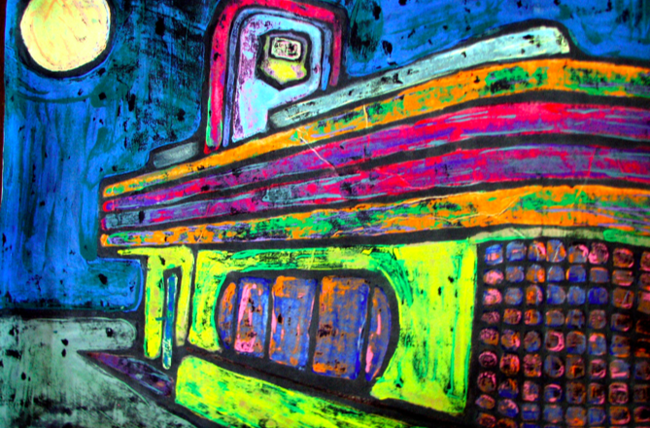
More Tempera Batik Examples

Slide 12
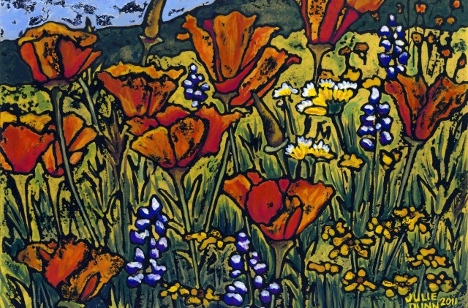

Slide 13
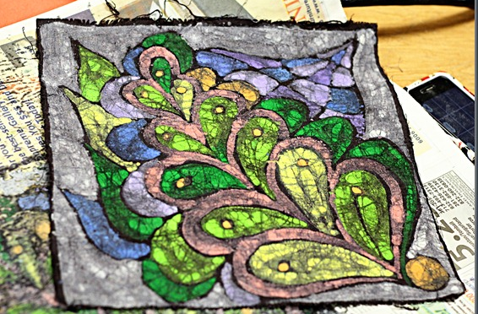

Slide 14
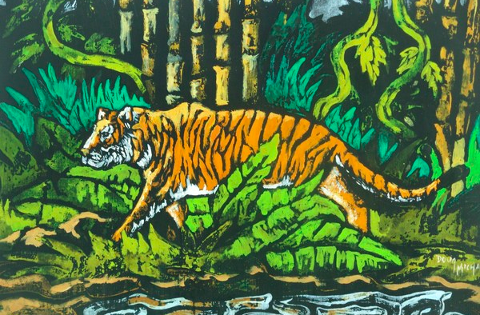

Slide 15
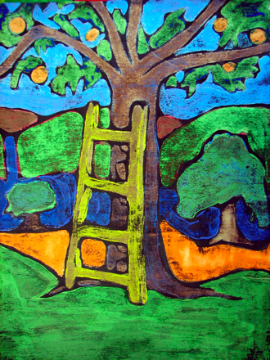

Slide 16
You will…
Create a self portrait using the tempera batik technique. Your work will be 12 x 20 to 18 x 24 (if you work slowly, go with a smaller size) You can choose to work rectangular or square.
You will draw yourself (freehand, working from a photo, projecting a photo and tracing etc. How you go about establishing your portrait is up to you). Don’t spend too much time on this; leave more time for painting.
You must have a significant likeness in your work, utilize correct facial proportions, etc. You must show your face, your hair, and at least part of your shirt.
You will do a minimum of at least THREE distinct colors/layers before applying your last layer of ink and then rinsing.

Slide 17
Remember!
Anything that does not have paint on it will take the ink permanently (so don’t paint over your outlines)
The bad news? We only five classes to finish this project (plus any extra time you come in). The good news? YOU DO NOT HAVE TO BE VERY NEAT AND PRECISE WITH YOUR PAINT APPLICATION. As a matter of fact, you will get a more interesting result if you aren’t neat. Being overly fussy will just end up wasting time, because the nature of this process is such that things will naturally become distorted. So, glop that paint on thick! Don’t rinse your brush when changing colors. Let colors swirl, mix and striate!
When you do your layers, make sure you are using DIFFERENT colors. The color what will show up the most will be the base layer.
Try not to wash away ALL the ink. That diminishes the batik effect.
You can work back into your batik after doing the final rinsing of the ink if you lost too much color (work in washes in select areas)

Slide 18
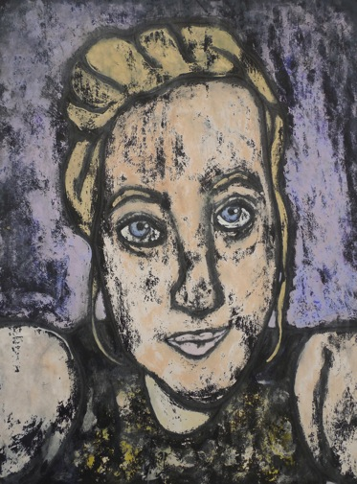
Student Examples

Slide 19
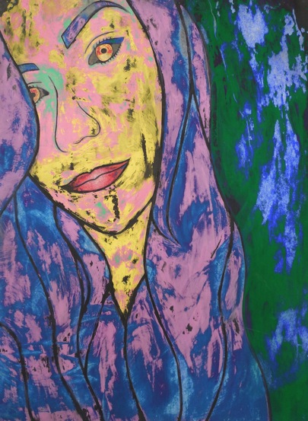

Slide 20
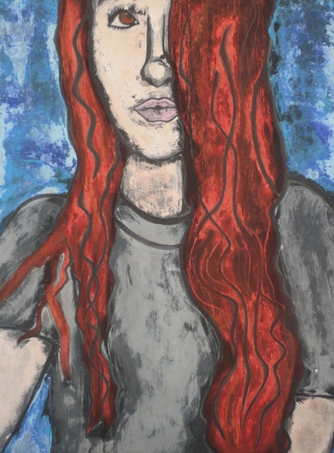

Slide 21
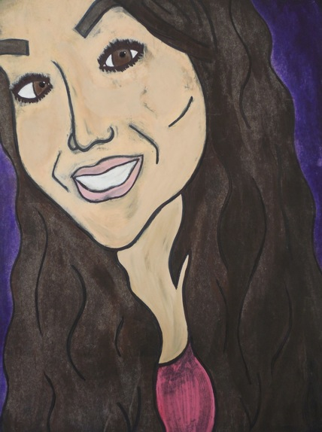

Slide 22
Due Date Information
This project should be READY TO GO (dry; completely finished) on the beginning of our exam block Monday January 11th at 7:42.
You will be discussing, sharing and critiquing your work during the exam block as an additional component of your final exam.
In order to finish this project during class time, you would need to get your drawing blocked out during one class period, do one layer of paint per class period (for a total of three) and do the ink and rinsing during one class period. Remember that the ink needs to dry for exactly a half hour, and that it takes about ten minutes to rinse it off.

