Slide 1
Tree Skills Mid-Term
Art 1

Slide 2
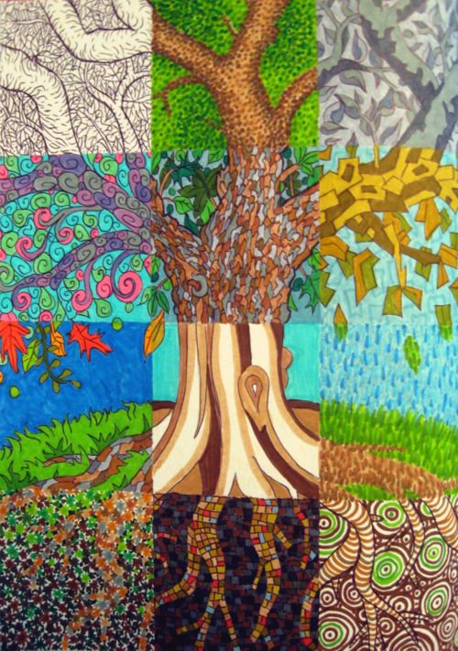

Slide 3
Gridding and Categories
The 8X12 paper will be evenly divided into 6, 4 inch squares
The size of this paper is on the smaller side because of the time constraint. There will not be extra time given to finish this project.
If you have a good amount of time to complete this project, take your time and add detailed, stylized aspects to your artwork.

Slide 4
Your tree composition
The composition needs to include these categories:
Value in ebony pencil
Pattern in sharpie
Tints and shades in monochromatic color scheme in tempera
Primary colors in colored pencil
Secondary colors in tempera
Intermediate colors in tempera

Slide 5
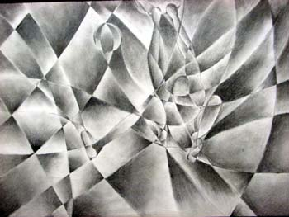
Value
Remember our value collage project?
Smooth transition from dark to light
Blending with circles or different directions
Large range of value: darks, mediums and lights

Slide 6
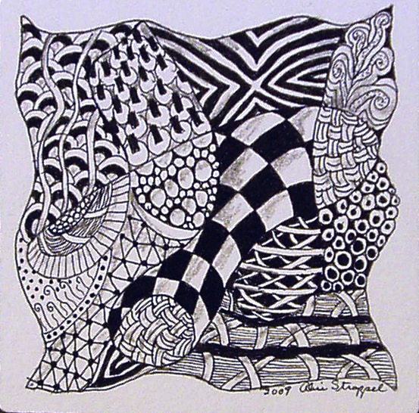
Pattern
Remember our Line Design project?
Variety of patterns and values
Repeated lines and shapes
Try going more complex: zentangles

Slide 7
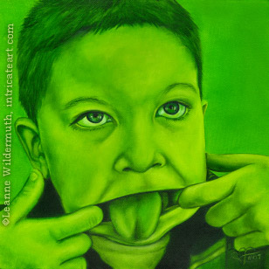
Tints/Shades in Monochromatic
Monochromatic scheme: 1 color
Tints: white added
Shades: black added
Be dramatic with the variety of value

Slide 8
Primary and Secondary
Primary: red, blue, yellow
Secondary: purple, orange, green
When applying your primary colors in colored pencil, we ask that you show us your blending techniques some where in the box.
Example: transition from red to yellow

Slide 9
Intermediate
Intermediate (6): red-orange, red-violet, yellow-orange, yellow-green, blue-green, blue-violet
Choose a box that has a good amount of positive and negative space so you can apply atleast 4 intermediate colors.

Slide 10
Style of tree
After splitting your paper up into 6 squares, you will draw a tree of your choice as long as the tree spreads to all 6 squares
Draw LIGHTLY with pencil so we don’t see the lines after you’ve drawn the tree
Some parts of the tree should go off the page
What kinds of trees are there?

Slide 11
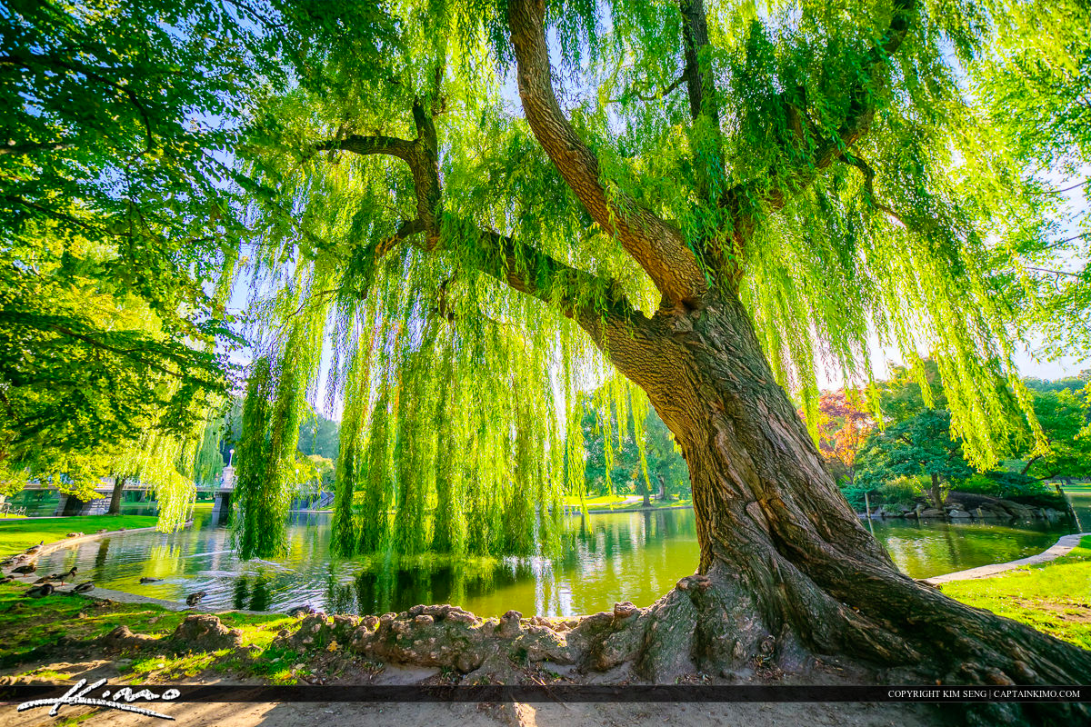
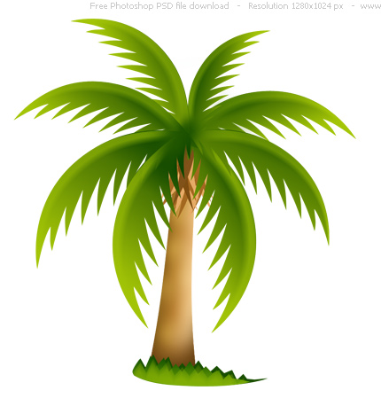
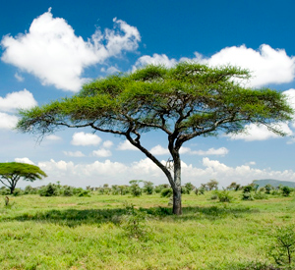

Slide 12
Be aware of…
Make sure there is positive and negative in each box when drawing the tree
You’re encouraged to do background info (horizon line, scenic details) but it’s not a requirement
This project should showcase your best work: craftsmanship, style, skill, creativity

Slide 14
Texture and Variety
When applying the category (primary, secondary, etc.) make sure to still give some details/texture/style to each square.
For example:
When painting with intermediate colors on the trunk of the tree, try to give variety and show texture of bark by applying more than 1 color to the trunk instead of making it flat

Slide 15
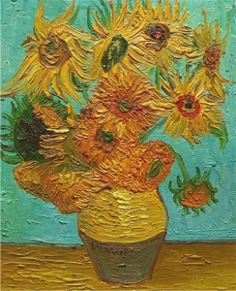
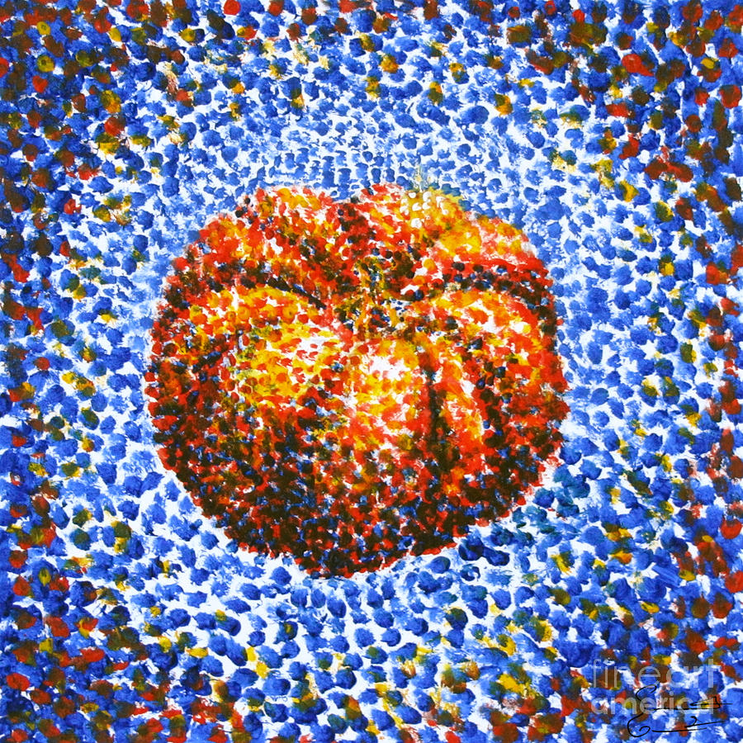
Different styles

Slide 16
Mid term
Your project must be finished by January 14th (the day of the midterm).
Points will be deducted for incomplete projects-there is no extra time given to finish the project.
Incomplete projects will be critiqued the way they are.
On this day, students will grade themselves then the class will critique these projects in small groups and as a whole class.

Slide 17
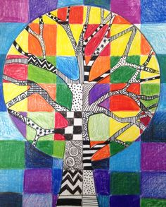
Questions?

