Slide 1
Watercolor Abstract Painting
Painting Studio

Slide 2
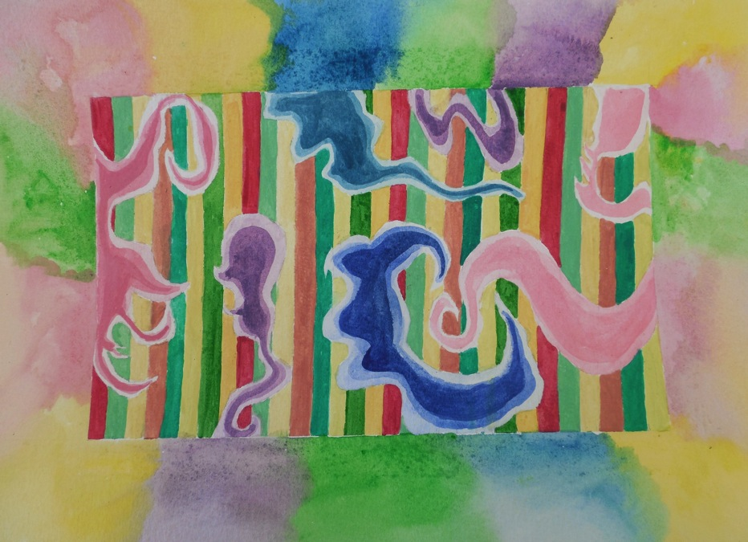

Slide 3
Watercolor- the Basics
Watercolor in tubes is not meant to be used without water. You need a TINY amount (like the size of a ladybug or smaller) of each color you’re using. Think of what’s in the tube as the pigment, and when it is mixed with water, that becomes your paint.
More water equals lighter values/colors. DO NOT lighten with white. This will make your work look “muddy” or “chalky.” (I also don’t like to use too much black. I think it gets too heavy in a watercolor painting. I only use it if I absolutely cannot use another color. I like to use the pthalo blue for shading).
A nice thing about watercolor is that you usually don’t have to put out more paint each session! Once you have prepared your palette, the colors can still be used, even if they’re dry (just put water on your brush and rub it on the dried pigment). The only time you will need to put out more color is if you run out of if you need an especially vibrant color.
There is a specific way that your palette needs to be set up…

Slide 4
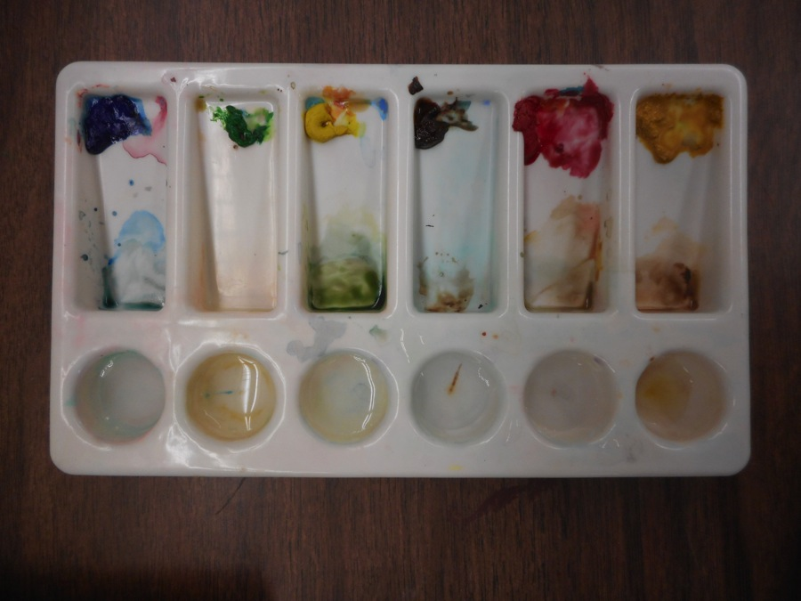
Prepping Your Palette
Watercolor pigment (only a tiny bit!) goes towards the top
This is where you mix the pigment and water, creating the paint you’ll be working with.
Each well is filled with a few drops of water (not all the way to the top)

Slide 5
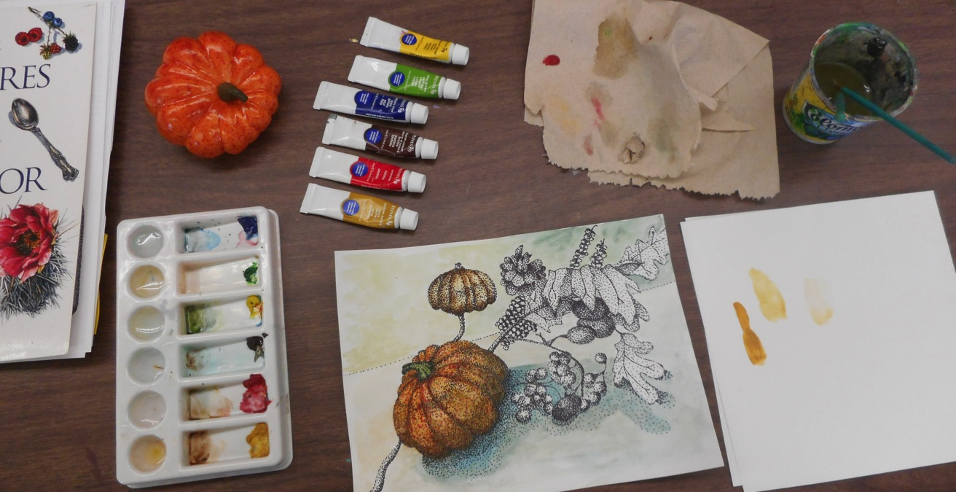
Prepping Your Work Area
Objects (if observing from life)
Reference book/material
Paper Towel
Water cup with 2+ brushes
Tubes of pigment
Sketchbook/Scratch paper
Prepped palette
Work in progress
You’ll also want to have a pencil and eraser nearby, especially when sketching out your work. A piece of tape or dust brush cleans up eraser shavings nicely.

Slide 6
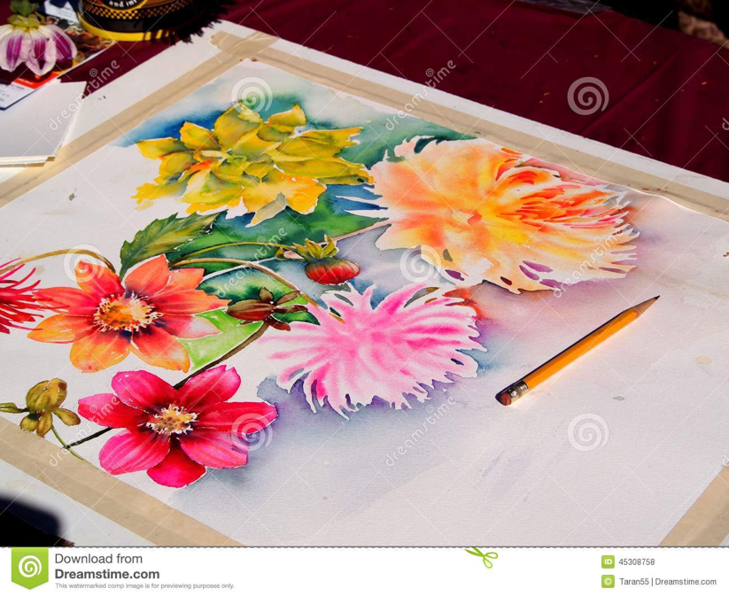
Prepping Your Paper
Mask off about a two inch border with masking tape. Often, watercolor pieces are very neat and precise, and a clean border helps further that effect. We’ll be working into our border eventually, and sometimes we will not use a border at all.

Slide 7
Set-Up (*write this down*)
Mask off the two inch border using the masking tape.
Do this part LIGHTLY in pencil. You don’t want the pencil lines to show through in the final painting.
Make a series of ¼ inch stripes. Use a ruler. Make tick marks at the top and bottom and connect the tick marks to get even, straight stripes.
Make five or more organic shapes in the composition (not too big, not too small). Some should go right up to the edge of the border. Erase the stripe lines thoroughly inside these shapes.

Slide 8
Your Assignment
(*write this down*)
The stripe lines will use the HARD EDGE technique. You will create a repeating pattern of eight colors.
The organic shapes will use the WET ON DRY technique. You will start light and get darker creating a “stepped in” effect.
The border (after you’ve finished the inside and peeled off the tape) will use the WET ON WET technique to carry out the colors used inside into the border.
You will create a color scheme to your liking, but the piece should ultimately be unified and balanced. Additionally, some of your colors should be straight from the tube, while others will be mixed.

Slide 10
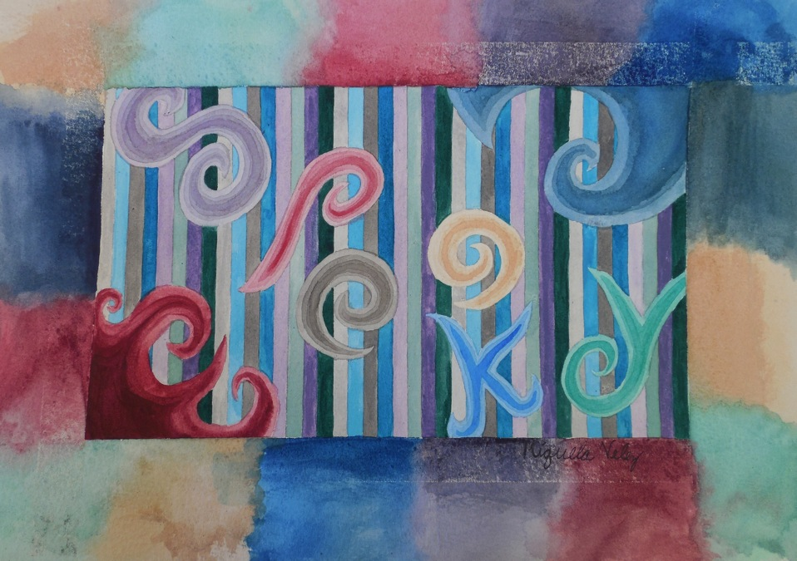

Slide 11
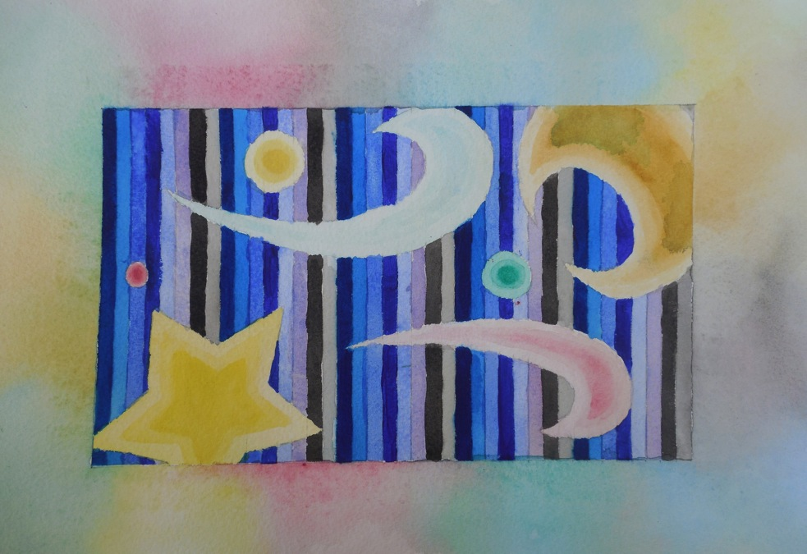

Slide 12
Three Techniques
Hard edge- The edge of the first shape has dried before you paint the shape that is next to it. No bleeding occurs. In your stripes, work this way. Jumping around (working sequentially) will give the stripes time to dry before moving on.
Wet on dry- The first layer is dry. Then additional layers are painted on top. In your organic shapes, work this way (step in parallel to the edge of the shape with each layer; start very light)
Wet on wet- The paint is left wet and colors bleed and blend into one another. Your border will be done this way. Put the colors down pretty quickly so they don’t dry and lose that effect.

Slide 13
Tips
I’ll do a quick demo for you if needed.
You may practice the techniques in your sketchbook if you feel you need to.
Use the newer brushes.
Think about what order you should be working in so that you can be as efficient as possible. Remember that some things need to be worked on while wet, other things need to be dry before you can paint the edge that sits up next to it.

Slide 14
Due Date Information
This will be the first grade for Quarter 2!
Work is due Friday 12/8 (it will go on Q2)
Remember that you must submit a completed rubric with your work (front and back)
Work loses 5 points per day it is handed in late. Work is not accepted after two weeks (extenuating circumstances may be given exception at teacher discretion).

