Slide 1
Watercolor Landscape Painting
Painting Studio

Slide 2
You Will…
You will create a landscape painting working from a photo that you have taken. Hopefully, the place you depict has a special meaning to you. Your landscape painting will:
Demonstrate clear foreground/middle-ground/background
Demonstrate clear and consistent light source as well as contrast to show form shadow and cast shadow
Demonstrate color mixing to show local color and value color
Use techniques to show textures and details

Slide 3
Set Up
Make a thumbnail sketch using pencil in your sketchbook. Work out the major shapes and forms as well as any major shadow shapes you see. Don’t get overly focused on detail, but, rather, look for major outlines (suggest detail, if anything).
When you are ready, use a well-sharpened #2 pencil and lightly transfer your outlines only onto the final paper. Lighten up dark lines and wipe away eraser shavings with tape or brush.
You may create a border, if you wish but keep it less than one inch
See next slide for easy transferring method
I like to put in the major things first (sky/land) then the pretty major things (big trees, rock walls, buildings etc.) then save small things for the end. T
Think of working background → foreground; general → specific, not left to right.

Slide 4
Easy Transfer Method

Slide 6
Steps to Transfer
Make sure the dimensions of the photo and the paper are relatively proportional; hold in the same orientation.
Make tick marks on the photo (halfway side to side, and halfway up and down).
Make equivalent tick marks on the paper.
Use the tick marks to determine where major objects and forms sit in relation to the picture plane in your photo. Sketch them accordingly. Think of it in terms of halves or quadrants.
If you need to break up a quadrant (if there’s a lot going on in one spot) you can; do so on the photo and on the paper.
This is a modified grid technique (it does basically the same thing, but won’t mess up your paper with lots of lines)
Don’t fall into the “trap” of making the thing that is most interesting/important too big!

Slide 7
General Painting Procedure
Begin with the sky. Paint sky in all the negative space. If you have dark forms like trees that will cover the sky, you can paint right into them, let them dry, and paint over them after.
Work starting in the background and move forward in space. Establish general, overall color and shadow first, then leave textures and details for later.
Atmospheric perspective- Making the background (very far distance) lighter, hazier and less defined; the foreground should gradually get more defined moving forward
I tend to start with the local color first, then do a wash of blue (or the local color mixed with blue) afterwards.
Remember: More water= lighter values (don’t lighten with white)
I use a smaller brush and/or a harder bristle brush to create my details and textures.
Important Note- Remember, you’re dealing with natural subject matter. Most of the color available to you are very man-made and un-natural. In order to achieve a realistic landscape painting, most of the colors will need to be mixed. You’ll definitely want to have a paper out next to you to test your colors and saturation on a regular basis.

Slide 8
Atmospheric Perspective

Slide 9
Painting Sky- General Tips
Use a large brush with soft bristles.
Use a wet-on-wet technique to get the bleeding/blending effect of the sky. You could also dampen or mist the whole area with plain water first, then work in your colors.
Sunsets/sunrises have LOTS of colors in them.
Typically, the sky is lighter towards the horizon and gets gradually darker as you go up.
Clouds- typically have several fluffy masses compiled together with shadow on the bottom (think of the light source as coming from the top; they are really just a bunch of bumpy spheres stuck together); I would use wet on wet technique first, then refine if needed

Slide 11
Painting Foliage- General Tips
Trees and bushes are typically a mass with an overall dark side and light side (including tree trunks)
Use the wet on wet technique first to show the overall form.
When that has dried, use a smaller brush or a stiff bristle brush and “stipple” or “hatch” textures (repeatedly dab or make lines)
Sometimes, I like to use a crumpled paper towel or sponge to help me create an implied texture.
If your tree has branches and leaves, you will be able to see those through the clumps of leaves.

Slide 12
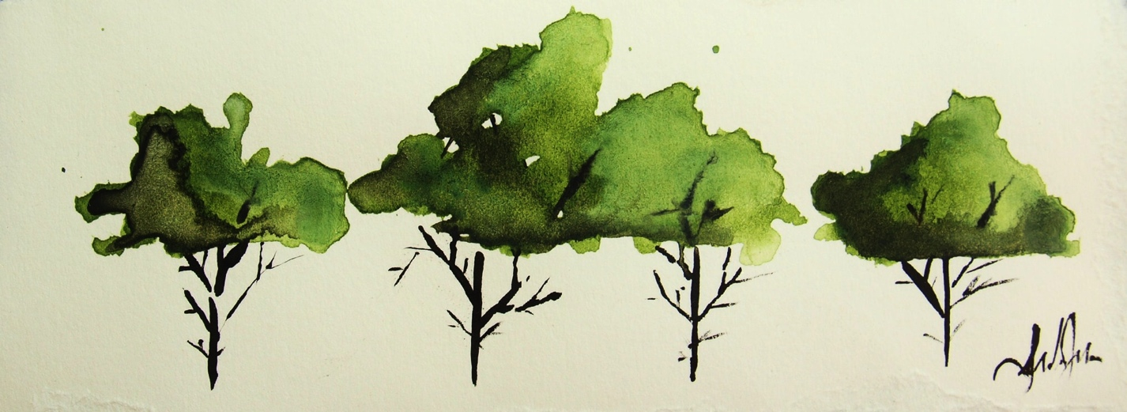
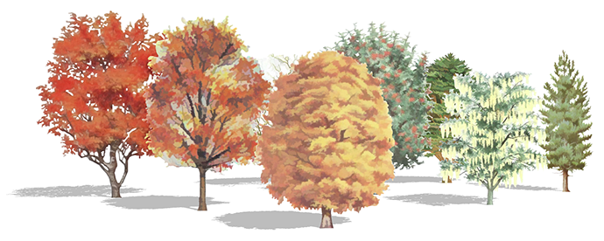

Slide 13
Painting Water- General Tips
Water tends to have ripples and reflections that go in a horizontal direction. The lines will get closer together and smaller as you move farther back in space.
You might want to start with a wet-on-wet technique, but don’t let the colors blend too much, or you’ll lose the watery effect.
The more rough the water is, the more “wobbly” the lines and shapes in the water will be.
A fun technique is to drop salt onto wet watercolor and let it dry, creating a crystal effect (this works really well for snow and ice)
Another technique is to dab, splatter or spray white tempera over dry watercolor to show foam or froth (in a really choppy sea or crashing wave)

Slide 14
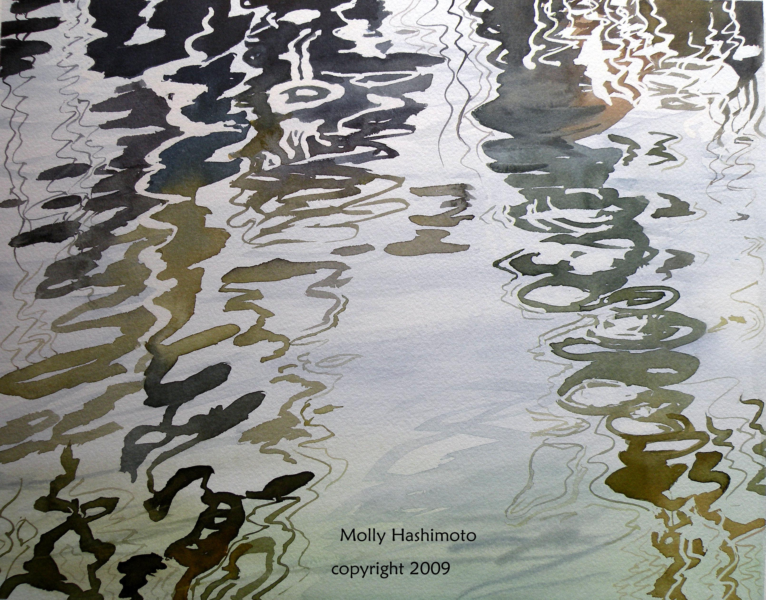
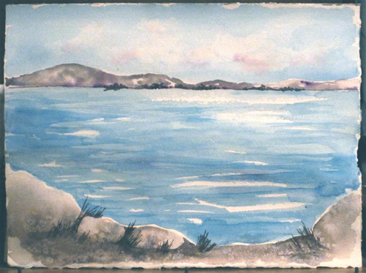
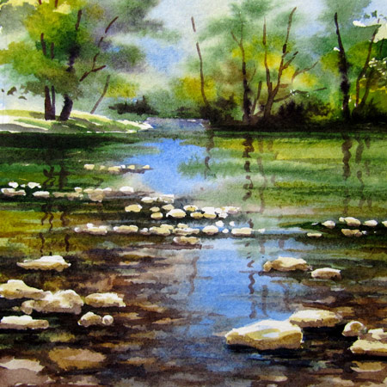
Salt Technique

Slide 15
Stones and Rocks- General Tips
Rocks are typically pretty box-like masses; the light source will really show up on them with a light side/dark side etc. Depending on how worn-down the rocks are, they might begin to get more spherical.
For boxy rocks, use more of a wet-on-dry(ish) technique, so you get pretty hard edges.
You might want to use a stiff brush and hold it straight up and down to “stipple” texture on the rocks.
If you’re seeing several rocks together in a clump, the rocks on the top will cast a shadow onto the rocks below.

Slide 16
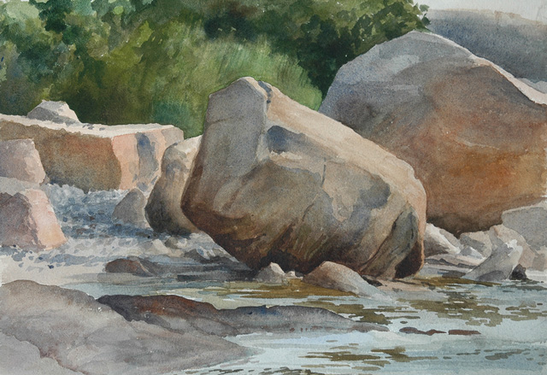
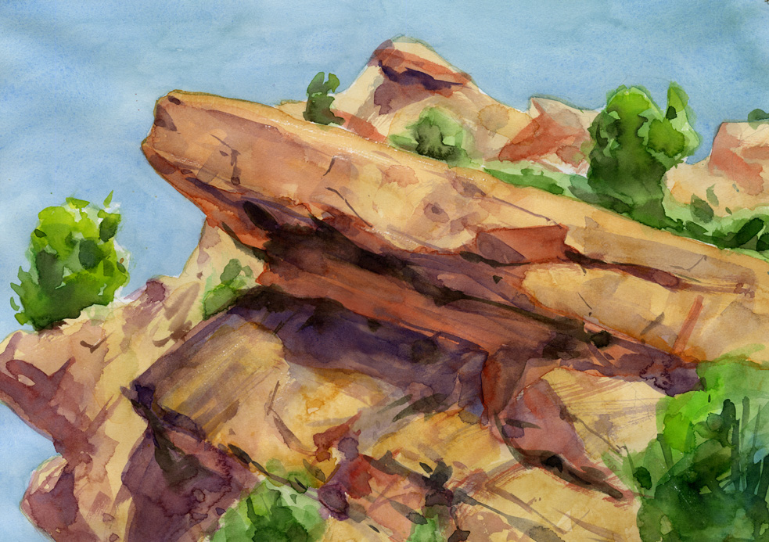
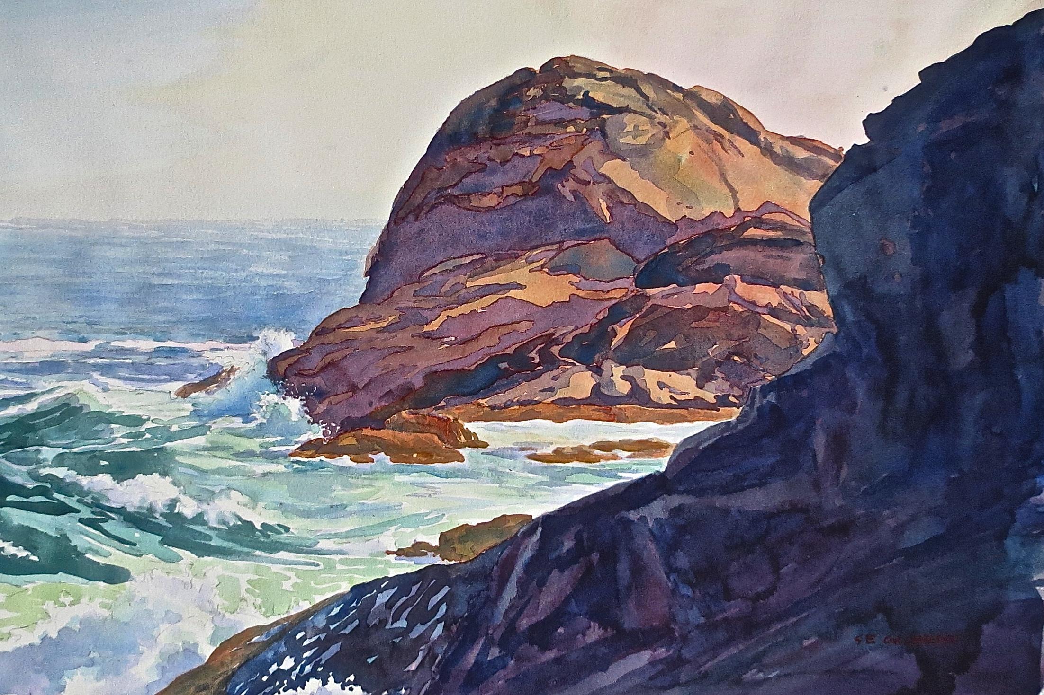

Slide 17
Overall Tips
Color unity- you want the colors in your painting to look unified. Use a little bit of every color throughout your work (even if it seems counter-intuitive or unexpected)
Practice in your sketchbook (smaller studies) if you need to before committing in your final piece.
Use resources; I have a few good watercolor landscape books and there are TONS of tutorials online for how to paint specific features.
For this project, you may “graduate” from the student-grade watercolors to the more professional Windsor-Newton’s. These have richer pigment and tend to have a “fresher” look. If you’re unsure, play around with them a little in your sketchbook first!

Slide 18
Due Date Information
Work will be due with completed rubric on December 17th, 2015.
You will have approximately six classes to work on this project (about 1-2 classes for intro/set up, one class for initial pencil drawing, then 3-4 for painting).

