Slide 1
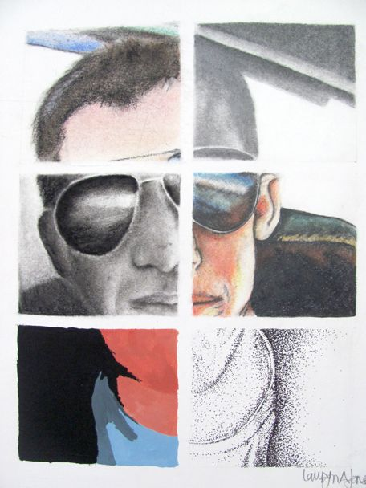
Advanced Studio
Self Portrait

Slide 2
Self Portraits…
Artists create multiple self portraits over the course of a life time.
Self portraits show how we change and grow. They can show our inner and/or outer qualities, different facets of our lives and personality,
Self portraits are great practice with a subject matter we always have on hand and are very familiar with!
Our first unit of the year is “self.” This project will get you back in the habit of making art, while allowing you to explore. It will be a fairly straightforward, observational take on the idea of “self” (what you look like physically) but you can also feel free to use the elements and principles of art to express different aspects of your personality.

Slide 3
You will…
Create an 18 x 24 self portrait that utilizes 4 to 6 different mediums/styles (some need to be black and white, some need to be color). The media will be split up in boxes, but the boxes will come together to form a single image. Choose media you are fairly comfortable working with. If you’re comfortable in several different media, choose more. If you’re not as comfortable in lots of media, choose less.
The portrait should display attention to detail and an accurate likeness, demonstrate value changes (Contrast! Volume! Form! Minimize the “pancake face” effect!) and color changes (where applicable). You should also show proficiency in the media you’re working with (this will help me to see your strengths and areas of interest.
You can also change around style! It doesn’t all have to be the same (expressive vs. graphic etc.) but the final image should make sense.
Media choices: ebony pencil, colored pencil, charcoal, ink, watercolor, pastel (oil or chalk), tempera, water-soluble graphite, oil pastel or colored pencil. Other media will be considered upon request.

Slide 4
Set Up
Find an image to work from. Choose a photo that YOU have taken of yourself. You should work with mostly your head/face, but you can also show some of your shoulders/torso. Try to let the expression/background/clothing/hairstyle show who you are as a person. Choose a photo that is clear and has a strong light source.
Sketch the image lightly (just focus on outline and establishing major shapes) on the 18 x 24 paper. If you’re comfortable using a grid, you may (just don’t get confused when you go to draw in the boxes that will divide up your media sections).
When your image is drawn out, divide up various sections. They do not necessarily have to be uniform in size, but they should be neat (you probably want to use a ruler in order to get straight lines). Think about where you are making the divisions and try to maintain a compositional balance and strength throughout.

Slide 6
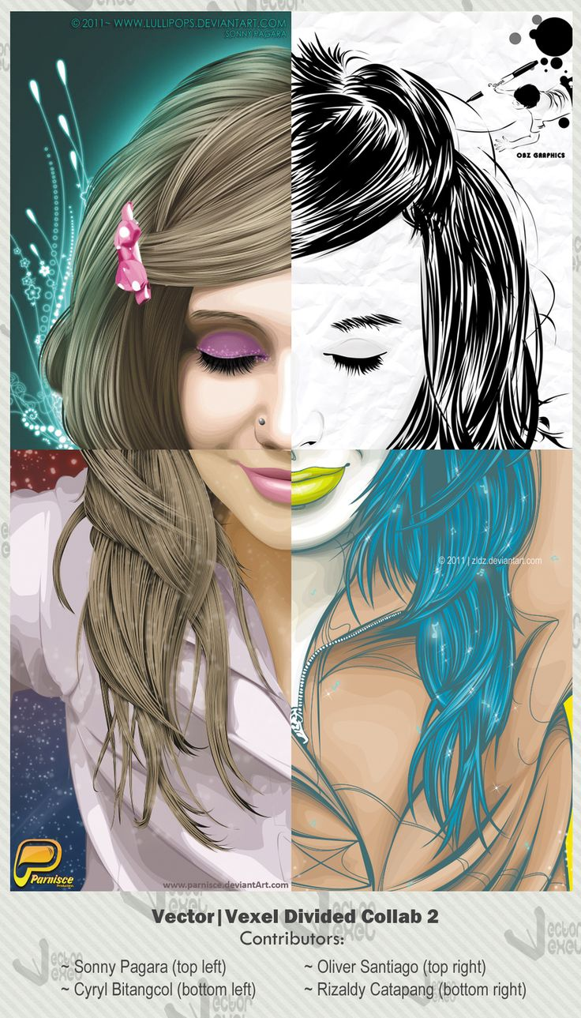

Slide 7
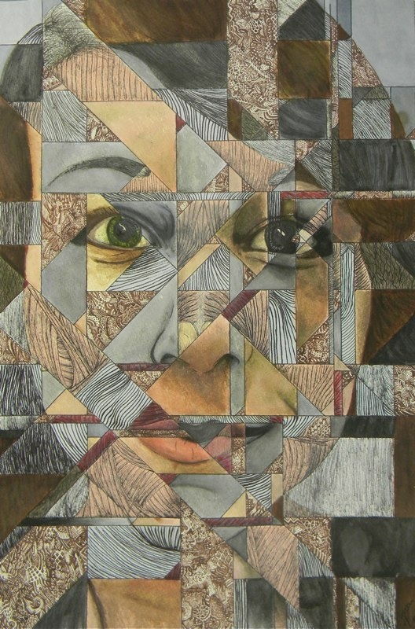

Slide 8
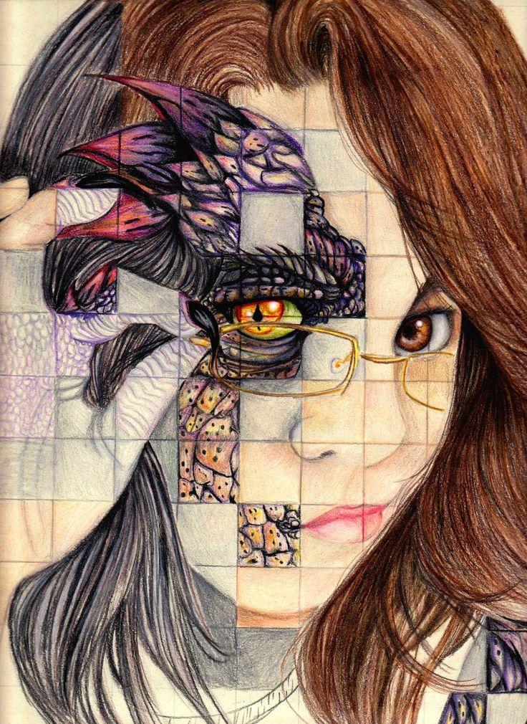

Slide 9
Decide what media you will use. Experiment in your sketchbook or on a piece of scrap paper if you need to. I would suggest to work a little on each section at first, so you develop the piece as a whole instead of finishing on section then moving on to the next.
Pause and step back from your work often. Ask questions and make suggestions to your peers. Work at a steady pace, but don’t get hasty/sloppy. Develop and refine.

Slide 10
Due Date Information
This project needs to be handed in with a completed rubric (front and back) on September ______________.
If I see that the entire class needs extra time, it will be given. However, extra time is given ONLY if I see the entire class working consistently.
Every day the project is turned in late, it’s 5 points off.
If a project is turned in without a name on it and/or the project isn’t turned in with a completed rubric, it’s 10 points off.

