Slide 1
Identity Masks
Advanced Studio

Slide 2
The theme of Q1 is “Self”.
We have explored the idea of “self” by creating a piece of artwork that shows what we look like physically in a variety of media.
Although you may have touched upon showing some aspects of your personality in the media and its applications (style) we haven’t really moved past the physical.
Our next project will be a 3D mask that shows diverse aspects of your identity using subject matter and the elements and principles of design.

Slide 3
Masks in History
Masks have a long and rich history in a variety of cultures.
Masks have been used by many societies in rituals, ceremonies, special occasions etc. all over the world.
Often, the mask is used to assume a new identity (ceremonial, theatrical, Halloween etc.)
Think of the mask as a metaphor: Who are you on the inside? How do you portray yourself? What identities do you assume?

Slide 4
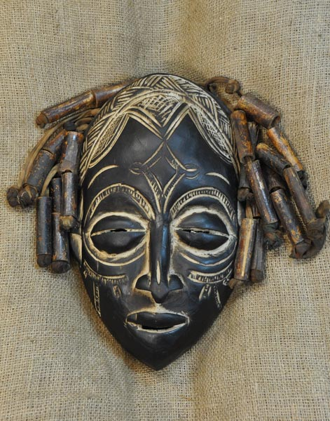
Masks of Africa

Slide 5
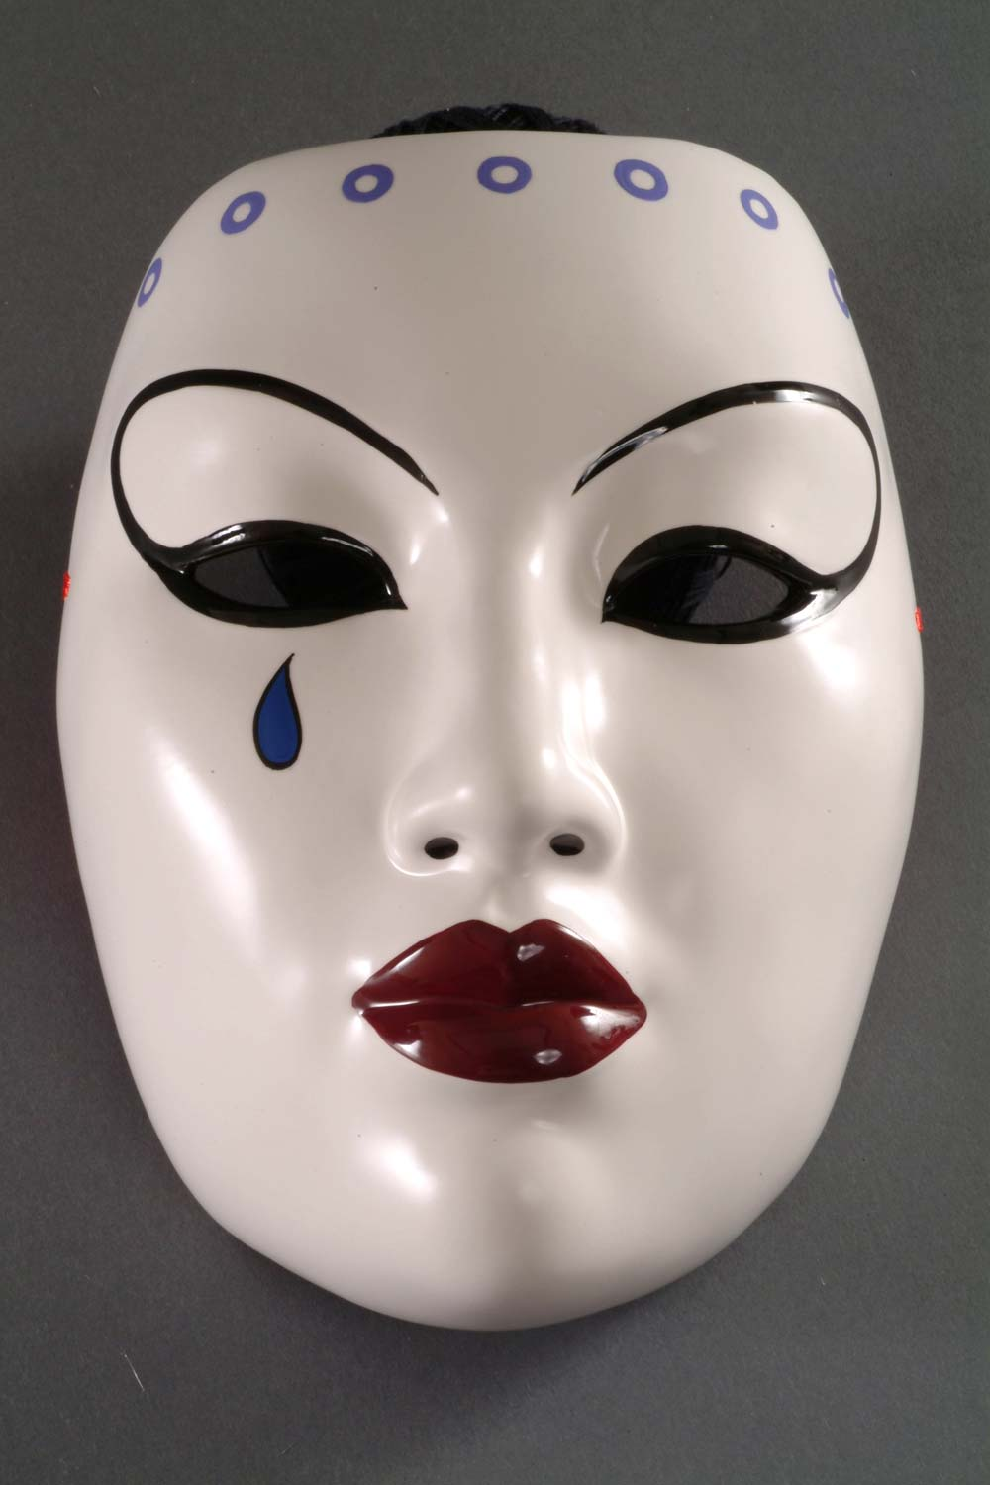
Japanese Kabuki Mask

Slide 6
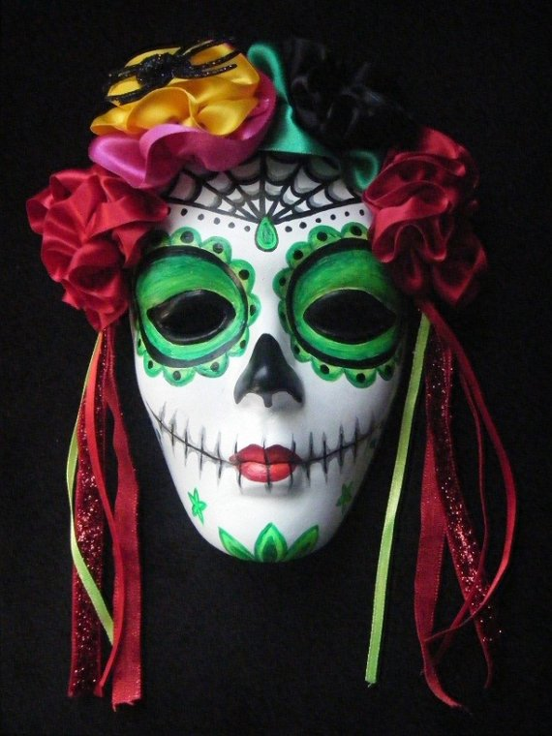
Day of the Dead (Mexico)

Slide 7
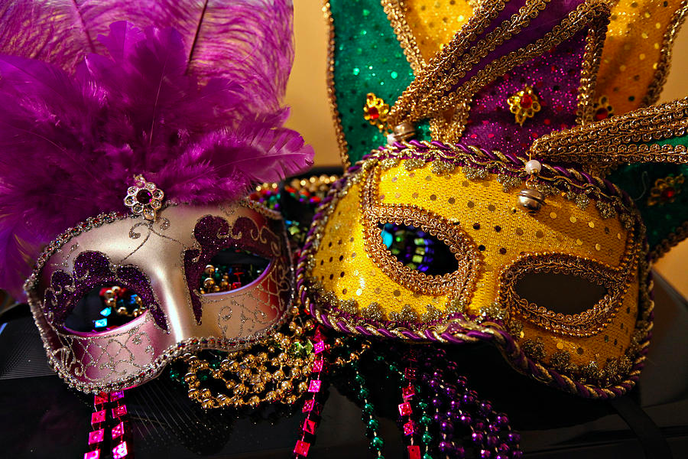
Mardi Gras Mask

Slide 8
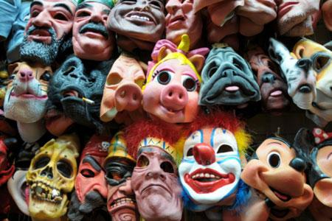
Halloween Masks

Slide 9
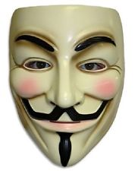
Guy Fawkes/Anonymous Mask

Slide 10
Masks Can…
Show different facets of one’s identity
Be used to hide or used to transform
Are mainly worn on or over the face, but can be built up as more elaborate costumes/headpieces
Have features representative of a face
Can be functional, ceremonial or decorative

Slide 11
You Will…
Create a mask that represents different facets of your identity
The mask will be started using a mold that has paper mache applied to it. When the paper mache dries, you will release it from the mold, and build it up with pieces of cardboard/paper that have paper mache applied on top.
Masks will be gessoed and painted with acrylic. Embellishments (sequins, feathers, wire etc.) are optional. Modge Podge to finish the surface is optional.

Slide 12
The Mask Must:
Be sculptural (you are starting with the mask form, but you must build onto it).
Be representational and symbolic (there are elements of what you actually look like, but also elements that show who you are as a person)
Be neat and finished on all sides
Be neatly, carefully and creatively painted

Slide 13
What is Identity?
Think of the things that make you what you are:
the clothes you wear and the way you look
the music you listen to and the music you make
the words you write and the images you create
what you've been through and how you feel now
where you live and where you belong
the things you love and the things you hate
your passions, politics and beliefs
your family and friends
the things that make you laugh and the things that make you cry
the places you like and the places you fear
the people you admire and the people you trust
the messages you write and the messages you receive

Slide 14
How Can These Things Be Represented Symbolically?
Line
Shape
Color
Texture
Form
Pattern
Think of what you’re showing and how you’re showing it.

Slide 15
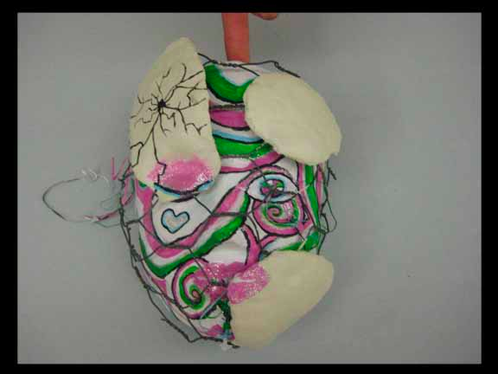

Slide 16
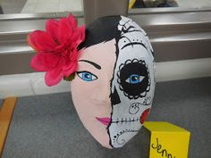

Slide 17
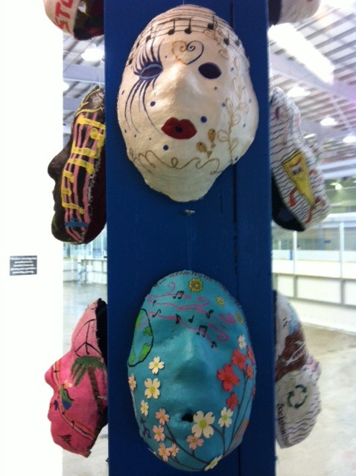

Slide 18
Time Line
9/22- Set up, intro, sketching, begin paper mache
9/24- Add paper mache to mask form
9/28, 9/30, 10/2- Building up mask sculpturally and adding paper mache
10/6- Gesso
10/8, 10/13, 10/15- Painting and embellishment
Masks due Monday October 19th

