Slide 1
Animal Portraits
Drawing 2

Slide 2
Set Up
You will bring in a photo of your pet.
You will be asked to create a sketch of your chosen animal in you sketchbook.
You will experiment with different applications to get a better idea of what you’ll do in the final drawing

Slide 3
What is a portrait?
A drawing of usually a person from the shoulders up
In this case, you will draw a part of the body as well as the head of the animal
Portraits can show expression, details of the subject, etc.
The subject does not have to be looking at the viewer, a side of the face can be drawn

Slide 4
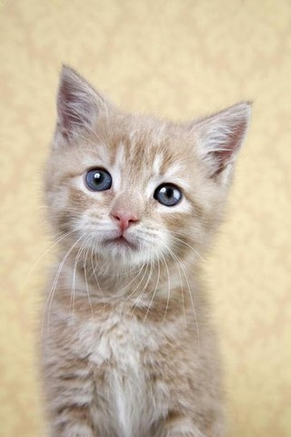
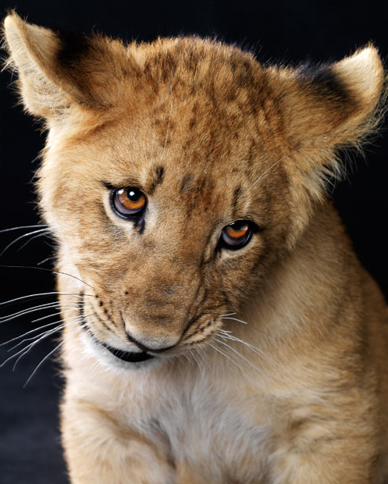

Slide 5
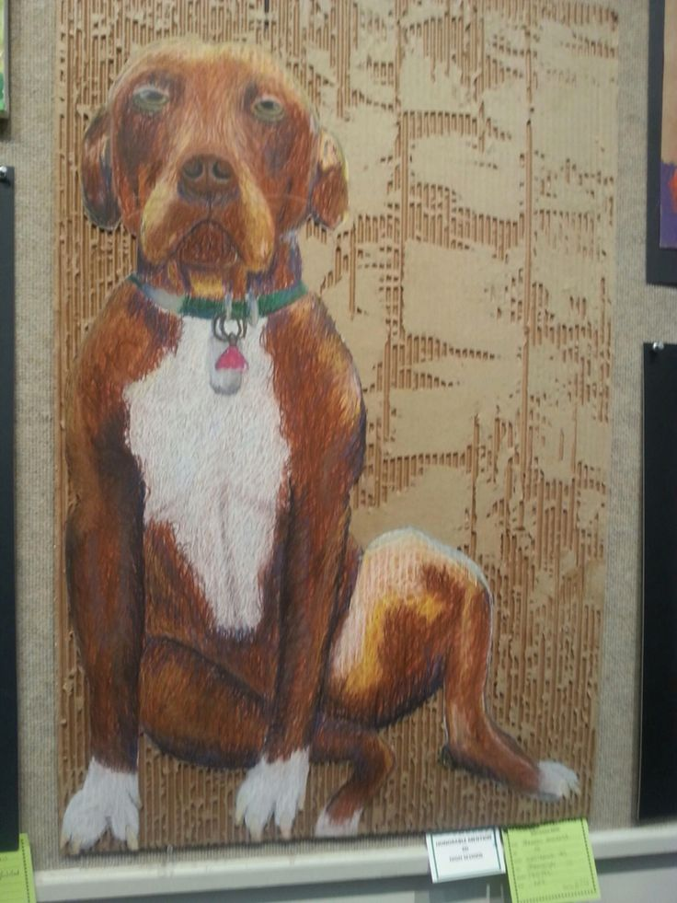

Slide 7
What the portrait should include
The subject should take up most of the paper…atleast 75%
Portrait should be detailed, rendered realistically
A horizon line should be created to ground your subject
Even though the subject is the focal point, there still should be color/objects/details in the background.

Slide 8
Materials Used
Cardboard
Water Soluble Oil Pastels
Option of sharpie/pen for small details (eyes, fur texture, background, etc.)
Xacto knives to cut/tear the top layer of cardboard

Slide 9
Transferring your sketch…
Transfer the pencil outline to the cardboard. Make it large. Include some background/context. Think about strong positive and negative shapes.
VERY CAREFULLY cut on the outline (silhouette) with the X-acto knife. Peel away the cardboard in the negative spaces. Create textures and visual interest in the background.

Slide 10
Creating Value and Form
You will use water-soluble oil pastels to add color and form to your drawing.
Remember that you can lay down areas of color value first with the pastels, then use them with water and a brush (“wash”). When that layer dries, work back in, describing texture and details.
Try to build up your textures and details little by little. Use multiple colors to depict an “optical mix.” (When you look at your work from far away, the colors should blend together. When you look at your work up close, the pastel marks should be obvious and show texture).
Option to add “embellishments” (tissue paper, fabric, string etc.) to make your work slightly 3D

Slide 11
What Am I Looking For?
A creative photo as source material (personality)
Careful observation and attempt to make work look realistic
Form/volume/shading (not flat)
Textures/mark-making/layering and building up of color

Slide 14
Due Date Information
This project needs to be handed in with a completed rubric (front and back) on October 2.
If I see that the entire class needs extra time, it will be given. However, extra time is given ONLY if I see the entire class working consistently.
Every day the project is turned in late, it’s 5 points off. After 2 weeks, the project is a 0.
If a project is turned in without a name on it and/or the project isn’t turned in with a completed rubric, it’s 10 points off.

