Slide 1
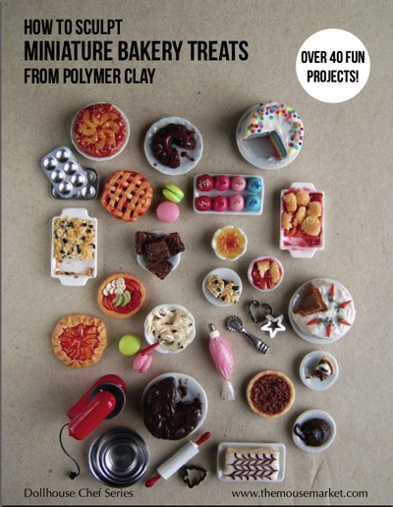
Mini Sculpture Series Fimo Clay
Art 2

Slide 2
You will…
You will create a series of miniatures using Fimo clay (“Sculpey”)
You will have ten different pieces in your series.
You series will be a theme (candy, animals etc.)
Each piece will be smaller than one square inch
You will create a base/setting to arrange your miniatures that goes with their theme

Slide 3
What is Fimo Clay?
Fimo clay is polymer-based (sort of plastic-like). The brand name we’re using is “Sculpey.”
Fimo clay stays workable until it is baked, then it hardens.
Fimo can be baked in a regular oven or toaster oven.
Fimo clay is versatile and fun to work with!

Slide 4
Fimo Clay Techniques, Tips and Tricks: Working with the Clay
*You need less clay than you think you do!
*Work on a clean surface (I like to put a piece of paper on my desk)
*Warm the clay by kneading it in your hands for a minute or two so it becomes workable.
*Tools (think small): palette knife, needle tool, toothpicks although your major tools are going to be your fingers!
*When attaching two pieces together, they stick better when they’re warm. Score pieces by making dots with a needle tool or toothpick (especially large pieces and fragile limbs) and roll the toothpick through the crease to smooth them together.
*You might be able to get away with not scoring tiny pieces, but make sure you press them on well.
*The clay shouldn’t be too thick, otherwise it might fall apart.

Slide 5
Fimo Clay Techniques, Tips and Tricks: Color
You can use the colors straight off the block or mix them
To mix colors remember how to mix paint. Select two or more colors and mash them together, pick them apart and repeat. The kneading will mix the two colors into one new one.
You can also create a “swirl” or “marble” effect by stopping the kneading before the colors mix fully.
You can create patterned effects by beginning with a base color, then taking smaller pieces of another color and sticking it on.

Slide 6
Fimo Clay Techniques, Tips and Tricks: Texture and Detail
You can create detail/texture additively or subtractively.
Additive- creating smaller pieces and adding on to the sculpture
Subtractive- carving or impressing into the clay to create texture/detail
If the detail sits on the surface, press it in firmly.
If the detail is more free-floating, score it so it sticks, but don’t press it down.

Slide 7
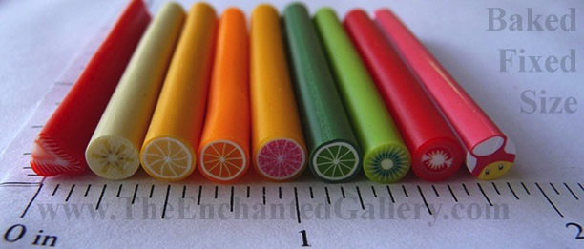
Slice Technique
Coils/long thin slabs of color are rolled into a tube then sliced. The flat pieces created have a design on them (like sushi or slice and bake cookies)

Slide 8
Other Stuff
Make sure your hands and work surface are clean so you don’t taint your colors
Sometimes, its easier to attach tiny things with a tool instead of your fingers (you may have more dexterity this way)
Smooth your surfaces (I don’t want to see fingerprints). You can create a shiny surface with clear nail polish once the sculpture has been baked.
Very fine details can be drawn on the baked sculpture with a Sharpie marker or painted in.
Not sure how to proceed? Google “Fimo/Sculpey __________ tutorial”

Slide 9
Logistics
Save scraps in the scrap box. These little pieces might be great for someone else’s detail work!
Take less new clay than you think you need. It goes a long way.
Store work-in progress in your Tupperware container.

Slide 10
Set up/Procedure
Come up with your theme
List the ten objects you will make
Sketch all ten and annotate your sketch (how will you create each one?)
When you’re ready, start creating! Try to make two pieces per class.
Remember, you need ten pieces total. Each piece needs to be smaller than one square inch (that’s about the size of dice or smaller)
You also need to create a base/display for your pieces. This does not have to be made out of Sculpey (be creative!)

Slide 11
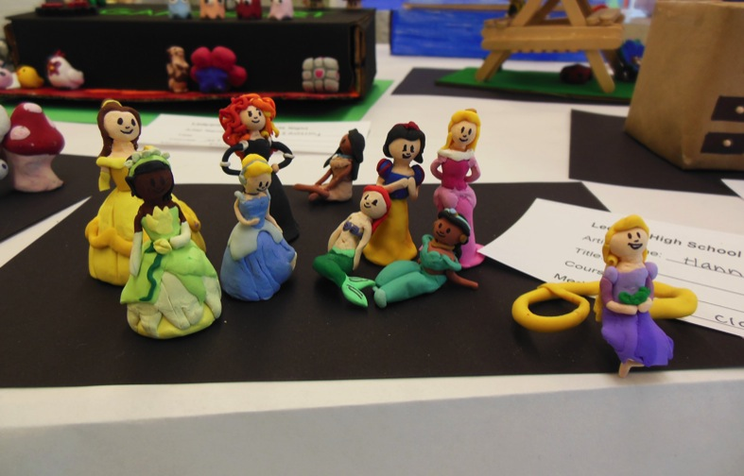
Student Examples

Slide 12
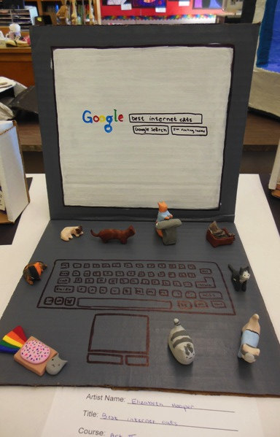

Slide 13
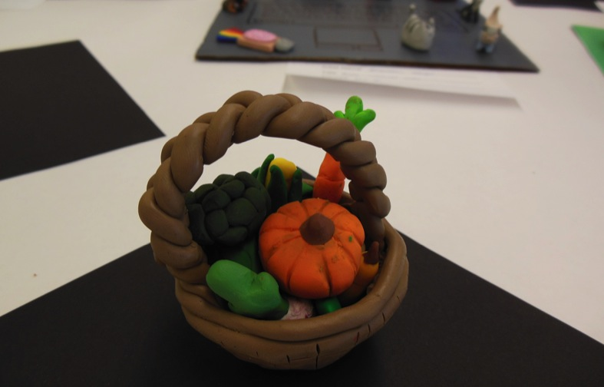

Slide 14
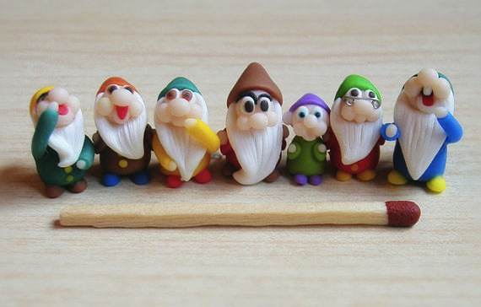
Online Examples

Slide 15
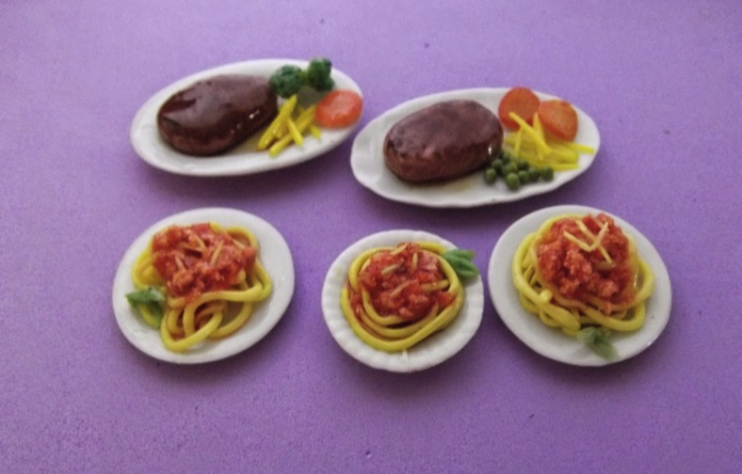

Slide 16
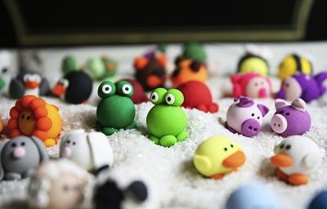

Slide 17
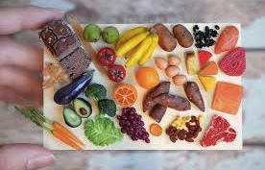

Slide 18
Due Date Information
This project is due ________
It will be the first major assignment to go on Q4.

