Slide 1
Package Design
Art 2

Slide 2
Which of these products would you be more likely to buy?

Slide 3
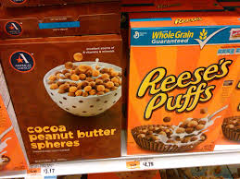

Slide 4
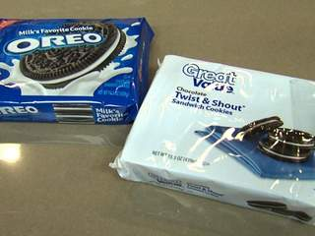

Slide 5
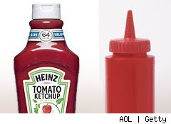

Slide 6
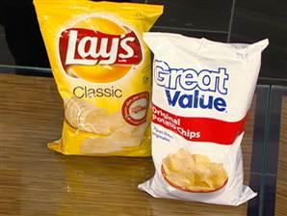

Slide 7
Tropicana Orange Juice
https://www.youtube.com/watch?v=Ny3kKNf1faU

Slide 8
Package Design
Companies know that there is a lot of competition out there for similar products. They can sell more by a) making a better product OR b) making you think a product is better because you associate it with certain ideas or feelings.
The packaging that the product comes in is just as important, of not more important, than the product itself.
Companies spend millions of dollars to try to make it so that their packaging/design makes customers choose their product over another. They want to send a visual message with their product’s packaging.
Package design is a HUGE area of graphic design and a diverse career field in the arts.

Slide 9
Factors of Package Design
Shape of package
Material of package
Color Scheme
Shapes/designs
Logo/graphic/imagery
Text/Font
Composition (how everything is laid out and compares to other elements on the package)

Slide 12
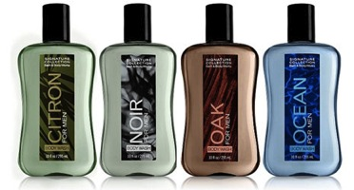
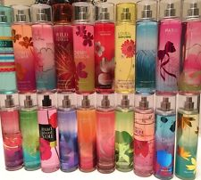
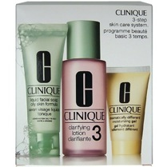
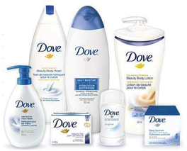
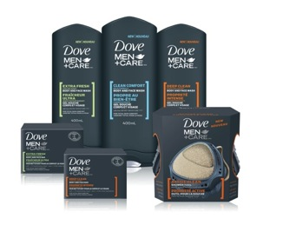
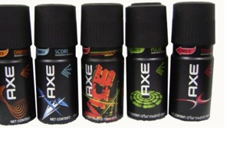

Slide 13
Your Assignment
You will come up with a product and create a package design for it. These can be a little silly of more serious. Have fun with it!
Think about what message/associations you want people to have with your product.
How are you going to get people to associate those things with your product in a non-verbal way?

Slide 14
Brainstorm/Sketch to address the following:
Shape of package
Material of package
Color Scheme
Shapes/designs
Logo/graphic/imagery
Text/Font
Composition (how everything is laid out and compares to other elements on the package)

Slide 15
Creating the package
Packages will be created out of cardstock, unless you have another material you would specifically prefer
Sketch your ideas; remember to show all sides.
Create a template (or use one of mine) and create a mock-up in paper. Figure out where the design will have to go and what way it will be facing. (www.boxtemplatesstore.com)
When you’ve figured out the shapes you will need to cut, and where you will fold and glue, you can move onto the final material.

Slide 16
Assembling and Painting
Draw out the shape of the package in pencil. Use a ruler. Draw out the design in pencil.
These will be painted with tempera paint. You may use a marker for details.
Your work should be neat, careful and precise. You want it to look like if could be an actual package!
Be clever and have fun with your product!

Slide 17
Requirements
No larger than 6 inches in any direction; no smaller than 3 inches in any direction
Shape of package must suit intended purpose of product
Package design must create a message/effect
Must have some logo/graphic
Must have some font/text
Must have some descriptive text
Product name must appear on package
It should be clear from the package what the product is for and WHO it is for
Package must be sturdy and well-built

Slide 18
Color Associations
Different colors often tend to be associated with different qualities.
Using color schemes and color associations are tools applied by marketing and designers on a regular basis to sell their products to certain people.
Color associations are also known as color psychology because our brain recognizes color and has a certain reaction to it.

Slide 19
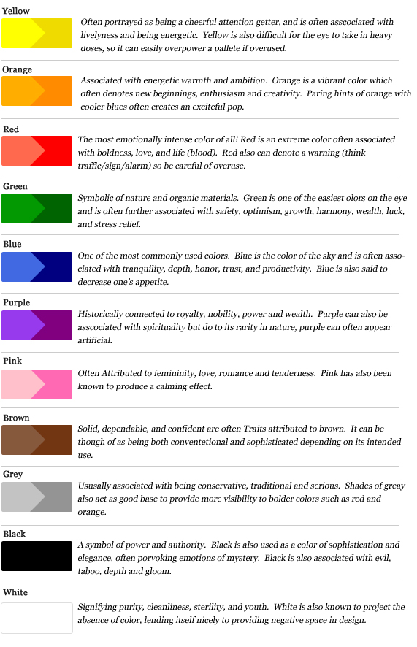

Slide 20
Color Schemes
Color schemes are the combination and arrangement of colors used in a piece.
Color schemes can create a specific effect, feeling or mood.

Slide 21
Monochromatic Color Scheme
Tints and shades of a single color are used.
Hint- you can remember this because “mono” means “one.” (a monorail has one rail; a monopoly refers to a single company having control of something; etc)
Monochromatic color schemes tend to look calm and stable.

Slide 22
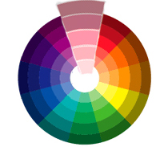

Slide 23
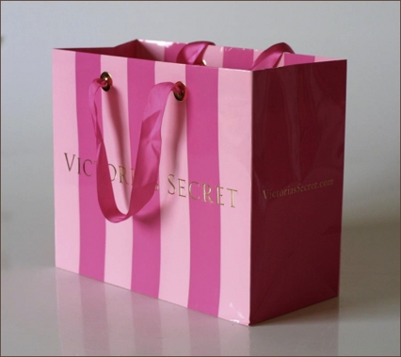

Slide 24
Complementary Color Scheme
Complementary Colors are opposite one another on the color wheel.
Hint- It’s not “complimentary” with an “I.”
Complementary colors make each other stand out, creating a sense of tension or action in a piece.

Slide 25
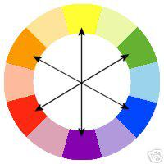

Slide 27
Analogous Color Scheme
Analogous colors are next to each other on the color wheel.
Hint- analogous means “similar.”
Analogous colors create a sense of stability when used together, but are a little more fun and vibrant than the monochromatic color scheme.

Slide 29
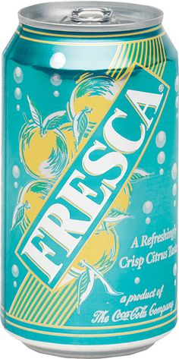
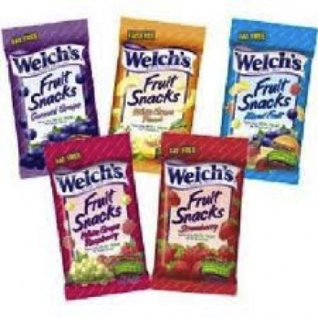

Slide 30
Triadic Color Scheme
Triadic colors are three evenly-spaced colors on the color wheel.
Hint- “tri” means three. (as in a tricycle has three wheels; a tripod has three legs; triangle has three sides etc.)
Triadic schemes are fun and vibrant.

Slide 33
Tetradic Color Scheme
Tetradic colors are four evenly-spaced colors on the color wheel.
Hint- “Tetra” means four. (a “tetrad” in music theory has four notes.)
Tetradic colors are also very fun and vibrant.

Slide 35
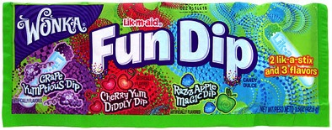
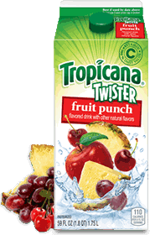
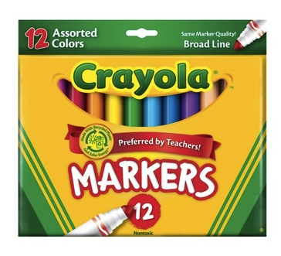

Slide 36
Due Date Information
Due November 24th/25th, 2015 (you have roughly eight classes to complete this project. 1-2 days will be spent coming up with idea/sketching. 2-3 days will be spent assembling the package. 3-4 days will be spent painting the package.)
Hand in rubric with self assessment to receive full credit for your work.
Work loses 5 points for every day it is turned in late.
Late work not accepted after 2 weeks unless in extreme circumstances with prior approval from teacher.

