Slide 1
Printmaking: Block Print Reduction Print
Art 2

Slide 2
Subject Matter
For this project, the subject matter will be a person you admire.
This prompt is broad. It could be a musician, actor, author, family member, friend, historical figure, even a character. The person does not have to be living.
Find a good reference photo (or multiple) to work from. You want a clear image so you can see details well. Consider your strengths. If you struggle with facial features, try to find a picture where part of the face if hidden. If you want to challenge yourself, think about including a background or other identifying details. If you do better with stylizing rather than realistic, you can take that approach. Make it your own!

Slide 3
Block Printing- Review
Block printing is one type of printmaking (intaglio, callograph and screen printing are others). In printmaking, a surface is taken away from or added to. Then ink is applied to the surface and printed on paper. With printmaking, you can make several images from the same source.
We will be using soft cut linoleum blocks and a linoleum cutter to carve out textures. Remember that what you carve away does not get ink applied to it and, therefore, becomes the color of your paper (so if you’re working on white paper, the carved parts will end up being white).
Remember that you are carving out textures and light values. Try to minimize outline.

Slide 4
Block Printing Process- Review (for one color only!)
1. Draw image in pencil.
2. Flip pencil image over onto surface of the block and burnish (apply pressure) so the image transfers onto the block. It will be backwards! That’s okay!
3. Carve out textures and light areas.
4. Roll ink on inking plate until it crackles.
5. Roll a few sweeps of ink onto carved block.
6. Set paper onto inked block.
7. Press down with barren.
8. Pull print (pull on a diagonal)
9. Did the print come out how you want? If not, is the problem with the image itself, or with the inking?
10. Carve/re-print if needed.

Slide 5
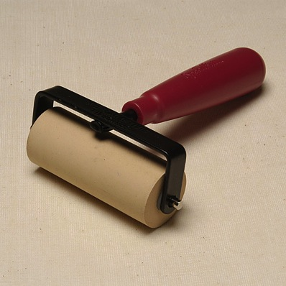
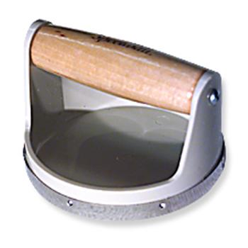
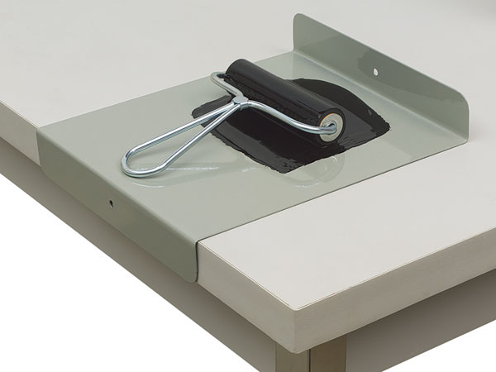
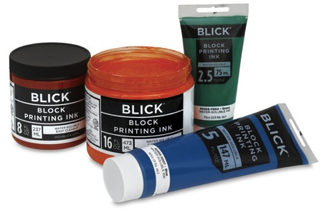
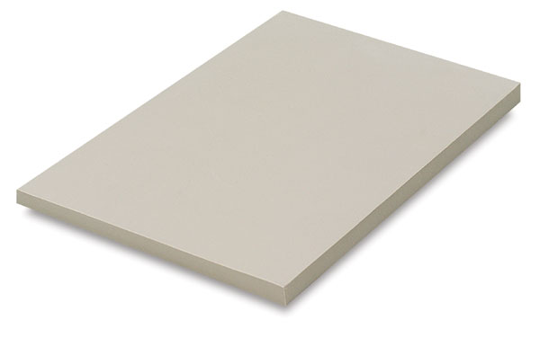
Printmaking Tools
Lino-cutter and gouge tips
Barren
Brayer
Block Printing ink
Inking plate
Linoleum (Soft-Kut)

Slide 6
How does a reduction print differ from a regular block print?
With a regular block print like you did in Art 1, you were only able to print one color.
With a reduction print, you carve and print multiple times. Each time you carve away a new area, the color you just printed will be revealed.
The colors that are added after will layer on top of the earlier colors.
The colors should be printed in order from lightest to darkest.
You have to get the block lined up in the right spot when you go to print (called “registering”). It’s pretty tough to get them image 100% perfectly registered. That’s okay. That will give the image a unique look. We can also use a tool called a “jig” to help with registration.

Slide 7
Confused? It’s easier to understand when you see it done.
https://www.youtube.com/watch?v=lRy5lvrWsa0
https://www.youtube.com/watch?v=enYSeVtcp_w

Slide 8
Set Up
YOU WILL DO A SMALL PRACTICE PRINT FIRST THEN GO THROUGH THE EXACT SAME PROCESS FOR THE FINAL PRINT. THE DIRECTIONS ARE THE SAME.
Decide on subject and gather source material. Draw out sketch on regular paper- aim for fairly large, simple, clear shapes. Transfer sketch to block. Color sketch with colored pencil.
Create jig if desired: take large, flat piece of cardboard; put linoleum block on cardboard and trace around block. Cut out carefully with X-acto knife. Lay paper down and create marks to show where the corners of your printing paper will need to line up.
Gather all materials. Have color plan nearby!

Slide 9
Carving and printing first color
Carve away all areas that will be white first. Remember to keep carve direction as consistent as possible. Carve enough off the block so that the shapes are clear, but leaving a little left over can help give the print some dimension. You can rest the block on the printing plate and brace it against the table edge to give you more leverage. Clean off all burrs and prepare your printing station with all materials. At this time, have the carved block in the jig hole if you’re using the jig.
Print the lightest color first. Pour about a dime size dollop of ink on the printing plate and roll flat with the brayer. Listen for the crackle to know when the ink is the right consistency. Roll the ink onto the block evenly. Place paper on top. Burnish with the barren and lift on the diagonal.
Assess the print (too much ink? Not enough?) Take this into account when pulling your next prints.
Repeat the printing process again several more times. Pull at least ten prints total. It is very difficult to get a nearly perfect prints, so the more you have to work with, the better your chances will be.

Slide 10
Printing Second Color
Wash and dry the block thoroughly. Place prints on drying rack or nearby to dry while you carve your next color.
Now, you will carve out all the areas that you want to show up as the LIGHTEST color (the color you just printed)
Carve again as instructed.
Bring the block back to the jig (if you’re using it) and print your second lightest color. Make sure the first layer/color is dry before printing the next layer. Line up the paper as best you can (use the corner registration marks on the jig to guide you). Remember, if it’s a little off, its okay.

Slide 11
Printing third (etc.) colors
Repeat the same steps (wash and dry block)
Now, carve out everything that is going to be the second color (the color you just printed).
Is this starting to make sense now? Wherever you carve is going to NOT take ink when the ink is rolled onto the block. Therefore, every shape you carve is going to reveal the color that’s underneath it. That’s why you want to carve away the color you just printed- that will cause that particular color to show up.

Slide 12
What am I looking for?
Requirements: Print must have at least three colors (four if you include white). I am looking for ONE good print.
Strongly-composed design; original thought and creativity in arrangement and depiction of person
Awareness of texture and detail in block carving (direction of carve marks helps establish the overall image)
Well-printed image (solid color- enough ink but not too much) mostly well-registered
Good craft (image centered on the page, image signed at the bottom in pencil with NAME, “TITLE,” PRINT #/EDITION #, print free of extra marks)
Good attitude towards the process and good work habits

Slide 13
What can I do to take this above and beyond? Options!
Create a print that has more than three colors.
Experiment with printing on different types of paper (different colors, different types)
Work a little watercolor, tempera or colored pencil into your final print
Put your extra prints to good use. Give them away to friends, cut them up and make a collage etc.
For extra fun, print on fabric (canvas bag, t-shirt etc.) May need to mix textile medium in with the ink; may have to iron the print

Slide 14
Examples

Slide 19
Timeline
Day 1- Intro; sketch and carve practice block
Day 2- Carve and print practice block
Day 3- Sketch for final design; begin carving
Day 4- Carve and print first color
Day 5- Carve and print second color
Day 6- Carve and print third color
Day 7- Tie up lose ends; sign etc.
We’re looking at the beginning of the week we come back from spring break on these (April 26th/27th or so- I’ll set an official due date soon)

