Slide 1
My Process:
Block Print
By Ms. Flanagan

Slide 2
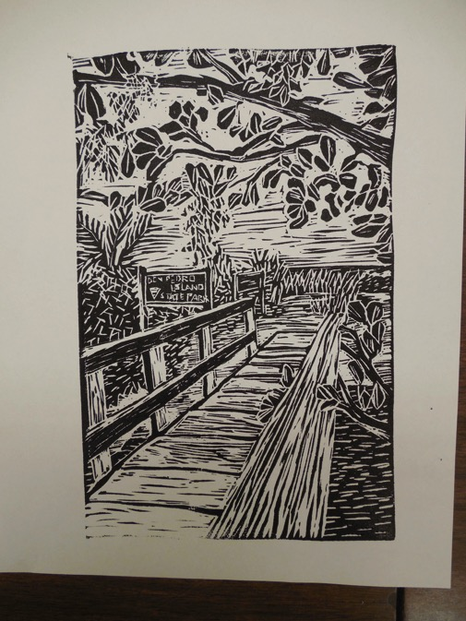

Slide 3
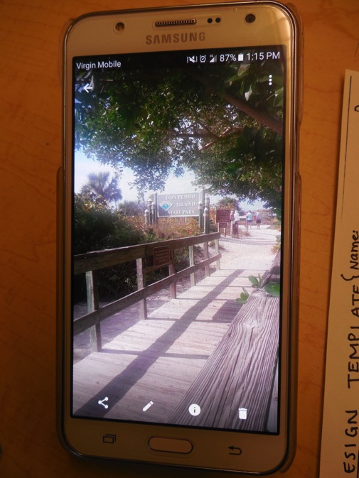
For my reference image, I chose a picture that I had on my phone that I had taken when I was in Florida recently on a walk. This is a special place to me because I always get to spend a lot of time with my mom and dad when I’m there.
Whenever I’m “out and about” I try to take pictures of interesting scenes from places I go. I liked how I framed this photo with the perspective of the receding walkway, the trees that come into the foreground, and the foliage and ocean that you can see in the background.
I thought this would make a good block print because of the composition as well as the different textures (wood grain, different types of plants etc.)

Slide 4
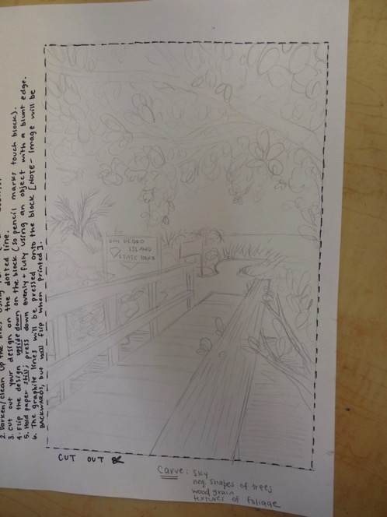
I sketched out my design on the template provided. I tried to focus on the overall shapes and forms, and didn’t worry about a lot of the details and textures at this point (those will come when I carve the block).
Luckily, the dimensions of the template and the photo are pretty proportional. When drawing out my design, I looked at different edges and how high/low they went off the edge of the picture plane (the railing in the foreground, for example). I find that easier than trying to just freehand everything; I like to look at start points and end points of major objects.

Slide 5
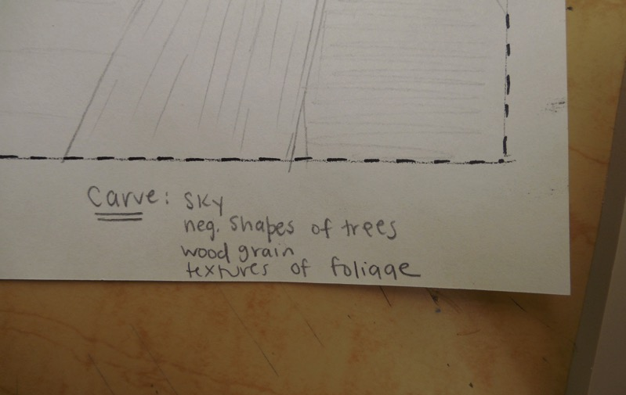
I made some little notes to myself so I would remember what I wanted to carve away (any areas that would appear as light areas. I knew I wanted the sky to appear light, I wanted the branches to appear dark (so I reminded myself to carve the spaces in between the branches), the grain on the wood to be prominent, and to show the different types of textures on the foliage (the spiky palm trees vs. the brushy grass vs. the rounded leaves).

Slide 6
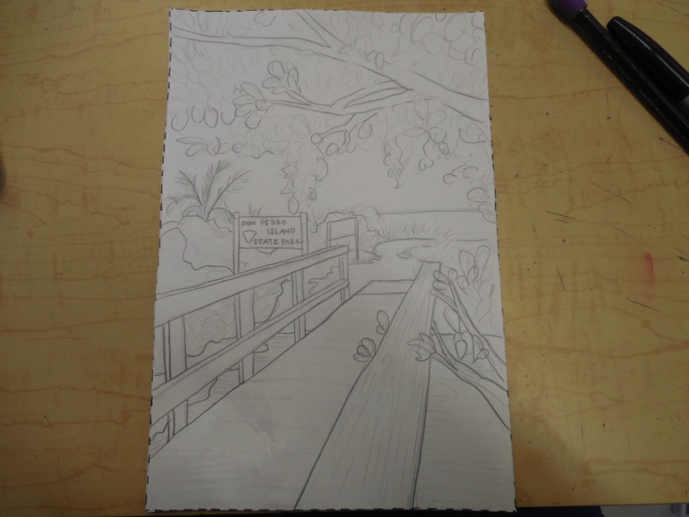
Here’s my finalized sketch. I darkened some of the lines so that they would transfer better because they had more graphite.

Slide 7
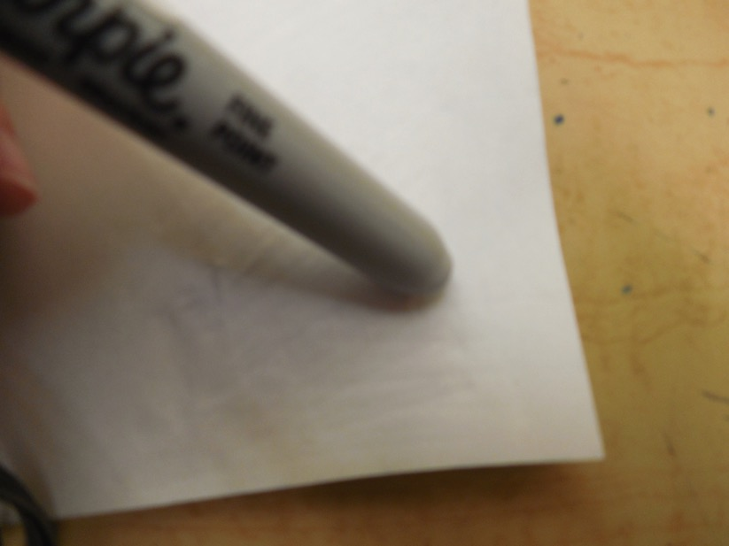
I flipped the sketch upside down on the block so the graphite was touching the linoleum surface (I washed the talc off with a damp paper towel first). Making sure the paper didn’t move, I pressed down pretty hard with the back edge of a marker. I had to make sure that I went over the whole thing so that the entire sketch would transfer.

Slide 8
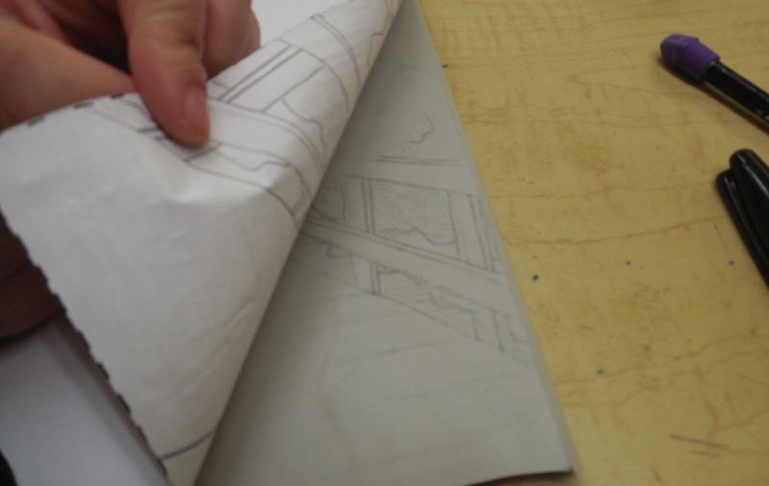
I like to check to make sure my sketch is transferring before I go over the whole thing (Just make sure you don’t move the paper, otherwise you might get a dual image that is unclear).

Slide 9
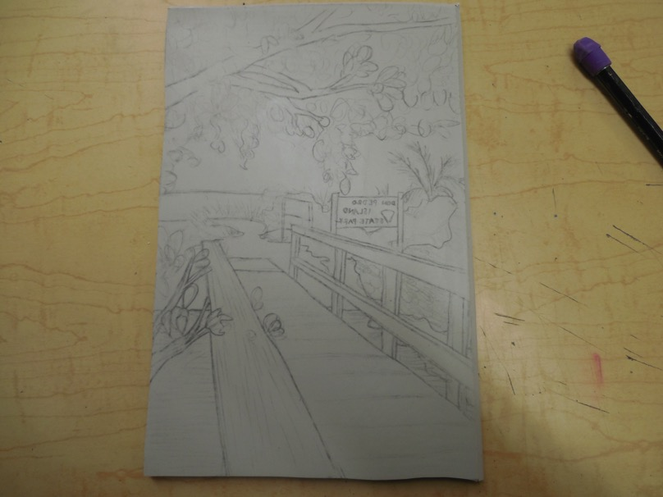
Here’s my transferred sketch. I took a pencil and made some of the shapes a little more clear by drawing right onto the block itself.

Slide 10
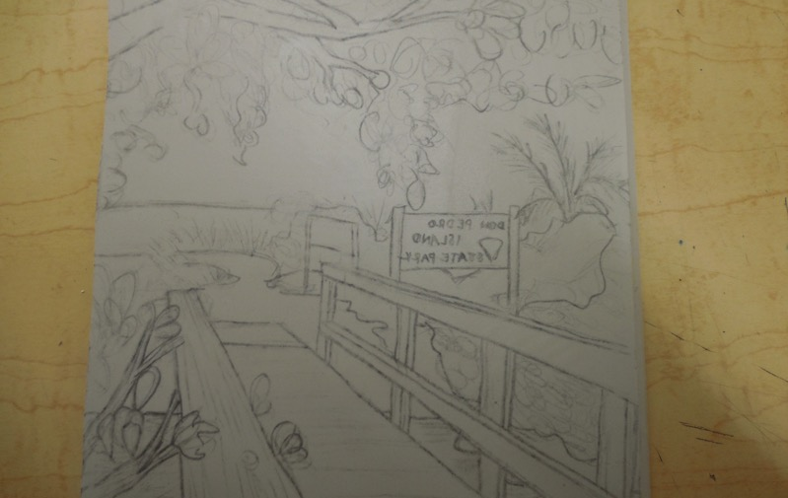
Notice that everything, including the words (“Don Pedro Island State Park”), are backwards on the block now. I will carve them backwards, too. They will flip back the correct way when I print.

Slide 11
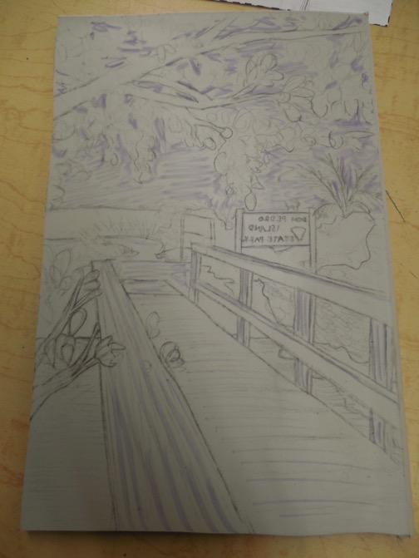
I took a crayon and colored in some of the negative shapes that I am going to carve out so it was a little easier for me to understand. This helps me to not get confused, especially in the areas like the trees where there is a lot going on. The crayon will mostly be on parts that are carved away anyways, so it isn’t going to effect my print. I could also take a Sharpie marker and make lines/shapes easier to see, so I know what to carve (people sometimes X out certain areas just to help themselves know where to carve and where not to carve).

Slide 12
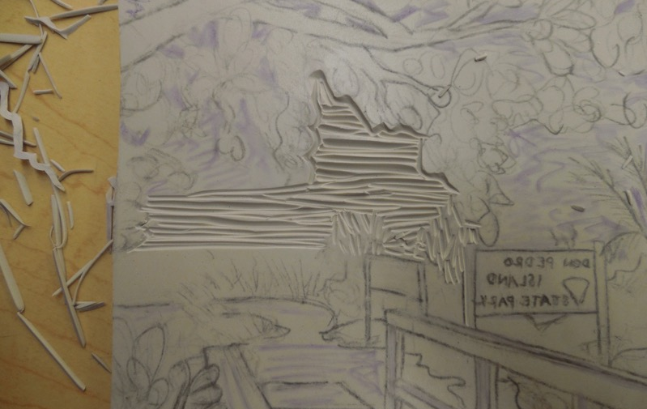
Okay, here’s my first carved part. I decided to start in the sky because a) it’s in the background and b) it’s going to be white. I do NOT go right in and carve over all those outlines! Think of your outlines as defining shapes that you will carve inside of and not true “outlines.” I also tried to keep most of my carves straight and consistent. I’m hoping that a little of the block will be left over in between passes of the lino cutter, giving my sky a little dimension instead of just being flat white.

Slide 13
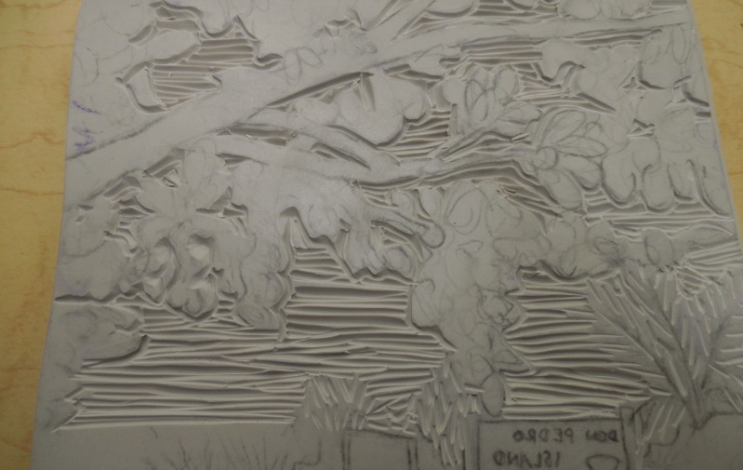
Here’s most of the sky (including the negative spaces between the tree branches and leaves where they sky comes through) carved away. On curved areas, I angle my block so I can get better leverage with the lino cutter. I can also angle the lino cutter in the palm of my hand. When I am carving a texture that should continue on behind an object, I like to start from the edge of the object and go out, instead of from the background into the edge of the object (this helps it to look like the object is overlapping the background).
My trees and leaves are going to be flat black shapes if I leave them like this; I will go back into them and carve out some textures.

Slide 14
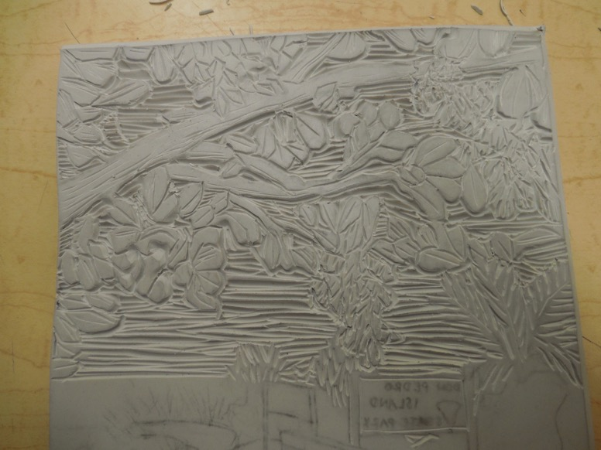
Here’s the top half of my block all carved away.

Slide 15
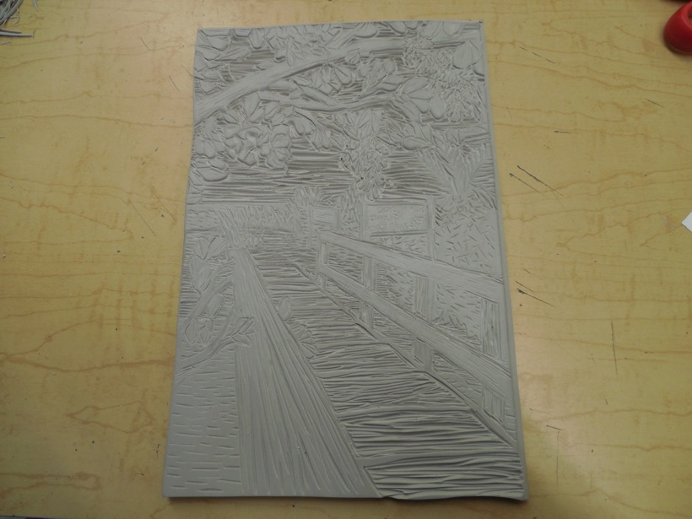
Here’s the entirety of my block all carved away. Before I print I rub over my block to make sure all the rubber pieces come off, and I usually rinse it again with a damp paper towel so I know that no little pieces will get into my print and make a mark on it.

Slide 16
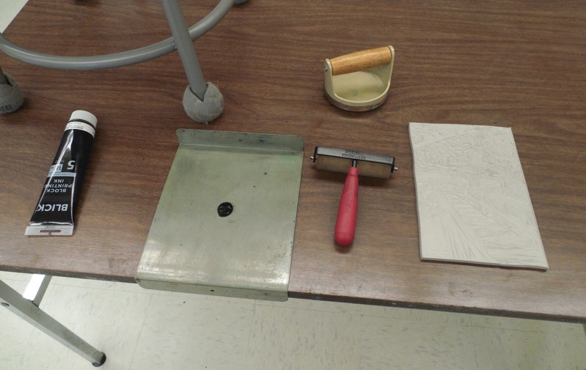
My printing “station” is all set up: I have my inking plate, ink, barren, brayer, carved block and printing paper.

Slide 17
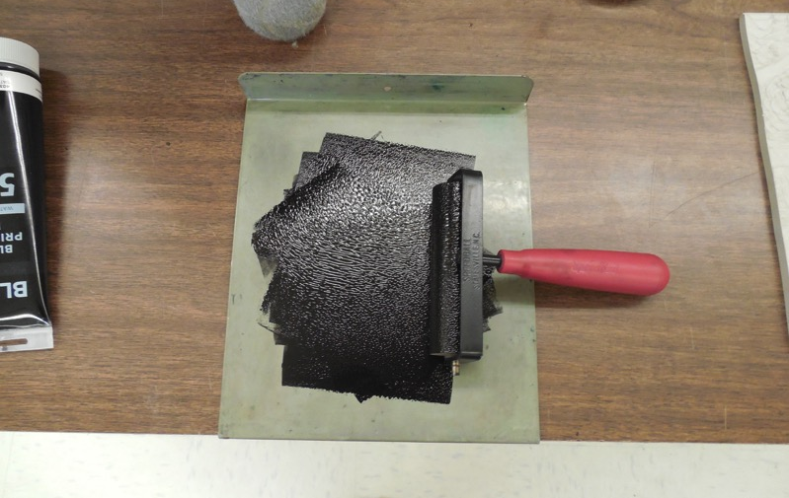
I rolled the dollop of ink into a thin layer using my brayer. I heard it crackle so I know I was good to go and it was the right consistency.

Slide 18
I rolled the ink into a thin, even layer on the block using my brayer (but I forgot to take a picture of it). I made sure I inked the whole thing evenly, and I made sure there was enough ink but not too much (it will look sort of shiny).
This is one of my favorite parts because you get to see for the first time what your black and white image will look like! (I was probably so excited that it made me forget to take the picture…)

Slide 19
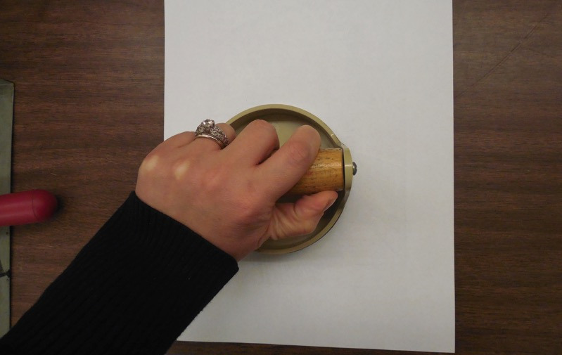
I put my printing paper upside down on the inked block, trying to get it centered (if you line the block up parallel with the edge of the table, that can help you to get your paper straight, too). I pressed the paper onto the block with my barren, applying thin, even pressure.

Slide 20
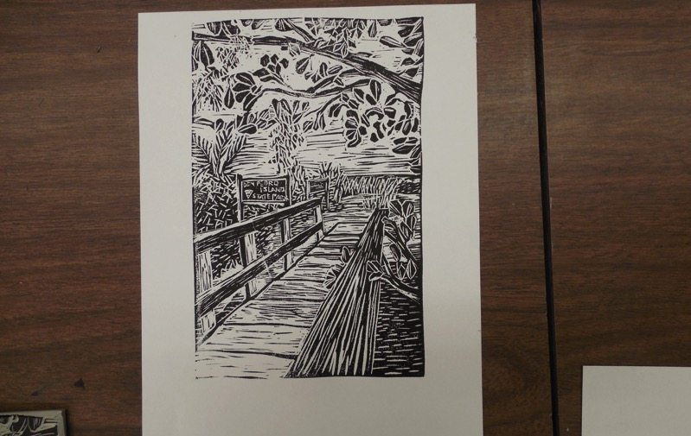
I peeled up the paper from the corner and took a look a my first print. Here it is! Now, I have to judge the IMAGE and the PRINT. As far as the image, I was pretty happy with it (I really liked how the tree came out against the sky) and I really liked the boldness of the dark shapes on light shapes (and vice versa) in the dock. I felt like the railing in the foreground was too dark. I washed and dried the block carved out a little more and printed again…

Slide 21
…and this is how it came out!
I was very happy with it overall.
As far as the printing, I felt like that went pretty well. There were a few areas that were a little fuzzy, so the next time I printed, I made sure totake extra care to press down evenly on all areas.

Slide 22
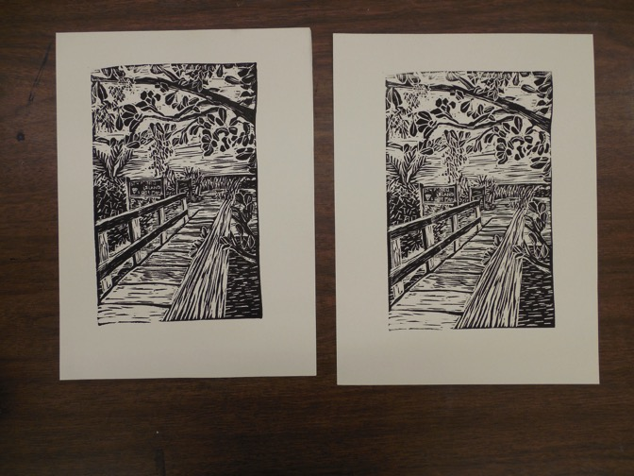
I tried inking again and printing a few more (inking the block again each time). I also tried a few different weights of paper.

Slide 23
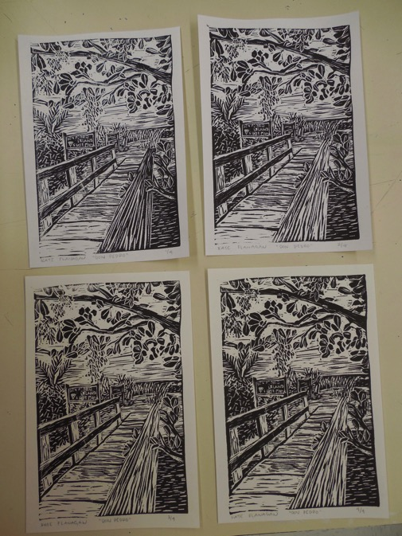
Here’s the four prints that I pulled.
I washed and dried my block so that I could print more later if I want.
I then trimmed down the edge of my paper, leaving a nice, clean even border of about an inch on all four sides.
I also signed my print at the bottom in pencil (my name, “Don Pedro” and then ¼, 2/4, ¾, or 4/4)

Slide 24
My next steps…
Now that I got a black and white print that I’m happy with, I’m thinking I might try experimenting printing with different colored inks and on different colored paper. I was thinking I might do some brighter colors (like pink and teal) to give the feeling of tropical Florida colors, or some more neutral colors to give the feeling of the wilderness.
I also took a picture and texted it to my dad (he was with me when I went on the walk where we took the original photo, and he’s also an artist, so I thought he would enjoy seeing how it came out!)

