Slide 1
Two Point Perspective
Drawing I

Slide 2
Objective
You will create a drawing of a futuristic building or structure from your imagination that utilizes the rules of two point perspective.
Your initial drawing will be in pencil and traced over in Sharpie marker, then finished off with watercolor pencil.
You will choose to draw either a futuristic:
Dream house
Public building
Cityscape

Slide 3
Process of this Unit
We will learn the rules of two-point perspective in class. We will also learn about the career of architects, specifically Frank Lloyd Wright.
You will complete a practice drawing of your name in block letters to get familiar with the rules of two-point perspective.
You will brainstorm what type of building/scene you will create for your final drawing and the details that will be in your picture.
You will create the final drawing using pencil.
The pencil lines will be traced over in Sharpie (thin) and colored in with watercolor pencil.

Slide 4
Artist Career: Architects
What do architects do? Architects design buildings and public structures. They come up with a to-scale plan of their ideas, build several 3D models, and work with a team to figure out the logistics of bringing the idea to life. Then, a construction company works to create the building.
Architects need to be creative, understand design principles, understand the strengths and weaknesses of different building materials, and be able to work with many different types of people from clients to builders.
Architects need to have a strong foundation in mechanical/technical drawing (perspective drawing is one type of this) so that when they create their plans and blueprints, they are drawn believably and accurately to scale.
When you create your building, you will sort of be doing what an architect does when he/she draws the sketch of what their building will look like. The purpose of this drawing/sketch is to give the public an very clear idea of the architects’ vision and what the building will look like.

Slide 5
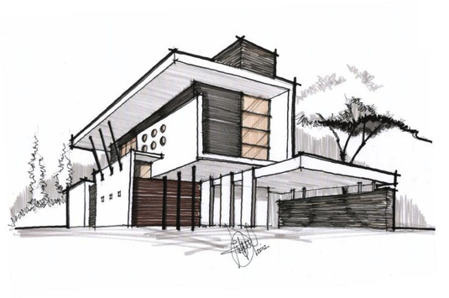
Example of an architect’s drawing/sketch (gives an idea of what the building will look like )

Slide 6
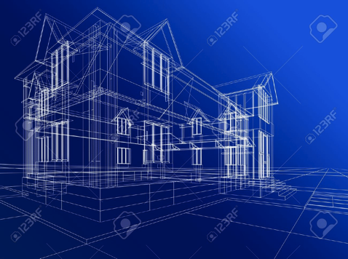
Example of blueprint (gives measurements and structural details for construction of building)

Slide 7
Frank Lloyd Wright
American architect and interior designer
Most major works designed 1900s-1950s
Designed homes as well as public buildings
One of the most prominent architects in America and the world

Slide 8
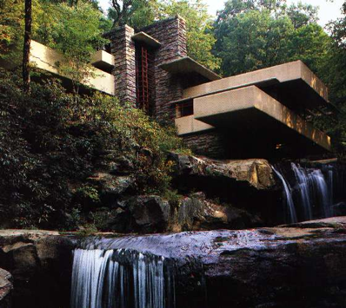
Fallingwater (Pittsburgh, Pennsylvania)

Slide 9
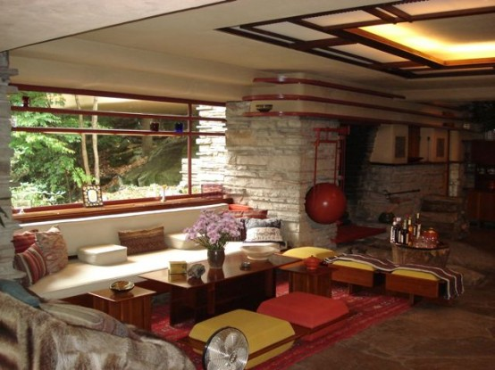

Slide 10
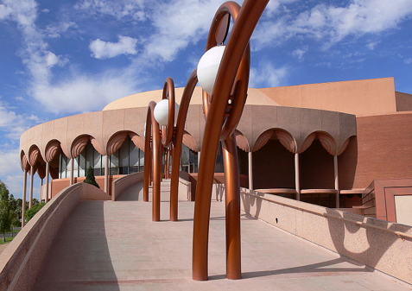
Gammage Auditorium (Arizona)

Slide 11
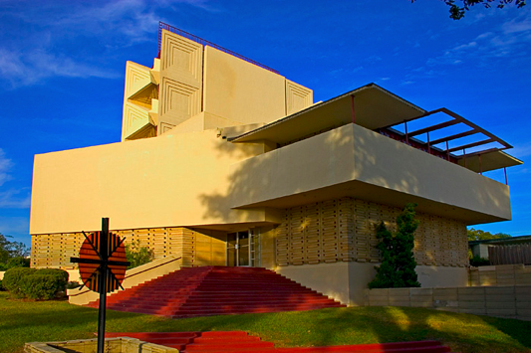
Annie Pfieffer Chapel (Florida)

Slide 12
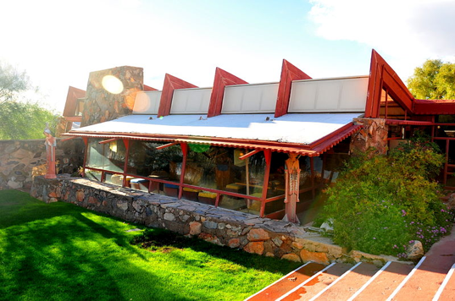
Taliesian West (Arizona)

Slide 13
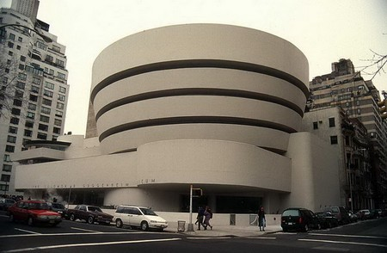
Guggenheim Museum (NYC)

Slide 14
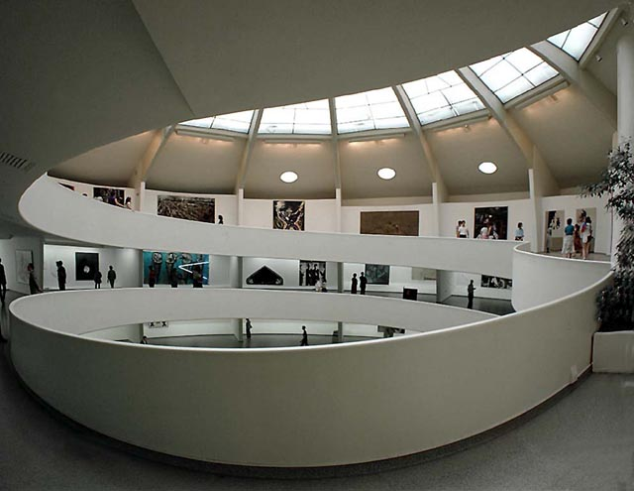

Slide 15

Atmospheric Perspective
Atmospheric perspective is the phenomenon whereby things appear smaller as they are further away in space. When we show this in a drawing, we can make our drawing look more accurate and describe depth. You will see perspective in anything you look at that has depth/space.

Slide 16
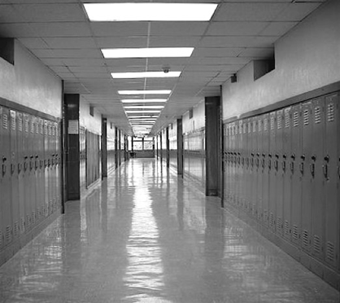
Linear Perspective
Linear perspective takes things a step further. With things that have straight edges and sides (“linear”=lines) things will appear to get smaller at a consistent rate. There are rules to linear perspective, which we will learn in this unit.
Renaissance artists such as Leonardo DaVinci were among the first to discover perspective and use it in their art so it looked more believable.

Slide 17
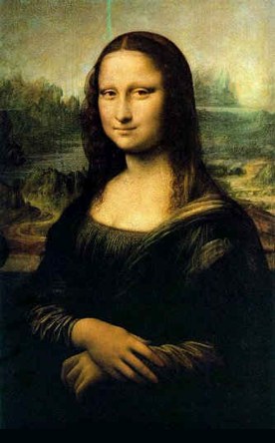
Da Vinci’s Mona Lisa
See how the trees and landscape behind the Mona Lisa appear much smaller than she is, even though we know that they are much larger in reality?

Slide 18
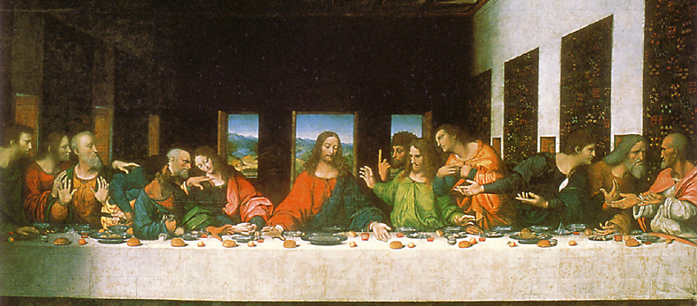
Da Vinci’s Last Supper
The same thing is going on here (the landscape seen in through the back window is much smaller than the men; the tapestries on the side walls use linear perspective so it appears that they get smaller at a consistent rate)

Slide 19
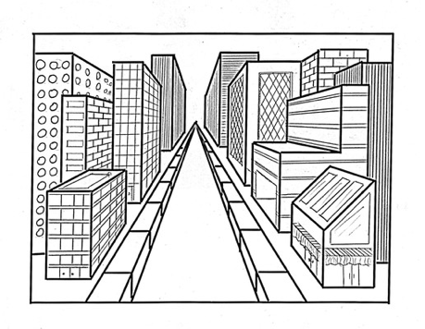
One Point Perspective
Before I show you two-point perspective (which is what we’ll be doing), I’ll show you one-point perspective. There is a vanishing point in the center that represents the farthest point that the eye can see (representing the eye level of the viewer). All sides that go away from the viewer (aka back in space) have diagonal lines that angle back to this vanishing point. Notice that the sides of the buildings that are right in front of the viewer stay straight and do not angle back.

Slide 20
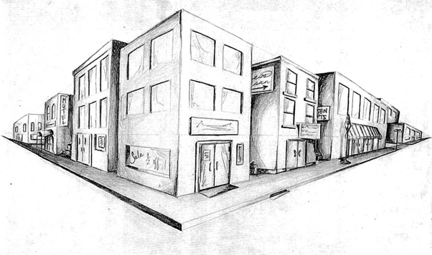
Two Point Perspective
With two point perspective, we now have two vanishing points with a central corner line with our diagonal lines angling towards the vanishing point. Notice now the left sides angle to the left vanishing point and the right sides angle to the right vanishing point. Notice how the verticals stay vertical (straight up and down).

Slide 21
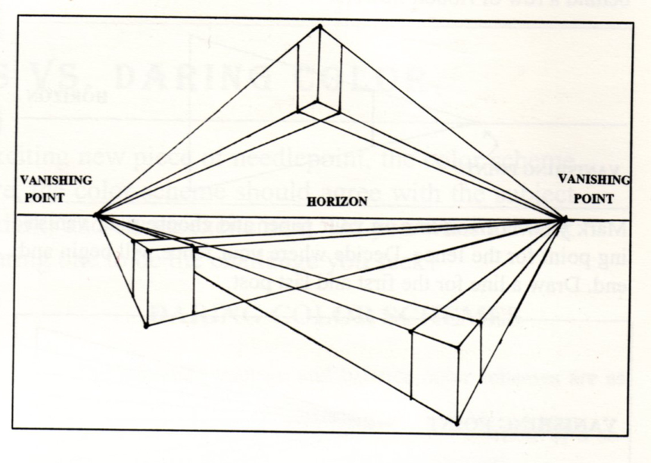

Slide 22
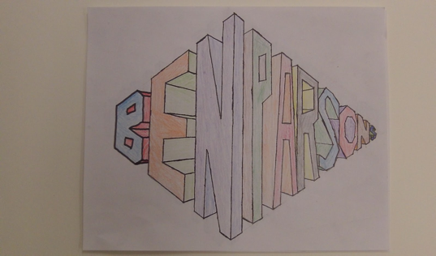
Two point perspective name practice (we’ll practice together before you do it on your own)
*Draw horizon line and vanishing points fist. Then establish center corner line.
*A few letters should be to the left of the corner line, and few letters should be to the right. It doesn't’t matter how you split up the name.
*Here’s the part that can be a little confusing…the left side always angles back to the left vanishing point, and the right side always angles back to the right vanishing point. So when you turn the corner, the letters and sides will switch which vanishing point they go back to.
*Remember that verticals remain vertical. You can use the edge of your paper as a guide to help you get the vertical edges straight up and down.
*Follow along with me now; we’ll try a couple letters together.

Slide 23
Name- procedure
Begin lightly in pencil. Use a ruler for all straight lines.
Trace over in Sharpie carefully. Still use your ruler. Erase pencil ghost lines and anything that is not part of the final drawing.
Color with watercolor pencil (these are like colored pencils but can be spread with water. Once dry, you can work back in with solid pencil). Choose a light side and a dark side to show shading. Remember that more pressure= darker values.

Slide 24
Brainstorming for building
What type of building or cityscape will you create? (Past, present, future? Fantasy? Realistic? Urban? Suburban? Country)
Be creative! Mansion? Church? Tree house? Haunted house? Shack? Cabin? Restaurant? Store? City hall? Castle? Downtown area? Etc. etc. etc. If you can dream it, I can help you figure out how to draw it in two point perspective.
List AT LEAST 20 details/features that you would find in this place. Think about the buildings as well as what would be around them in the background.

Slide 25
Your final drawing must…
Use two-point perspective fully, completely and correctly
Be creative in overall idea with plentiful interesting details (there should be a lot to look at in your drawing; it should be clear what the building is by looking at the drawing)
Show value with a consistent light source (one side light and one side dark)
Use Sharpie well (use a ruler to make edges straight)
Use watercolor pencil well (build up color; be creative with color; use both wet and dry to show overall color/value as well as texture/detail)
Be neat, careful, and quality work
You should be a good art student with good work habits. If you’re struggling with how to depict something, ask me, look at the books/posters, search online (Google “Two point perspective ___________”)

Slide 26
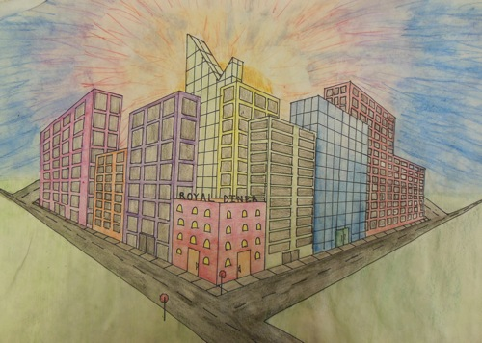
Student Examples

Slide 27
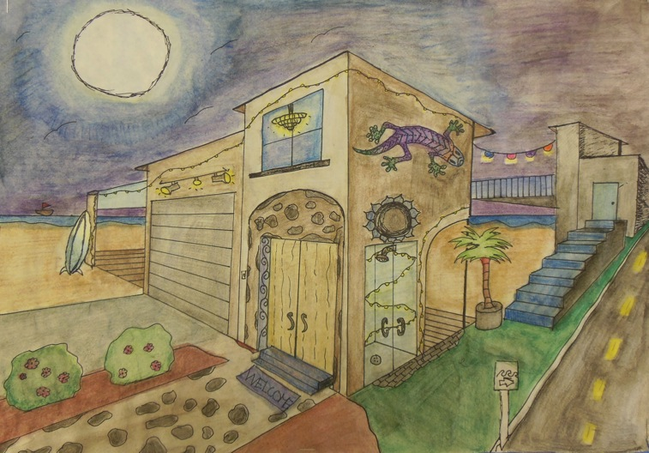

Slide 28
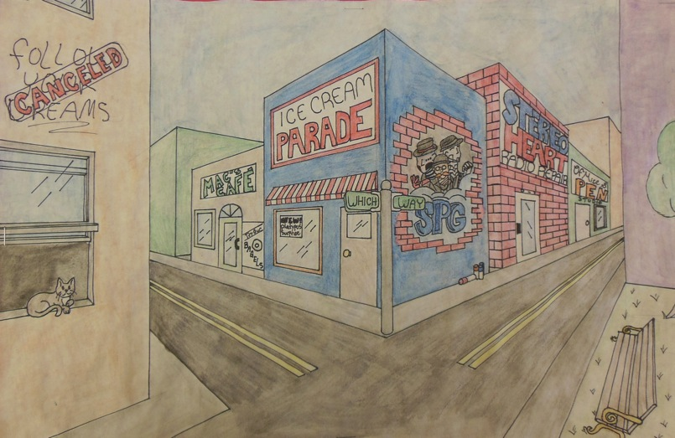

Slide 29
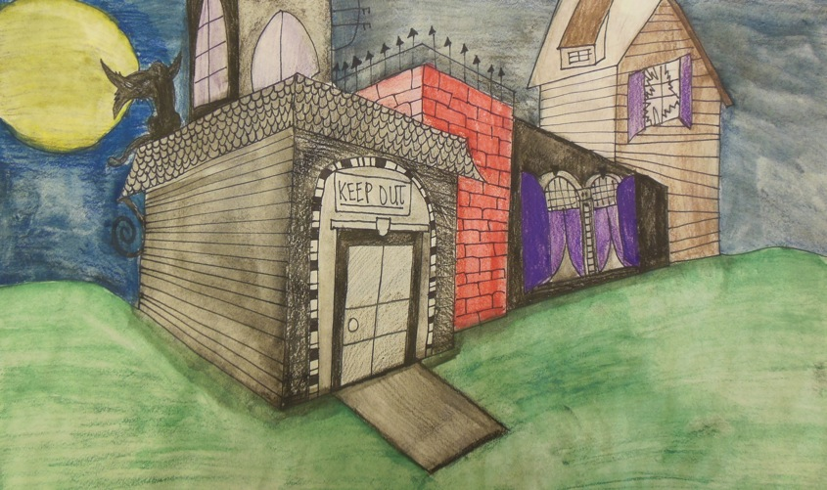

Slide 30
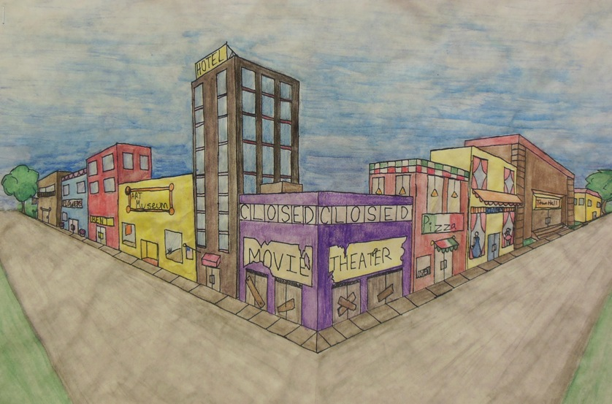

Slide 31
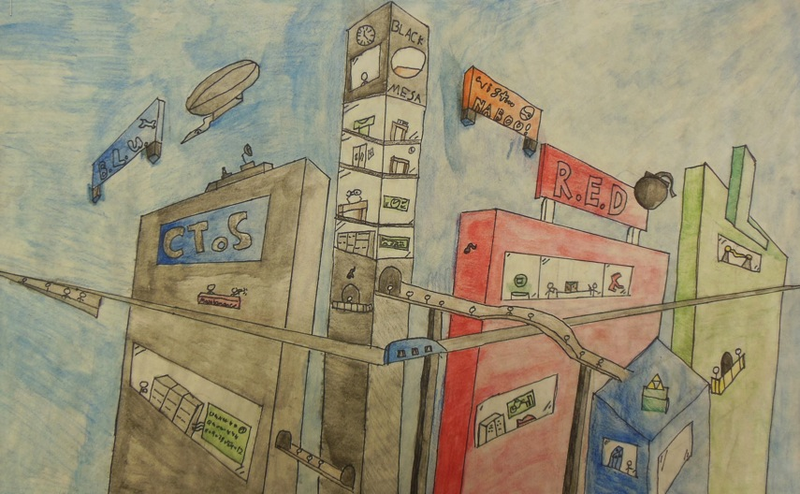

Slide 32
Timeline
4/28 and 5/2- Intro
First week in May- work on names
Second and third week in May- work on building drawing (one day to plan, two days to draw in pencil, one day for Sharpie tracing, two days for watercolor)
We’re looking to be done with these about the beginning of the 3rd week in May (the 23rd/24th ish) I’ll set a concrete date when we get closer.
If you finish yours early and want to submit it for the art show, that may be an option.

