Slide 1
Line Design
Drawing 1

Slide 2
This Project Will…
Familiarize you with different types of line
Introduce the concept of line weight
Show you how to create a strong composition using the Rule of Thirds to choose a focal area
Show you how you can create the illusion of a flat drawing being 3D
Let you practice your creative ideas and challenge you to make an intricate, captivating piece of artwork

Slide 3
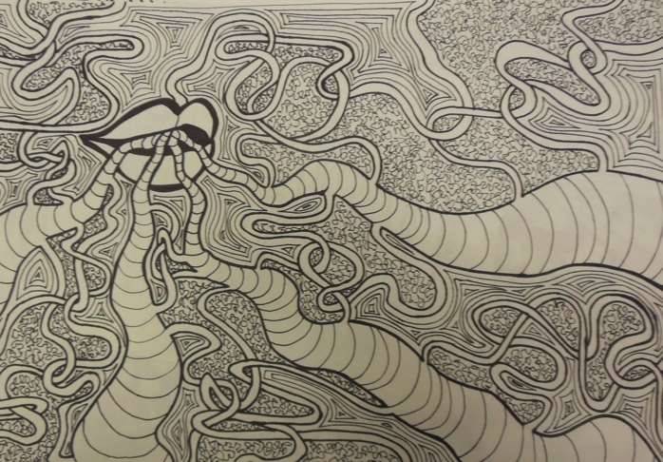

Slide 4
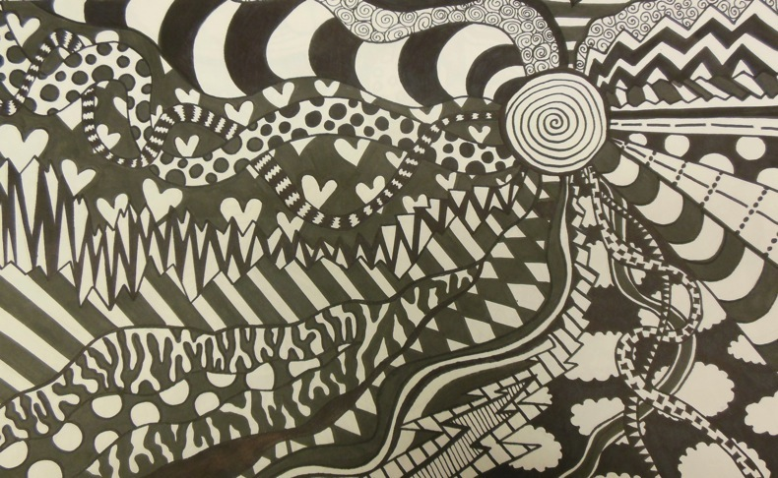

Slide 5
Composition/Focal Area
Composition- How the elements in a piece of artwork are set up to communicate visually
As artists, we are in control of where the viewer’s eye goes in our piece. We can manipulate elements of the composition so our viewers see different things in our piece.
The focal area is where the viewer’s eye travels first. This is usually the most interesting or important thing in the composition.
But where in the composition is a good place to put the focal area? Well, that’s where the Rule of Thirds comes in. This gives us a good idea of where to place our focal area in our piece.

Slide 6
Rule of Thirds
As humans, our eye naturally likes things that are arranged in threes.
The Rule of Thirds tells us that we should put our focal area a third of the way down/up and a third of the way across the page in a composition.
This might be contrary to what you would think…most untrained artists simply put the focal area in the center of the page, which isn’t always the best place.
This works for all types of art: painting, photography etc. (that’s why some digital cameras have a “tic tac toe” grid on them- so you can easily locate the thirds)

Slide 7
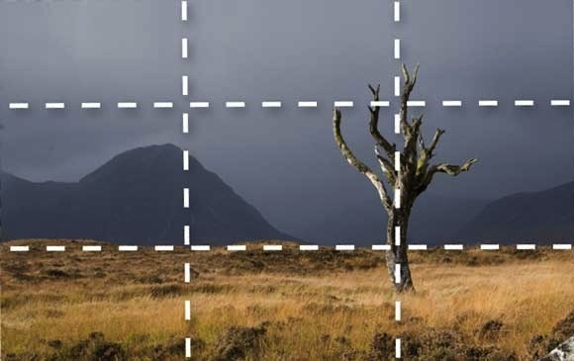

Slide 8
Line Types/Line Weight/Line Direction
There are so many different things you can do with a line! There are straight lines, curved lines, zig-zag lines, dotted/dashed lines (“implied line”).
By “closing up” a line you create a shape.
By repeating the same type of line, you can create a texture or pattern.
Lines also have line weight which refers to how thick or thin a line is (the thicker the line, the more visual weight).
Lines with more visual weight cause your eye to travel to them first. You can use this to add additional emphasis on your focal area, as well as to make your viewer’s eye “flow” around the page by evenly distributing darker, thicker shapes throughout your composition.
Line direction- Your viewer’s eye is going to follow the direction of the lines you create. You can use this knowledge to direct the eye to the focal area and around your piece.

Slide 9
Creating Three-Dimensionality in your Work
Our paper is flat or two dimensional when we draw. How can make our work look like it has the illusion of being three-dimensional?
Overlap- Making something look like it is sitting on top of something else by having the thing that is in front block part of the thing that is behind
Cross-Contour- Curving lines that look like they pop out or off the page

Slide 10
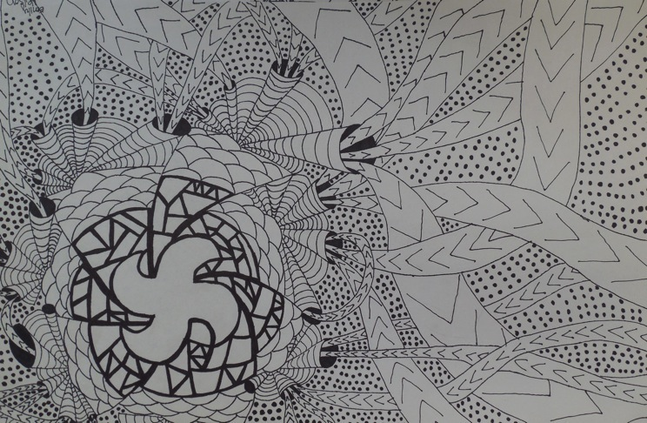
Line
Direction
Cross-Contour Lines
Overlap
Focal Area
Line Weight

Slide 11
You Will…
You will create a line design that has a clear and interesting focal area using the Rule of Thirds.
You will create a variety of interesting lines that direct the eye to the focal area.
You will fill up the larger lines with smaller lines, shapes, textures, patterns and designs.
You will create a 3D illusion using overlap and cross contour.
Your initial work will be started in pencil, then traced in Sharpie marker.

Slide 12
Your work should…
Have a variety of interesting, complex, intricate and engaging lines and designs (try to minimize cliché things like checkerboards, criss-crosses, hearts etc.)
Fill up the page well (any white space bigger than a lima bean? That’s too much!)
Evenly distribute the visual weight by having dark shapes throughout
Show thought, effort, time and development

Slide 13
Set up
Lightly, using a #2 pencil, draw a “tic tac toe” grid on your paper.
You will put your focal area at one of the intersections of the grid (hint- remember this should be the most important/interesting part. If you can’t think of what to do right away, that’s okay- leave a space to fill in later).
Erase the tic tac toe lines so you don’t get confused.
Begin creating a series of lines that lead back to the focal area.
Fill in the rest of the composition with smaller lines, shapes and designs.

Slide 14
Tips
Don’t rush! We will spend 2-3 classes on the pencil portion of this project.
If you start to run out of ideas, I have pattern and design books that you can look at.
If you have an area that you want to fill in (so it will be black) you don’t necessarily have to color that part in first with pencil.

Slide 15
When the pencil part is done…
Trace over all the pencil lines carefully and fluidly using Sharpie.
Make sure the lines are neat and precise (angle your paper, make sure the adjacent lines go all the way to the edge, don’t rest the marker in one spot for too long etc.)
Fill in dark areas evenly and carefully.
You should use thick AND thin Sharpie pens (please cap them when not in use)
Carefully erase pencil “ghost lines” with an erase to give your work a finalized, graphic look.

Slide 16
More examples- What makes these successful?
http://ledyardart.weebly.com/drawing-i.html

Slide 17
Due Date Information
Project is due with completed rubric (both sides) on February 3rd or 4th
You will have about five classes to complete your work. I would budget 2-3 for the pencil drawing and about 2 for the Sharpie tracing.
Work looses 5 points for each day that it is turned in late.
Work looses 10 points for not being turned in with a completed rubric.

