Slide 1
Oil Pastel Landscape
Drawing 1

Slide 2
Set-Up/Photo Choice
You will be creating a landscape drawing working from a photo that you have taken of a place that you have been. Try to have it be a special/memorable place, because that will make a more personal drawing.
Photo should have interesting colors.
Photo should have clear foreground, middle-ground, background (depth).
Photo should be interesting but not overly complex/complicated.
You can work from a picture on your phone or a physical copy, but you need to be able to see the features of the photo well enough to draw from it, and you should always have your photo with you in class to refer to while you are working.
Don’t like the photo you brought in for today? Find a better one for next time!
Try running the photo through a filter to make the colors easier to see or soften details.

Slide 3
Set-Up/Preliminary Works
You will create a pencil sketch in your sketchbook of the landscape photo, then experiment with color and approach by adding oil pastel to your sketch.
Tips:
-Do not be overly detailed in the sketch! Don’t sit there and spend half a class drawing every single leaf on a tree in pencil, then coloring it in! Draw the outline of the tree and suggest the leaves in pastel.
-Try to work general from specific when drawing (just like you did with the still life, sketch out loose placeholder shapes first, then go back in and refine). You can also think about starting in the background and coming forward in space as you draw.
-See the next slide for a tip about transferring an image from a photo…

Slide 4
Transferring an Image from a Photo: an Easy Technique
Find halfway across the photo and halfway down on all four sides; make a little mark showing each (estimate; doesn’t have to be precise)
Do the same thing on your paper: find halfway across the top and halfway down on all four sides; make a little mark showing each (again, estimate)
Look for what features line up with what halfway points on the photo; look for what quadrant major features are in
This will avoid the beginner mistake of accidentally making the most important thing the biggest

Slide 5
Color and Technique
Apply oil pastel (again, think about working general to specific; we should usually start in the background and work our way forward in space as we apply color)
What techniques worked well during your mini project practice? What techniques could you use in your landscape?
You DO NOT want to approach this as if you were coloring inside the lines in a coloring book with one single color in each shape. This will make your work look flat and not 3D.
Instead, look for the light source in the photo. Then proceed by coloring in different landscape features with color combo’s (remember the chart?) relative to the light source.
Also, brown works well when shading warm colors, {dark} blue works well when shading cool colors.

Slide 6
Other tips
Set up general color and form first; apply water, THEN apply texture once the wash has dried
Blend gradually to make forms seem more realistic
Try to keep the light source consistent
Use a little of all colors in all areas of the drawing, even when unexpected. This will tie everything together.
Try to let your own style and approach come through to make your drawing unique! Are you more washy or bold? Are you more blended or more hard-edge? Are you tight or are you expressive? Are you more literal or more interpretive with color? The oil pastels are versatile!

Slide 7
A couple other things…
Things appear smaller the further back in space they are (they get smaller gradually) This is called perspective.
Things also appear hazier/less detailed the further back in space they are. This is called atmospheric perspective.
Knowing where the horizon line is in the drawing will make it make sense. Things should recede (get smaller) as they approach the horizon.
If you’re having difficulty with a particular aspect (trees, rocks etc.) try Googling “drawing trees tutorial”

Slide 8
Choices?
Change colors to make them more abstract/interesting
Simplify shapes and textures for a bolder, more graphic effect
Let the wash flow and drip, creating unexpected expressive effects
Do the entire landscape using only circles/dots/dashes
Outline some shapes with a darker color so everything stands out
Work on black paper (or another color) instead of white to make the colors pop (this might work well with a night scene)
Scratch into the built-up oil pastel to create texture

Slide 9
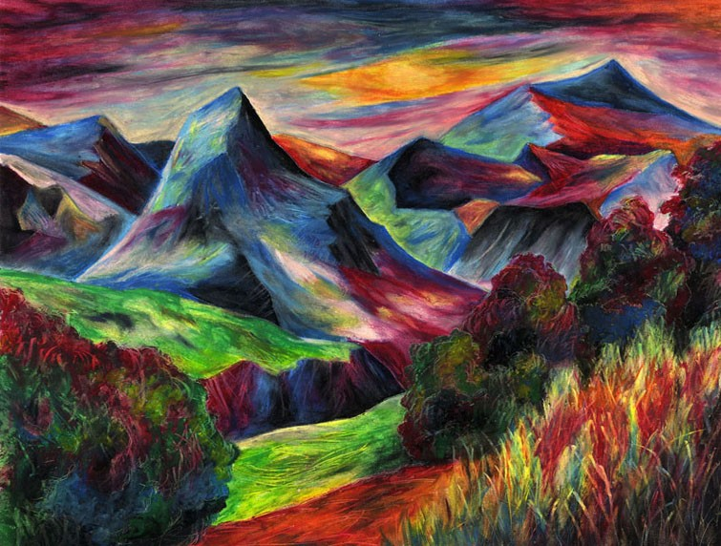
Examples

Slide 10
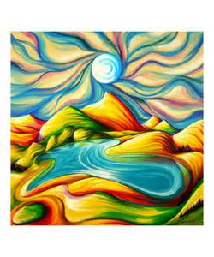

Slide 11
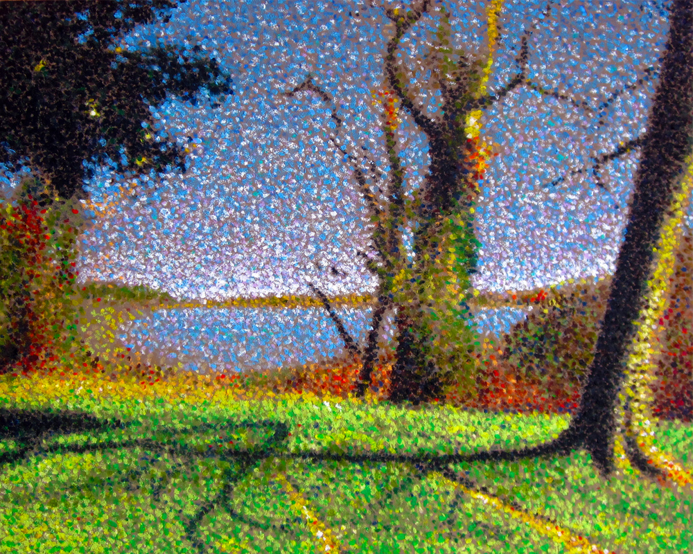

Slide 12
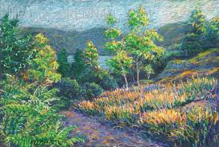

Slide 13
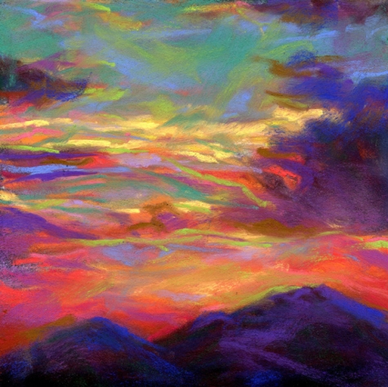

Slide 14
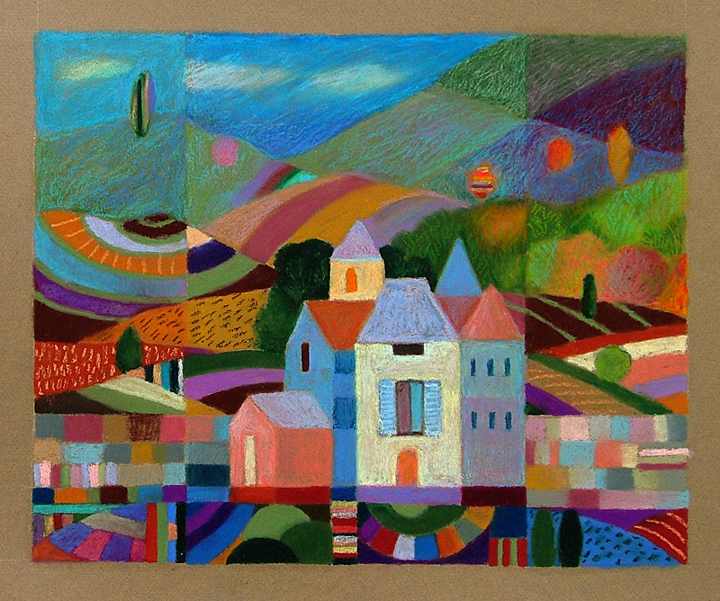

Slide 15
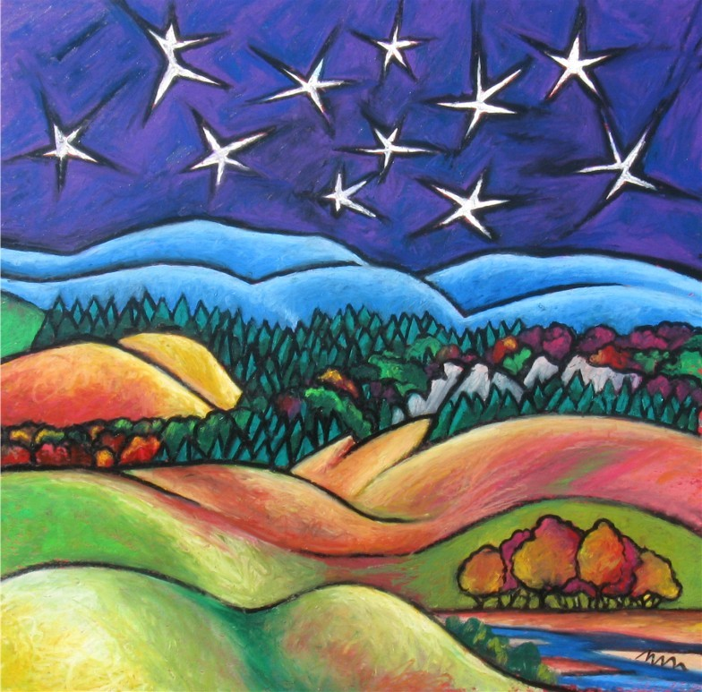

Slide 16
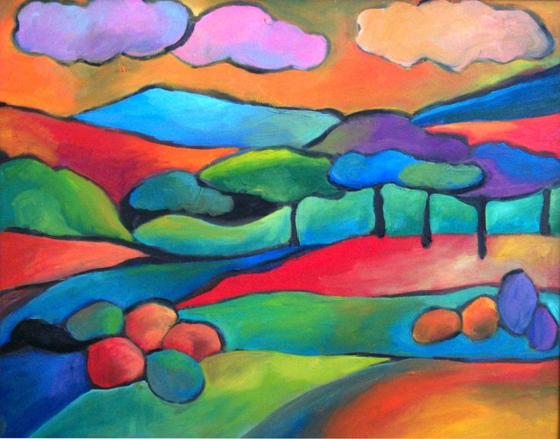

Slide 17
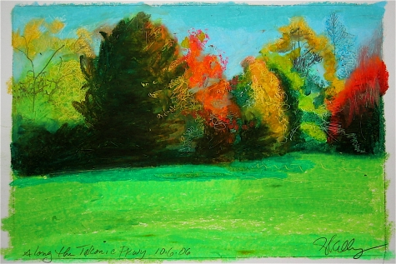

Slide 18
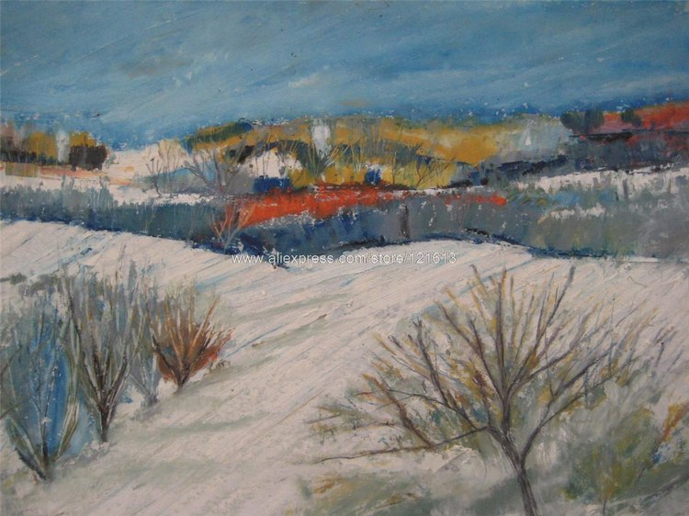

Slide 19
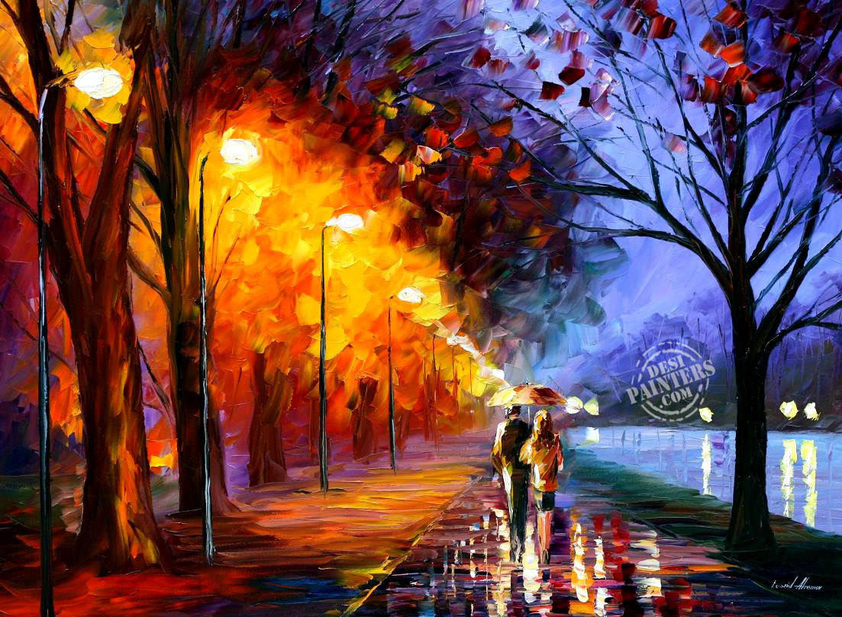

Slide 20
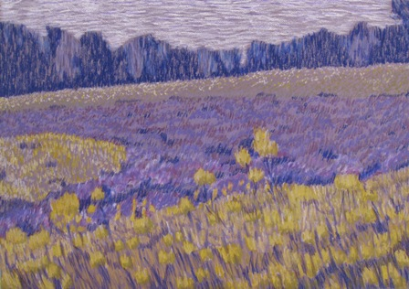

Slide 21
Due Date Information
B Day- Due October 28th
A Day- Due November 2nd
Four classes to work on this project
Fill out rubric (both sides) and submit
Work loses 5 points every day it is turned in late and is not accepted after two weeks late
Work without a self assessment/rubric looses up to 10 points

