Slide 1
Winter Design Scratchboard Etching
Drawing 1

Slide 2
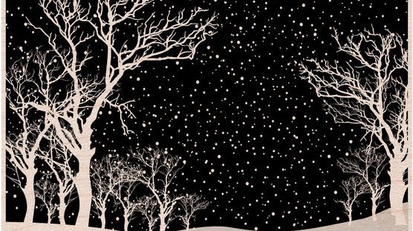

Slide 3
What is Scratchboard?
Scratchboard is a special kind of paper that has been rolled over with a very fine layer of white clay, and then the clay is rolled over with a very fine layer of India Ink.
The artist can use a scratch tool and etch onto the scratchboard. As the artist scrapes away the India Ink layer on the top, the white from underneath shows through/
Stunning, bold black and white images can be created.

Slide 4
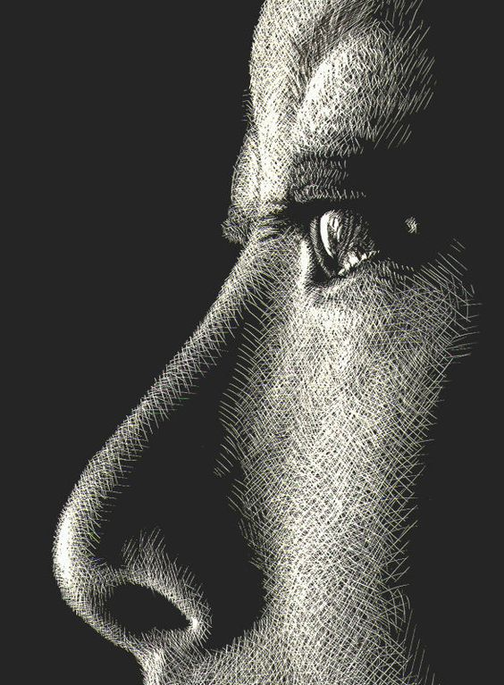

Slide 5
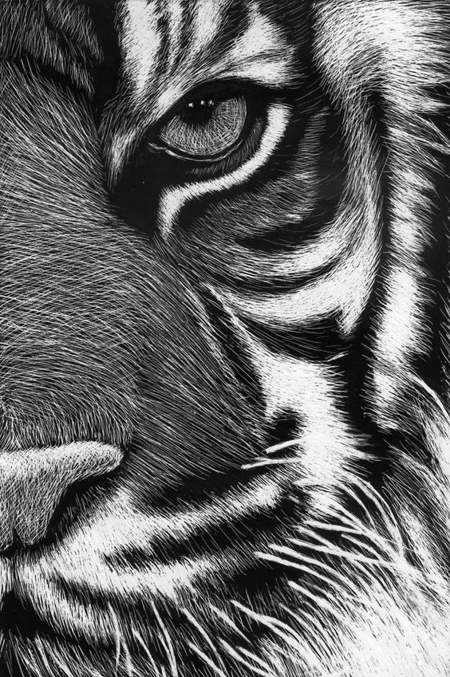

Slide 6
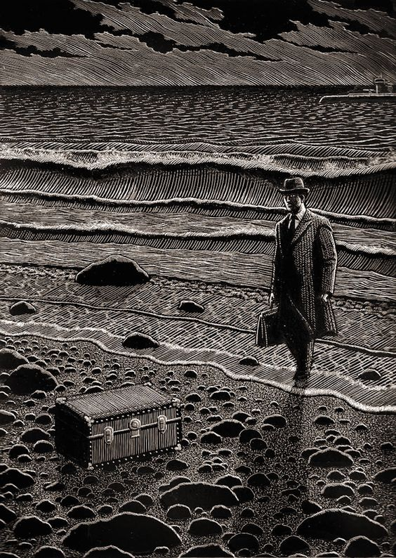

Slide 7
What will you be doing?
You will create a 7 x 11 scratchboard etching of a winter design as your subject matter (examples of things you might choose to depict will follow in a minute).
You will evenly distribute black and white areas as much as possible, and aim for a black/white balance of about 50/50.
You will focus on line quality/direction, texture, and value (etching away light values)

Slide 8
What will the procedure of this unit be?
Because of exams, this will be a FIVE day project only.
Day 1 (today)- Intro project, work on small practice scratch sheet to practice technique, draw out design on paper
Day 2- Transfer drawing onto scratchboard and begin etching
Days 3, 4, 5- Etching

Slide 9
Subject Matter Ideas- Whatever you want as long as its interesting, will look good and it relates to Winter! Be creative!
Can be outside (snowy landscape, evergreen trees, mountains, bare trees, tundra, Northern Lights, sledding, ice skating pond, winter cottage)
Can be inside (cozy fireplace, ski lodge, your bedroom on a snow day, hockey rink)
Can be a person (someone all bundled up, a snowman, kids/people playing in the snow)
Can be a thing(s) (mug of cocoa, boots, winter clothes, holly/greenery, snow globe, candles)
Can be an animal(s) (cardinal, polar bear, penguin, arctic fox, seal, owl, snow leopard, husky, your dog playing outside in the cold)

Slide 10
Cont’d…
*Can be from your imagination, from direct observation (like a photo) or combination
*Can be an actual scene or more of a design
*Can be realistic or stylized (but we should be looking at something; it shouldn’t be 100% abstract)
*Try to keep the subject matter itself fairly large, bold and simple
*Try to have a lot of opportunity to etch textures/line work
*Think about showing the light source so you know where to make lighter areas and keep it consistent

Slide 11
Process
Draw out your design on regular white paper with a #2 pencil.
When the design is all worked out, lay the paper on top of the scratchboard (tape down?) and go over your pencil lines, pushing fairly hard (use newspaper cushion?) This will press an indentation of your image right onto the scratchboard.
STOP! Don’t go right in and trace over all those outlines! You want to etch away textures and light areas first. Save outlines for last if more definition is needed. Hatching/cross-hatching are commonly utilized.
Remember, whatever you etch will become WHITE. Whatever you don’t etch will stay black.

Slide 12
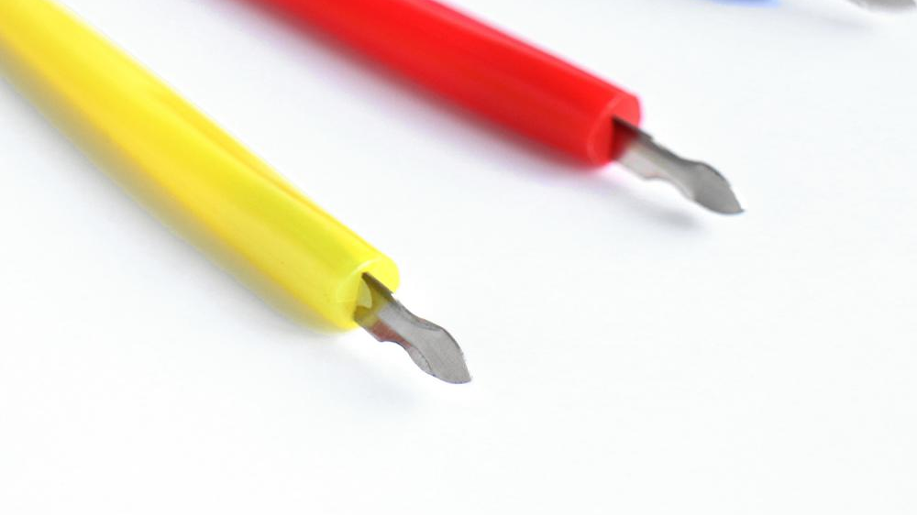
Scratch tool
*Hold the tool like a pencil (most of them have little indentations so you can get a good grip).
*I usually hold the tool so that the curve of the metal (the part with the writing) faces away from me, and I make my strokes towards me.
*I usually pick up the tool and drag forward, I don’t drag backward.
*Use the side (curved) of the tip to create thick lines and use the top (point) of the tip to create thin lines.

Slide 13
Other tips, tricks and techniques
You only want to scratch off the top layer of black ink. If you start to see fuzzy white stuff, that’s telling you you’ve scratched down to the paper layer and that’s too far. Try to avoid that.
As you etch, little black specs will come off. Stop and wipe off your work from time to time. You’ll need to clean the tables at the end of class.
The oils in your hand might get on the scratchboard and make it harder to etch or make weird marks in your work. You can rest your hand on a paper towel or scrap paper to protect your work.
You can’t put the black back once it’s gone! Don’t over etch in any one area- you can always go back through the whole thing and take out more black later on. If you’ve made a very distracting mistake, you can put black back in with a Sharpie marker.

Slide 14
What am I Looking For?
Creativity- interesting winter image; well-rendered (even if stylized)
Black/white balance (evenly distributed dark and light areas, ratio of black to white about 50/50)
Variety of line types, line weights, line directions etched to show texture and light value as well as to define objects
Care in executing work neatly (not ripping/smudging etc.)- should be your best quality work

Slide 15
https://www.youtube.com/watch?v=QmvwkiA_Y1Q

Slide 16
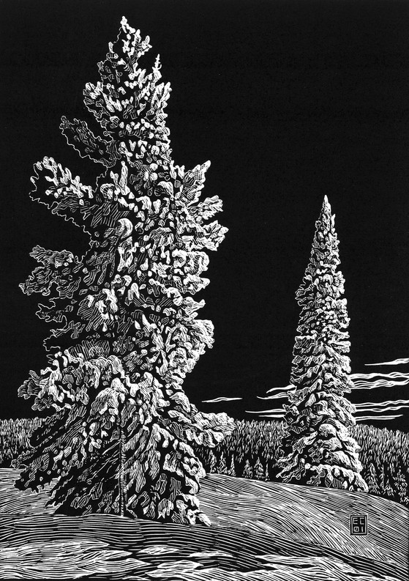

Slide 17
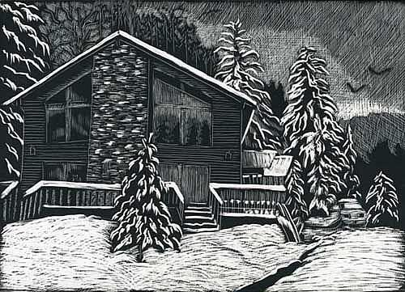

Slide 18
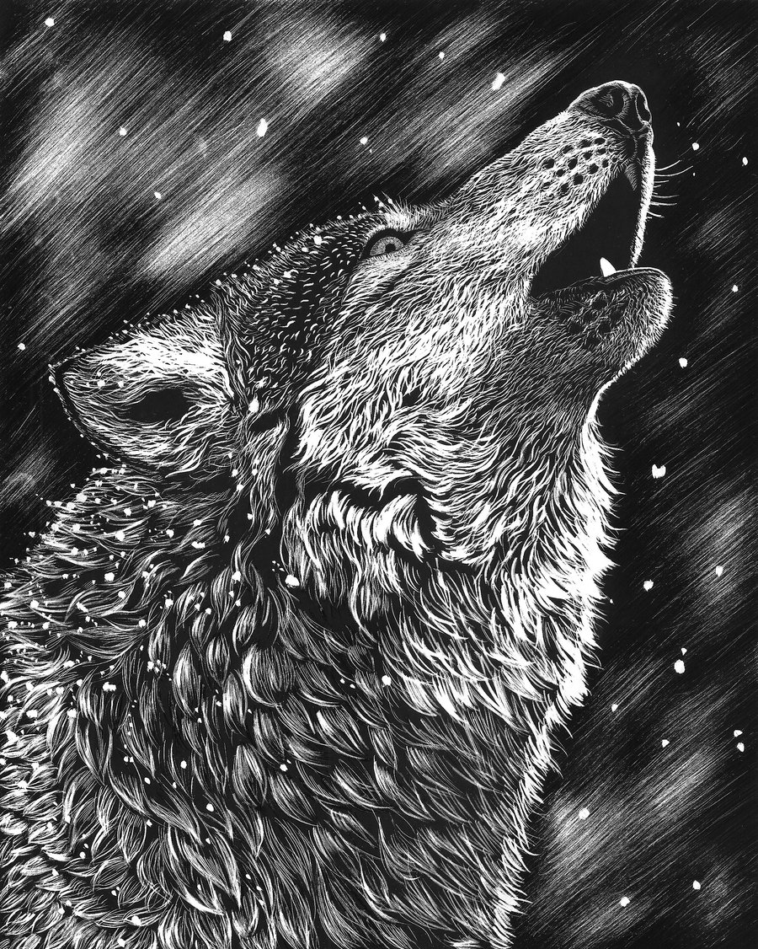

Slide 19
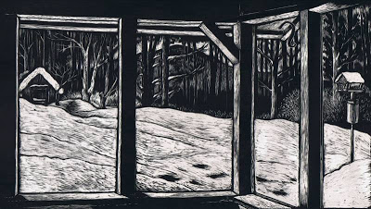

Slide 20
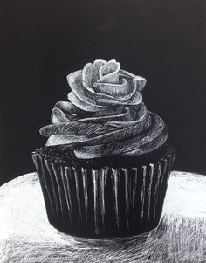

Slide 21
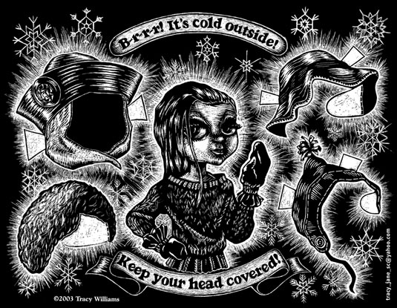

Slide 22
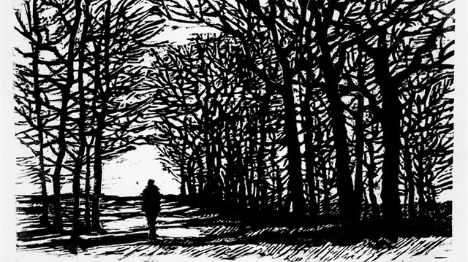

Slide 23
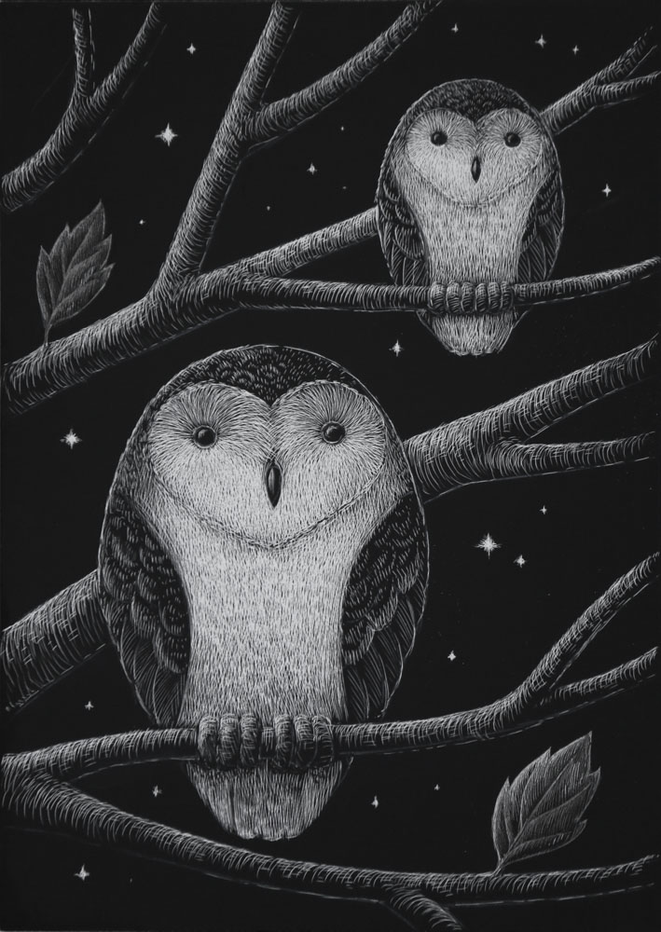

Slide 24
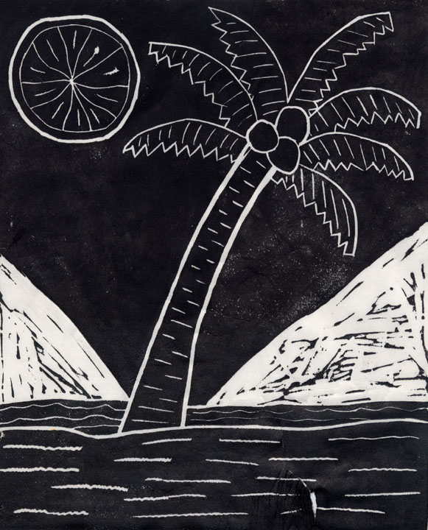
What to avoid…

Slide 25
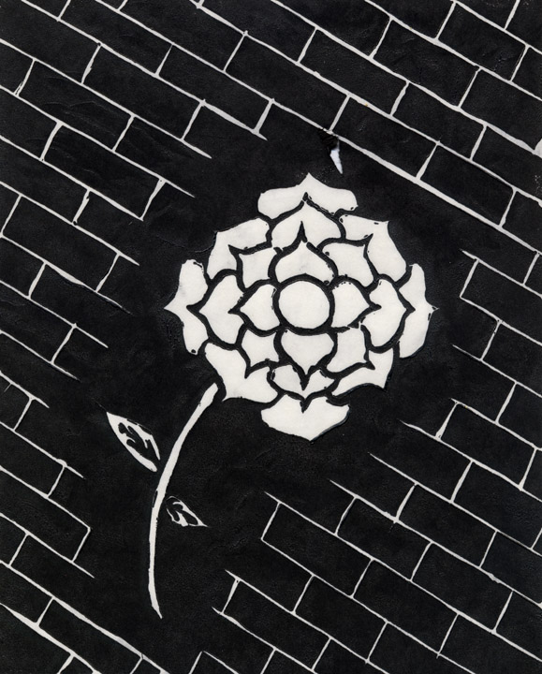

Slide 26
