Slide 1
Self Portrait: Oil Pastel
Drawing 1

Slide 2
Self Portraits- the “what” and “why”
Drawing or painting of your face/head/hair (usually from the shoulders up)
Tells what you look like physically but can also give insight into your interests and personality based on the details/style
Artists typically create multiple self portraits over a career; this shows how they change over time but, also what’s a more readily available subject to observe than your face?!
I bet all of you have taken a “selfie” in here at one point or another! A self portrait is along the same lines (before the camera was invented, this was the only option for artist selfies!) Think of this assignment as a selfie you’re going to draw using what you know about oil pastel!

Slide 3
Famous Self Portraits
Vincent Van Gogh (late 1800s)
Known for shading using colors (blues and greens); small and thick blips of paint; swirly backgrounds
Van Gogh did hundreds of self portraits throughout his career.

Slide 4
Famous Self Portraits
MC Escher (early 1900s)
Known for hyper-realistic drawings of perspective and tessellations (mathematical approach to art)
Distorted his reflection as well as the background in a gazing ball

Slide 5
Famous Self Portraits
Gustave Courbet (mid 1800s)
Known for dramatic, moody lighting and facial expressions/gestures that convey the emotions the subject might be feeling

Slide 6
Famous Self Portraits
Pablo Picasso (mid 1900s)
Known for bolder lines, exaggerated geometric shapes, gestural color application

Slide 7
Famous Self Portraits
Frida Kahlo (mid 1900s)
Known for including metaphors/symbols in her portraits that showed how she felt mentally and physically (she was injured in a very bad accident and was in a lot of pain during most of her career)

Slide 8
Famous Self Portraits
Chuck Close (current)
Known for several small squares of abstract shapes and colors that make up an image when viewed from a distance (works are very large mosaic-like painting)

Slide 9
What will you be doing?
Creating a 12 x 20 self portrait in oil pastel
You will be observing yourself carefully using a mirror
You can choose to keep the portrait more straightforward or, if you’re more comfortable to do so, make choices about how you’re depicting yourself to reveal more of your interests/personality in your work
Emphasis will be on creativity, correct facial proportion, depiction of value (planes of the head) and use of oil pastel.

Slide 10
How will we break this down?
Learn facial proportions (5-10 minute demo; follow along with me)
Practice (20-30 minutes) adapting the facial proportions to your own face as you look carefully in a mirror
Learn facial shading/planes of the head (5-10 minute demo; follow along with me)
Practice (20-30 minute) shading in the sketch of yourself as you look carefully in the mirror
“Second draft” sketch of you using oil pastel with color plan (1 class period or less)
Move onto final paper: sketch lightly in pencil (1 class period or less), show shading and color using oil pastels (2-3 class periods)

Slide 11
Facial Proportions
Although everyone has unique facial features that make you look like you do, we all are made up of basic facial proportions.
Start by blocking out the basic facial proportions, then change features so they are more unique to you.
Remember to use what you know (facial proportion knowledge/rules) and what you see (what you observe in the mirror)

Slide 12
I’m going to do a 5-10 minute demo so you learn the basic proportions. Follow along with me in your sketchbook! This will be a generic face, it doesn't’t have to look like you at this point.
After that, you’ll spend 20-30 minutes looking in the mirror and adapting the proportions to your own face.

Slide 13
Facial Shading/Planes of the Head
When you look at someone, you focus on facial features. However, that’s only the first half of what you’re really seeing.
The face is basically a sphere with indentations and protrusions. There should be an overall light side and dark side (where’s the light source?) and things that go in or stick out will cause areas of light and shadow.
If you really bring out the shading in the right places, your portrait is going to look more realistic and mature and less juvenile.

Slide 14
Let’s go back to the facial proportions sketch you did a little bit ago (the generic one- not the one of you just yet). We’re going to shade it; we’ll pretend the light is coming from the left and center. Follow along with me.
When we’re done learning about facial shading/planes of the head, you’ll practice going back into the sketch of you and shading that based on what you see in the mirror (so pay attention to the actual light source)

Slide 15
Now it’s time to put it all together!
You should have a shaded portrait reference and a shaded sketch at this point.
Now, make a “second draft” sketch in your sketchbook. This is where you get to be creative (or you can keep it a little more straightforward if that’s what you’re comfortable with right now)
Think about:
-Color scheme (Realistic or abstract? What color combo’s will you use to show value? See the chart!)
-Pose (Straight on or side view? Calm or expressive? Any interesting details included?)
-Oil pastel approach (Careful or gestural? Lots of pastel built up or more washy?)
-Background (Plain color? Pattern? What you actually observe? Imagined?)

Slide 16
Final Product
When you’ve mostly figured out what you want to do, start on the large paper. Sketch in pencil first (light outline only) then begin to add color.
Your hair and shirt will probably change from day to day. Try to finish those parts in one day to make it easier on yourself.
You’re going to mess up if you’re talking a lot- not only does it break the concentration but it changes the way you look in the mirror when your mouth is open!
Remember to work in layers; work gradually. Use water, let it dry. Refine and develop little by little. Stand back often. Take a pic and look at the thumbnail.
Have fun and enjoy your work- it will show in the final product! You may not realize it, but this drawing will be just like a school picture in a way, only more authentic; this is how you look right now at this interesting teenage stage in your life. Your drawing will reflect who you are physically and personality-wise in this moment.

Slide 17
Student Examples
http://ledyardart.weebly.com/drawing-i.html ← Link to LHS student examples (What makes these successful? What could make them stronger?)

Slide 23
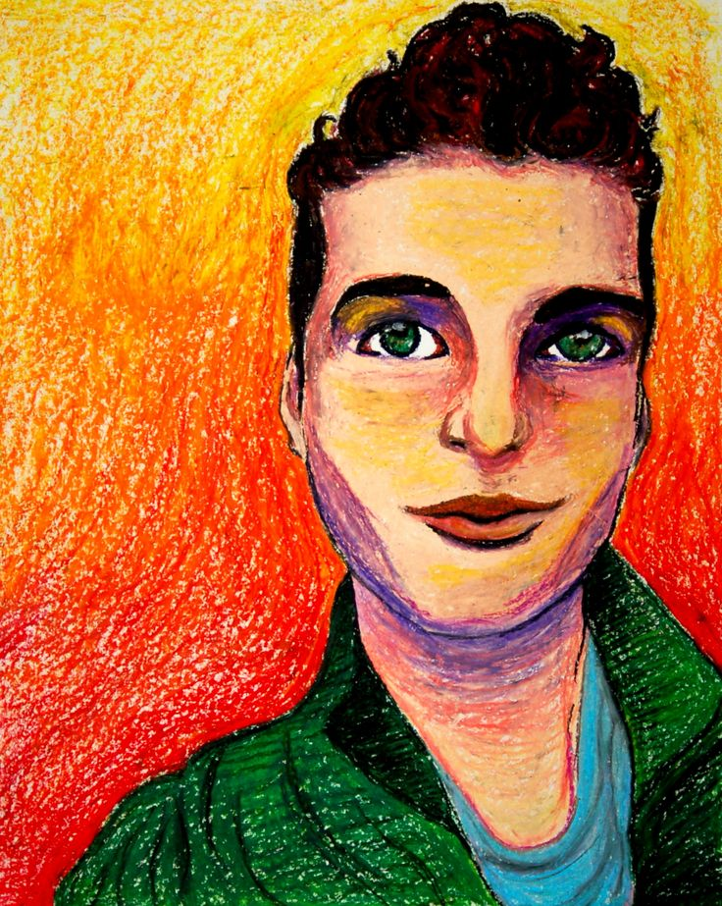

Slide 24
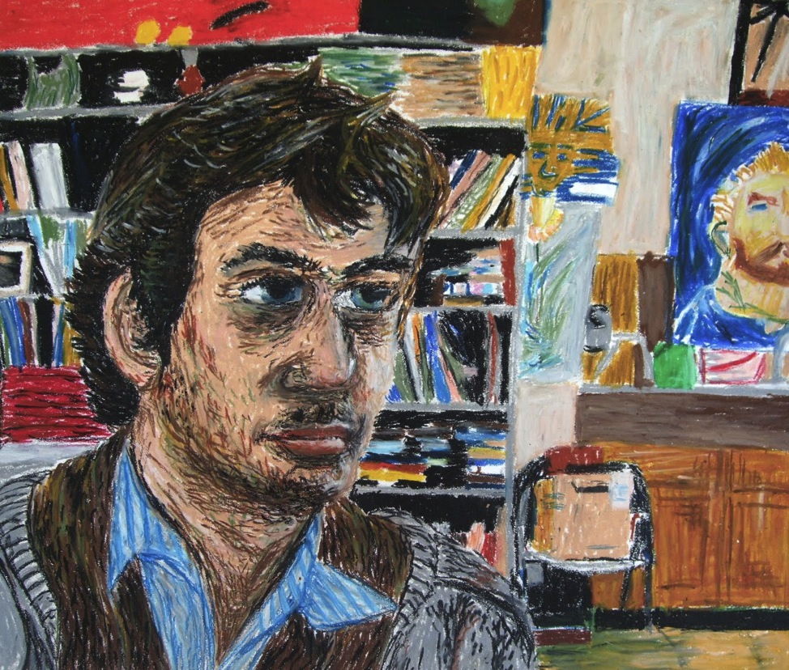

Slide 25
What am I looking for?
Awareness of correct facial proportions
Awareness of correct/consistent facial shading/planes of head (contrast; not flatness)
Careful observation at all times
Creativity/unique choices/sense of personality
Proficiency with oil pastel (color schemes; wet and dry approach)
Care and pride in work
Good effort, willingness to grow, positive attitude, good use of class time

Slide 26
Timeline
Day 1/2: Intro (learn about proportions and shading; practice with self in mirror)
Day 2/3: Second draft sketch (figure out creative approach and color plan)
Day 3/4: Final paper: line drawing
Days 4, 5, 6 and 7(if needed): Developing oil pastel
Self portraits due: April ___________

