Slide 1
Self Portrait
Oil Pastel

Slide 2
You Will…
You will create a self portrait.
You may work from a photo (on your phone or I can print a pic out for you, or take one and print it out- I also have mirrors.)
You have the choice of using charcoal (working in black and white/grayscale) or water-soluble oil pastels (color)
You can work on 16 x 20 or 18 x 24 inch paper (big or really big)

Slide 3
Your Work Must…
Make good use of the space on the page (the head/face should take up 75% of the paper or more)
Apply knowledge of the facial proportions we learned in class
Show facial shading with a clear and consistent light source (not a flat face/head)
Show careful observation and attention to detail, as well as using the resources and information from class
Make good use of the chosen medium (showing a range in value, showing texture/dimension, possible showing color changes)

Slide 4
Procedure
Once you have your chosen photo, create practice studies in your sketchbook. You can do a plain pencil sketch, and you can also practice adding your chosen medium.
When you get the final paper, sketch out the major outlines lightly in pencil first. It helps me to use the guidelines and block out the facial features using the proportions like we learned in class. Don’t forget to erase your guidelines before adding medium! You might also want to lighten up outlines.
Begin applying your choice of media (more about the different types in a minute…) I would suggest to fill in large areas of color/value first, then refine details little by little.
Don’t forget to resolve your background!

Slide 5
Charcoal
Two types available: vine (comes in black only) and pencil (comes in black or white)
Vine: small sticks (its okay if they break), very soft and smudges nicely; you can create excellent tonal blends, while still maintaining contrast.
Pencil: comes in pencil form (some types you sharpen, some types you peel), a little harder lead but still able to smudge somewhat; you can do detailing, texture work, and build up line work to show volume. Black is great for showing darkest darks, white is great for showing brightest highlights.
Can be smudged with a finger or with a tortillon. Needs to be erased with a kneaded eraser.
I would suggest working in overall color and form with the vine charcoal, then working in details/textures, darkest areas and defining with the black charcoal pencil. You can erase out highlights and show bright highlights with the white charcoal pencil.
Heads up- don’t smudge as you work; be really aware of where you’re putting your arm/hand and be careful, because the charcoal smears super easily. We can spray your work with fixative to help set it a little at the end, and you can also wrap some newsprint around it when putting it in the folder to protect it.

Slide 6
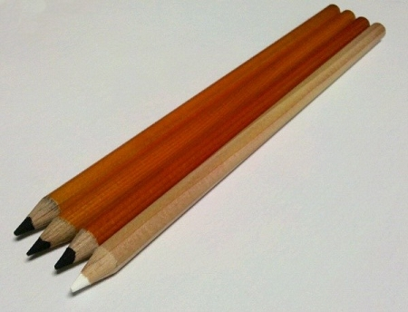
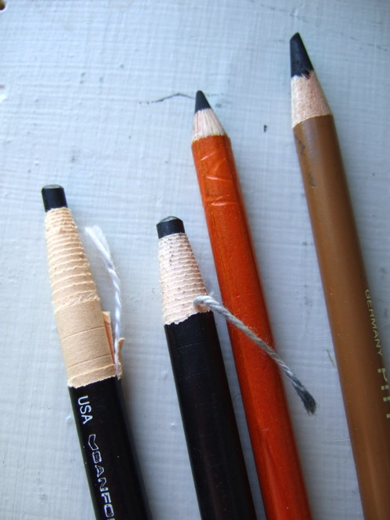
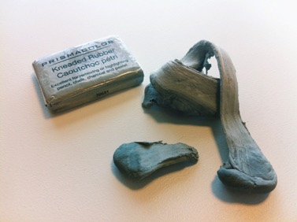

Slide 7
Oil Pastel
You know how to use these pretty well at this point…remember that you can use them all dry and really build up for a bold/juicy/colorful look, or use lots of water with them for a more muted/washy approach (or a combination).
Remember you can show the local color (what color things actually are) and you should also show the value color (the light and shadow color).
You can choose your color scheme:
-Realistic (things are what colors they would be)
-Interpretive realistic (things are what colors they would be, but there are unexpected colors worked in)
-Limited palette (there have been only a few colors utilized; there may be some realism, but it has been mostly interpreted in a new way)
-Abstract (the colors have been re-interpreted in a non-realistic way)

Slide 20
What to avoid…
Heavy outline, little shading (where’s the light coming from?)

Slide 21
Not paying attention to correct facial proportions and over-simplifying facial features (also the heavy outline and lack of shading) will make your work look very child-like

Slide 22
How to finish the background?
Single color/tone- gets the job done but kind of boring
Gradient (relative to light source)- better; more interesting. Can be understated, yet dramatic.
Pattern/design- can look good if you match the colors/style so everything is unified
Observed background- What you actually see in the photo behind you (sense of context/setting/background) Interesting because it gives you a sense of who the person is due to the place that they are in
Imagined background? What could you imagine that would be in the background? Could you give us an idea of your personality/identity/individuality? This might be the most interesting, because it will be unique to you as an individual.

