Slide 1
Still Life Drawing
Drawing 1

Slide 2
What are we doing?
We will be drawing a still life from observation.
A still life is a set up of objects arranged in an interesting way. Since the objects do not move, the artist can carefully look at them over a long period of time.
Drawing from observation means that you are drawing from real life (not a picture, not your imagination).
For this project, your teacher will be setting up the still life arrangement for you at your table.
The first part of this lesson will involve placement and depiction of 3D forms.
The second part of this lesson will involve shading.
We’ve moved on from working from our imagination and now we are trying to make a drawing as accurate and realistic as possible based on what we see.

Slide 3
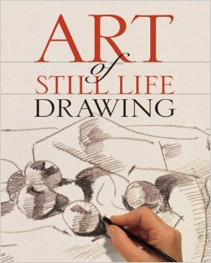
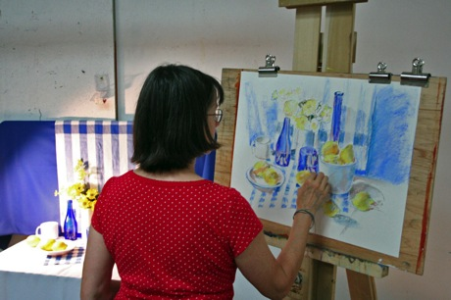
Still Life: Looking and Knowing
The key to a successful still life drawing is constantly looking carefully at what you’re drawing but ALSO keeping in mind certain rules and tricks and using them as you draw. This presentation will focus on the second part of that (rules and tricks). Your teacher can’t crawl inside your brain and make you keep looking at what you’re drawing, but she can point out certain things that will give you an easier time and make your drawing stronger/more accurate. It’s up to you to follow through.

Slide 4
Before you even start drawing
Make sure you can clearly see the still life arrangement. Make sure you sit the exact same way in the exact same spot if you don’t finish the drawing in one sitting (which you won’t). Make sure you’re pretty close but not too close. I’ll put a still life at each table and you’ll be sitting around it, so this will make things easy.
Think about how you will hold your paper, vertical or horizontal? (Are the objects arranged so that they sit more wide or more tall?)
Make sure you draw large enough; you want to fill up the paper but everything should pretty much fit on the paper. A good rule of thumb is that the objects should take up 75% of your page. Some people say that there should also be something interesting to look at in all four corners of the page (as well as the center, of course).
Train yourself (and this takes practice) to look at the still life and look at the paper back and forth all the time. You’ll probably spend a few seconds looking, a few seconds drawing. Back and forth, back and forth always.
Don’t finish any one part of the drawing before working on another part. Your drawing should grow as a whole, little by little. The four steps are:
1. Placeholder shapes
2. Creating 3D shapes
3. Refining the outlines
4. Shading

Slide 6
Blocking it out: Placeholder Shapes
We are first going to make what are called “placeholder shapes.” These are a rough outline of the objects on our paper and where they sit in space. You’re working out basic placement and proportion; you can always go back and fix these later, but it’s giving you a starting point.
Be loose with your pencil at this point. Swing LIGHT and LOOSE lines. You might hold your pencil on the side. At this point, you can make “sketch lines” that are broken and imperfect; we’ll fix them later.
Your still life objects should be slightly bigger than life size.
Start in the middle (what object is in the middle of the arrangement? Put it in the middle of your paper) and work your way out.
Don’t forget to establish the surface that the objects are sitting on.
We’ll move on to filling in these placeholder shapes with more clear 3D shapes next.

Slide 7
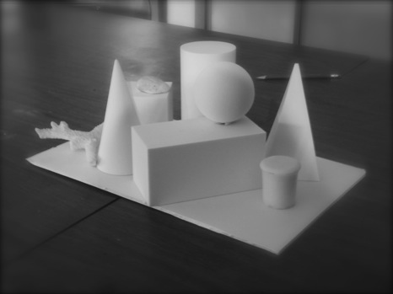

Slide 8
Drawing 3D Shapes
The objects you see have edges. The 3D foam shapes especially might have angles and surfaces. The trickiest part about this is going to be drawing what you see instead of what you think you know.
Start with one placeholder shape, and move through one at a time. Still keep your lines light and loose (you’re going to have to go back through and fix things and move things around).
The biggest tool that will help you here is to look at edges and where they intersect. Similarly, you can also draw imaginary lines up and down or side to side to see where objects line up with other objects.
Using a ruler and an eraser breaks the hand/eye/brain/drawing flow. Try to not use them until the refining stage.

Slide 9
Still Life: What You See

Slide 10
Still Life: What You Imagine-
Points of Intersection

Slide 11
Still Life: What You Imagine-
Lining Up Features

Slide 13
Refining the drawing
When the basic outlines are in tact, go back through and check and refine your drawing.
Depending on how well you did drawing the 3D shapes at first, this may mean significant revision or it may mean minimal revision.
Check your proportions- how big is an objects’ width to its height? How big is an object related to another object? How big is the top face of an object compared to the side?
HINT- The sphere and the cube are roughly the same size. The cylinder, rectangle, cone and pyramid are all about the same length. The lengths are roughly double the heights.
Check your negative spaces. These are the spaces around and between objects. Looking at them will help you draw the objects more accurately (it forces you to look at them in a different way).

Slide 14
Still Life: What You Imagine- Proportions (demonstration)

Slide 15
Still Life: What You Imagine- Negative spaces/shapes

Slide 16
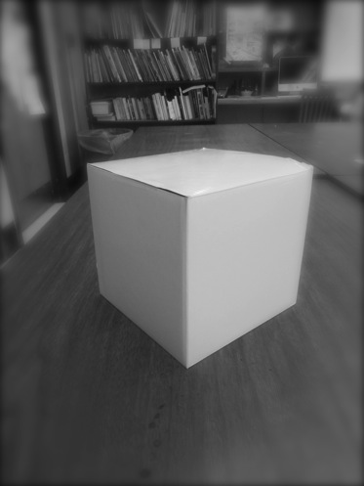
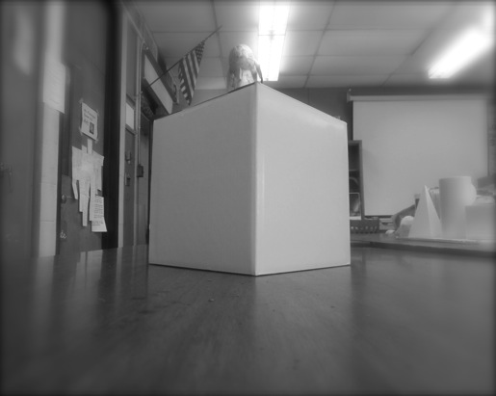
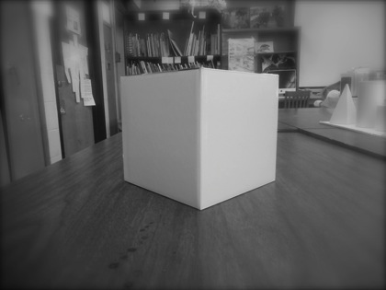
A Tutorial on cubes/3D rectangles
Cubes and 3D rectangles are three sets of three parallel sides.
Depending on where your eye level is you may be able to see more or less of the top (higher=more; lower=less and more to the left/right based on where you’re sitting).
When the top of a surface appears flattened/squished because of our eye level, we say that it is foreshortened.

Slide 17
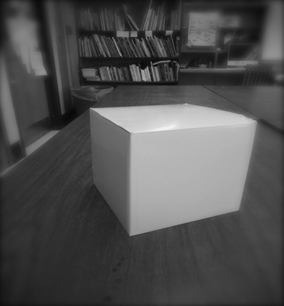
Rotating Cube- Notice how the center shifts and you can see more/less of the left/right side

Slide 18
Three Sets of Three Parallel Edges
Note: I took a picture of a cardboard box to show this concept. The cardboard sides had caved in a little, so they’re not completely straight. The cubes and 3D rectangles you’ll see in your still life arrangement are going to be perfectly straight.

Slide 19
Other things
Overlap- Things sitting in front will block what’s sitting behind them (don’t make them look see-through when they’re solid)
Higher on the paper= further back in space (you’re looking down at the objects but also out at them)
Don’t forget your “horizon line” (where does the table meet the background?)
Don’t forget your base (look at where the edges run in with the objects)

Slide 20
Sorry for the terrible squiggles…I was drawing with the mouse pad on my laptop…
Overlap

Slide 21
Background surface in front of you
Flat surface going away from you
Horizon line
Higher= Further
Lower= closer
Draw the base! Look at where it runs into the other objects. It, too, will be foreshortened.

Slide 22
Part Two: Shading
Remember what you know about value. We can see a range in value from dark to light. You will be have to demonstrate at least four to five different different values in your work.
Instead of just placing values randomly, you will create dark and light areas based on what you see and observe (we’ll see rules on how to do that on the next slide)
Almost all areas of your paper will have some value on them (background and surface included!)
The spotlights will be on so its easier to see the shadows. The objects are all white so its easier to see the shadows, too.
Your natural objects will also have texture on them. Establish value first and establish texture next.
Our goal is to minimize outlines.

Slide 23
Shading: all about Light Source
The light source is where the light is coming from.
The objects will be lighter on the side closer to the light source, and darker on the side that’s further away from the light source.
Objects will cast a shadow away from the light source onto surfaces (right under the object or onto other objects). You can draw these cast shadows in as shapes and fill them in with a dark value.
Objects with flat surfaces will utilize hard edge values because the light hits the side evenly.
Objects with curved surfaces will utilize gradated values because the light dissipates gradually.
The MAIN light source are the spotlights at the front of the room. However, depending on where you are sitting, you may also have another source of light from the window or the hall.

Slide 24
Light is coming from the left. The left of all the objects will be lighter, and the right will be darker.
Cast shadow
Hard Edge Value
Gradated Value
Hint: Squint your eyes to help you easily see the values.
Demonstration: Where are the light, medium and dark areas?

Slide 25
Remember
More pressure=darker values
Maintain contrast for a dramatic drawing
Bring value right up to the edge of hard-edge shapes
Make marks in the direction of the objects’ form (curve lines on spherical objects; straight lines on flat objects)
Value first, texture second
Don’t forget to resolve background and surface (this will also be lighter closer to the light source)
You can “pull out” value with an eraser
Remember to draw what you see and draw what you know!

Slide 26
I want to see…
Good use of the page; objects take up 75% of the paper; there is shading on 90% of the paper
Objects are placed correctly and proportions are correct
3D shapes are drawn correctly
There is a range in value (at least four distinct values) accurate to what was observed
Objects are shaded to describe their volume
Outline is minimized
Careful observation AND using what you know (and showing it in your work)
Care and effort

Slide 27
One Thing to Note…
Your verbal and observational parts of your brain are in opposite hemispheres. This means that you physically CANNOT carry on a lengthy conversation and carefully observe at the same time. Remember that “flow” between looking, thinking and drawing that we need to constantly be doing? Every time you talk, that breaks the flow, and you have to re-focus yourself. You can’t be talking a lot if you want to be successful during this project.

Slide 28
Another thing to note…
DRAWING 1
This process is hard. There’s no two ways about it. I’m not looking for photographic accuracy; I know that for many of you, this is your first time doing a still life. I want to see that you are using the things I am teaching you, looking carefully, asking for help when you need it, and trying your best. I promise if you do those things, you WILL get better.

Slide 29
Student Examples

Slide 33
Due Date Information
This project is due with a completed rubric on March 3/4th.
Work looses five points for each day it is turned in late.
You cannot take this home because the still life’s have to stay in the classroom. You can come in extra time after school and maybe during study hall, but if I have another class going on, it’s going to be difficult to work at your same spot and see the still life the same way. This means that you really have to use your class time well.

