Slide 1
Ornament Reflection Self Portrait
Drawing 2 Final Exam Project

Slide 3
You will…
You will create a hyper-realistic observational drawing of yourself shown in a reflective ornament (the spherical ones that are usually made of glass or plastic and reflect a distorted mirror image).
You will work on 14 x 14 paper.
You will choose from the following media:
-Graphite (ebony and #2 pencil)
-Pen (stippling with Sharpie- thin and pens)
-Colored pencil (professional ones)

Slide 4
Your work should…
Demonstrate very careful and accurate observation (your work should be hyper-realistic, so it will almost look like a photograph)
Have a strong range and contrast between dark and light areas
Depict yourself and the background as it is reflected and distorted in the ornament
Demonstrate a proficiency with your chosen medium
Demonstrate the utmost precision, neatness, care and craftspersonship (I’m having you work small and giving you a good chunk of time so that you can really develop these)

Slide 5
MC Escher
This project idea was inspired by the work of MC Escher.
Escher created hyper-realistic optical illusion drawings and etchings.
His work simultaneously does and does not make sense.
MC Escher’s self portrait is what inspired this assignment; I’ll show you that image but also a few more of his pieces so you can get an idea of his work.

Slide 11
Ornament Reflection Drawings- Examples

Slide 15
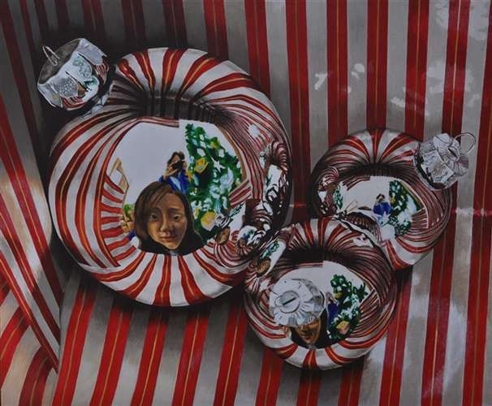

Slide 17
Tips and Suggestions- Set-Up
Careful observation is key for this assignment. The most rich and interesting work tends to come from direct observation of life. That said, it is going to be logistically challenging to make sure your subject matter looks the same over the course of several sittings, so you might have to do some problem-solving here.
If you would like to compile some reference photos, you may do so. Think about how you are going to hide the camera in the reflection (or are you?)
I have some plastic ornaments you are welcome to use; if there is another one you have that would work better, you are welcome to do so. Just be careful with the glass ones because they shatter if they fall!

Slide 18
Subject Matter
You could choose to depict your hand in the drawing.
You could choose set up things around the ornament that will reflect in it to make the drawing more interesting (pattern, objects etc.)
Think about how you will resolve the negative space around the ornament in your drawing (Gradient? Color? Depiction of setting?)
Please note: we are working 14 x 14; the ornament should take up the majority of the space on the paper (your composition could even be slightly cropped). This means that we are enlarging and that the ornament will be AT LEAST double in size. Most will probably be a minimum of ten inches wide. This will give you a lot of room to show reflections and shapes.

Slide 19
What is Happening?
On the ornament, you will notice an overall dark side and light side as related to the light source (these are, after all, very shiny spheres).
The reflections will have a curve to them. The shapes will be distorted. Paying attention to this distortion and showing it and even exaggerating it a bit in your work will help it to look more believable. Resist the urge to flatten and straighten!
The reflection will be the most “true” and straightforward mirror image directly in front of your eye-level (this is where the sphere will appear the most flat, and it will gradually round out as you move further out from this spot.) This means that the reflection’s curves and bends will be more prominently distorted as you move further away from the middle flat spot.
The reflected shapes will bend in the direction of the sphere’s curve (“C” shape to the left; straightening towards the center, backwards “C” shape to the right)
A cast shadow will probably also demonstrate some sort of reflection.
The lightest shapes (white of the paper) will be reflections of lights (the window, the lights in the room or in the hall)
Above all, look for shapes of shadow and color.

Slide 22
How should I work on this?
Set up your subject. Really take the time to think about this, and work in a way that is going to make it easy on yourself. Think about your strengths- whether you want to get more complex and challenge yourself, or whether keeping it a little simpler will allow you to do your best work.
Make a practice sketch in your sketchbook if you choose to do so.
Using a #2 pencil, lightly sketch out the drawing’s major defining lines.
The overall shape is important, but the reflections are the most important. Draw those shapes that you see. You’ll see yourself, but you’ll also see shapes of the background, surface and ceiling (windows, ceiling tiles, lights etc.)
Next, move to your chosen medium. (see next slide)

Slide 23
Medium: Graphite
Ask yourself how dark/medium/light the shapes are that you’re seeing. I would block in the light values first, then darken up little by little. You can use an eraser to re-introduce highlights if they get lost. I wouldn’t smudge too much, as you’ll loose the crispness of the shapes. You can use an HB or #2 pencil to do detail work. As you work, try to eliminate outline by bringing the value of a shape right up to its edge. The shapes that sit next to each other will created the edges without you having to outline. Remember that as you’re shading, curve your pencil marks in the direction of the sphere’s curve.

Slide 24
Medium: Pen (stippling)
Use a thin Sharpie first. Ask yourself how dark/medium/light the shapes are that you’re seeing. I would block in the light values first, then darken up little by little. Remember that more dots/closer together= darker. It takes time to build up the dots; that said, in your darkest areas, you can “scribble” a little and nobody will know the difference because your dots are clustered so close together. You can use a smaller Sharpie pen for tiny details, if needed. Don’t forget that once a dot is there, it’s pretty much going to stay. So don’t get too dark too fast. Make sure your shapes are fully filled with stipple dots; don’t simple outline with dots.

Slide 25
Medium: Colored Pencil
This approach is a little different, because not only will you see color in the reflections, but everything will take on a slight wash of the color of the ornament. I might lightly color the ornament first (so first create a plain sphere with light and shadow, as if the ornament had no reflection) then, work in the reflection shapes after. As you go, you could go over the reflection shapes again with that color. With colored pencil, you have to go little by little, starting with a light touch. Remember that the more pressure you apply, the darker your color will be. Your marks should go in the direction of the sphere as you color. You can also use a colorless pencil to blend, if needed. Additionally, I have a few erasers specifically for colored pencil.

Slide 26
As you go…
Pause often and evaluate your work. Look at it from far away, as a friend, ask a teacher, take a photo and look at the thumbnail.
Move forward at a steady pace, but do not rush.
Your work is due at the beginning of class on exam day (January 12th, 7:42). You will share, discuss and critique during the exam session as an additional component of the exam.
You have eight classes to work on your drawing. You may come in extra time or take your work home if you choose to do so.
I cannot extend the due date to this project, so if you are behind, you need to catch up along the way instead of after the fact.

