Slide 1
Geometric Still Life Painting
Painting Studio

Slide 2
What are you going to be doing?
You have recently completed a painting using acrylic paint that shows form by using hues and tints. The cross-contour painting sections should look 3D because of how you painted them; the placement of areas of light and shadow give the illusion of popping out (if you didn’t have as much contrast between light and dark areas, your pieces probably flattened out).
You did this using a subject matter from your imagination (in other words, I told you what to do, and how it should look, but you weren’t looking at something and attempting to make your painting look realistic to what you saw)
Now, however, your subject will be an arrangement of geometric shapes. You will look at what you see, and your painting will create the illusion of realism through observation.

Slide 3
Set-UP
We will be again working on canvas board (9x12).
Begin by making a practice sketch in your sketchbook in pencil. Look at placement of the shapes; compare widths to heights, and examine proportion. Pay attention to edges and angles, and look at where the objects overlap, or where a side disappears. Remember the concept of foreshortening. Draw the foam core and the back edge of the table (even if you have to move the table edge forward a little; you want the eye level to seem as though you are looking out at the objects, not a birds’ eye view of them. Describe where the plane that moves away from you meets the plane that is flat in front of you, aka the horizon line).
When you have outlined the drawing, you can look for shadows and put them in using pencil. Look for shadows as shapes. Don’t spend too long on this; you just want to get an idea of where the shadows are. The shadows will be described in paint, but you are attempting to block them out so you know what areas to fill in.
All this is pretty much a review from Art 1 or Drawing 1.

Slide 4
Transferring to the canvas
Transfer the drawing to the canvas board. Use pencil and make your lines as light as possible so that they don’t show through too much in the final painting. Make sure the composition fills the canvas board well! You want the objects to be a little smaller than life size. Also try to make it centered so the composition is balanced. I would rather see a drawing that is a little too big and doesn’t quite fit on the canvas than one that is too small and/or significantly imbalanced. Don’t forget to give the objects context by including the foam core, table edge, and background/surface plane (horizon).
You can draw the outlines of shadow shapes but DO NOT shade with the pencil.

Slide 5
Beginning Painting
Stop! Your instinct is going to be to paint the objects themselves first. But you ALWAYS want to start painting in the background first and work your way forward in space! That way, the overlap of the paint will mimic the overlap of the objects themselves in space.

Slide 6
The Background/Surface
The background and surface will be dark and light in relationship to the light source. Determine where the light is coming from (your cast shadows should be going away from the light source).
Create a gradient in the background that goes from dark to light (it should get gradually darker moving away from the light source). You can use both tints and shades as well as hue. Remember to mix and blend with water and matte medium, and keep your brushstrokes in a consistent direction.
The same will be true for the table (and the foam core if you’re really observing light and color changes carefully).

Slide 7
Painting the Objects
You will begin by mixing the local color first, and adding black or white to it for the shadows and light areas respectively. Local color is the term used to refer to the color of an object before it is changed by light. Some of the colors of the paint right out of the tube will work for local color. Others you will have to mix the local color first, then mix in the black or white with the color you’ve made. Remember that you will typically use more white paint and less black paint when mixing lights and shadows.
On the flat sides of objects, you will bring the color right up to the edge, creating a clearly defined edge in your painting. The light hits these surfaces pretty evenly and uniformly, so it will appear as a flat shape with one color in your drawing.
On the curvilinear sides of objects, you will use blending (like in the cross-contour painting). The light doesn’t hit these objects in a uniform way, but fades gradually, so it will appear as a gradient.
Try to have your brushstrokes follow the form/volume of the objects (remember my bug analogy?).
Work general to specific, establishing overall color and form. Then, once the first layer of paint has dried, you can go back in and fix, refine, and describe detail.

Slide 8
Another way to approach value as color
Instead of just using black for shadows and white for light areas, you can approach the values more in terms of the color of the light. Often, shadows reflect light that is slightly blue in color. Therefore, you can use blue instead of black to show shadow. Everything else is the same (mix the local color first, then mix the shadow color in). Additionally, the spotlight in here has a slight yellow glow to it. You might want to mix a little yellow into the white in your light areas.

Slide 9
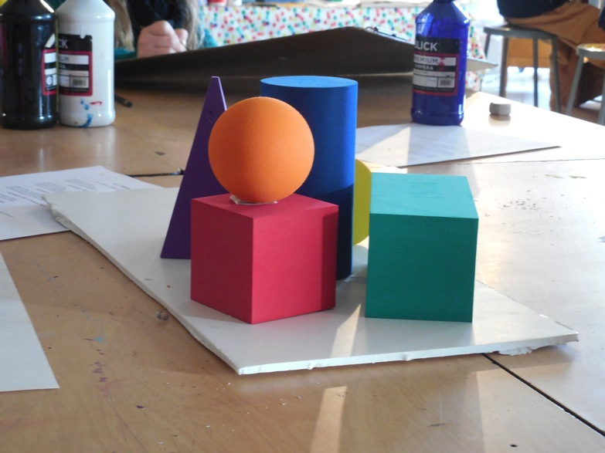

Slide 10
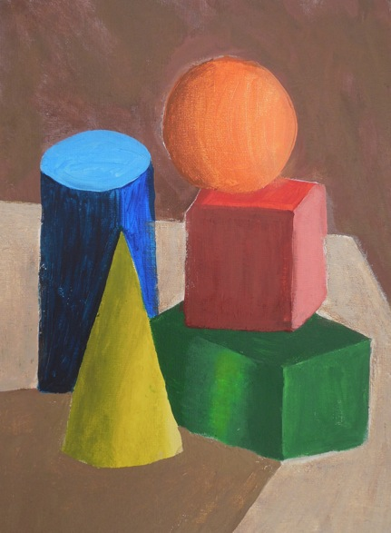

Slide 11
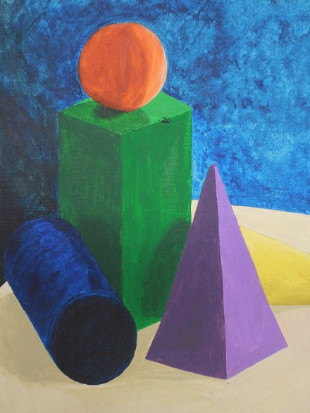

Slide 12
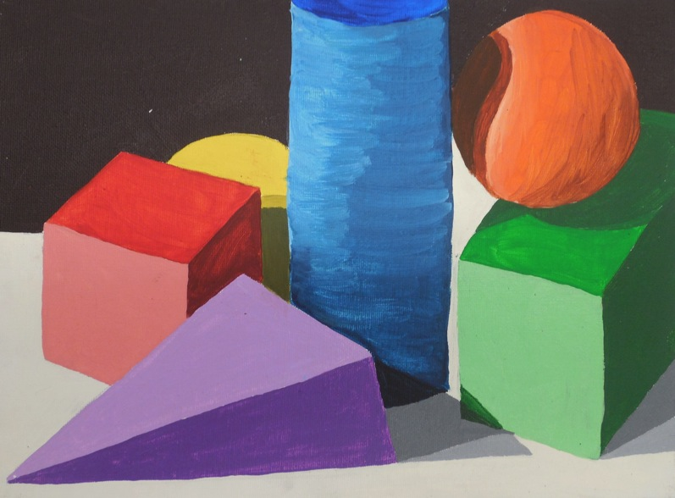

Slide 13
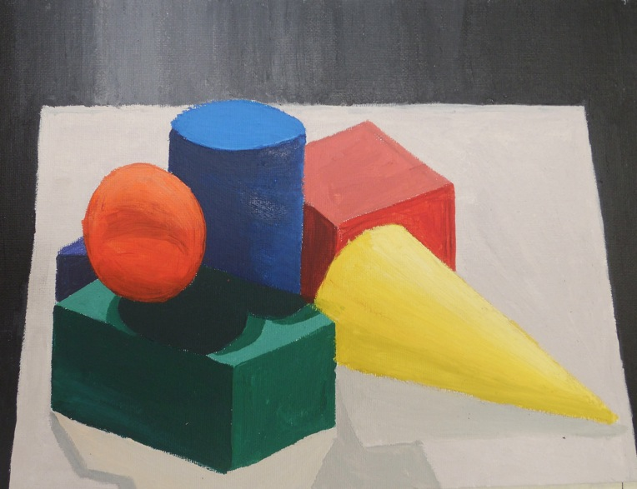

Slide 14
What Am I Looking For?
*Correctly placed and rendered 3D forms (drawing skills)
*Good use of the canvas (composition)
*Range in value (at least three clearly distinct values on each shape)
*Properly-mixed local colors and value colors (tints/shades)
*Resolved surfaces and backgrounds
*Painting skills (matte medium/blending, brush stroke direction)
*Neatness and care in work

Slide 15
Due Date Information
You will have four classes to complete this project. Figure one to sketch and draw out your composition on the canvas, and three classes to paint. That means that your work will be due on Monday, September 28th.
Remember that work looses 5 points every day that it is submitted late. If you are behind don’t play catch-up after- get caught up now!
Remember that you are to submit a completed rubric (both sides) with your work, or loose 10 points off your grade.

