Slide 1
Oil Pastel Mini Project
Drawing 1

Slide 2
Experimentation
Just like our last mini value collage project, we will be creating a small, 2 day project to help us experiment with the new media.
After applying (drawing with) the pastel, you can take a damp brush and apply water to where the oil pastels overlap to create more of a gradation of color.
Once the area dries, you can go back in and re-apply the pastel too!
Try applying the oil pastel in different motions to see how it works
Streaks/hatch marks
Circles/swirls
Dots

Slide 3
Materials
12” x 12” paper
#2 wood pencil (no mechanical! It will indent your paper)
Brushes and water cup
Water-soluble oil pastels
Oil pastels are oil-based pigments that are soft and they are easy to create texture as well as blend with each other
Regular oil pastels do not work with water…just like oil doesn’t mix with water.
The pastels you will be using do work with water! Hence the name: water-soluble oil pastels.
You will try the dry application method as well as wet application method to help blend the colors to create color gradations

Slide 4
Cleaning your brushes!
The brushes you’ll be using are also being used by Art 1 students with tempera paint
I would recommend you clean your brush BEFORE you use it on your oil pastel just in case there is tempera paint trapped in the brush
Brushes are to be cleaned with SOAP AND WATER in the palm of your hand so you can see if the soap turns a color or if it stays white. White soap=clean brush
After there isn’t any color coming from the brush, form the brush back to a tip and place UPRIGHT in the brush container

Slide 5
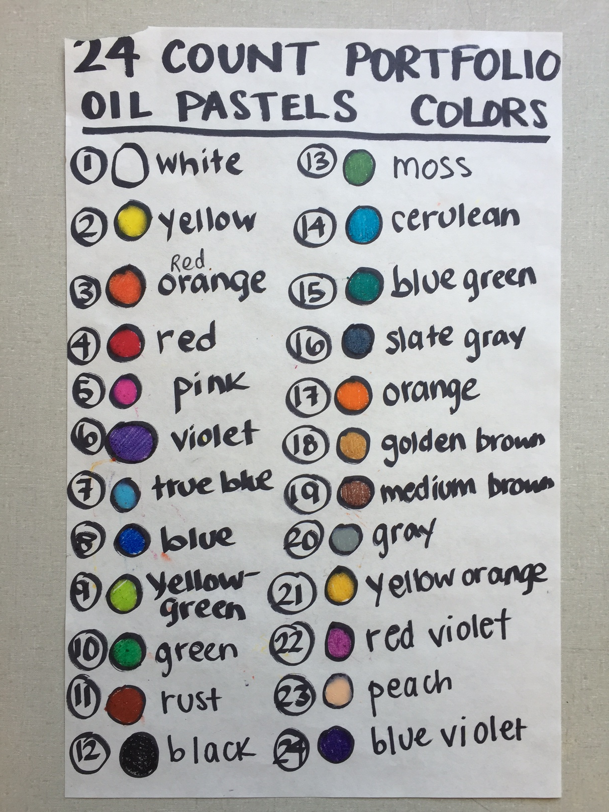
Color Combinations
There are 24 different colors!
You will need to apply at least 4 different color combinations
So how do we know which to use together?

Slide 6
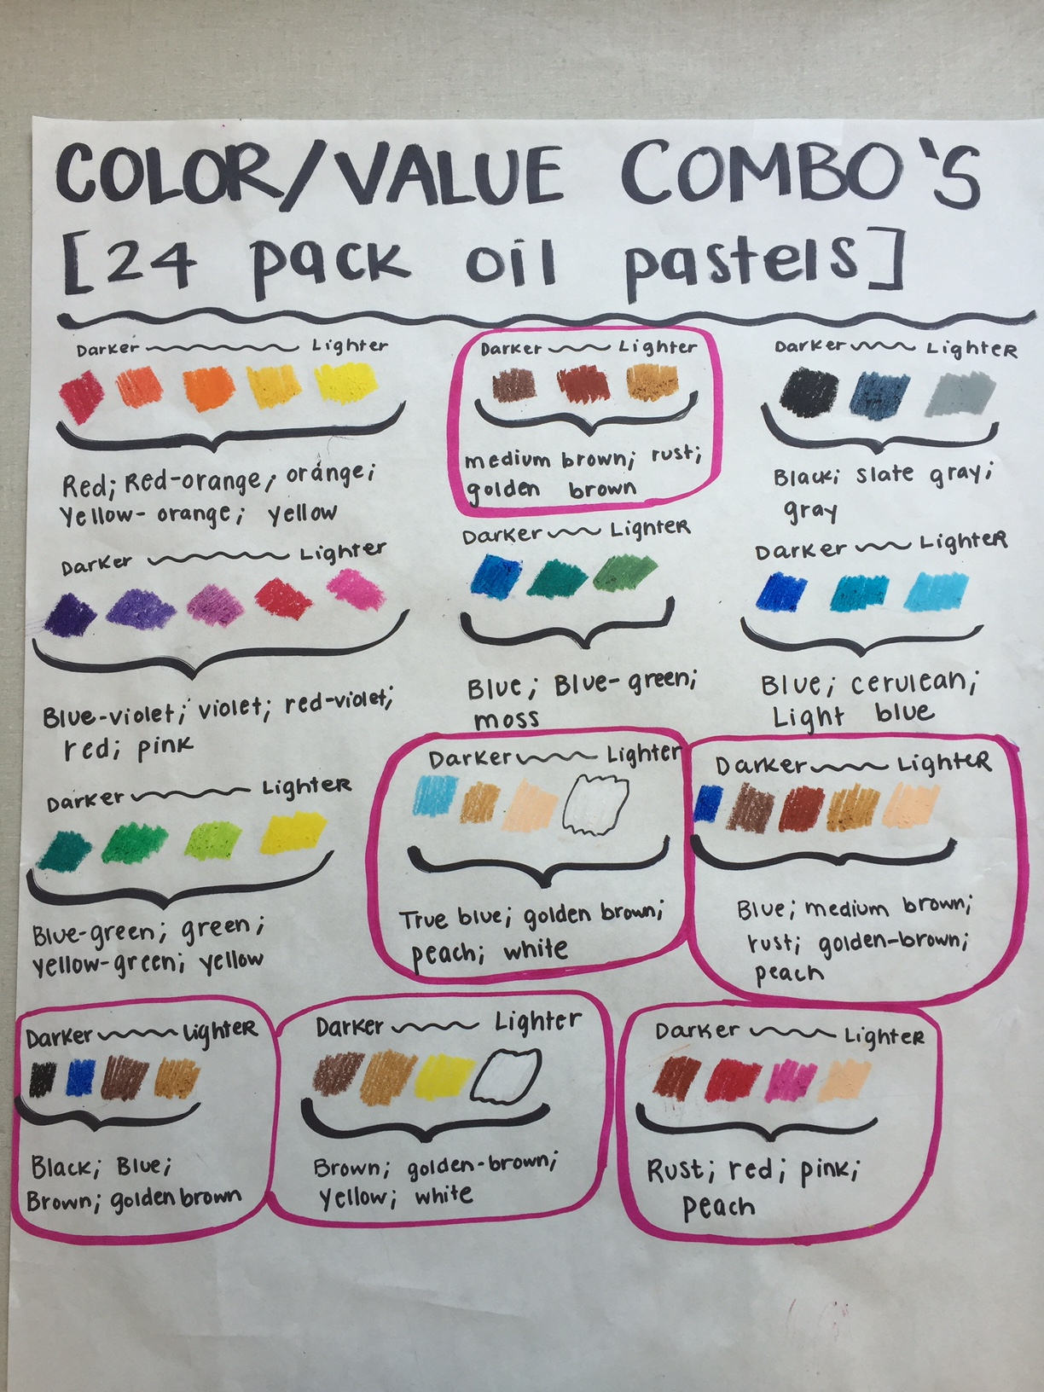
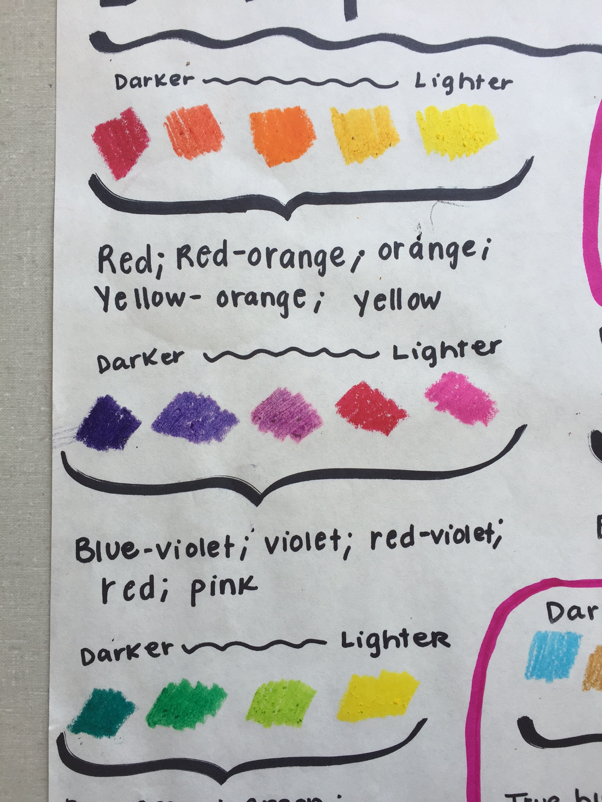
Our Handy-Dandy Color Combo’s Chart!

Slide 7
How to create the collage
Draw LIGHTLY curved lines through out your paper to create 12-15 shapes
Make sure the shapes are large enough so you are able to apply 2-3 colors to each shape
You are applying oil pastels to the entire paper so make sure we don’t see any white spots!
Most shapes should have atleast 3 values
Once you apply the pastel, go back and give a water wash on top of the overlaps to blend and make a gradation

Slide 9
What I’m looking for
Care and effort
Experimentation
Gradation between different values/colors
Atleast 4 different color combinations through out the composition
Wet and dry application
Completed project and completed rubric handed in on the due date

Slide 10
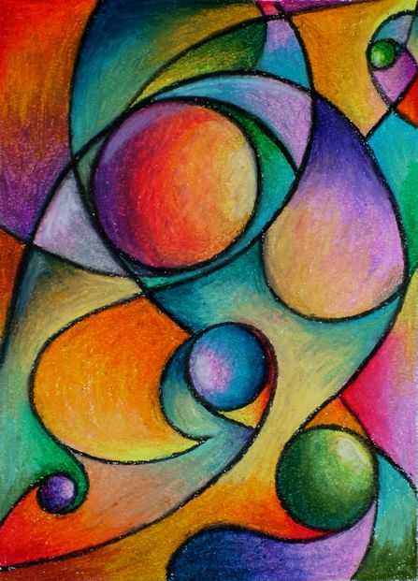
Due Date: March 21st
After school March 14th + 15th if you’re not going to finish on time
This project is worth 30 points!
Every day late is 5 points off
Incomplete rubric 5 points off

