Slide 1
Paper Mache Sculpture
Art 1

Slide 2
You will…
*Create a stylized sculpture of an animal or creature
*Sculpture will stand roughly 12-18 inches high, 12-18 inches wide and 6-8 inches deep
*Sculpture’s armature will be created from recycled materials (cardboard and heavy paper)
*Sculpture’s surface will be made sturdy and cohesive using paper mache
*Sculpture will be finished in a stylized manner using acrylic paint

Slide 3
Romero Britto
Modern-day sculpture artist (Brazilian)
Creates large sculptures that are featured in public sites (Pop Art themes and styles)
Known for whimsical characters (usually animals and people, but sometimes other symbols)
Known for bright colors, bold lines and patterns, simplified shapes (very playful and cartoon-like)
Britto comes up with the design and constructs the original, then a team of workers creates an edition of smaller sculptures that replicate his original (often sell for several hundred dollars or more depending on how limited the edition is)

Slide 9
Britto creates prints, too (typically digitally-created and printed)

Slide 12
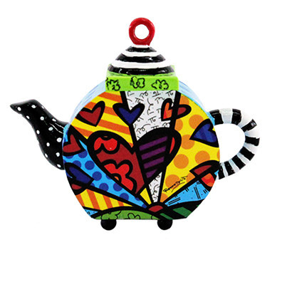
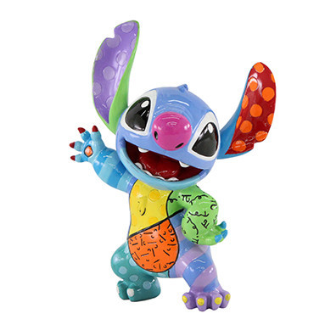
Companies also mass-produce collectible figurines based off of Britto’s designs that are more affordable (about $20 to $100). We recently finished a unit on art careers. See how you can be an artist and make a name for yourself and market originals, limited editions and mass-produced collectibles? See why some pieces cost more than others?

Slide 13
He even designed a Build-a-Bear!

Slide 14
Video Clip (Romero Britto speaking about his artwork and career)
https://www.youtube.com/watch?v=qNGbzPqHais&feature=player_embedded

Slide 15
Set-Up
Decide what animal/creature/character you want to make. Sketch the:
Design (form)
Color/pattern plan
Figure out the dimensions (the sculpture needs to stand on its own, but think about unique ways you can position your sculpture to make it more interesting)

Slide 16
Armature
An armature is the base of a sculpture that the surface material gets applied to.
We will be making our armatures out of cardboard but artists use other things, too for armatures like wire, crumpled paper, plastalina etc. We will hold our pieces together with masking tape.
The armature will define the overall form of the thing you are creating. Think of it like the bones of a body, whereas the paper mache would be the skin. Sturdy armature= sturdy sculpture.
If you’re having trouble getting the armature to stand, you can put it on a base. Think of how this base can be finished as a part of your sculpture in order to enhance it.

Slide 17
Armature- tips and tricks
Think of your armature as two identical pieces (front and back) and a side that holds them together.
The front and back will probably be the exact same shape just cut out twice.
The side will be as long as the perimeter of the front/back and as high as however deep you want the sculpture to be (6 to 8 inches).
To curve, make score marks and bend back and forth on the table’s corner.
Every time your sculpture has a corner, bend the side piece. You can also construct these with a series of smaller pieces.
If you want, you can build out with additional pieces (just make sure the weight is balanced)
You can attach several pieces together if one piece of cardboard it not big enough.
Pull off little pieces of masking tape and put them on the edge of your table to make it easier on yourself when you are work.

Slide 18
*Bear body shape x2
*Length of perimeter of bear shape x about 1 inch deep
*EACH arm x2
*Length of perimeter of arm x about one inch deep
*Eyes, nose, mouth, bowtie EACH x2
*Length of perimeter of each from above x about one inch deep
*Base rectangle x2
*Length of perimeter of base x about one inch.
*Note- this example is from a middle school art class. They used foam core, which was already about an inch thick to begin with.

Slide 19
Paper Mache
Paper mache refers to the process of adding wet pieces of paper with adhesive applied to the armature.. Once the paper dries, it hardens, permanently taking on the form of the armature underneath.
We will be using newspaper and wheat paste to create our paper mache sculptures. You will apply 2-3 layers to create a strong surface.
Some paper mache sculpture artists remove their armature after the paper has hardened (for example, you may have seen kids make Easter eggs by applying paper mache to a balloon; once it dries and hardens, the balloon is popped, but the shape stays). Our armatures will stay inside the sculpture.

Slide 20
Paper Mache- tips and tricks
Rip the newspaper strips, don’t cut them with scissors (weave of ripped paper pulp adheres better)
Dip the strip in wheat paste and run between your two fingers to “push” the paste into the weave of the paper pulp.
Apply the paper mache strips carefully and smooth them down completely (eliminate bumps, bubbles, wrinkles and flakes)
Pay special attention to corners!
All areas of armature should have paper mache strips applied, even the parts you don’t see.
Criss-cross your strips (especially on 2nd and 3rd layer) for a stronger surface.

Slide 22
Remember how irritating it was to find crusty desktops, nasty wheat curds in the sink/drain, puddles of wheat paste everywhere, sticky pieces of newspaper everywhere, wheat pastes left in cups etc. when my other classes were doing paper mache a few weeks ago? Now that you have been on the receiving end of these gross and inconvenient consequences, pay it forward and don’t leave the mess for someone else. Reminder that a poor clean-up job will result in group studio cleaning (no due date extension for loss of work time!), pop quizzes, and an angry art teacher!

Slide 23
Gesso and Drawing Design
Once paper mache has dried completely, you will do a layer of gesso (white primer) to seal the surface so the paint adheres better. This will also help the newspaper words and images to not show through. This part is pretty simple- just do a neat, thin coat of gesso.
Once the gesso dries, you can sketch out the shapes of your design in pencil so you know where to apply the paint.

Slide 25
Painting
We will be using acrylic paint to finish our work (acrylic is plastic-based and will not flake and crack like tempera would on a 3D surface) Adding a little water and mixing it in with the acrylic is a good idea.
Think of the painting as an essential component of the overall sculpture not an afterthought (good form +good surface = good sculpture whereas good form + poor surface = not as good sculpture)
Remember everything you know from your painting unit (good mixing of colors, good brush technique, enough coats of paint etc.)
Remember in Britto’s work, he uses bright, bold colors, thick dark lines, and shows pattern on some areas. The colors aren’t usually realistic!
Optional- Once the painting is completely finalixed and dry, you can go over it with Modge Podge to give your work a shiny surface

Slide 26
What am I looking for?
Creative idea for subject matter
Dimensions within criteria (at least 12 x 12 x 6 and no larger than 18 x 18 x 8)
Form is sturdy; armature is strong; sculpture stands on its own and is balanced
Sculpture is “in the round” (visually appealing from all sides)
Paper mache is carefully applied and makes the sculpture even more sturdy
Painting is neat and careful; elements of Pop Art style incorporated and surface enhances form

Slide 27
Timeline
Sketches/plans should be finished by
Armature should be finished by
Paper mache should be finished by
Gesso should be finished by
Painting should be finished by
Please note- balance and budget your time! If you spend too long on the armature and paper mache, you will loose out on time for painting. The painting needs to be just as well done as the construction!

